Slide 1
House Price Prediction in King County
By Elsie Juma

Slide 2
Problem Statement
As a junior data scientist in a real estate company in King county that helps homeowners to sell and buy houses,my first project was to determine and analyse the factors affecting the house prices and further build a pricing algorithm for the houses based on the factors.
The goal is to help the agency advice homeowners on the factors that might increase the estimated value of their homes and by what amount.

Slide 3
Objectives
1.
2.
3.
Which factors affect house prices?
Which factors affect house prices?
What is the average cost of a house?

Slide 4
Data was provided in csv form
Univariate analysis
Bivariate analysis
Multivariate analysis
Checking linear assumptions
Evaluating the RSME and R score
Checking if the model solves the problem
Data Collection
Data Cleaning
Exploratory
Data
Analysis
Modelling
Evaluation
Dealing with missing values
Data type conversion.
Defining evaluation criteria
Splitting data
Building different models

Slide 5
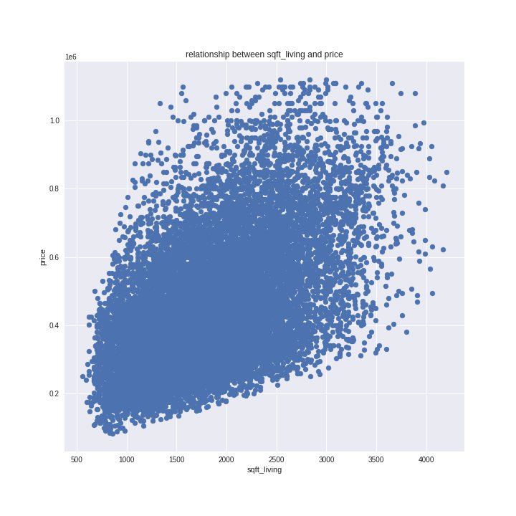

Slide 6
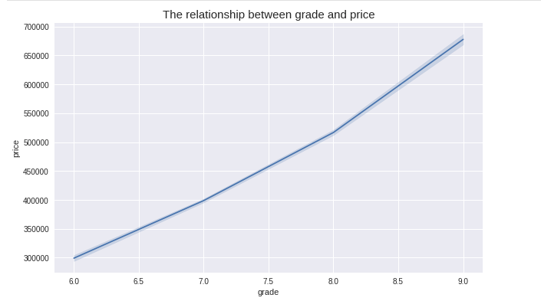

Slide 7
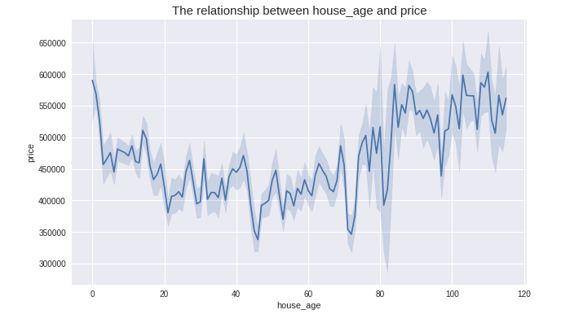

Slide 8
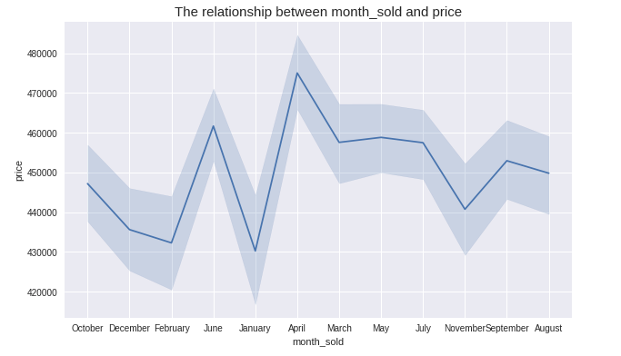

Slide 9
Correlations with price
grade 0.534513
sqft_living 0.523146
lat 0.476237
sqft_living15 0.456092
bathrooms 0.350147
bedrooms 0.236562
sqft_basement 0.232642
view 0.228574
floors 0.220818

Slide 10
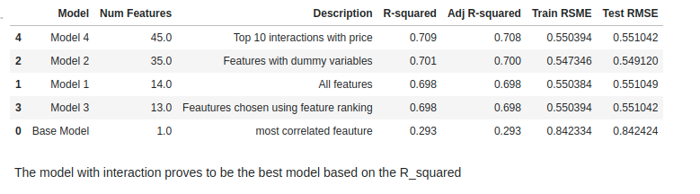
Summary of models

Slide 11
Key Findings
Adding interaction increased the value of our R_squared in our model
The best predictors for home prices in King County are sqft_living, grade and latitude.
The average house cost in King county is 450000 USD
Although latitude seemed to have high correlation with price,it cannot really define the location on its own.
Houses sold in January were the cheapest and in April the houses were more expensive.Maybe this could be attributed to fewer houses being sold in January as compared to April.

Slide 12
Recommendations
The real estate agency should consider how different combinations of house features may increase sales than focusing on just individual variables
They should consider houses that have a higher grading as this will increase their sales
They should also consider houses with larger living spaces as they sell more and have a very linear relationship with price.As the sqft_living increases the price also increases

Slide 13
THE END

