Slide 1
PHASE ONE PROJECT
Exploratory analysis of best performing films at the box office

Slide 2
INTRODUCTION
Microsoft sees all the big companies creating original video content and they want to get in on the fun. They have decided to create a new movie studio, but they don’t know anything about creating movies.
The aim of this project was to explore what types of films are currently doing the best at the box office and give actionable insights to the head of the new Microsoft’s movie studio that they can use to help decide what films to create

Slide 3
PROBLEM STATEMENT
Exploring what type of films are currently doing the best at the box office in order to help Microsoft's new movie studio decide on what types of films to create

Slide 4
OBJECTIVES
To identify which type of films have the highest votes
To identify the films with the highest gross
To find the average duration of a film
To find the estimated cost(budget) of creating a film

Slide 5
DATA COLLECTION
Data was provided inform of zip files
This project focused on three data sets:
1. title.basics.csv
2. title.ratings.csv
3. tn.movie_budgets.csv

Slide 6
DATA CLEANING
There was missing values in the basics data set which were dealt with by
Dropping some rows
Replacing missing values with the median
Replacing a string column’ missing values with a constant

Slide 7
DATA CLEANING
There were also columns that were set as string yet they were supposed to be integers.
Here columns data types were transformed

Slide 8
DATA ANALYSIS
Data exploration stage

Slide 9
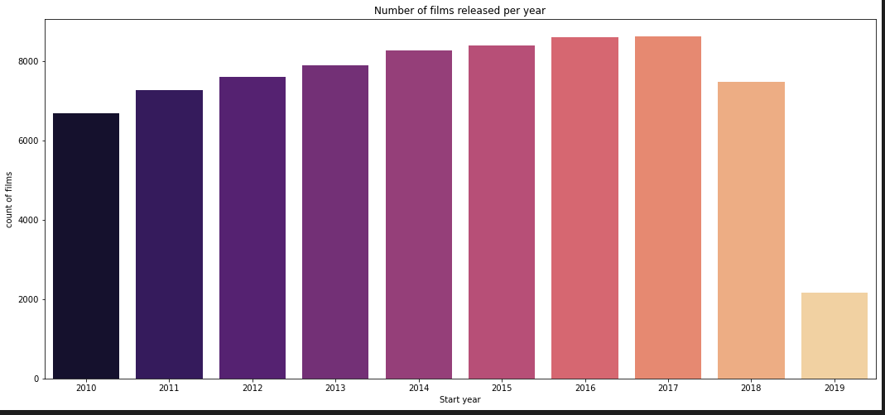
Number of released films per year from 2010

Slide 10
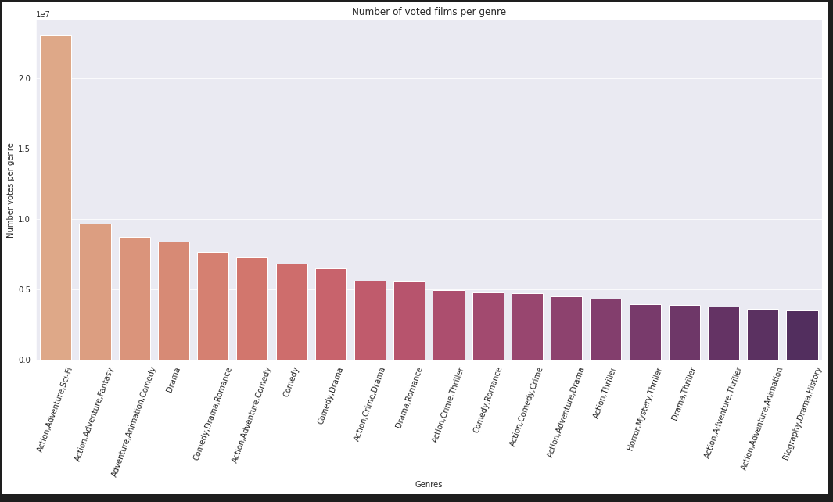
Highest voted genres

Slide 11
Distribution of the average rating
Notes:
The average rating was 6.3

Slide 12
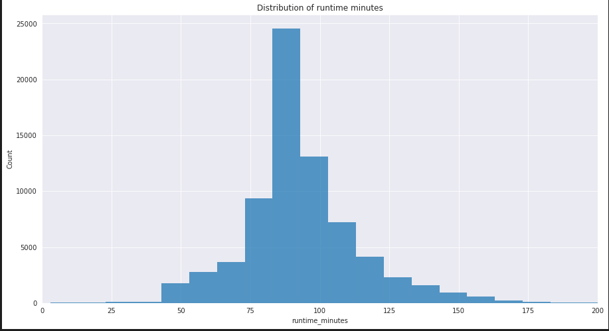
Distribution of run-time minutes

Slide 13
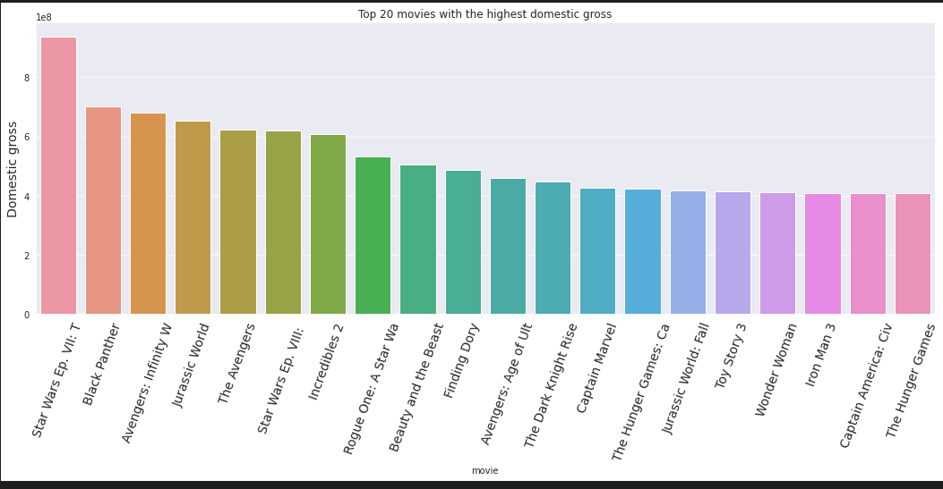
Most profitable movies

Slide 14
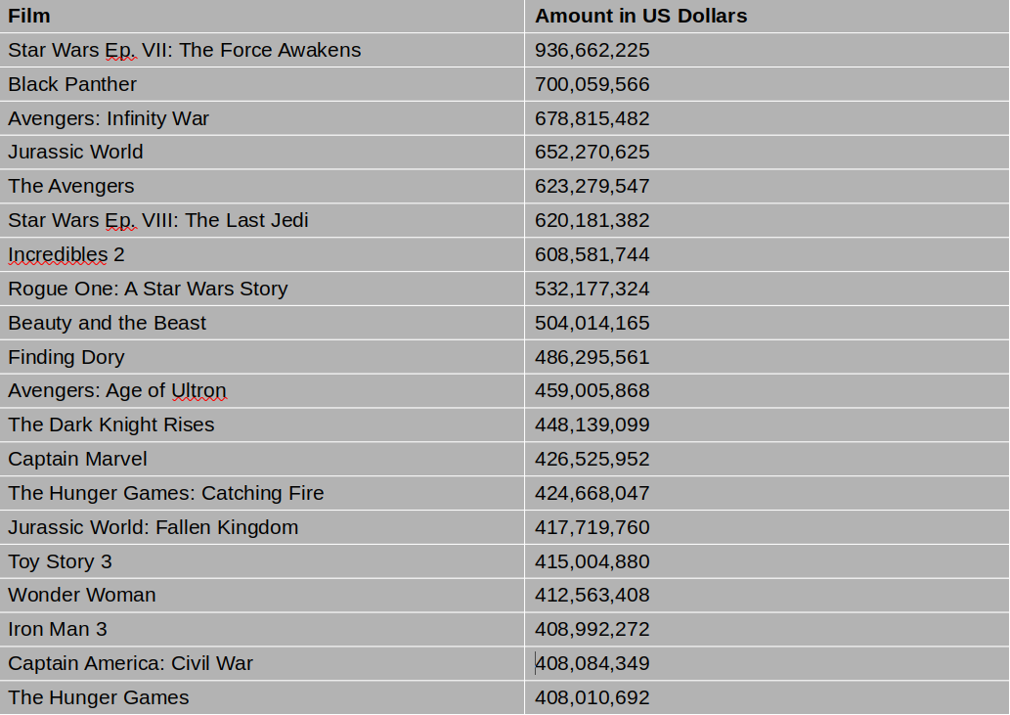
Top 20 Films with the highest domestic gross

Slide 15
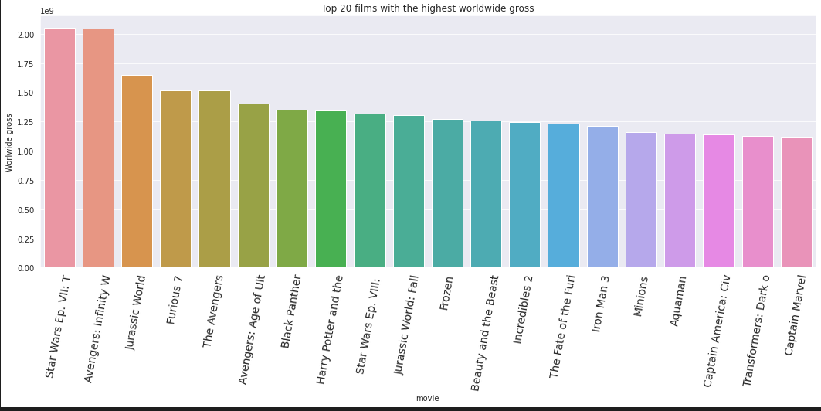
Most profitable movies

Slide 16
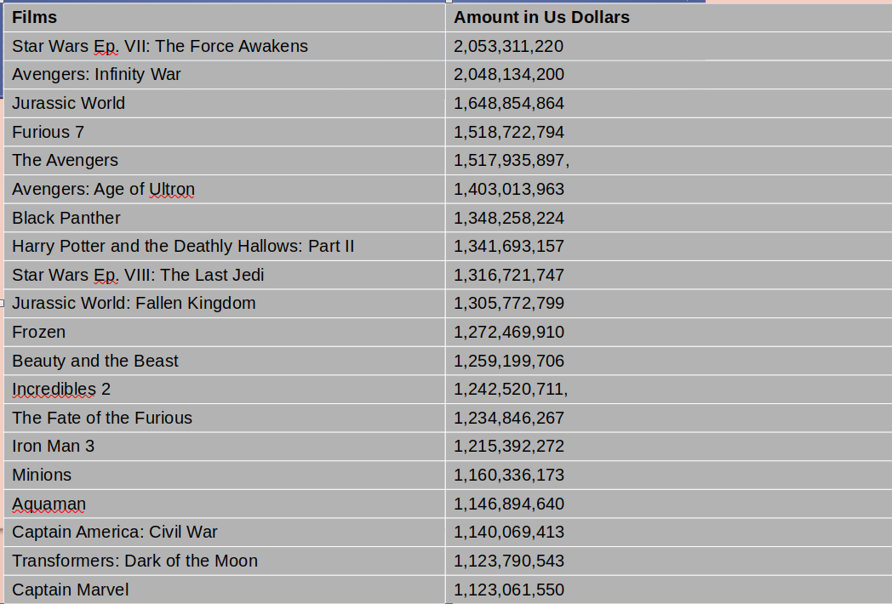
Top 20 films with the highest worldwide gross

Slide 17
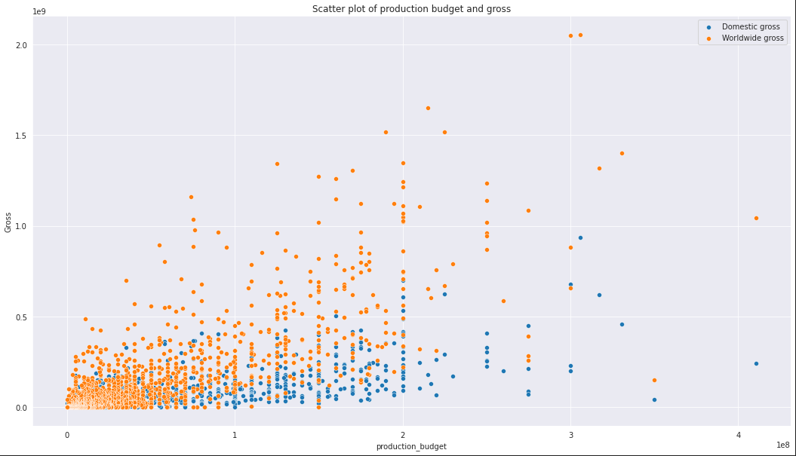
Production Budget vs Gross

Slide 18
Conclusions
The type of films with the most number of votes were from a combination of different genres(action,adventure and science fiction) and not just one particular genre
There was a significant rise in the number of films released from 2010 to 2017,but there was significant drop in 2019.This could be due to the covid_19 pandemic
Most films were averagely rated between 6 and 7 out of 10
The average budget of producing a film is around 36.5 million
The average run-time was 94 minutes
There is a strong relationship between the production budget and gross having a correlation coefficient of 0.732 with domestic gross and 0.794 with worldwide gross

Slide 19
Recommendations
The head of Microsoft's new movie studio should consider creating films with different genres and not just one particular one. A combination of adventure,action and science fiction received more votes.
The head of Microsoft's new movie should also ensure that they have enough capital because the average cost of producing a film is around 37 million US dollars.
The head of Microsoft's new movie studio should consider creating films that are not more than 2 hours
There is also a significant return on investment due to the strong correlation between production budget and worldwide gross

