Slide 1

Client
Layer
Security
Layer
Application
Layer
Domain
Layer
Infrastructure
Layer
Bean
Bean
Spring
Security
Spring MVC
Service
Controller
Config
css
js
MyBatis3
H2
JSP
Form
Repository
Mapper
XML
Bootstrap
Domain
Object
Bean Validation
AngularJS
jQuery
TERASOLUNA Server Framework for Java (5.x)
Common Library
Bean
Bean
Bean
Spring Framework (DI, AOP, Tx, etc.)
web
.xml
Java EE Servlet Container
JVM

Slide 2
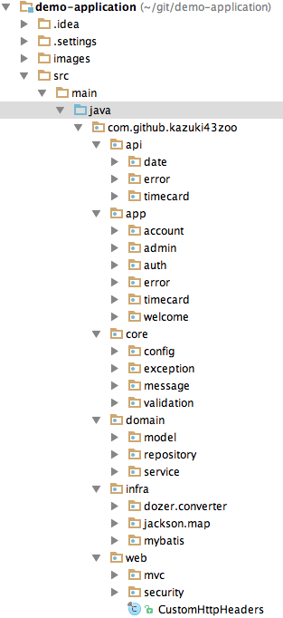
(1)
Application Layer for REST API
(2)
Application Layer for Screen
(3)
Core components that
not depends on each layer
(4)
Domain Layer
(5)
Infrastructure Layer
(6)
Common components that
depends on web layer

