Slide 1

Client
Layer
Security
Layer
Application
Layer
Domain
Layer
Infrastructure
Layer
Bean
Bean
Spring
Security
Spring MVC
Service
Controller
Config
css
js
MyBatis3
H2
JSP
DTO
Repository
Mapper
XML
Bootstrap
Domain
Object
Bean Validation
AngularJS
jQuery
TERASOLUNA Server Framework for Java (5.x)
Common Library
Bean
Bean
Bean
Spring Framework (DI, AOP, Tx, etc.)
web
.xml
Java EE Servlet Container
JVM

Slide 2
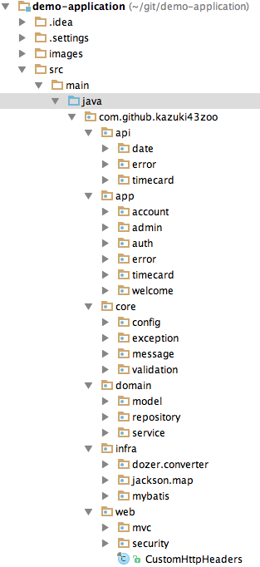
(1)
Application Layer for REST API
(2)
Application Layer for Screen
(3)
Core components that
not depends on each layer
(4)
Domain Layer
(5)
Infrastructure Layer
(6)
Common components that
depends on web layer

Slide 3
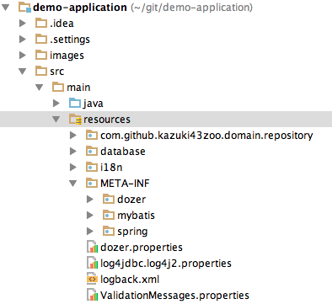
(1) Root
(2) Mapper XMLs of MyBatis3
(3) DDLs and DMLs
(4) Message definitions
(5) Dozer configurations
(6) MyBatis3 configurations
(7) Bean definitions and
Property definitions
for Spring Framework

