Slide 1

Smashing/Dashing Overview
Tsvetoslav Dimov
Intern project

Slide 2


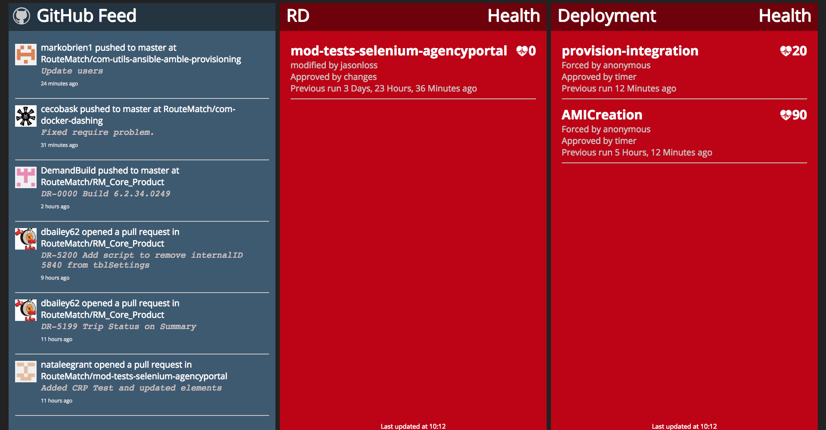
Sinatra based framework
Large library of premade widgets
Create custom widgets using HTML, CSS & CoffeeScript
Widgets harness data bindings (batman.js)
Data can pushed to widgets using Ruby
Drag & Drop interface for rearranging widgets

Slide 3


Installation
Run command: gem install smashing
Clone/Download the GitHub repo
cd com-docker-dashing/Docker/
Build image: docker build –t smashing .
Run container: docker run -d -p 8080:3030 smashing
Enter the following URL into a browser: http://172.25.1.10:8080
If you want to access the AWS instance enter this URL & make sure you are on the RouteMatch VPN:
http://10.128.5.92:8080

Slide 4

Raspberry Pi Setup
Download and install Raspbian OS
Install Chromium Browser
Place kiosk.desktop file from the GitHub repo into /home/pi/.config/autostart/
Make dashboard_load.sh script executable: chmod +x /home/pi/kiosk.sh
Place it in: /home/pi/dashboard_load.sh
Disable screensaver using xscreensaver: sudo apt-get install xscreensaver
Run xscreensaver, then navigate to preference>screensaver>Disable
Connect to RouteMatch Wi-Fi and restart Pi

Slide 5

How to create a widget
cd into com-docker-dashing
Run command smashing generate dashboard <dashboard_name>
Run command smashing generate widget <widget_name>
Run command smashing generate job <job_name>
This will create template files to get you started
In dashboard file replace <widget_name> with the name of your widget. Capitalize first letter for data-view!

Slide 6
Sending data to widgets (jobs)
Create a Ruby job file in /jobs (e.g. job_name.rb)
Write code in Ruby to do what you need to accomplish and use method
where event_id should be the same as data-id from .erb file in /dashboards and the second parameter is the data to be pushed to the widget.

Slide 7
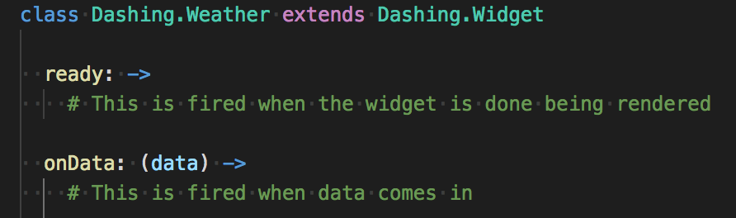
CoffeeScript
CoffeeScript controls views when data comes in or when the widget is rendered:
Here you can modify widget behavior and make it conditional.

Slide 8

Demonstration

