Slide 1
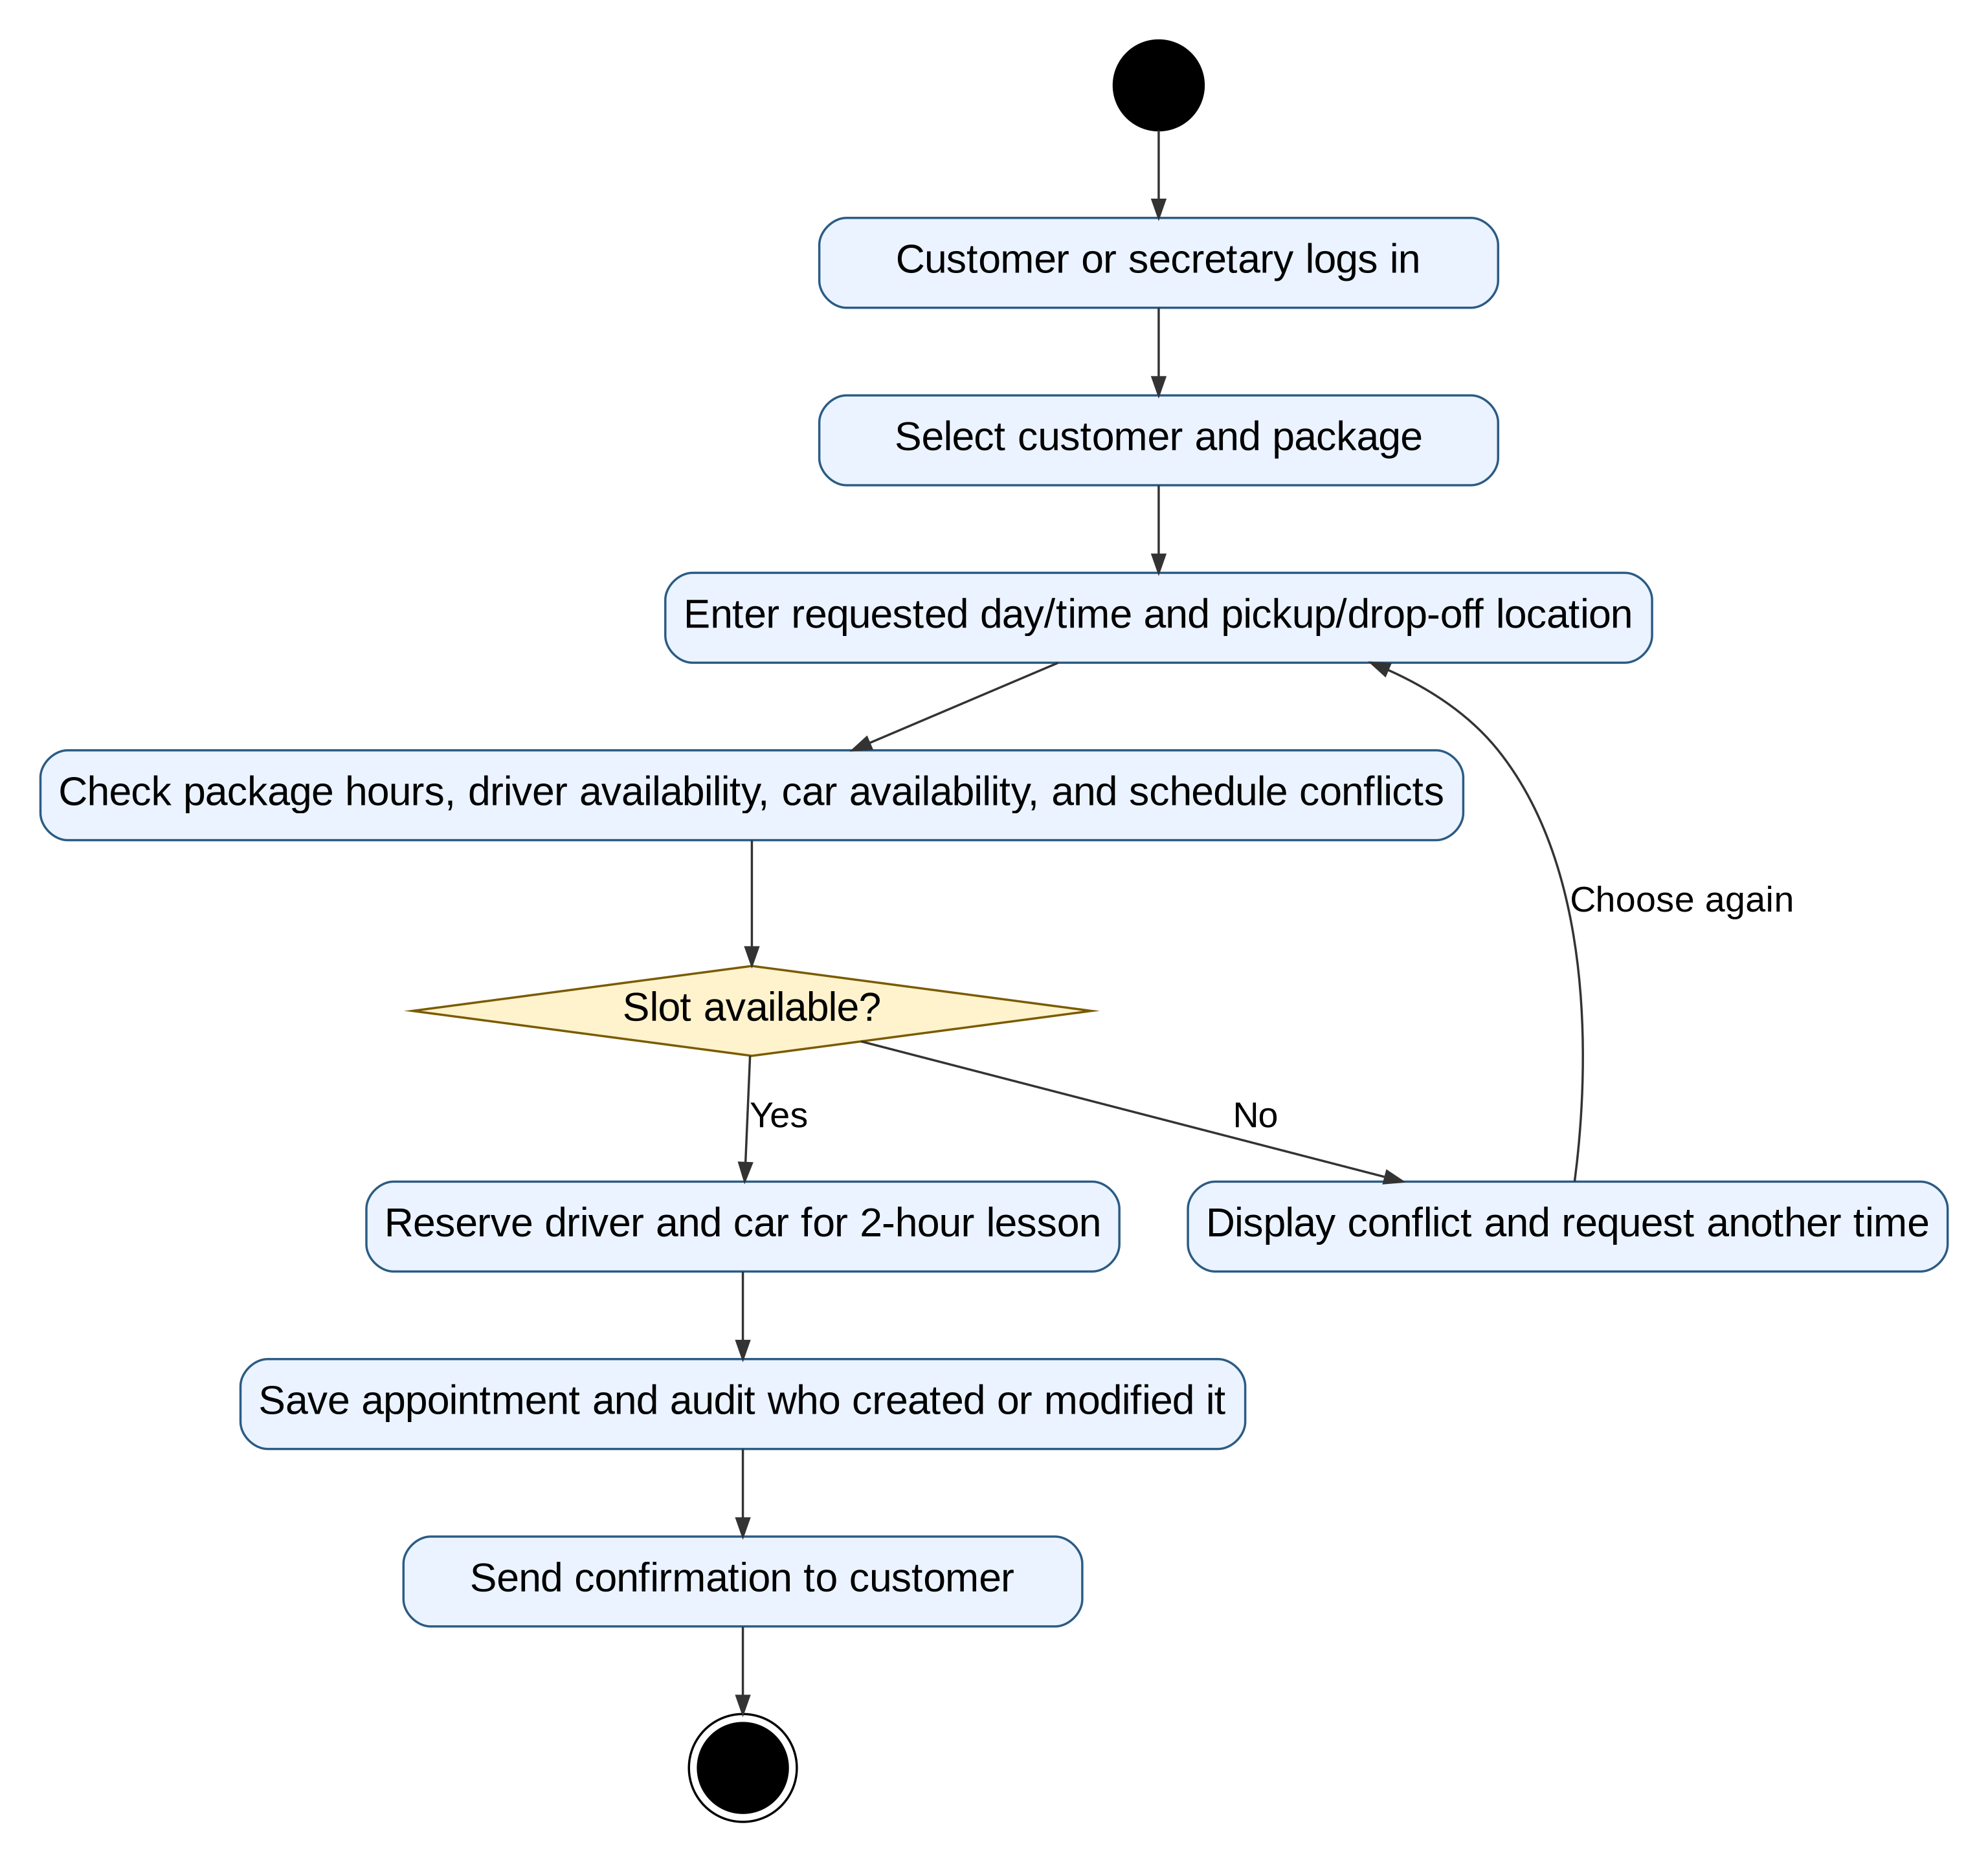
DriverPass
System Analysis
DriverPass System Analysis
Cloud-based driver training solution
Online practice testing and training
Driving lesson scheduling and management
DMV content integration and updates
Secure customer and employee access
Scalable platform for future business growth
Speaker Notes
This presentation explains the proposed DriverPass system design. The goal of the system is to help customers prepare for their DMV exams through online classes, practice tests, and driving lessons. The design supports customer scheduling, driver assignment, reporting, and DMV content updates while providing a secure cloud-based environment that can grow with the business.
CS 255 DriverPass System Analysis | 1
Notes:
This presentation summarizes the proposed DriverPass system design for the client. The focus is not on technical implementation details alone, but on how the design solves the business problems DriverPass described: online training, practice tests, lesson scheduling, driver and vehicle assignment, security, reporting, audit tracking, and current DMV content. The diagrams are used to make the system easier to understand for business stakeholders and to show that the design connects directly to the client needs.

Slide 2
System Requirements
Functional and nonfunctional requirements selected from the DriverPass interview.
Functional Requirements
Customer registration and account creation
Lesson scheduling, modification, and cancellation
Online classes and practice testing
Driver and vehicle assignment
Progress tracking and reporting
Nonfunctional Requirements
Cloud accessibility
System security
Reliability and availability
Scalability
Backup and recovery support
Speaker Notes
DriverPass requires several key functions. Customers must be able to register, schedule driving lessons, complete online training, and take practice tests. The system must also support business operations such as assigning drivers and vehicles. In addition to these functions, the system must remain secure, available, scalable, and accessible from multiple devices.
CS 255 DriverPass System Analysis | 2
Notes:
The functional requirements describe what the system must do for DriverPass. These include registration, scheduling, package selection, practice testing, report generation, and account management. The nonfunctional requirements describe how the system should perform and be protected. DriverPass asked for web access from different devices, a system that avoids local maintenance problems, different access rights for different users, and tracking for changes. These requirements support the company’s goal of helping customers prepare for driving tests while keeping business operations organized and secure.

Slide 3
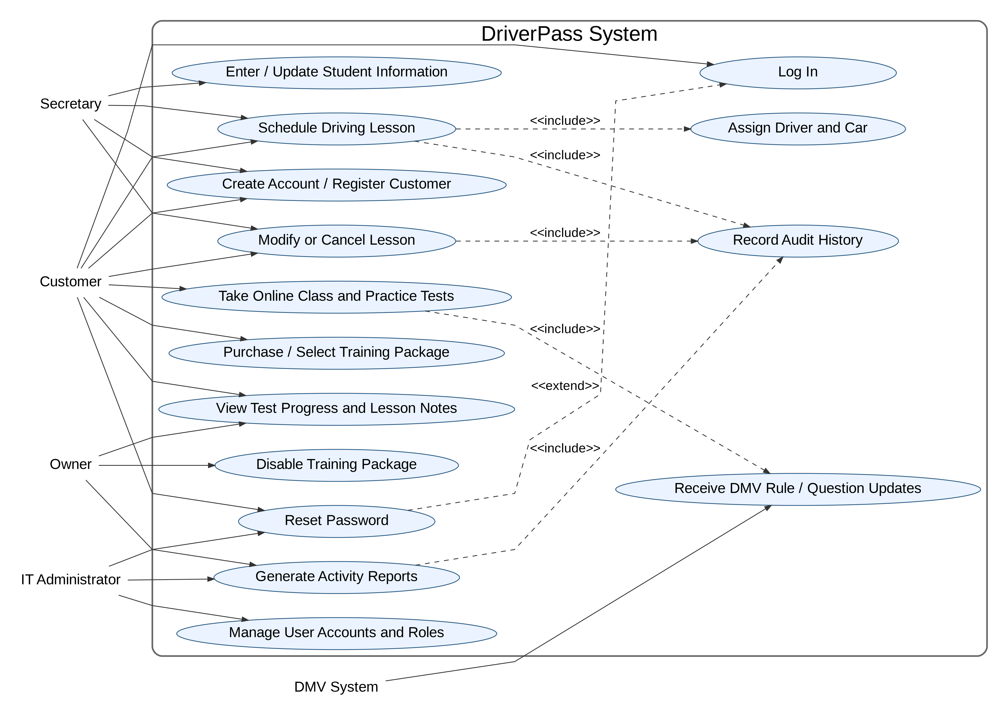
Use Case Diagram
Major people and systems involved in DriverPass, with formal UML relationship markings.
Customers register, log in, buy/select packages, schedule lessons, and take practice tests.
Secretaries support customers by entering information and scheduling appointments on their behalf.
Owners and IT administrators manage reports, user accounts, access rights, and package availability.
The DMV system supplies rule and question updates so practice content stays current.
Formal <<include>> relationships show required supporting actions, such as assigning a driver/car and recording audit history.
The <<extend>> relationship shows password reset as an optional path when login support is needed.
Supports customer self-service scheduling
Allows secretary-assisted scheduling
Provides password reset functionality
Supports DMV content updates
Enables reporting and account management
Tracks important business activities
Speaker Notes
This diagram illustrates how different users interact with DriverPass. Customers can register, schedule lessons, and complete training activities. The secretary can assist customers with scheduling. The owner and IT administrator manage reports, packages, and user accounts. DMV updates help keep the training content current. The design ensures that each user only accesses the functions appropriate for their role.
CS 255 DriverPass System Analysis | 3
Notes:
This diagram explains who uses the DriverPass system and what each group needs from it. It is important because it connects the design directly to DriverPass business needs. Customers need self-service options. Secretaries need to support customers who call or visit the office. The owner needs reports and package control. The IT administrator needs account and access control. The DMV system provides external updates. The include and extend labels make the design more precise by showing which supporting actions are required and which actions happen only under certain conditions.

Slide 4
Activity Diagram: Schedule Driving Lesson
Step-by-step workflow for scheduling a two-hour DriverPass lesson.
The workflow starts after a customer or secretary logs in.
The system collects the selected package, requested time, and pickup/drop-off location.
Before confirming, the system checks package hours, driver availability, car availability, and schedule conflicts.
If the requested time is unavailable, the user is prompted to choose another time instead of creating a bad reservation.
If the slot is available, the system reserves the driver and car, records the audit history, and sends confirmation.
This directly supports DriverPass scheduling, accountability, and customer communication needs.
Validates customer eligibility
Checks driver availability
Checks vehicle availability
Prevents scheduling conflicts
Creates audit records
Sends confirmation notifications
Speaker Notes
This workflow demonstrates how driving lessons are scheduled. Before confirming an appointment, the system verifies package eligibility, driver availability, vehicle availability, and scheduling conflicts. Once the lesson is confirmed, the system records the activity and sends confirmation to the customer. This process improves efficiency while reducing scheduling errors.
CS 255 DriverPass System Analysis | 4
Notes:
This activity diagram focuses on the most important business workflow in DriverPass: scheduling a driving lesson. Liam explained that each driving session is two hours long and that DriverPass must track the customer, driver, car, time, and location. The design prevents scheduling conflicts by checking the requested slot before confirming the appointment. It also supports accountability because the system records who created or changed the reservation. The confirmation step helps ensure customers know their appointment details.

Slide 5
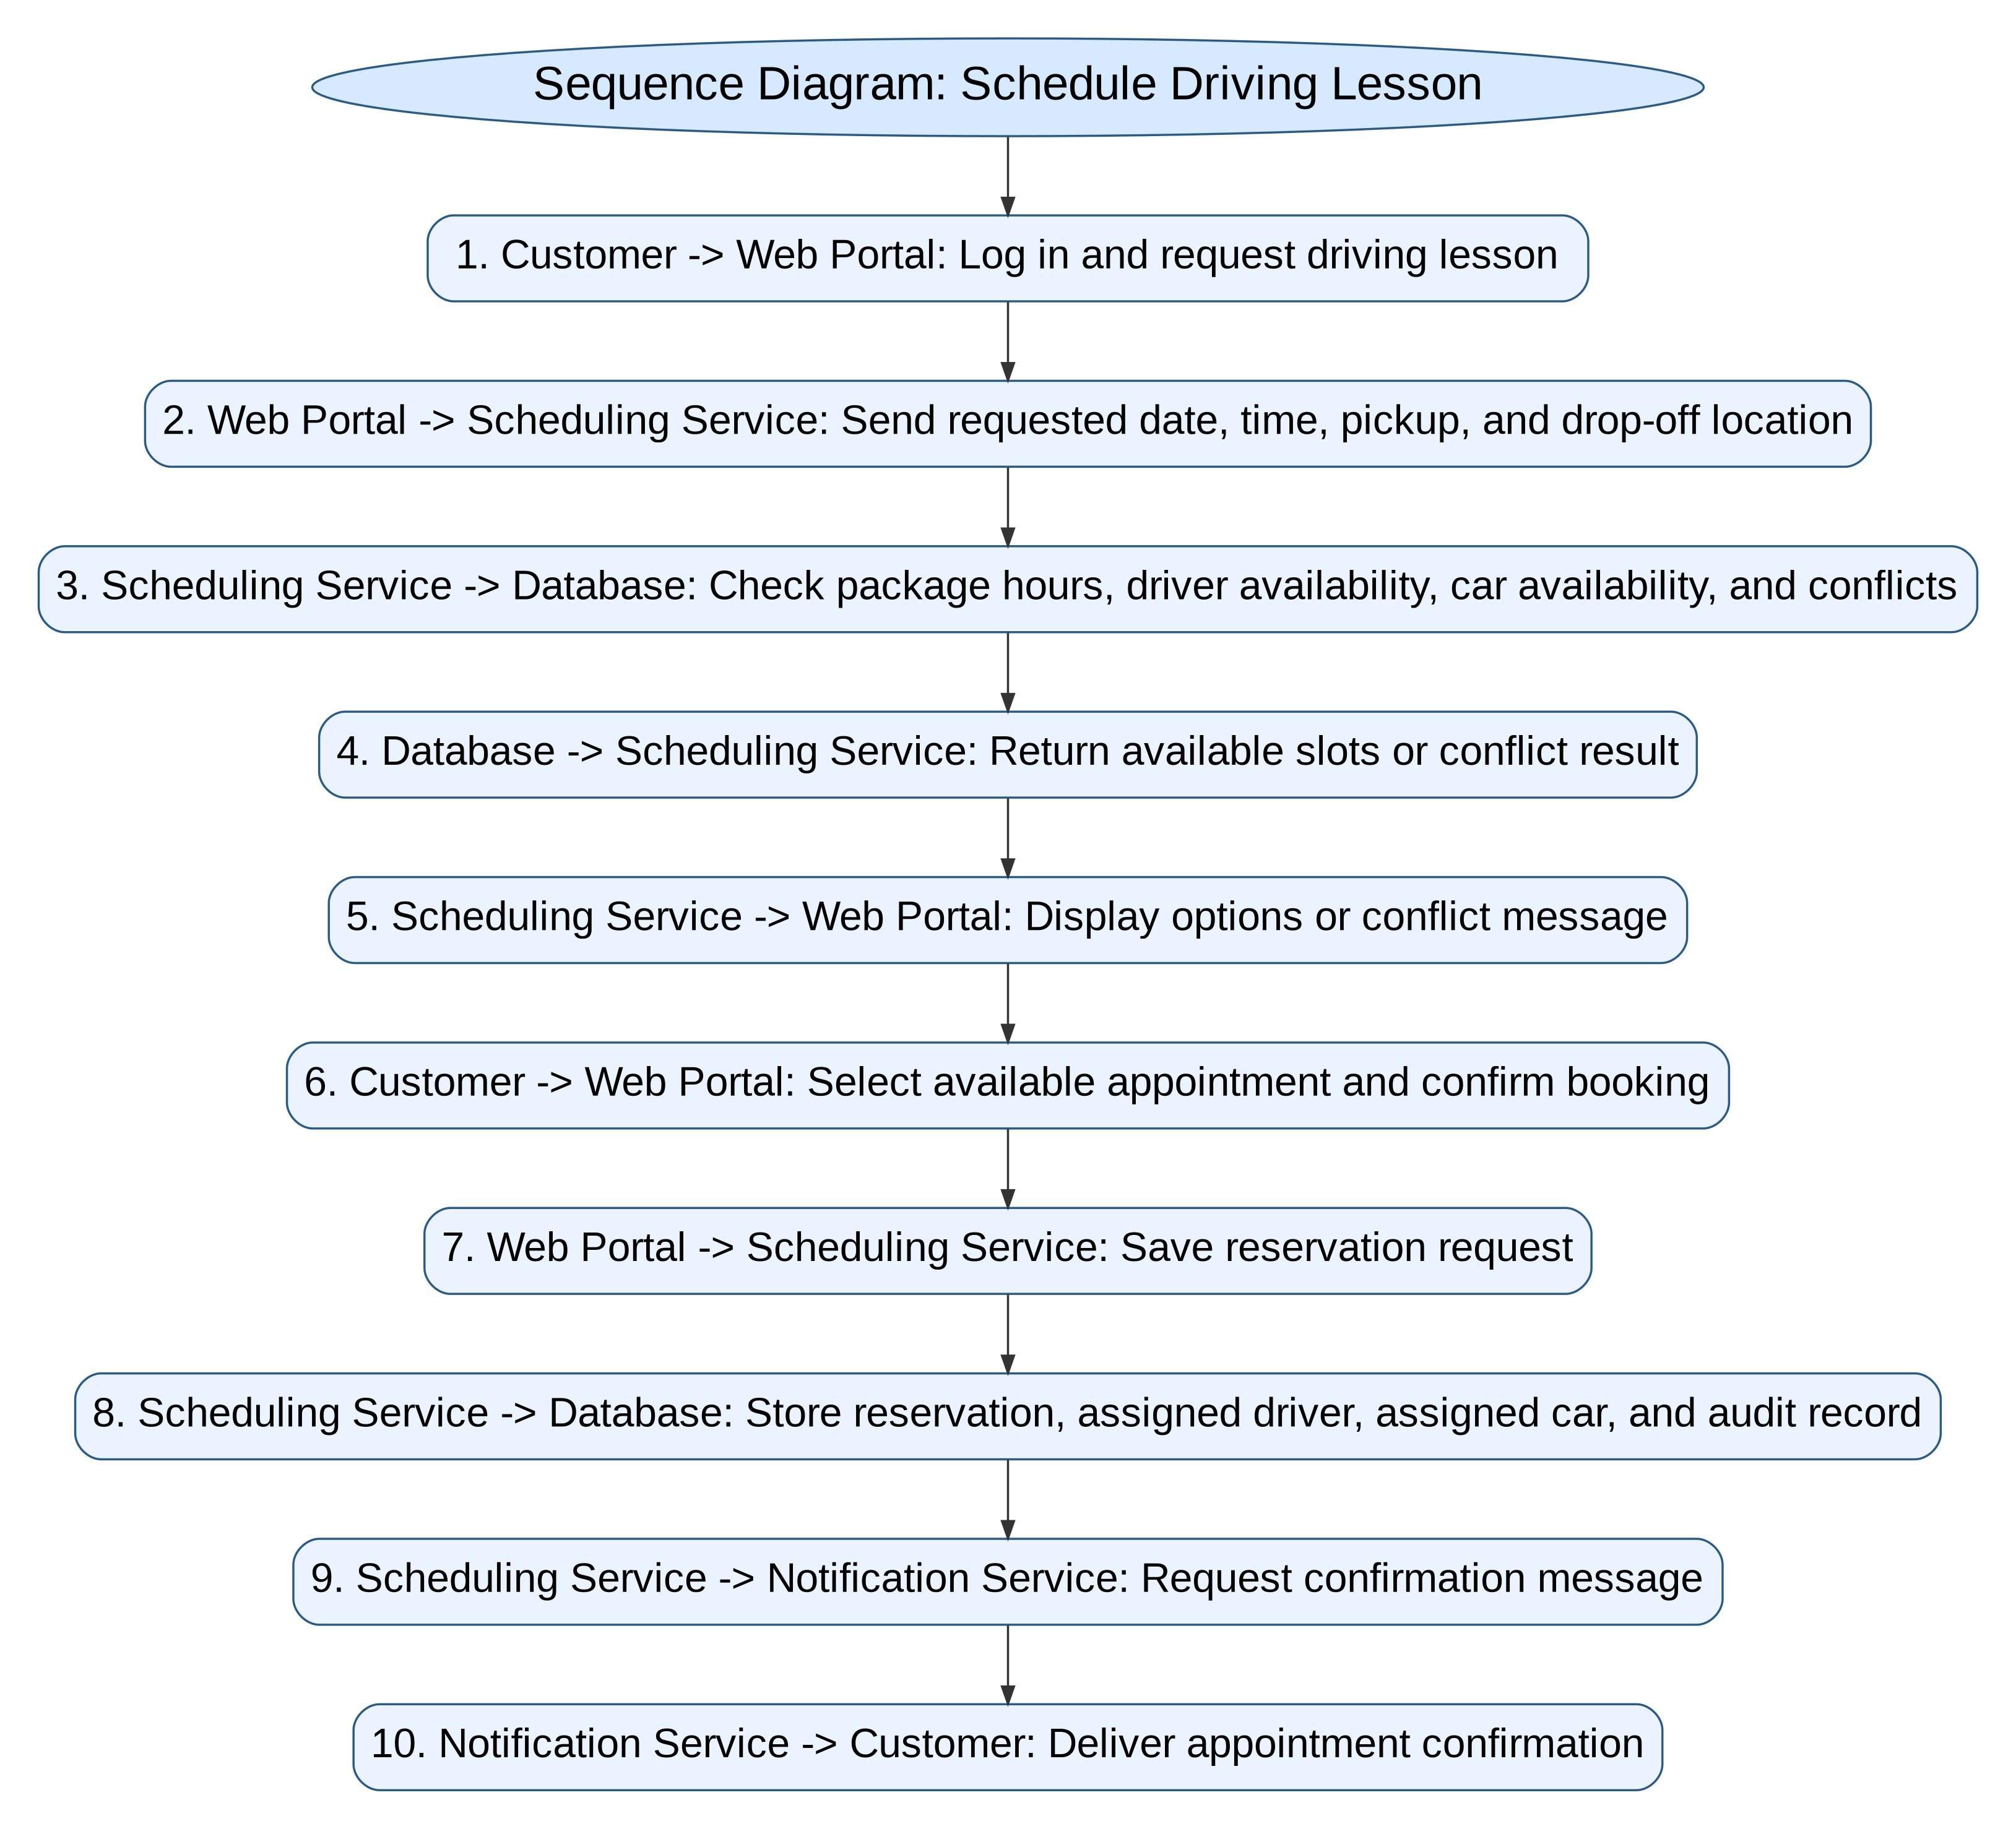
Sequence Diagram: Scheduling Interaction
Readable communication flow among the customer, portal, services, database, and notification process.
The customer requests a driving lesson through the web portal.
The scheduling service checks package hours, driver availability, vehicle availability, and conflicts.
The database returns available slots or conflict results.
After confirmation, the reservation and audit record are stored.
The notification service sends the customer an appointment confirmation.
Large labels make the sequence readable without zooming.
CS 255 DriverPass System Analysis | 5
Notes:
The sequence diagram explains the order of messages that happen when a customer schedules a lesson. This fixes the earlier readability issue by using large labels and a clear numbered order. The diagram shows how the customer request moves from the web portal to the scheduling service, then to the database, and finally to the notification service. This matters to DriverPass because the system must not only show available times, but also save the correct driver, car, reservation, and audit information before confirming the appointment.

Slide 6
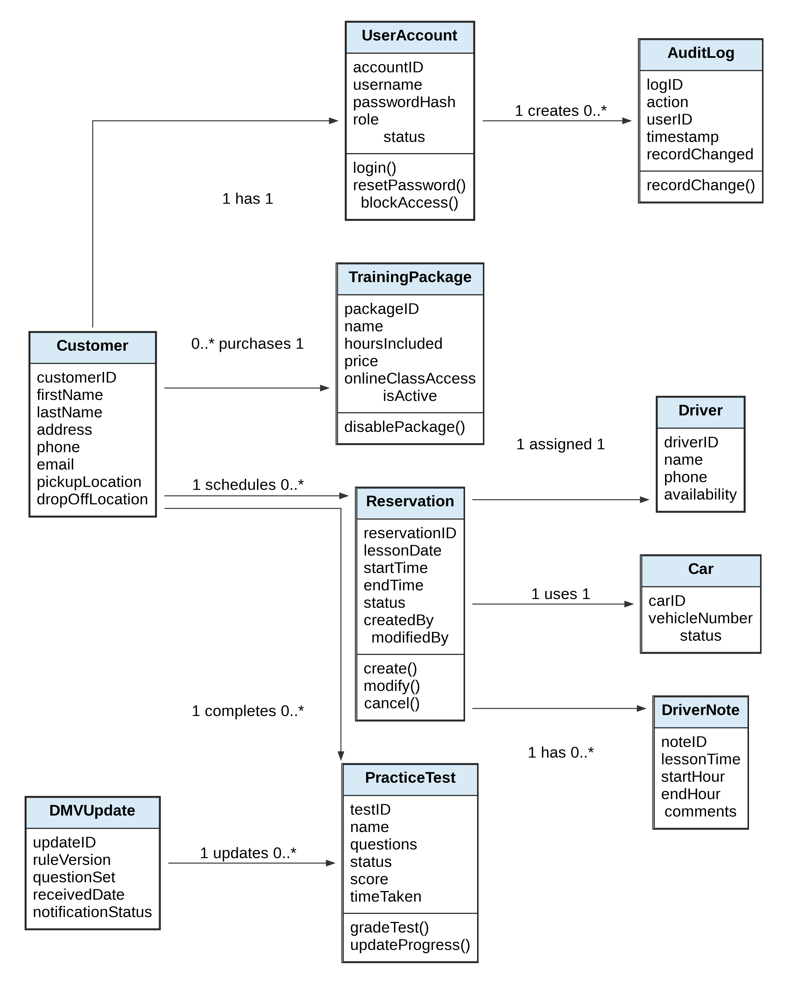
Class Diagram and Data Design
Main information the system must store to support DriverPass operations.
Customer and UserAccount store personal information, login access, roles, and account status.
TrainingPackage stores package hours, online class access, price, and active/inactive status.
Reservation connects each lesson to one customer, one driver, and one car.
PracticeTest and DMVUpdate support current testing content and customer progress tracking.
AuditLog records important changes so DriverPass can identify who created, modified, or canceled records.
Multiplicity labels clarify how many records can be connected, strengthening database planning.
CS 255 DriverPass System Analysis | 6
Notes:
The class diagram supports the database and the long-term structure of the system. It shows the main information DriverPass must store, including customers, accounts, packages, reservations, drivers, cars, practice tests, driver notes, audit logs, and DMV updates. The multiplicity labels are important because they explain the business rules. For example, one customer can schedule many reservations, but each reservation uses one driver and one car. This supports the client requirement to track customers, drivers, cars, lesson times, and changes accurately.

Slide 7
Security
How the design protects DriverPass users, records, and business operations.
Customers and employees must log in before accessing personal information, reservations, tests, or reports.
Role-based access limits each user to the functions they are allowed to perform.
Password reset and account blocking support both customer access and administrator control.
HTTPS/TLS encryption protects information sent between users and the web application.
Audit logs record who creates, changes, cancels, or reports on important records.
Payment information should be handled through a secure payment processor instead of being stored directly by DriverPass.
CS 255 DriverPass System Analysis | 7
Notes:
Security is built into the design because DriverPass will handle customer personal information, account access, schedule details, and payment-related information. The design uses login requirements, role-based access, password reset, account blocking, encrypted communication, and audit tracking. These security choices are explained in nontechnical terms because the business need is clear: customers and employees should only access what they are supposed to access, and DriverPass should be able to trace important changes if something goes wrong.

Slide 8
System Limitations
Known boundaries of the proposed design and future considerations.
Users need internet access to create, change, or cancel records because updates must stay consistent.
Offline work is limited to downloaded reports or exported information, not live database changes.
DMV content depends on the timing and quality of updates provided by the DMV source.
Major package customization beyond disabling a package should be planned as a future release.
Secure payment processing may require a third-party payment provider and related compliance controls.
Future growth may require additional drivers, cars, storage, reporting features, and monitoring.
CS 255 DriverPass System Analysis | 8
Notes:
This slide gives the client a realistic view of the system boundaries. The design supports online access from different devices, but live changes still require internet access so the system does not create duplicate or conflicting data. DMV updates depend on the external DMV source. Package customization can be expanded later, but the current system should at least allow DriverPass to disable packages. These limitations do not mean the system is weak; they explain what is included now and what should be considered for future development.

Slide 9
How the Design Meets DriverPass Needs
Business benefits of the proposed system.
Improves customer success by combining online classes, DMV-based practice tests, and lesson progress tracking.
Improves scheduling accuracy by checking packages, drivers, cars, and time conflicts before confirmation.
Improves accountability by tracking who creates, modifies, or cancels reservations and records.
Improves administration by giving the owner and IT administrator reporting and account-control functions.
Improves flexibility by allowing package management and supporting future system expansion.
Improves accessibility by using a secure cloud-based web system available from modern devices.
CS 255 DriverPass System Analysis | 9
Notes:
This slide ties the system design back to DriverPass business goals. The company wants to help people pass their driving tests and provide better driver training. The design supports that by connecting online learning, practice tests, scheduling, lesson notes, and reporting. It also helps the business run more smoothly by giving employees the tools they need and by tracking changes. The result is a system that is useful to customers, manageable for employees, and scalable for the future.

Slide 10
Conclusion
Final recommendation for the DriverPass system design.
The proposed design satisfies the core DriverPass requirements from the interview.
All major user groups are represented: customers, secretaries, owner, IT administrator, and DMV updates.
The UML diagrams show user interactions, workflows, system communication, and data structure.
Expanded technical requirements address hardware, software, infrastructure, database, security, backup, and scalability.
The design is secure, organized, client-focused, and ready to guide implementation.
CS 255 DriverPass System Analysis | 10
Notes:
The final recommendation is to move forward with the proposed DriverPass system design. It directly supports the needs described in the interview, including online training, practice testing, lesson scheduling, driver and car assignment, reports, security, and DMV content updates. The diagrams and requirements provide a clear foundation for development. The design is also written in a way that DriverPass stakeholders can understand, which helps the client see how the system will support both customers and employees.

