Slide 1

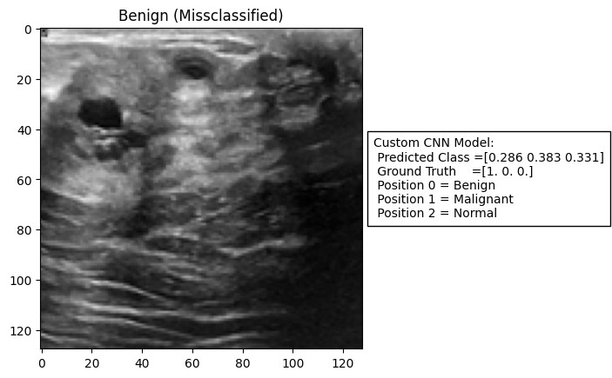
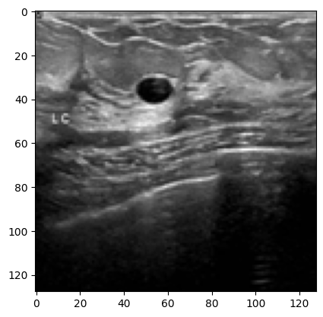
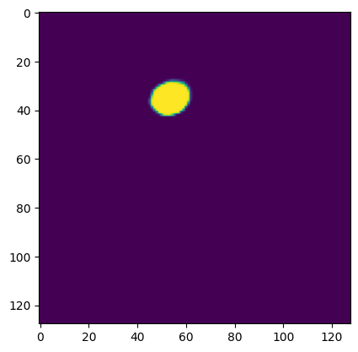

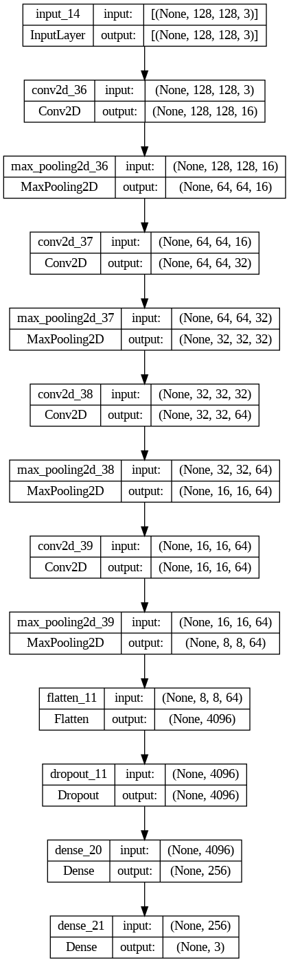
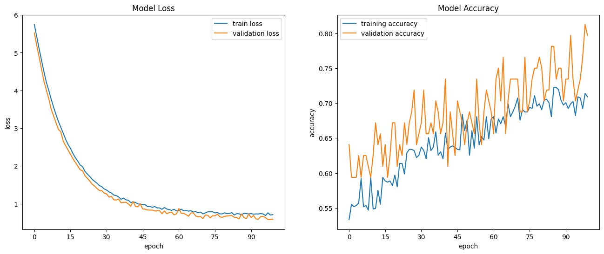
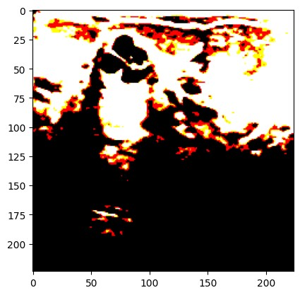
Custom Convolutional Neural Network and UNET for Classification and Segmentation of Imaged Tumours
Introduction
In recent years CNNs have revolutionized the field of automated image classification and segmentation. High accuracy automated models are of particular interest to the medical community as they have the potential to outperform manual classification and segmentation in both accuracy and speed.
Dataset and Preprocessing
The dataset of 701 images provided was divided into three folders, Benign, Malignant and Normal. All data was unlabeled. The first step before building any models was to label the data correctly and join the individual tensors together to form single input-output tensors.
Preprocessing was necessary for using the images with VGG16 transfer learning. The images needed to be resized to 224x224px, converted to BGR colour space and recentred.
Results
The custom CNN Model 2 gave the best performance metrics overall with the highest accuracy on submission to Turing and lowest validation loss, although no improvement on f1 score over the larger Model 1. Note that the loss function used for UNET is binary cross-entropy.
Making Predictions
Using the UNET and custom models to make visual predictions helps to understand the performance of the models as well their limitations.
Fig.4 Misclassified Tumour
Tumour
UNET Segmentation
Ground Truth
Model Architecture
A total of four Models were evaluated, two custom convolutional neural nets and transfer learning with VGG16 for the classification task, and an implementation of UNET for the segmentation task. UNET was chosen as it is designed to perform extremely well on very small datasets. Both CNN models had the same structure and differed only in the number of filters used.
Table 1.) Performance Metrics
Metric | Model 1 (η = 0.01) | Model 1 (η = 0.001) | Model 2 (η = 0.01) | Model 2 (η = 0.001) | VGG16 | UNET
Accuracy | 79% | 70% | 83% (Turing) | 69% | 85% | 96%
Loss | 0.63 | 6.25 | 0.59 | 3.03 | 1.29 | 0.43
F1 | 0.707 | 0.400 | 0.706 | 0.419 | Not Evaluated | 0.750 (Turing)
Param | 4437187 | - | 1110115 | - | 75267 (trainable) 14789955 (total) | 540217
Data Augmentation
Due to the very small dataset, achieving high classification accuracy required the use of data augmentation. Several effects were applied.
Rotation, Width & Height Shift, Flips and more.
Some augmentations, such as random changes in brightness, negatively affected the performance of models.
Fig.5 UNET and Ground Truth Comparison
Conclusions
All of the models performed relatively well and were capable of making accurate predictions based on the data set. The VGG16 model however could not be assessed on Turing as it was too large in size. Model 2 achieved good results however it is far from being state of the art. UNET is proven here to be extremely accurate even on small datasets.
References
F. Chollet, Deep Learning with Python, Chapter 4&5, 2018 (Book)
Ronneberger, O., Fischer, P., Brox, T. (2015). U-Net: Convolutional Networks for Biomedical Image Segmentation. In: Navab, N., Hornegger, J., Wells, W., Frangi, A. (eds) Medical Image Computing and Computer-Assisted Intervention – MICCAI 2015. MICCAI 2015. Lecture Notes in Computer Science(), vol 9351. Springer, Cham. https://doi.org/10.1007/978-3-319-24574-4_28
Fig.1) Model 2 Architecture
Fig.2 Pre-processed
Image for use with VGG16
Fig.3 Loss and Accuracy Plots for Model 2, note the presence of underfitting.
Student Name: Eoghan O’Leary
Student Number: 18319011
Department of Mechanical and Manufacturing Engineering
Trinity College Dublin

