Slide 1
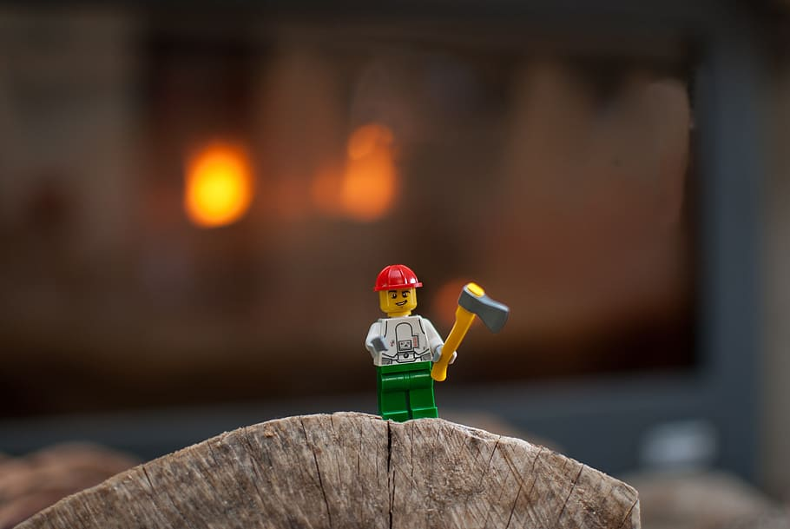
LEGO dataset

Slide 2
Initial dataset
I have found the initial data set on https://rebrickable.com/downloads/ site
The data is regularly updated and my data is of April 27, 2020
The dataset is a summary of information on a kind of fun site. The data was collected during a long period of time and contains rather accurate and detailed information which was to some extent supported with information on official LEGO site. However the dataset is not officially checked or approved by LEGO company

Slide 3
Assumptions of the dataset
Inventories can contain lego_sets and/or Parts and/or Minifigs. Each set has a number of inventories within it, and each inventory has a given assortment of parts in it. But each inventory might also be used with multiple sets, which I think is why the set_num (the key to the specific set) is not unique. The different versions reflect whether there were changes to the parts in a given inventory when it was republished, like a different number of bricks or if some bricks were a different color
The dataset provides information on the major Lego theme which are further broken down to sub-themes

Slide 4
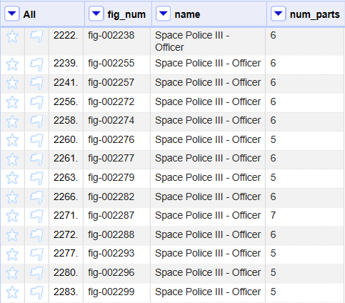
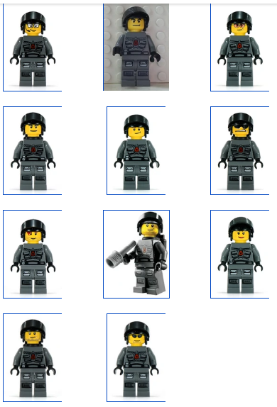
Example of “duplicates”

Slide 5
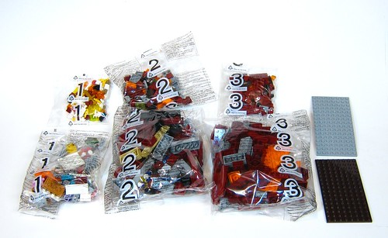
Inventories

Slide 6
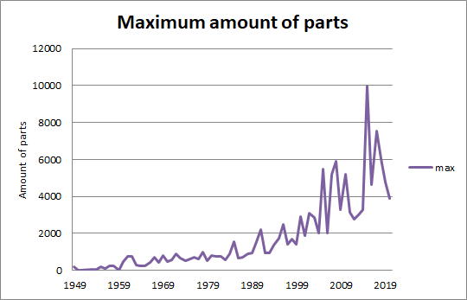
Maximum amount of parts in set

Slide 7
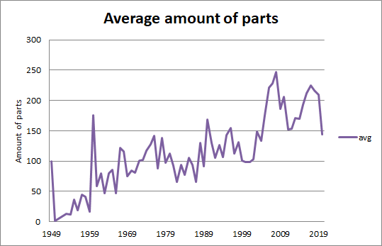
Average amount of parts in sets

Slide 8
Most popular colors by year
2011 | Black
2012 | Light Bluish Gray
2013 | Black
2014 | Black
2015 | Black
2016 | Black
2017 | Light Bluish Gray
2018 | Black
2019 | Black
2020 | Black

Slide 9
Top 10 themes by number of sets
Theme ID | Theme | N of sets | Years
505 | Basic Set | 41 | 1969-2017
632 | Town | 38 | 1978-2019
516 | Duplo and Explore | 36 | 1976-2020
504 | Duplo | 34 | 1972-2020
497 | Books | 33 | 1955-2020
1 | Technic | 30 | 1965-2020
7 | Construction | 28 | 1984-2019
227 | Christmas | 27 | 1977-2019
507 | Educational and Dacta | 26 | 1985-2020
453 | Technic | 24 | 1973-2000

Slide 10
Most popular colors by themes
505 | Basic Set | Yellow
632 | Town | Red
516 | Duplo and Explore | White
504 | Duplo | Red
497 | Books | Black
1 | Technic | Black
7 | Construction | Black
227 | Christmas | White
507 | Educational and Dacta | Black
453 | Technic | Black

