Slide 1
Counterexample generalization
For the IVY language

Slide 2
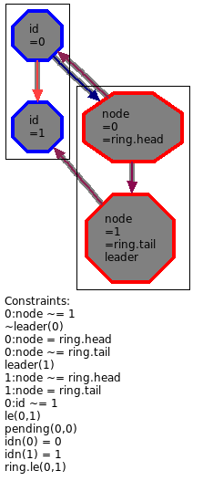
Current method of generalization
List of constraints on variables, relations and functions.
Specific to the structure of the counterexample
Generalization to any structure that contains this substructure.
Named values are replaced with an existentially quantified variable.
The whole thing is negated because we don’t want this substrcture to exist (it is a counterexample).

Slide 3
Minimization
It gives us the following formula :
Then, Ivy will use model checking to check that this formula is always satisfied with a given number of iterations (and unbounded space).
If it succeed, it will automatically suggests a stronger generalization, based on a minimal (UN)SAT core. This is the minimization.

Slide 4
Remarks
General method, but less relevant for existential conjectures (because it bans EVERY structure that contains a substructure matching some constraints).
-> For existential conjectures, it should be possible to do the dual : banning every structure that doesn’t own a substructure matching some constraints.
Can be used without any help of the user, but in this case the generalization is the result of a min-UNSAT core, which is quite arbitrary and often not relevant.
-> If the user want a more relevant result, he has to highlight constraints that make the state incorrect. It can be difficult when there is a lot of non-native structures and relations of arity > 2.

Slide 5
Some ideas
This method doesn’t look at the conjecture we want to prove, nor the code of the iteration: it could be possible to have more relevant and user-friendly results by taking those into account (it could help Ivy to decide whether a constraint matter or not).
We could also ask to the user to « fix » the counterexample in order to be able to compare the faulty example/execution with a fixed one that is almost similar.

Slide 6
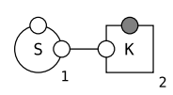
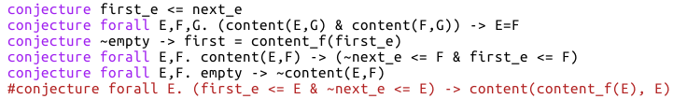
Bridge with counterfactual analysis ☺
Kappa model analysis
Ivy protocol analysis
We are interested in :
The value of a formula (conjecture) after one iteration
The creation of a specie
We compute :
Two traces that are quite close,
one resulting on the creation of the specie and the other that fails to create this specie
Two initial states that are quite close (and thus two different executions of the iteration), one satisfying the formula at the end and the other not
We want to find :
Some events that are important for the creation of the species
Some constraints (=invariants) of the good initial state that are important to satisfy the formula at the end

