Slide 1
Finding an inductive invariant
For protocols in IVY

Slide 2
Checking an inductive invariant
Or finding a counterexample

Slide 3
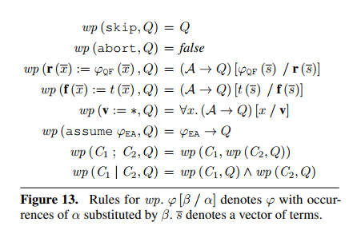

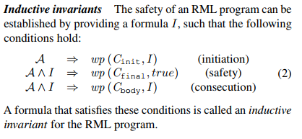
Weakest preconditions & Inductive invariant

Slide 4

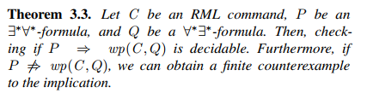
Some theorems
Restrictions:
Quantifier-free updates
Assumes are always of the form ∃* ∀*
Function symbols are stratified
Under these conditions, we have:
So we can compute weakest preconditions (wp) for ∀*∃* conjectures!

Slide 5
Constraints on conjectures
In order to find an inductive invariant, why can’t we just compute the wp of the desired conjecture until we reach a conjecture that imply it’s wp?
Can take an infinite number of iterations
Weakest preconditions are of the form ∀* ∃*, and we can’t decide the implication between two ∀* ∃* formulas (only between ∀* ∃* formulas and ∃* ∀* formulas)
So we must have conjectures without quantifier alternation in order to be able to compute their wp AND to decide the implication.

Slide 6
Generating a counterexample
If IVY finds that our invariant implies its wp, then it is an inductive invariant.
Otherwise, IVY is able to find a minimal structure that satisfy the invariant but not its wp: it is the counterexample that is shown to the user.

Slide 7
Counterexample generalization

Slide 8
Why ?
Why does Ivy try to generalize a specific counterexample generated from a general wp instead of directly using this wp ?
We have seen that we can’t directly use a wp as a new conjecture in order to strengthen the invariant, because it has not the right form (it can’t have quantifier alternation).
With a universally quantified conjecture, we can only ban states depending on whether or not they own a substructure matching a specific pattern. For this reason, reasoning on a specific counterexample is not restrictive.
Using a concrete counterexample is also more user-friendly than an abstract formula, and so the user can help IVY to find the right invariant

Slide 9
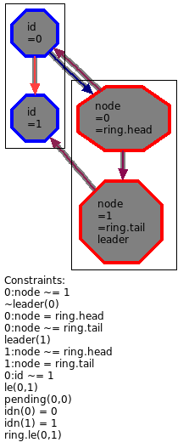
Current method of generalization
List of constraints on variables, relations and functions.
Specific to the structure of the counterexample
Generalization to any structure that contains this substructure.
Named values are replaced with an existentially quantified variable.
The whole thing is negated because we don’t want this substrcture to exist (it is a counterexample).

Slide 10
Minimization
It gives us the following formula :
Then, Ivy will use model checking to check that this formula is always satisfied with a given number of iterations (and unbounded space).
If it succeed, it will automatically suggests a stronger generalization, based on a minimal (UN)SAT core. This is the minimization.

Slide 11
Remarks
General method, but can’t generate existential conjectures (it bans EVERY structure that contains a substructure matching some constraints).
-> For existential conjectures, it should be possible to perform the dual : banning every structure that doesn’t own a substructure matching some constraints.
Can be used without any help of the user, but in this case the generalization is the result of a min-UNSAT core, which is quite arbitrary and often not relevant.
-> If the user want a more relevant result, he has to highlight constraints that make the state incorrect. It can be difficult when there is a lot of non-native structures and relations of arity > 2 (bad representation).

Slide 12
Some ideas
This method doesn’t look at the conjecture we want to prove, nor the code of the iteration: it could be possible to have more relevant and user-friendly results by taking those into account (it could help Ivy to decide whether a constraint matter or not).
We could also ask to the user to « fix » the counterexample in order to be able to compare the faulty example/execution with a correct one that is almost similar.

Slide 13
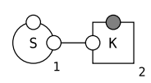
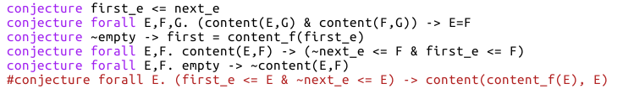
Ivy counterfactual analysis ☺
Kappa model analysis
Ivy protocol analysis
We are interested in :
The value of a formula (conjecture) after one iteration
The creation of species
We compute :
Two traces that are quite close,
one resulting on the creation of the specie and the other that fails to create this specie
Two initial states that are quite close (and thus two different executions of the iteration), one satisfying the formula at the end and the other not
We want to find :
Some events that are important for the creation of the species
Some constraints (=invariants) of the good initial state that are important to satisfy the formula at the end

Slide 14
Let’s explore these ideas

Slide 15
Description
We only keep a (minimal) subset of constraints that is sufficient to be sure that, after the execution, the faulty conjecture is broken.
We start with the post-execution state and highlight important constraints that allow us to determine that the conjecture is not satisfied. We only consider constraints that correspond to: variable=value, relation(values)=true/false, function(values)=value, structural (in)equalities on values. NEW: Each variable/relation involved should have values in its own copy of the type, so (in)equality between two values can be expressed as a structural (in)equalities between two values of two different types.
We rewind the execution. At each step we update the list of constraints and we hightlight some new constraints if needed.
If, at some point during the rewind, we have to express a non-existance (that would require a number of constraints that depends on the structure), the user should be informed (it means that the new conjecture would need quantifier alternation). The user can then « fix » the counterexample in order to help Ivy to express a conjecture.

Slide 16
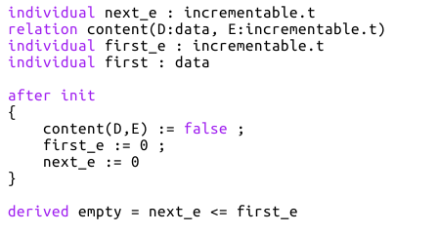
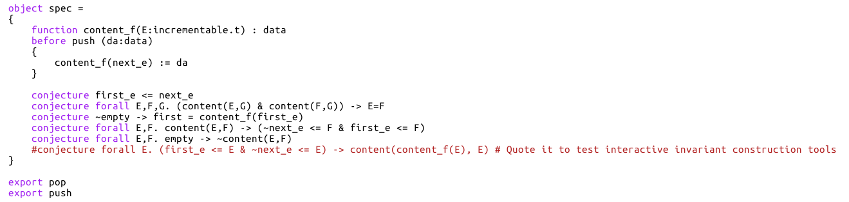
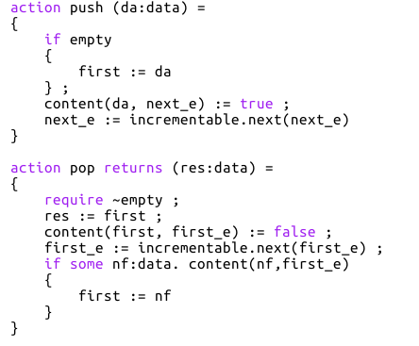
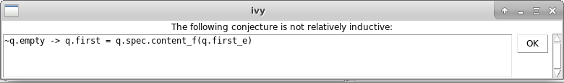
Example: a queue

Slide 17
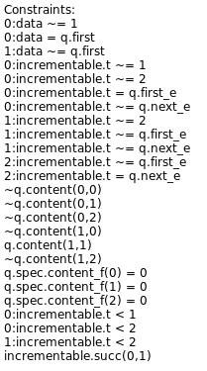
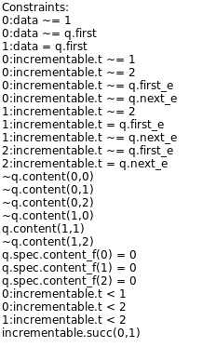
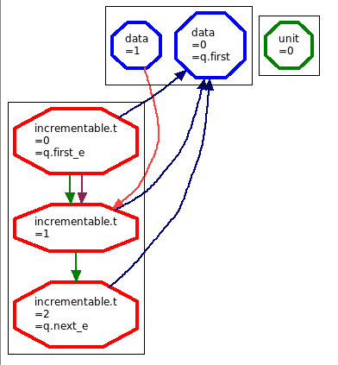
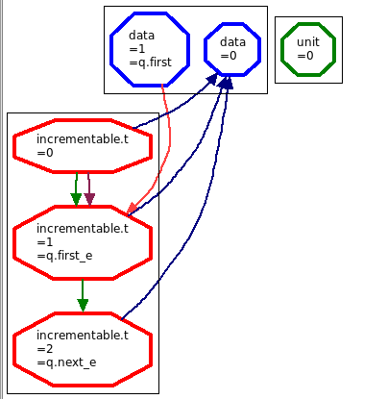
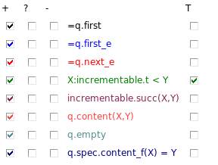

Slide 19
If the spec of incr.next was more precise, incr.succ(0,1) should also be highlighted.

Slide 20
Finally, by generalizing, we obtain the following conjecture:
∃A,B. content(A,B) & content_f(B)~=A & first_e < next_e & B < next_e & first_e < B
We negate it:
∀A,B. ~ (content(A,B) & content_f(B)~=A & first_e < next_e & B < next_e & first_e < B)
∀A,B. first_e < B & B < next_e & content(A,B) -> content_f(B) = A
This conjecture is true and exclude all states that contain this counterexample.

Slide 21
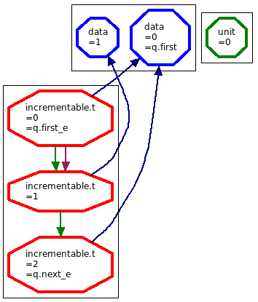
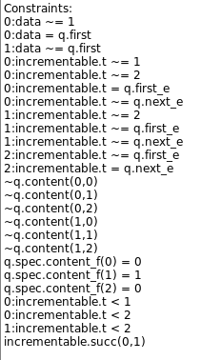
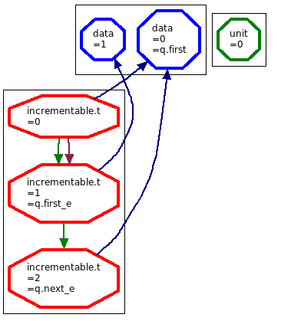
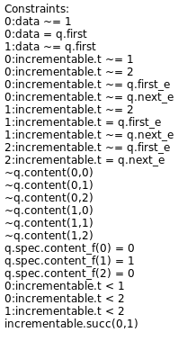
Let’s continue…

Slide 22
This time, we would have to express the non-existence of an element nf such that content(nf, first_e) is true.
It is not possible without quantifier alternation (we would have to highlight a potentially infinite number of constraints), so we can:
Ignore it for now. However, the conjecture generated is likely to be wrong (too general). The user is informed and provides Ivy with a « fix » of the counterexample in order to refine the conjecture (see next slide).
Propose an invariant with quantifiers alternation.

Slide 23
Option 1:
The user chooses to fix this counterexample by setting content(1,1) to true.
Then we highlight constraints that ensure that the conjecture stays true.

Slide 24
Then we compare the highlighted constraints of the two examples. If there is contradictory highlighted constraints, we should ask the user an other fix because this one is unexploitable.
The conjecture that will be proposed is of the form: ∀ … . conjunction of green&red constraints -> conjonction of blue constraints
∀A,B. content_f(B) = A & A ~= first & first_e < B & B < next_e
-> content(A,B)
∀B. content_f(B) ~= first & first_e < B & B < next_e
-> content(content_f(B),B)

Slide 25
Option 2:
Using the second option, the invariant found would be:
∀B,C. succ(first_e,C) & content_f(B) ~= first & first_e < B & B < next_e
-> ∃A. & content(A,C)

