Slide 1
Explainable Generative AI for Wind Speed Scenario Generation
Conditional diffusion model with built-in explanations
[Student Name(s)]
Guide: [Guide]
[Department / University] · [Date]
Notes:
Good morning. Our project generates many plausible future wind-speed paths with a generative diffusion model and explains, for each forecast, which inputs and which past hours drove it. I will cover the motivation, data, model, explainability methods, results, a demo of the app, and limitations. About 15 minutes.

Slide 2



One forecast line hides the uncertainty and the reasons
Deterministic forecasts give a single number per hour. Operators cannot see how wrong it might be, or why the model predicts it.
Wind-farm planning
Energy yield and risk ranges
Wind is variable and intermittent
Decisions need a range of plausible futures (scenarios), not one value
Black-box AI is hard to trust: each forecast should come with its drivers
Battery scheduling
Charge / discharge under uncertainty
Grid operation
Reserves and balancing needs
Notes:
Wind power is variable. A single deterministic forecast hides the spread of possible outcomes and gives no reason for the prediction. Planners, battery schedulers and grid operators all need many plausible scenarios, and they need to trust them, so we pair a generative model with explanations.

Slide 3
Objectives
1
Generate
Conditional diffusion model: 20 plausible 24 h wind scenarios from the past 24 h of weather
2
Explain
Group SHAP, attention maps, occlusion and counterfactuals show which inputs and hours drive each forecast
3
Evaluate
Benchmark against persistence, climatology and ridge with probabilistic and realism metrics
4
Check the explanations
Measure faithfulness, stability and attention–occlusion agreement
5
Make it usable
Turbine power, P10/P50/P90 energy and an interactive Streamlit app
Notes:
Five objectives, matching the abstract: generate scenarios with a diffusion model; explain them; evaluate against standard baselines; check that the explanations themselves are faithful and stable; and make the result usable through power conversion and an app.

Slide 4

Data: 76 years of hourly ERA5 reanalysis
~671k
1950–2026
8
20 × 24 h
hourly records
Jan 1950 to Aug 2026
input feature groups
scenarios per 24 h history
14.6°N 79.6°E · Andhra Pradesh, India
Chronological split (no leakage)
u10 / v10 → wind speed and direction
Temperature; dew point → relative humidity
Surface pressure, precipitation, solar radiation
Calendar: hour of day, day of year
Train
Validation
Test
< 2016
60,000 windows
2016–2020
1,754 windows
≥ 2021
1,000 windows
Each window: previous 24 h of weather → next 24 h of 10 m wind speed
Notes:
We use ERA5 hourly reanalysis for one grid point in Andhra Pradesh, from 1950 to August 2026, about 671 thousand hours. From the 10 m u and v wind we derive speed and direction; dew point gives relative humidity; we also use pressure, precipitation, solar radiation and calendar features. The split is strictly by time: training before 2016, validation 2016 to 2020, test 2021 onwards, giving 60,000, 1,754 and 1,000 windows.

Slide 5


End-to-end pipeline
ERA5 hourly data
Features & windows
Conditional DDPM
Scenario set
7 weather variables + calendar
speed, direction, RH; 24 h history
MLP or cross-attention denoiser
20 trajectories × 24 h
Evaluation
Explainability
Power & app
CRPS, energy score, calibration, realism vs 3 baselines
SHAP, attention, occlusion, counterfactuals + quality metrics
100 m turbine power, P10/P50/P90 energy, Streamlit demo
Notes:
The pipeline: load and join the ERA5 files, engineer features and cut leakage-free 24 hour windows, train a conditional diffusion model, and sample 20 scenarios per forecast. The scenario set then feeds three things: evaluation against baselines, the explainability methods, and the power conversion and Streamlit app. Everything runs from one script.

Slide 6
Conditional diffusion model with an attention backbone
Denoising diffusion (DDPM)
Cross-attention denoiser
Gaussian noise
100 denoising steps, conditioned on past 24 h
One scenario
Noisy future (24 h) + step t → Query
24 history hours → Keys / Values
Different noise → 20 different scenarios
Cosine schedule, T = 100, EMA weights
Written from scratch in NumPy, manual backprop + Adam
CPU only: 15–40 s per training run
85 unit tests incl. gradient checks; fully reproducible
4-head cross-attention
MLP → predicted noise
History reaches the network only through attention, so the attention maps are faithful.
Notes:
The model is a conditional DDPM. Starting from Gaussian noise, a denoiser removes noise over 100 steps while conditioned on the past 24 hours; different starting noise gives different scenarios. We wrote it from scratch in NumPy with manual backpropagation, so it trains on a laptop CPU in 15 to 40 seconds. There are two backbones. The MLP flattens the history. The attention backbone uses the noisy future as the query and the 24 history hours as keys and values; history enters only through attention, so the attention weights are a genuine explanation, not a side-product.

Slide 7




Explainability methods
Group SHAP
Attention maps
Shapley values over 8 feature groups for the mean generated wind speed
Cross-attention weight on each of the 24 history hours, per head
Occlusion attribution
Counterfactuals
Mask one history hour at a time and measure the output change (model-agnostic)
What-if edits (e.g. −5 hPa pressure) and search for the smallest change reaching a target
Explanation quality is measured: deletion faithfulness · top-1 deletion ratio · seed stability · attention–occlusion agreement
Notes:
Four complementary methods. Group SHAP attributes the mean generated wind to eight input groups. Attention maps show which past hours the attention backbone reads. Occlusion masks one hour at a time, which is model-agnostic and lets us cross-check attention. Counterfactuals ask what the model generates if, say, pressure were 5 hPa lower, and a search finds the smallest change that shifts the forecast by a target amount. We do not just show explanations; we score them.

Slide 8
How we evaluate scenarios
Accuracy
Calibration
Realism
Power
CRPS, energy score, MAE / RMSE
90% coverage, rank histogram, calibration error
KS, Wasserstein, ACF distance, ramp distance
CRPS on turbine capacity factor
Baselines
Persistence
Climatology bootstrap
Ridge + residual bootstrap
Test period 2021+, 1,000 windows, 20 scenarios each; 3 random seeds per model, reported as mean ± std
Notes:
CRPS is the main score: it rewards scenario sets that are both accurate and sharp; lower is better. Energy score is its multivariate version over the whole 24 hour path. Calibration checks that the observed value falls inside the 90% band 90% of the time. Realism metrics compare the distribution and temporal structure of generated versus real trajectories. Baselines are persistence, a month-hour climatology bootstrap, and a ridge regression with bootstrapped residuals, which is a strong baseline.

Slide 9
Results: diffusion beats all baselines on CRPS
Model | CRPS ↓ | Energy score ↓ | Cov. 90% | KS ↓ | ACF dist. ↓
Diffusion (MLP) | 0.392 ± 0.005 | 2.355 ± 0.033 | 0.900 | 0.027 | 0.008
Diffusion (attention) | 0.406 ± 0.007 | 2.430 ± 0.037 | 0.898 | 0.024 | 0.009
Ridge + bootstrap | 0.413 ± 0.007 | 2.467 ± 0.041 | 0.894 | 0.044 | 0.002
Persistence | 0.624 ± 0.013 | 3.778 ± 0.070 | – | 0.007 | 0.002
Climatology | 0.730 ± 0.006 | 4.195 ± 0.029 | 0.901 | 0.030 | 0.005
−4.9%
CRPS vs ridge (MLP); attn −1.6%
0.90
90% band coverage: on target
Weakness
Mean ± std over 3 seeds, test 2021+. Persistence has no spread (single trajectory); persistence and climatology reuse observed values, so their KS is low by construction.
ACF / ramp: noisier hour-to-hour than ridge
Notes:
Main result. The MLP diffusion model has the best CRPS, 0.392, about 5% better than ridge at 0.413, and the best energy score. The attention model is only marginally better than ridge; that is the price we pay for built-in interpretability. Coverage of the 90% band is 0.90, right on target. The diffusion marginal distribution is closer to reality: KS 0.024 to 0.027 versus 0.044 for ridge. Being honest about the weakness: the ACF and ramp distances are worse than ridge, so generated trajectories are noisier from hour to hour.

Slide 10
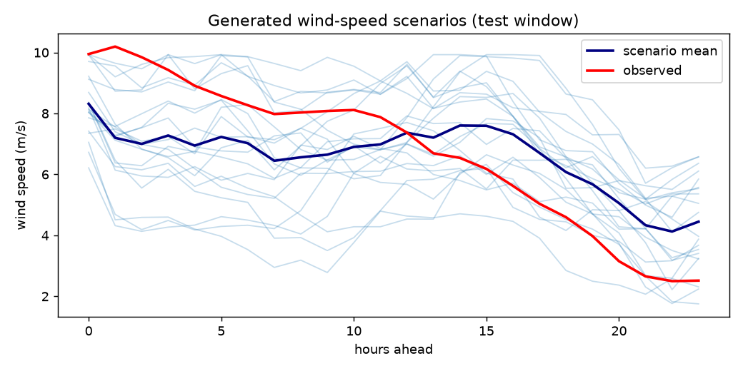
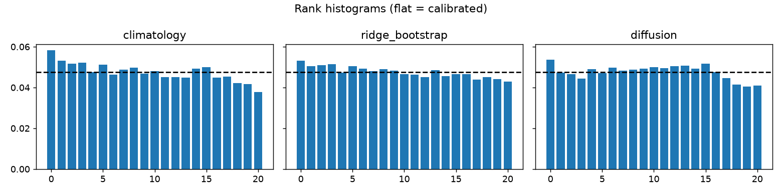
Generated scenarios are calibrated and realistic
Scenarios follow the observed decline; the sharpest late drop falls at the edge of the fan
Distribution match: Wasserstein ≈ 0.055 vs 0.089 for ridge
Calibration error 0.005–0.007
Rank histograms: flat = calibrated. Diffusion is close to flat, with a slight deficit at the top ranks.
Notes:
Top: 20 scenarios for one test day, with the scenario mean in dark blue and the observation in red. The spread widens where the future is uncertain. The fan captures the downward trend, but the very sharp drop in the last hours sits at the lower edge of the scenarios, which is the same hour-to-hour weakness we saw in the ACF and ramp metrics. Bottom: rank histograms. A flat histogram means the observation is equally likely to fall at any rank among the scenarios, which is what calibration means. The diffusion histogram is close to flat, with a slight deficit at the top ranks.

Slide 11
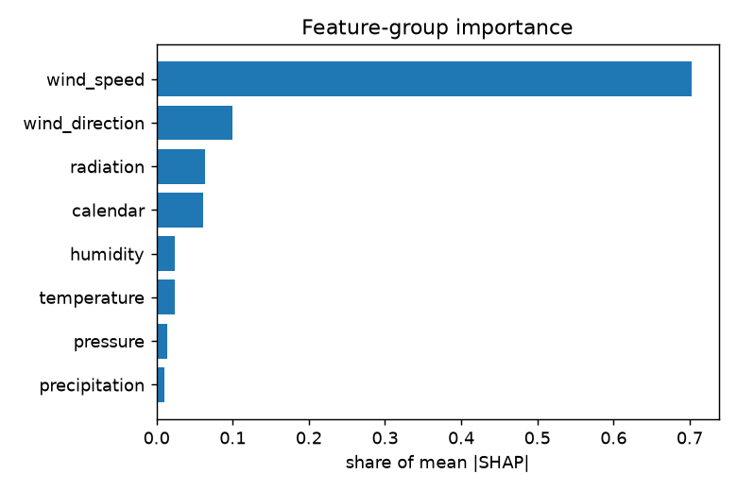
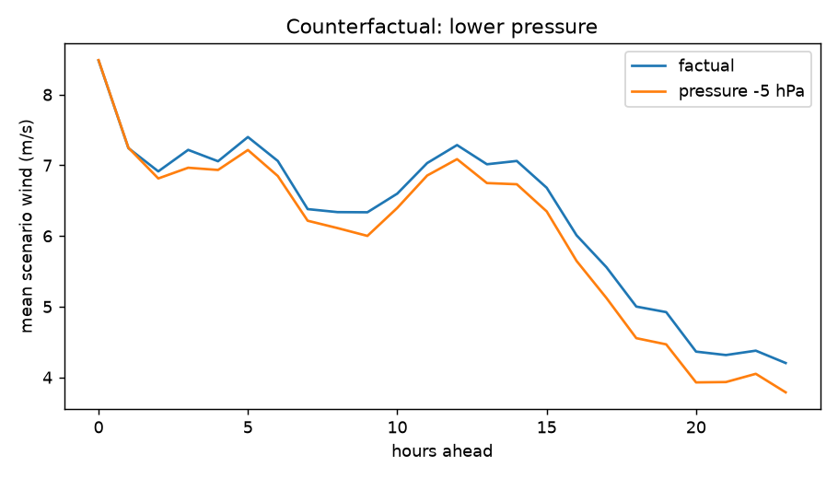
What drives the forecast: SHAP and counterfactuals
Past wind speed: 64–70% of importance
Then direction, radiation, temperature, calendar (diurnal); pressure 1–4%
−5 hPa pressure → −0.27 to −0.33 m/s mean wind on a windy day
+20% past wind → about +1 m/s
Notes:
Left: global group SHAP. Past wind speed dominates with 64 to 70 percent of the importance across runs, which is physically sensible because wind is persistent. Direction, radiation, temperature and the calendar, which captures the daily cycle, follow; pressure is small at 1 to 4 percent. Right: a counterfactual on a windy test day. Lowering pressure by 5 hPa lowers the generated mean wind by about 0.3 m/s; raising past wind by 20 percent raises it by about 1 m/s. These are statements about the model, not causal claims about the atmosphere.

Slide 12
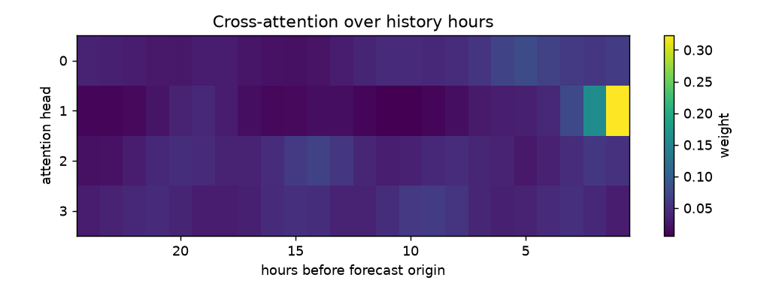
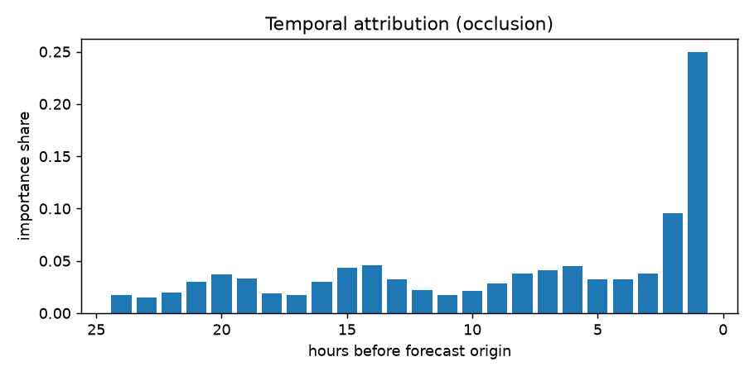
Which past hours matter: attention vs occlusion
0.81 ± 0.07
Spearman agreement between attention and model-agnostic occlusion
Head 1 focuses on the last 1–3 hours
Other heads spread across the day
Occlusion confirms: the last 2 hours carry most of the signal
Notes:
Top: average attention per head over the 24 history hours. Head 1 is a short-memory head that looks at the last one to three hours; the other heads spread across the day, picking up the diurnal pattern. Bottom: occlusion, which masks each hour and measures the change, without looking at attention at all. Both agree that the most recent hours matter most, with a Spearman rank agreement of 0.81 plus or minus 0.07 across seeds, which supports that the attention maps are trustworthy.

Slide 13
Are the explanations trustworthy?
0.61–0.67
SHAP deletion Spearman
≈ 3.9×
Top-1 deletion ratio
Groups with larger SHAP change the output more when removed
Removing the top SHAP group vs an average group
≈ 0.88
Stability Spearman
0.81
Attention–occlusion
Same ranking with a new background sample and permutations
Two independent methods rank history hours alike
Spearman 1.0 = perfect agreement. Mean over 3 seeds and both backbones.
Notes:
We test the explanations themselves. Deletion faithfulness: when we remove each feature group, groups with larger SHAP values change the output more, Spearman 0.61 to 0.67. Removing the single top group changes the output about 3.9 times more than an average group. Rankings are stable, around 0.88, when we change the background sample and permutations. And attention agrees with occlusion at 0.81. So the explanations are faithful and stable, not just plausible-looking.

Slide 14
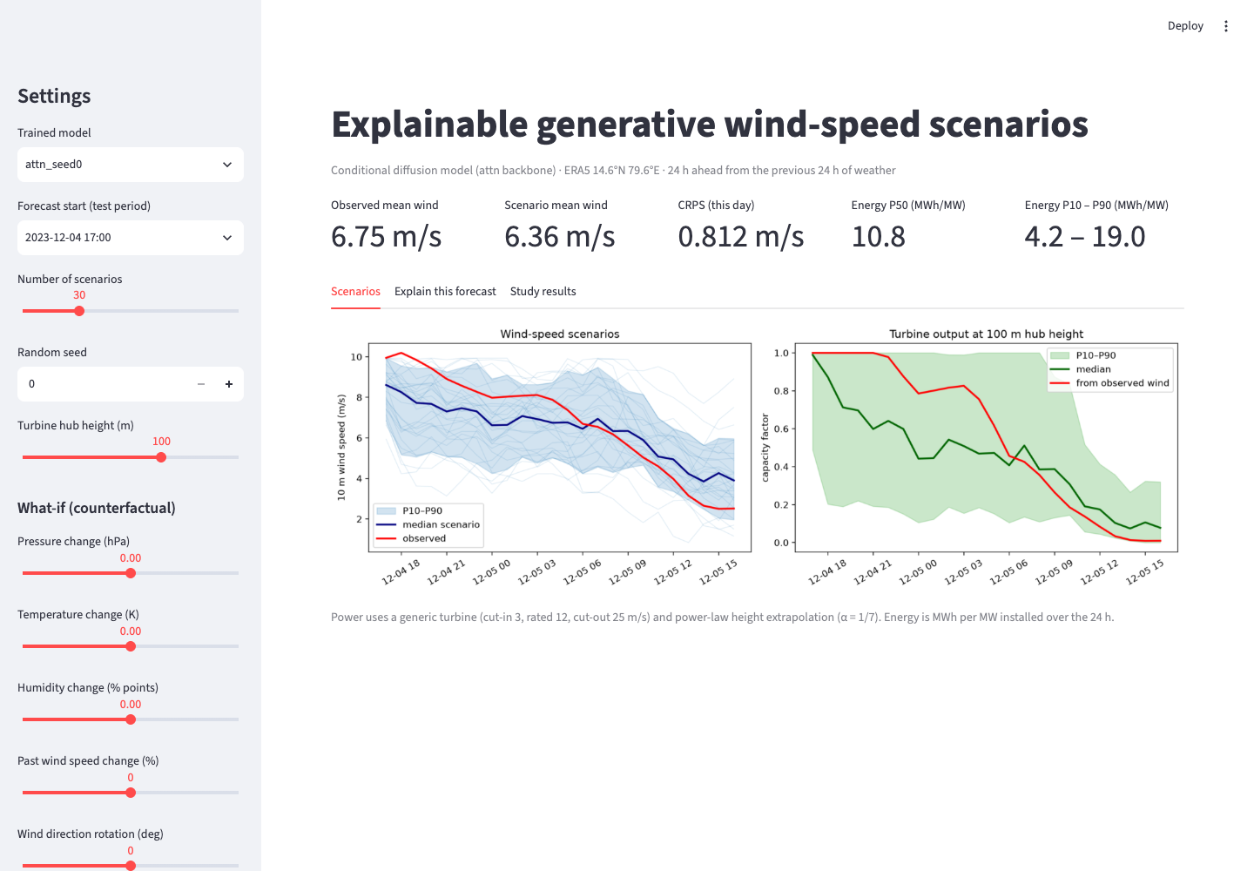
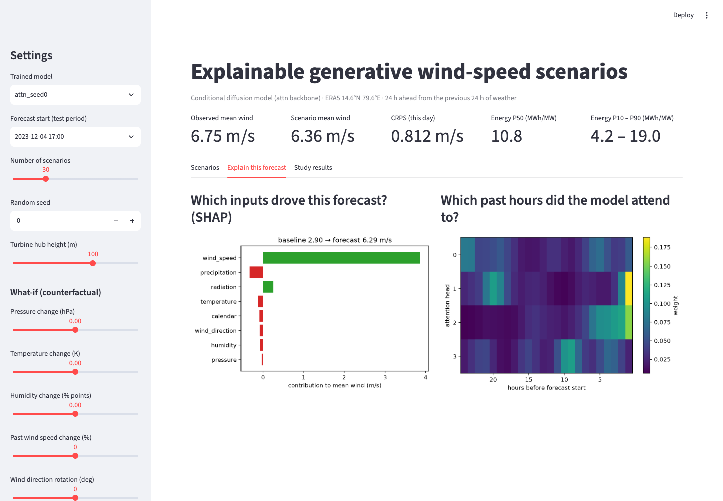
Live demo: interactive Streamlit app
Pick a test day; wind and power fan charts
P10/P50/P90 daily energy and CRPS of that day
What-if sliders: pressure, temperature, humidity, past wind, direction
Per-forecast SHAP and attention
Notes:
Demo. (Run: streamlit run app.py.) Pick a test day, for example 4 December 2023 at 17:00. The scenarios tab shows the wind fan and the turbine output fan with P10 to P90 bands, and the daily energy. The explain tab shows which inputs drove this forecast and which past hours the model attended to. Moving the what-if sliders, for example lowering pressure or past wind, regenerates the scenarios immediately. If the live demo fails, these screenshots show the same views.

Slide 15

From wind scenarios to energy decisions
Example test day (4 Dec 2023, attention model): daily energy, MWh per MW installed
Battery scheduling
P10
4.2
P50
10.8
P90
19.0
Plan charging against the low (P10) case
Wind-farm planning
0
24
Energy at risk, not just an expected yield
100 m hub height (power law), generic turbine curve: cut-in 3, rated 12, cut-out 25 m/s. Illustrative, not a site assessment.
Grid operation
A single forecast would give one number; the scenarios show the day could deliver anywhere from 4 to 19 MWh/MW.
Size reserves from the P10–P90 spread
Notes:
Converting scenarios to power makes them actionable. For this test day the median expected energy is 10.8 MWh per installed MW, but the 10 to 90 percent range is 4.2 to 19. A battery operator can plan against the low case, a planner sees energy at risk, and a grid operator can size reserves from the spread. The turbine curve is generic and 10 m wind is extrapolated to 100 m, so these numbers are illustrative.

Slide 16


Limitations and future work
Limitations
Future work
Single site (one ERA5 grid point)
10 m reanalysis wind; generic power curve
24 h horizon only
No GAN / flow comparison yet
Counterfactuals are model-based, not causal
Trajectories noisier hour-to-hour than ridge
PyTorch transformer denoiser
Multi-site, spatially correlated scenarios
Measured hub-height wind and real turbine data
Compare with GANs and normalising flows
Battery scheduling optimisation on scenarios
Notes:
Limitations: one site, 10 m reanalysis wind rather than measured hub-height wind, a generic power curve, a 24 hour horizon, no GAN comparison, and counterfactuals that describe the model rather than physical causation. The temporal smoothness weakness is also open. Next steps: a PyTorch transformer denoiser, multiple sites, measured hub-height data, comparison with GANs and flows, and using the scenarios inside a battery scheduling optimiser.

Slide 17
Conclusion
0.392
CRPS: diffusion beats persistence, climatology and ridge (≈5% vs ridge)
0.90
Coverage of the 90% band: well calibrated scenario sets
0.81
Attention agrees with occlusion: built-in, verified explanations
85
Unit tests; NumPy from scratch, CPU-only, reproducible
Notes:
To conclude: a from-scratch conditional diffusion model generates calibrated wind scenarios that beat strong baselines on CRPS. Its explanations are built in and verified: SHAP is faithful and stable, and attention agrees with occlusion. The interpretable attention backbone costs a little accuracy, which is an honest trade-off. The work is reproducible with 85 unit tests and runs on a laptop CPU.

Slide 18
Thank you
Questions?
Code, results and demo: files/wind_scenarios · streamlit run app.py
Notes:
Thank you. Happy to take questions. Likely questions: why diffusion rather than a GAN (stable training, good calibration; GAN comparison is future work); why the attention model is less accurate (it restricts how history is used in exchange for faithful attention); why pressure has low importance (at this site and hourly scale, persistence of wind dominates).

