Slide 1
E-Team Squadra Corse
Introduzione al software

Slide 2
Architettura Hardware
Sensori: temperatura, pressione, velocità (“foniche”), PPS, IMU
Attuatori: Inverter (+ motore), pompa, contattori HV
Battery Pack + BMS + IMD
Vehicle Control Unit (VCU)
Shutdown Chain (SDC)
Display, Logging, Telemetria

Slide 3
Architettura di Comunicazione
Uno o più bus di comunicazione basati su protocollo CAN
EV-A: 3 can bus
  CAN-S: signal bus, CAN-I: inverter can, CAN-B: BMS CAN
ET-16: bus unificato (il BMS usa anche un bus interno)
LoRA per la comunicazione telemetria

Slide 4
Software “in-house”
can_common: generazione DBC, bindings C, documentazione, analisi del carico del bus
can_bootloader: STM32 and AVR
config_lib: configurazione dei parametri senza ricompilare
etdv_dashboard: visualizzazione
Telemetria: CAN2Radio, Radio2CAN
Firmware MCU

Slide 5
Software utilizzato
Git/Github per il controllo di versione e collaborazione
PlatformIO: programmazione dei micro
Meson e Cmake: compilazione su linux
STM32CubeMX: Configurazione degli STM32 (VCU)
FreeRTOS: scheduler real-time che gira sulla VCU
cantools, asammdf, can-utils
Linux (sviluppo e raspberry)

Slide 6
CAN Bus Design

Slide 7
Design space
CAN bus speed: as high as 1Mbit/s (up to 40m cable length). Higher speed is associated to less noise immunity.
Can Messages (Standard Frame):
Message Period
ID (11bit)
Payload (up to 8 bytes)
Affects bus utilization and worst case delay of lower-priority messages.
Lower ID means higher priority.
Affects worst case message delay.
Affects total transmission time (MCU)
Affects bus utilization

Slide 8
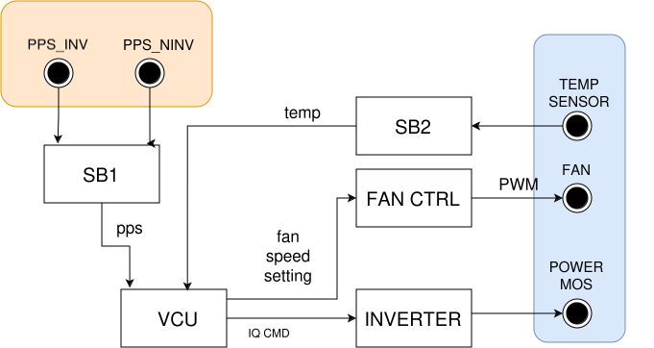
Design example

Slide 9
can_common
Python based, generates a bunch of stuff:
DBC for reading the CAN bus
C bindings to automate packing/unpacking messages
Bus documentation in PDF
Bus load and timing analysis

Slide 10
using can_common to describe the bus
can_def.py
vcu_messages = [
{
'name': 'iq_cmd',
'senders': [NodeId.VCU],
'receivers': [NodeId.INVERTER],
'message_id': MsgId.IQ_CMD,
'comment': 'Quadrature current command',
'cycle_time': None,
'signals': [
{
'name': 'iq_rms',
'scale': 0.1,
'range': (0, 200),
'unit': 'Arms',
'comment': 'RMS value of quadrature current',
},
]
},
...

Slide 11
Generating the DBC and bindings
1 from dbc_dict_processor import create_dbs, fail_on_overlapping_ids
2 from dbc_bindings_generation import write_dbc_files, write_nodes_header
3 from can_def import main_messages, NodeId, DBC_VERSION
4 import cantools
5
6 main_db, main_bindings_db = create_dbs(main_messages(), NodeId, NodeId, DBC_VERSION)
7 fail_on_overlapping_ids([main_db])
8 cantools.database.dump_file(main_db, r'dbc/main.dbc')
9
10 write_dbc_files(main_bindings_db, 'main', 'bindings/main_db.h', 'bindings/main_db.c')
11
12 write_nodes_header([
13 ('main', DBC_VERSION, NodeId),
14 ], 'bindings/nodes.h')

Slide 12
Firmware development
Concepts and tools

Slide 13
HAL (Hardware Abstraction Layer)
Abstracts hardware details from implementation
  CAN sending/receiving, sensor reading, pin control, timers, etc.
Allows simulating the firmware code on a Linux PC (posix_hal)
Used by almost all our firmwares (VCU, sensorboard, pdu)

Slide 14
HAL for design example SB
1 #pragma once
2
3 #include <stdbool.h>
4 #include <stdint.h>
5
6 bool hal_can_init();
7 extern bool hal_send_can_message(uint32_t addr, const uint8_t* data, uint8_t length);
8 extern void hal_handle_can_message(uint32_t addr, const uint8_t* data, uint8_t length);
9
10 extern void analog_sensor_conversion_ready(int num_sensor, float value);
11
Called from interrupt on real hardware

Slide 15
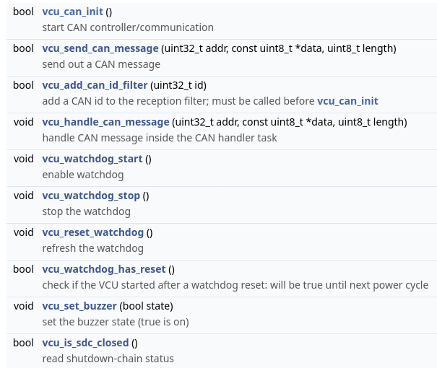
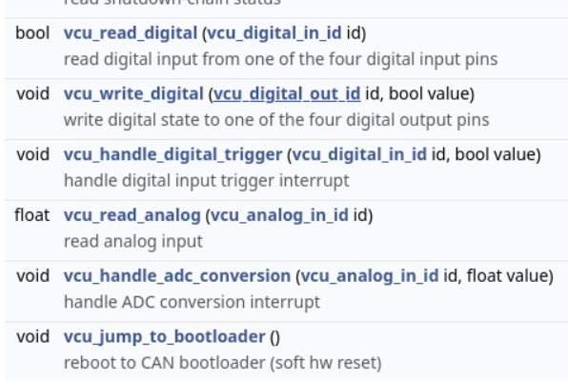
VCU HAL

Slide 16
Scheduling periodic tasks
Simple approach: use a timer (fake_bms, sensorboard, pdu)
When more control is needed, use a RT scheduler/OS (e.g. FreeRTOS)

Slide 17
Heartbeats
Periodic signals (usually CAN messages) generated by a board to signal it is alive
Usually has some info attached (state, faults etc)
Choose the period by estimating needed response time to a fault
Some commands need to be issued periodically to be valid, e.g. inverter control or BMS command

Slide 18
Critical Signals and CRC
Critical signals are valid only if their last updated value is recent enough
Example: PPS (pedal position signal) needs to be updated at a fast enough rate (15ms~20ms period) to ensure safety
For stronger safety, CAN messages can have an additional CRC of few bits to check message intentionality (assuring that another board is not writing a message with wrong id)
To ensure message ordering, add a rolling counter field to the payload

Slide 19
VCU Critical Signals
Updating a critical signal (done in the can handler task):
Reading a critical signal: if value was not updated, dest value is garbage. Must either fail or provide an alternative safe value (e.g. 0 PPS)

Slide 20
State Machines
Communicate design intent to others
Reason about correctness
Validation and code generation from state machine definitions is common in automotive (see Simulink + Stateflow)
See VCU State Machine

Slide 21
CAN bootloader
Inspiration for the protocol from an AVR doc example/technical note
Lives in a sector of the flash
Each board has a unique identifier for flashing
[env:can_bootloader]
build_type = debug
can_baudrate=500000
canbl_id=0x06
canbl_node=0x02
Bootloader config is embedded in the platformio env.
Upload using
pio run -t can_upload_stm32

Slide 22
config_lib
Somewhat similar to standard XCP protocol for ECU
Discoverable parameters with descriptions and bounds
Supports bool, float, int datatypes
Forward compatible storage on flash if used correctly
Has a GUI… improvements or rewrites are welcome

Slide 23
PlatformIO tips
Use environments to have different configurations for the same project (e.g. different build time flags/options)
Can be used in vscode, but try to use it with the command line at least a couple of time

Slide 24
Firmware testing
Unit testing: testing the single functions (see platformio documentation)
Functional testing: testing of the functionality of a software unit (e.g. one particular firmware)
Integration testing: testing the interaction between two ore more components (e.g. testing the whole firmware)

Slide 25
Reproducible Testing
My attempt: ETeam Test Framework
1 def test_vcu_precharge_missing_signals(logging_manager):
2 mgr = logging_manager.with_can_dispatcher(vcu=True)
3 precharge_start = 3
4 total_time = precharge_start + 5
5
6 # create the following bms states sequence:
7 # montoring -> precharge -> error
8 bms_status_signal = mgr.main_can_signal("bms_BMS_Status.BmsMasterStatus")
9 bms_status_signal.set_values(
10 [0, precharge_start, precharge_start + 3, total_time],
11 [
12 "eFsmState_STANDBY",
13 "eFsmState_PRECHARGE",
14 "eFsmState_OPERATIONAL_LOAD",
15 "eFsmState_OPERATIONAL_LOAD",
16 ],
17 )
19 # ts button press for ~3 seconds
20 button_press_signal = mgr.main_can_signal("STEERING_WHEEL_ButtonInputs.buttons")
21 button_press_signal.set_value(0.2, 1)
22 button_press_signal.set_value(precharge_start + 1, 0)
23
24 mgr.set_main_can_signals(bms_status_signal, button_press_signal)
25 logs = mgr.run(total_time)
26
27 vcu_status_signal = logs.select(mgr.main_bus_name).extract_signal(
28 "VCU_VCU_Heartbeat.Status"
29 )
30
31 assert (
32 vcu_status_signal.predicate(lambda s: s == "IDLE" or s == "PARAM_UPDATE")
33 .always()
34 .eval()
35 )

Slide 26
Vehicle Model/Simulator
el_vehicle_model: C++ implementation of a vehicle model (dynamics, powertrain, some control electronics)
Preliminary support for export as FMU (Functional Mock-Up Unit), which can be used inside Simulink or Modelica
Works alongside the other simulated firmwares, so structure needs to be coded directly in (C++, boost, not really easy)

Slide 27
Homework: design example
Control the fan speed to regulate the heatsink outflow and keep the inverter under 90 C
Max power to dissipate: 70kW * 0.05
Water temperature is measured

Slide 28
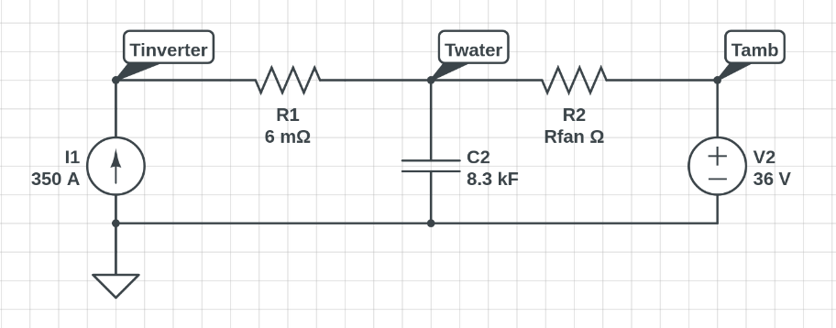
???
The value of Rfan must be controlled indirectly using VCU CAN messages

Slide 29
Homework: design example
Control the fan speed to regulate the heatsink heatflow and keep the inverter under 90 C
Max power to dissipate: 70kW * 0.05
Water temperature is measured
Thermal model simulator is already there, follow README for compilation and further instruction
VCU pps signal should be critical, fix the bug!
Sensorboard code for temperature reading is missing!

