Slide 1


QUESTIONS
DATA ANALYTICS (ONLINE)
The impact of COVID-19 in relation to
Unemployment
Crime
In the Kansas City Missouri Area
DATA SUMMARY
DATA EXPLORATION
ANALYSIS
SUMMARY
IMPLICATIONS
Team Members:
Natalie Shaw
Eric Weber
Kevin Smith
FOR REVIEW
GROUP 4: PROJECT 1

Slide 2
QUESTIONS
DATA ANALYTICS (ONLINE)
DATA SUMMARY
DATA EXPLORATION
HYPOTHESIS
Covid-19 rates in the Kansas City Metropolitan area have had an impact on
Crime and 2)Unemployment rates for the time period of
October 2019 – December 2020
ANALYSIS
SUMMARY
IMPLICATIONS
FOR REVIEW
GROUP 4: PROJECT 1

Slide 3



QUESTIONS
DATA ANALYTICS (ONLINE)
Stages
CRIME
COVID -19
UNEMPLOYMENT
1
DATA SUMMARY
NATALIE SHAW
KEVIN SMITH
ERIC WEBER
DATA EXPLORATION
2
ANALYSIS
NATALIE SHAW
KEVIN SMITH
ERIC WEBER
3
SUMMARY
COVID -19
COVID -19
CRIME
UNEMPLOYMENT
GitHub Manager
Eric Weber
IMPLICATIONS
MINING
COVID -19
4
NATALIE SHAW
UNEMPLOYMENT
ERIC WEBER
FOR REVIEW
ANALYSIS
CRIME
KEVIN SMITH
GROUP 4: PROJECT 1 (PLANNED STAGES)

Slide 4
QUESTIONS
DATA ANALYTICS (ONLINE)
DATA SUMMARY
Was there an impact on crime rates and unemployment due to the COVID-19 Pandemic in the Kansas City Metropolitan Area?
If so, can we discover a correlation between the variables?
Was there a rise in crime, and if so what types?
Was the rise in crime due to unemployment? How can we highlight that relationship if one exists?
Did the COVID-19 pandemic influence one of the variables more than the other?
Was there any impact at all?
What should we use as benchmark (time wise)?
What kind of crimes were we going to use for our data?
Should we incorporate demographics?
DATA EXPLORATION
ANALYSIS
SUMMARY
IMPLICATIONS
FOR REVIEW
GROUP 4: PROJECT 1

Slide 5

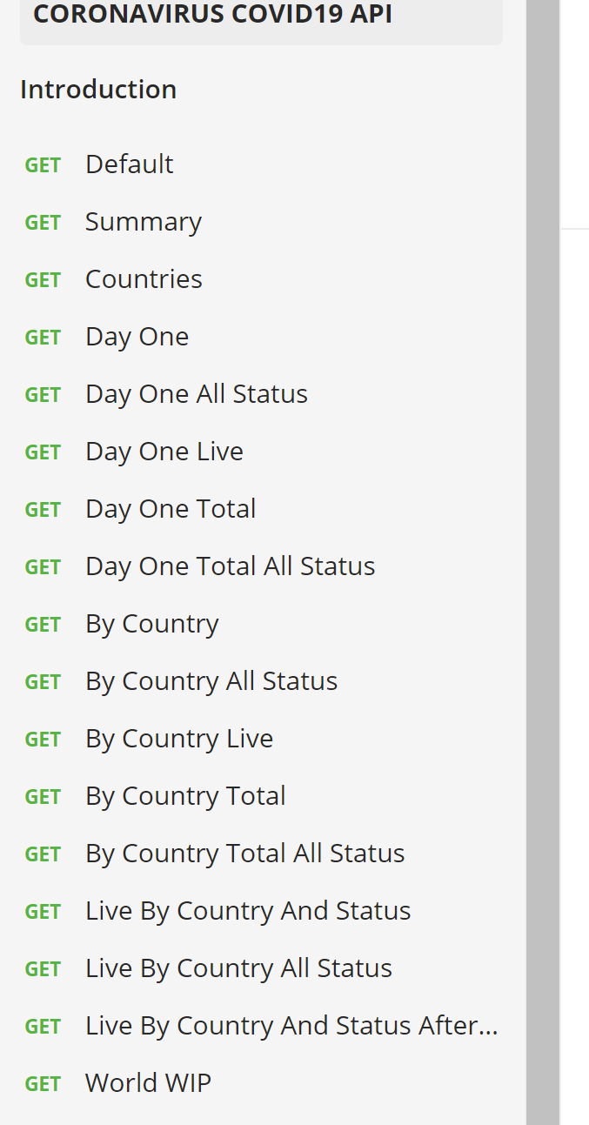
QUESTIONS
DATA ANALYTICS (ONLINE)
DATA SUMMARY
COVID-19
https://covid19api.com/
Free API on the coronavirus
Data is sourced from John Hopkins CSSE (Center for Science and Systems and Engineering)
Through Postman (at bottom of site)
You can get data pre-sorted by category
DATA EXPLORATION
ANALYSIS
SUMMARY
IMPLICATIONS
FOR REVIEW
GROUP 4: PROJECT 1

Slide 6

Start Date End Date Total Incidents
0 2019-10-01 2019-10-31 96
1 2019-11-01 2019-11-30 110
2 2019-12-01 2019-12-31 126
3 2020-01-01 2020-01-31 0
4 2020-02-01 2020-02-29 0
5 2020-03-01 2020-03-31 0
6 2020-04-01 2020-04-30 0
7 2020-05-01 2020-05-31 0
8 2020-06-01 2020-06-30 0
9 2020-07-01 2020-07-31 0
10 2020-08-01 2020-08-31 0
11 2020-09-01 2020-09-30 0
12 2020-10-01 2020-10-31 12478
13 2020-11-01 2020-11-30 13825
14 2020-12-01 2020-12-31 15196
QUESTIONS
DATA ANALYTICS (ONLINE)
DATA SUMMARY
CRIME
Data provided by instructor, Ben (thank you)
Incident-based crime API for KC Metro
Data from local police agencies
Location and incident type
Aggregated on a monthly basis
Volume and trends in crime over time
DATA EXPLORATION
Kansas City Police Dept.
Liberty Police
Riverside Dept. of Public Safety
Blue Springs Police Department
North Kansas City Police Dept.
University of Kansas Public Safety Office
St. Joseph Police Dept.
ANALYSIS
SUMMARY
IMPLICATIONS
FOR REVIEW
GROUP 4: PROJECT 1

Slide 7
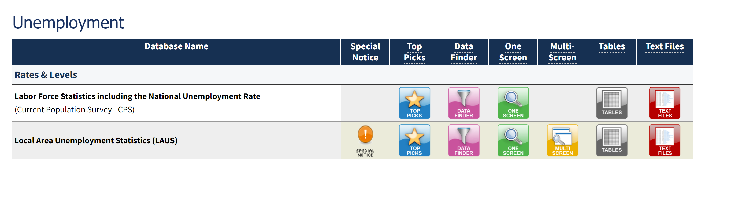
QUESTIONS
DATA ANALYTICS (ONLINE)
DATA SUMMARY
UNEMPLOYMENT
Unemployment data found at: https://www.bls.gov/data/#unemployment
Unemployment data collected on a monthly basis from Kansas City, MO in 2019 and 2020 to show the impact COVID-19 had on the economy
DATA EXPLORATION
ANALYSIS
SUMMARY
IMPLICATIONS
FOR REVIEW
GROUP 4: PROJECT 1

Slide 8
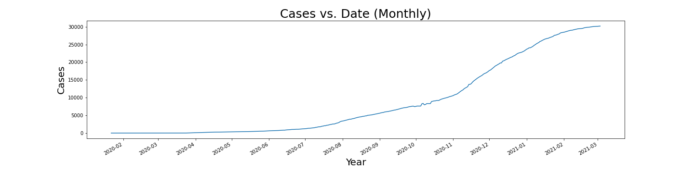
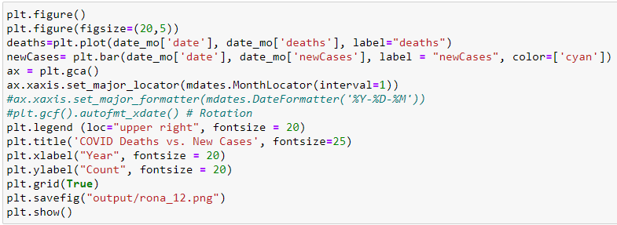

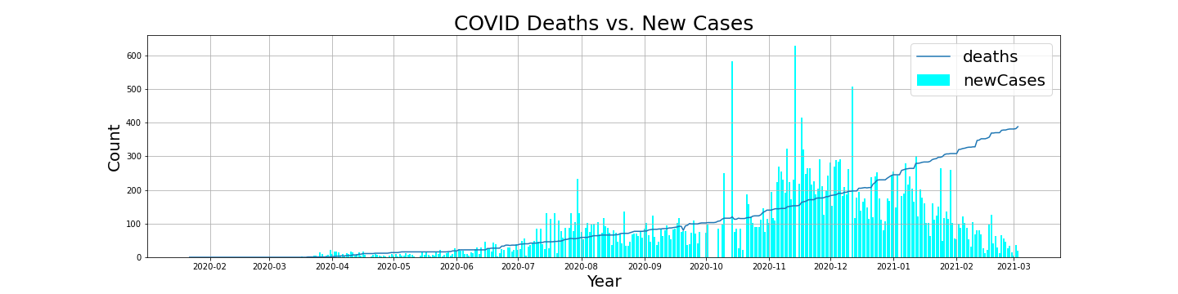
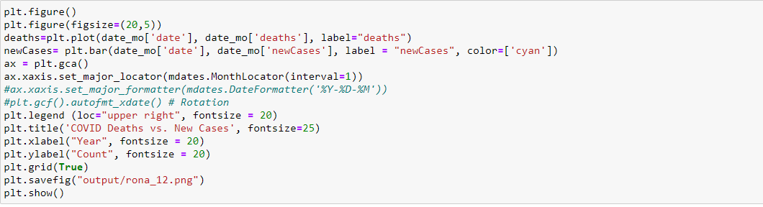
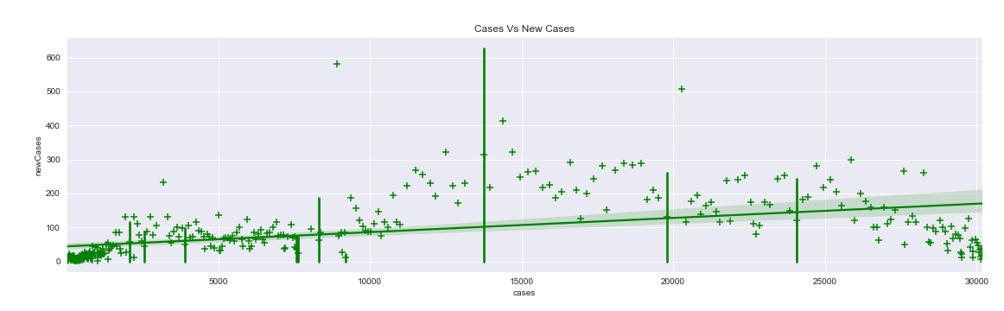
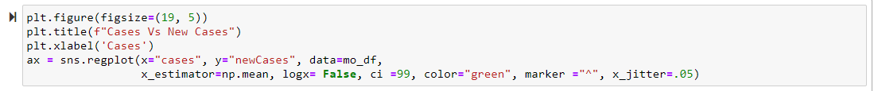
QUESTIONS
DATA ANALYTICS (ONLINE)
Linear vs. Non-Linear Equations (“The Baseline”)
DATA SUMMARY
DATA EXPLORATION
COVID-19
ANALYSIS
SUMMARY
IMPLICATIONS
FOR REVIEW
GROUP 4: PROJECT 1

Slide 9
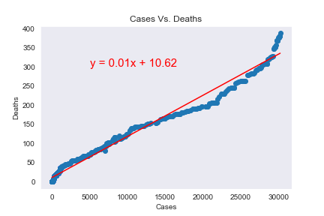
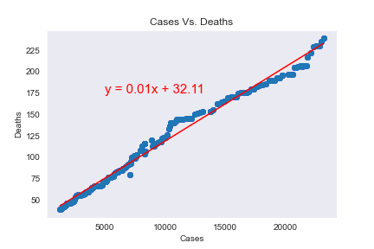
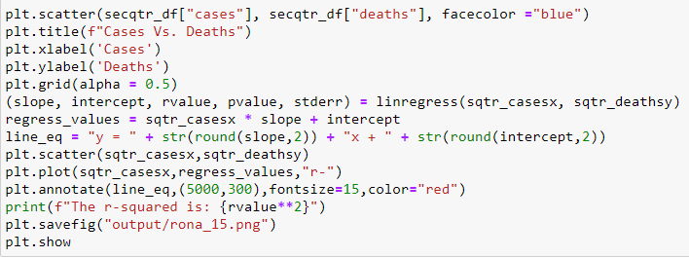
QUESTIONS
DATA ANALYTICS (ONLINE)
Correlation of Cases vs. Deaths
DATA SUMMARY
March 1st 2020 – June 30th 2020
July 1st 2020 – December 30th 2020
DATA EXPLORATION
COVID-19
ANALYSIS
SUMMARY
IMPLICATIONS
The r-squared is: 0.9825204775479639
The r-squared is: 0.9878841847717416
FOR REVIEW
GROUP 4: PROJECT 1

Slide 10
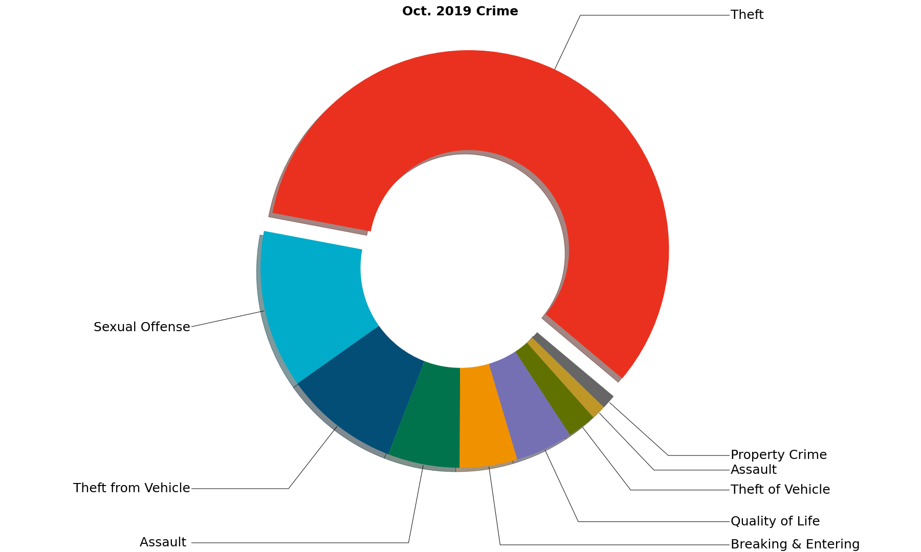
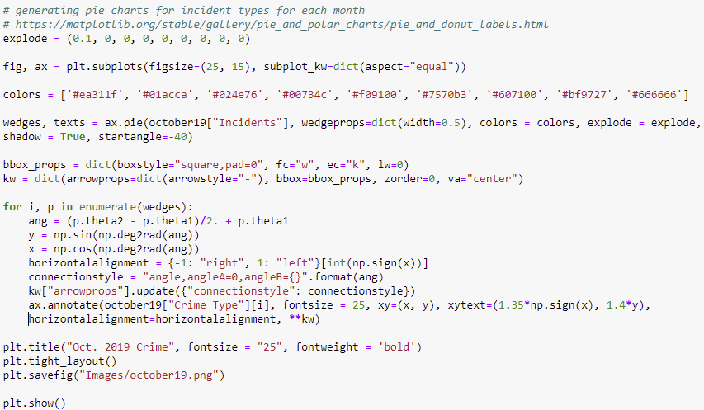
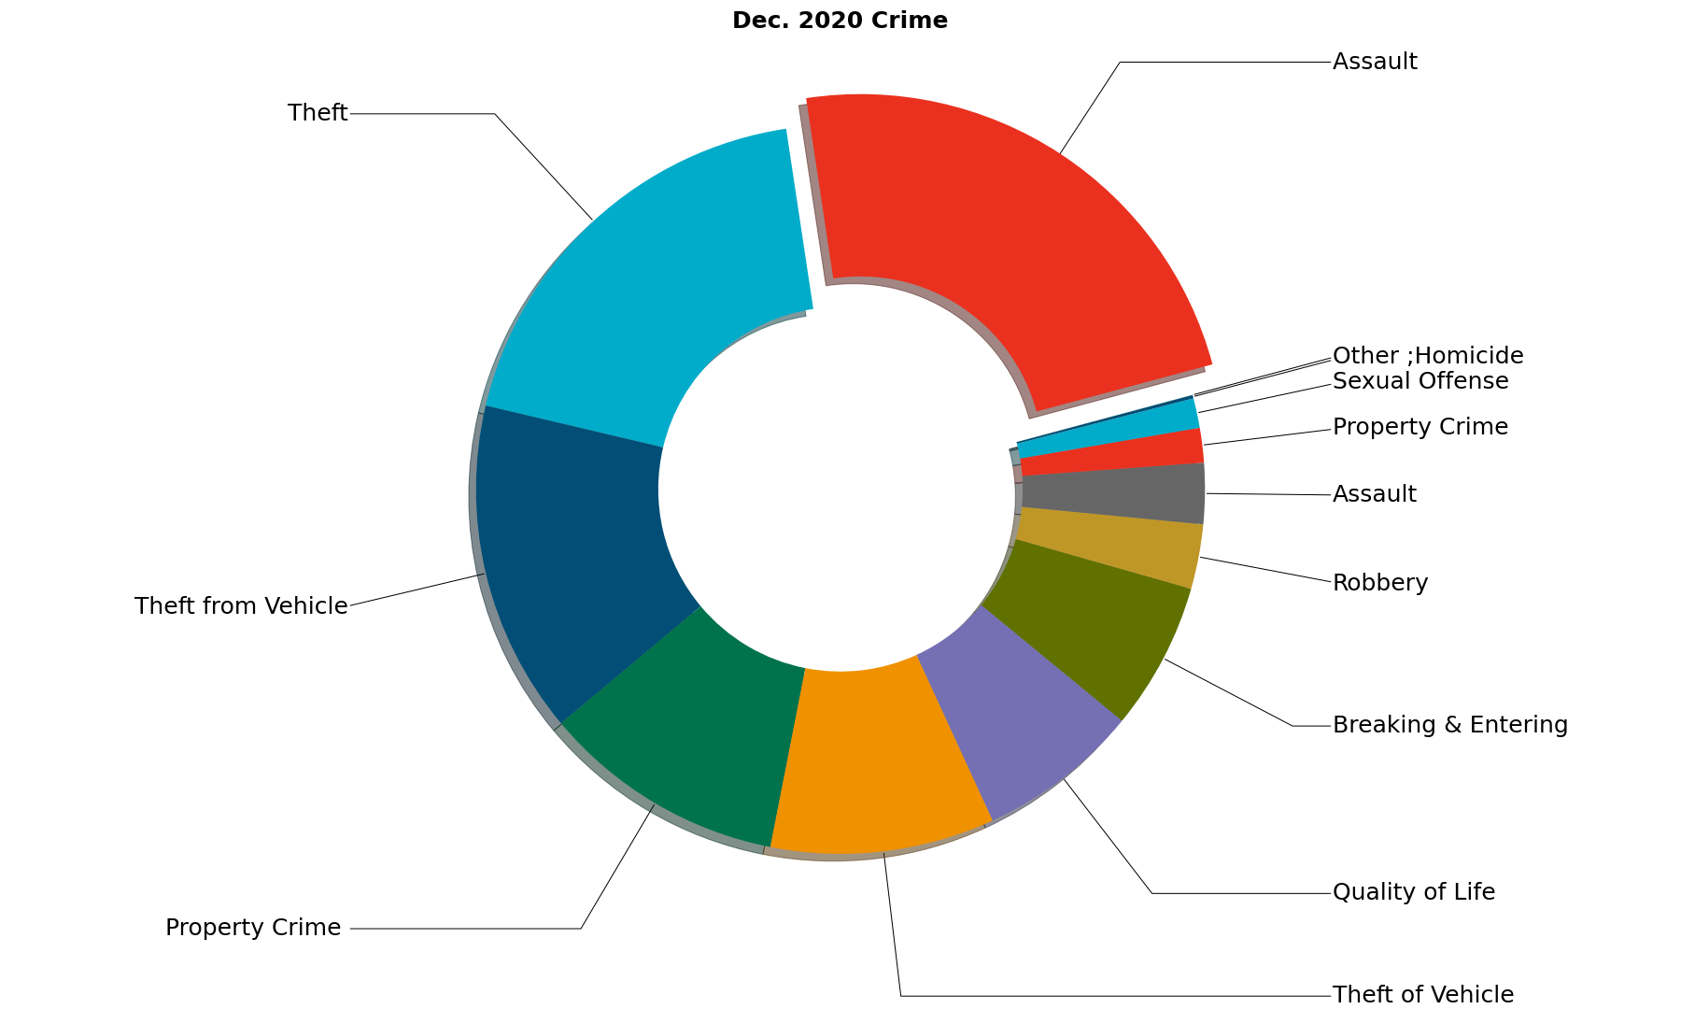
QUESTIONS
DATA ANALYTICS (ONLINE)
DATA SUMMARY
Crime Segments | Assault | Breaking & Entering | Homicide, Other | Property Crime | Quality of Life | Sexual Offense | Robbery, Theft, Theft from and of Vehicle
DATA EXPLORATION
CRIME
ANALYSIS
SUMMARY
IMPLICATIONS
FOR REVIEW
GROUP 4: PROJECT 1

Slide 11
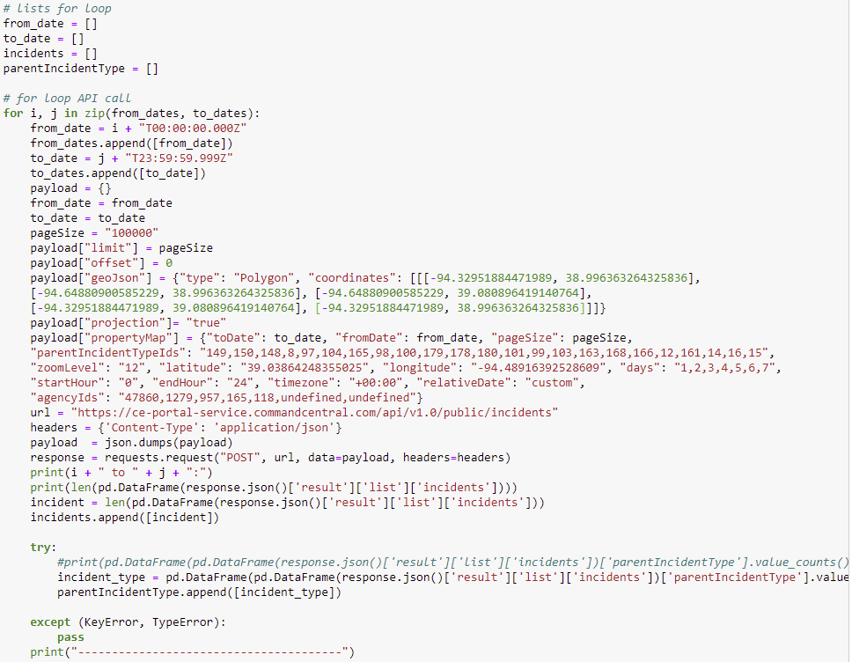
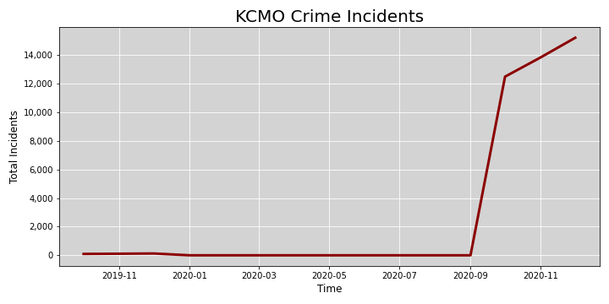
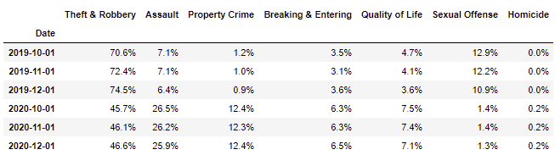
QUESTIONS
DATA ANALYTICS (ONLINE)
For Loop for API Call (Crime)
DATA SUMMARY
DATA EXPLORATION
CRIME
ANALYSIS
SUMMARY
IMPLICATIONS
FOR REVIEW
GROUP 4: PROJECT 1

Slide 12
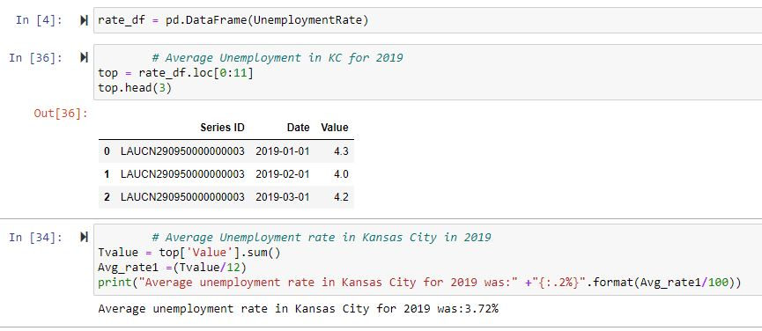
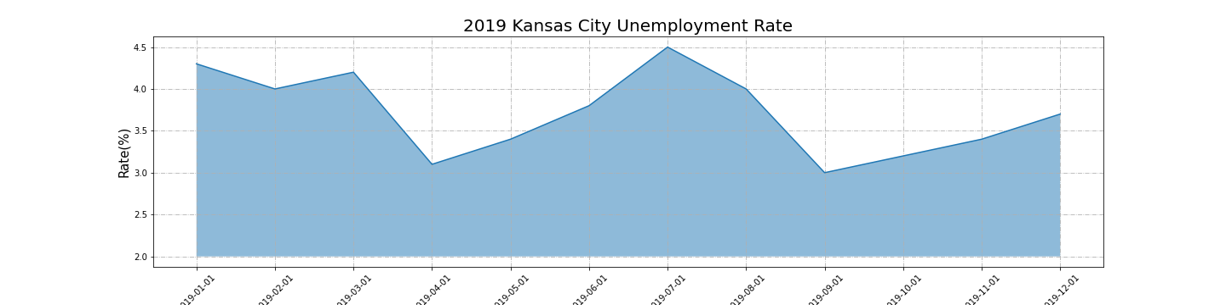
QUESTIONS
DATA ANALYTICS (ONLINE)
DATA SUMMARY
DATA EXPLORATION
UNEMPLOYMENT
ANALYSIS
SUMMARY
IMPLICATIONS
FOR REVIEW
GROUP 4: PROJECT 1

Slide 13
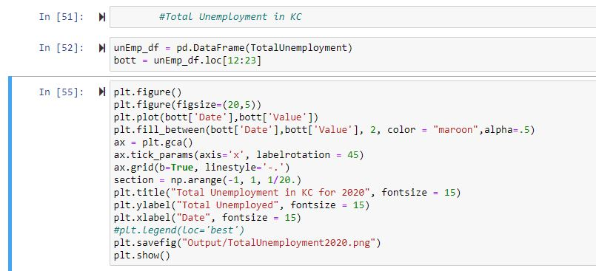
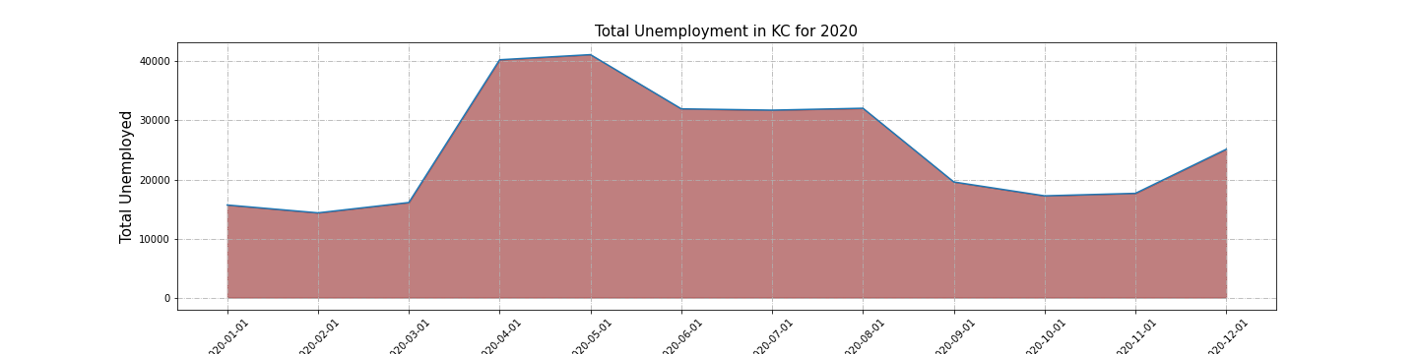
QUESTIONS
DATA ANALYTICS (ONLINE)
DATA SUMMARY
DATA EXPLORATION
UNEMPLOYMENT
ANALYSIS
SUMMARY
IMPLICATIONS
FOR REVIEW
GROUP 4: PROJECT 1

Slide 14
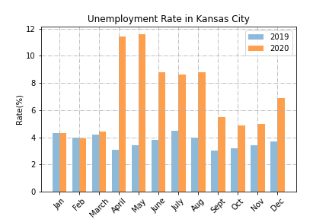
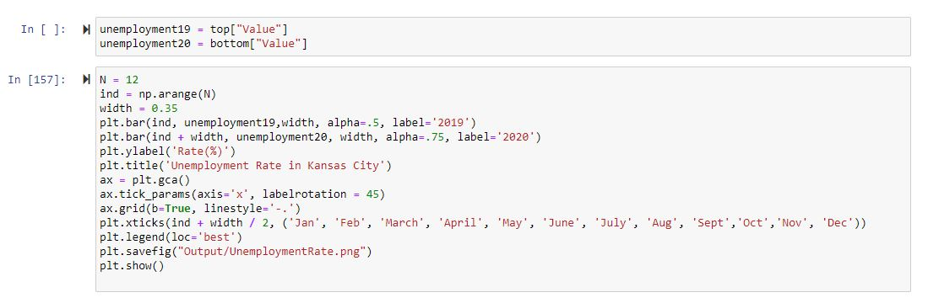
QUESTIONS
DATA ANALYTICS (ONLINE)
DATA SUMMARY
DATA EXPLORATION
UNEMPLOYMENT
ANALYSIS
SUMMARY
IMPLICATIONS
FOR REVIEW
GROUP 4: PROJECT 1

Slide 15
QUESTIONS
DATA ANALYTICS (ONLINE)
DATA SUMMARY
DATA EXPLORATION
ANALYSIS
COVID-19 / UNEMPLOYMENT
SUMMARY
IMPLICATIONS
FOR REVIEW
GROUP 4: PROJECT 1

Slide 16
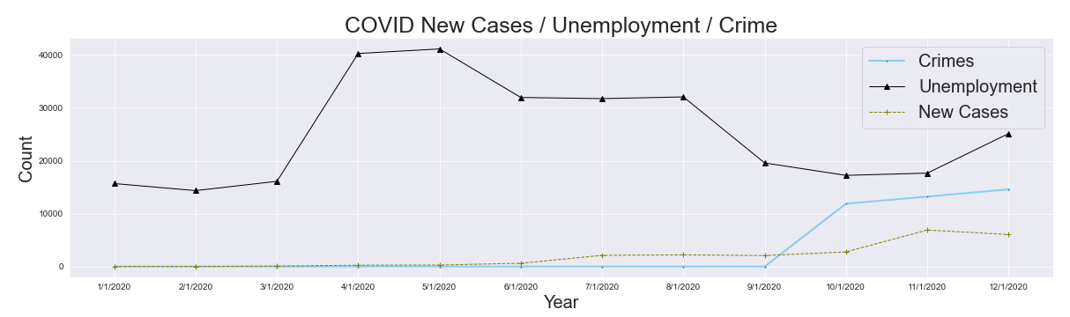
20,5))
QUESTIONS
DATA ANALYTICS (ONLINE)
DATA SUMMARY
DATA EXPLORATION
ANALYSIS
SUMMARY
IMPLICATIONS
FOR REVIEW
GROUP 4: PROJECT 1

Slide 17
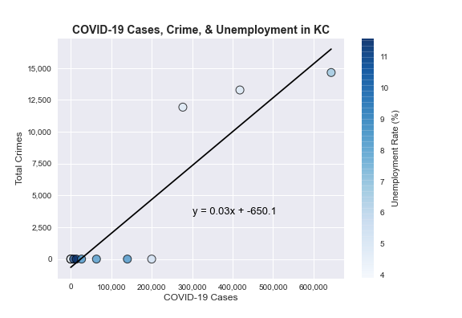
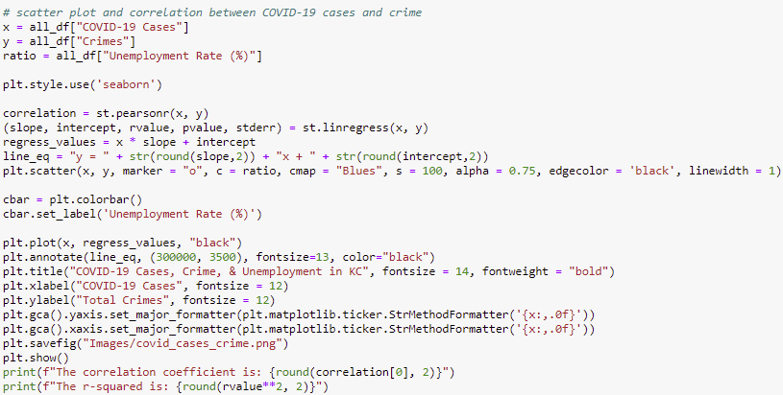
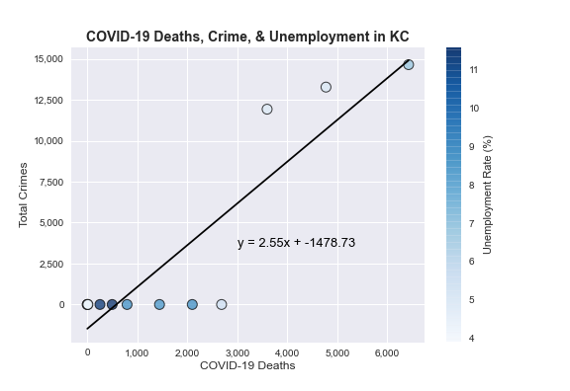
QUESTIONS
DATA ANALYTICS (ONLINE)
DATA SUMMARY
DATA EXPLORATION
ANALYSIS
The correlation coefficient is: 0.91 The r-squared is: 0.82
SUMMARY
IMPLICATIONS
FOR REVIEW
The correlation coefficient is: 0.89 The r-squared is: 0.8
GROUP 4: PROJECT 1

Slide 18
QUESTIONS
DATA ANALYTICS (ONLINE)
DATA SUMMARY
DATA EXPLORATION
ANALYSIS
SUMMARY
IMPLICATIONS
FOR REVIEW
GROUP 4: PROJECT 1

Slide 19
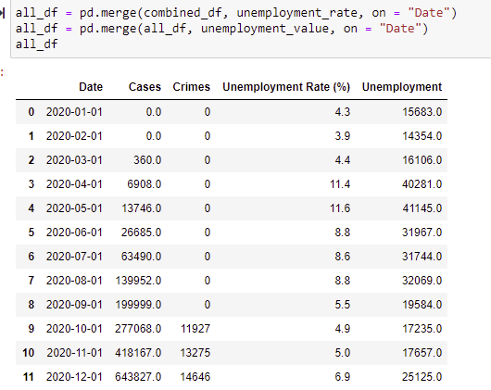
QUESTIONS
DATA ANALYTICS (ONLINE)
DATA SUMMARY
1) It is still in question whether COVID-19 caused an increase in crime in KCMO:
Crime shows a strong, positive correlation between COVID-19, but with incomplete data.
Corr coeff. 0.91 and r-squared of 0.82 between COVID-19 cases and crime incidents.
2) Thefts and sexual offenses decreased pre-to-post COVID-19 outbreak, while (theft from/of vehicle), assault, robbery, property crime, quality of life, breaking & entering, and homicide incidents increased.
3) Unemployment, crime, and COVID-19 increased from October to December 2020 (See Image 1)
DATA EXPLORATION
ANALYSIS
SUMMARY
IMPLICATIONS
FOR REVIEW
GROUP 4: PROJECT 1

Slide 20
QUESTIONS
DATA ANALYTICS (ONLINE)
DATA SUMMARY
1) Crime API had large gaps, so results are inconclusive.
2) Hoped that all relationships regarding COVID-19 were linear, this was not the case.
Made relating the three subjects of New Cases, Deaths, and Cases (total) hard to find a correlation.
3) Limited data, with unemployment somewhat difficult to place in a proper dataframe due to specific naming conventions for Date and Time.
a) Data lacked detail seen in Crime Breakdown.
DATA EXPLORATION
ANALYSIS
SUMMARY
IMPLICATIONS
FOR REVIEW
GROUP 4: PROJECT 1

Slide 21
QUESTIONS
DATA ANALYTICS (ONLINE)
DATA SUMMARY
Would like to include demographics with COVID-19 data.
To include access to Hospitalization and proper healthcare.
How were cases discovered (data did not indicate how new cases were revealed).
Timeseries for different types of crimes with higher quality data.
Would have liked to present data in a geospatial context.
We cannot quantify the amount of geopolitical influence that might have resulted in causation for crime and unemployment.
Did people leave the workforce and not re-enter for fear of contracting the virus or did they get laid off?
Did people find secondary employment?
DATA EXPLORATION
ANALYSIS
SUMMARY
IMPLICATIONS
FOR REVIEW
GROUP 4: PROJECT 1

Slide 22
QUESTIONS
DATA ANALYTICS (ONLINE)
DATA SUMMARY
DATA EXPLORATION
ANALYSIS
QUESTIONS?
SUMMARY
IMPLICATIONS
FOR REVIEW
GROUP 4: PROJECT 1

