Slide 1


DATA ANALYTICS (ONLINE)
QUESTIONS
DATA SUMMARY
Education and unemployment/underemployment
Across the continental United States
CODE/DATA APPROACH
VISUALS
IMPLICATIONS
Team Members:
Richard Moseley
Natalie Shaw
Eric Weber
Kevin Smith
GROUP 4: PROJECT 2

Slide 2
DATA ANALYTICS (ONLINE)
QUESTIONS
How are national universities ranked across space?
How does education affect employment outcomes?
Majors and unemployment versus underemployment
What were the educational trends across U.S. states from 2005 to 2020?
DATA SUMMARY
CODE/DATA APPROACH
VISUALS
IMPLICATIONS
GROUP 4: PROJECT 1

Slide 3
DATA ANALYTICS (ONLINE)
QUESTIONS
Education
1) Bachelor's Degree Holders in the Labor Force 25-44 Years Old
2) https://data.world/education/university-rankings-2017/workspace/file?filename=National+Universities+Rankings.csv
3) https://nces.ed.gov/programs/edge/Geographic/SchoolLocations
DATA SUMMARY
CODE/DATA APPROACH
Employment / Underemployment
Source: https://www.newyorkfed.org/research/college-labor-market/college-labor-market_underemployment_rates.html
VISUALS
IMPLICATIONS
GROUP 4: PROJECT 2

Slide 4
DATA ANALYTICS (ONLINE)
SQL Database
PgAdmin
Flask-Powered API
Connected to SQL database
Data endpoints from visuals
HTML/CSS
Interactive web page with visuals
JavaScript
D3.js
Leaflet.js
Chart.js
PostgreSQL
Drop-down menus
Plotly.js
QUESTIONS
DATA SUMMARY
CODE/DATA APPROACH
VISUALS
IMPLICATIONS
GROUP 4: PROJECT 2

Slide 5
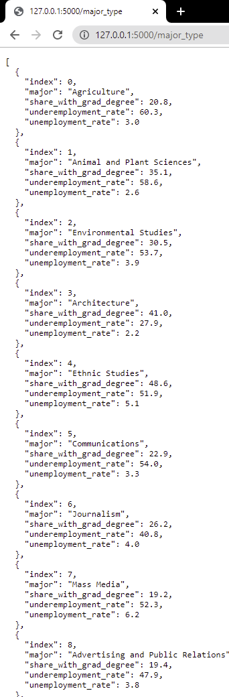
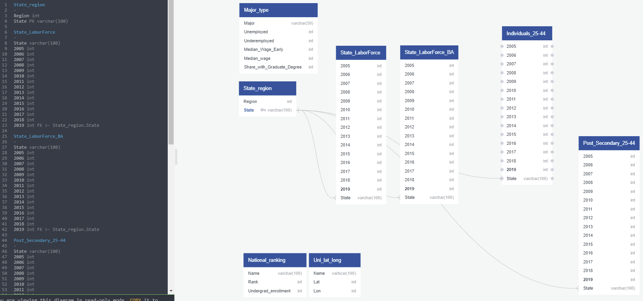
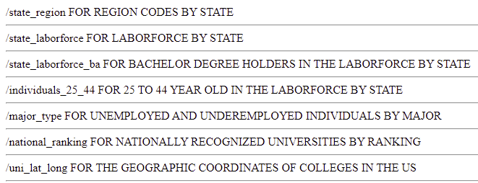
DATA ANALYTICS (ONLINE)
SQL database (ERD, PostgreSQL) and Flask-powered API
QUESTIONS
DATA SUMMARY
major_type = engine.execute(
"SELECT * FROM major_type").fetchall()
major_type_json = []
index = 0
for i in major_type:
major_type_json.append(
{'index': major_type[index][0], 'major': major_type[index][1], 'unemployment_rate': major_type[index][2], 'underemployment_rate': major_type[index][3], 'share_with_grad_degree': major_type[index][4]})
index += 1
@app.route('/major_type')
def major():
return jsonify(major_type_json)
CODE/DATA APPROACH
VISUALS
major_type = pd.read_csv("By_Major_type_mod.csv")
major_type_df = major_type.to_sql("major_type", connection)
major_type = pd.read_sql('SELECT * FROM "major_type"', connection)
major_type
IMPLICATIONS
GROUP 4: PROJECT 2

Slide 6
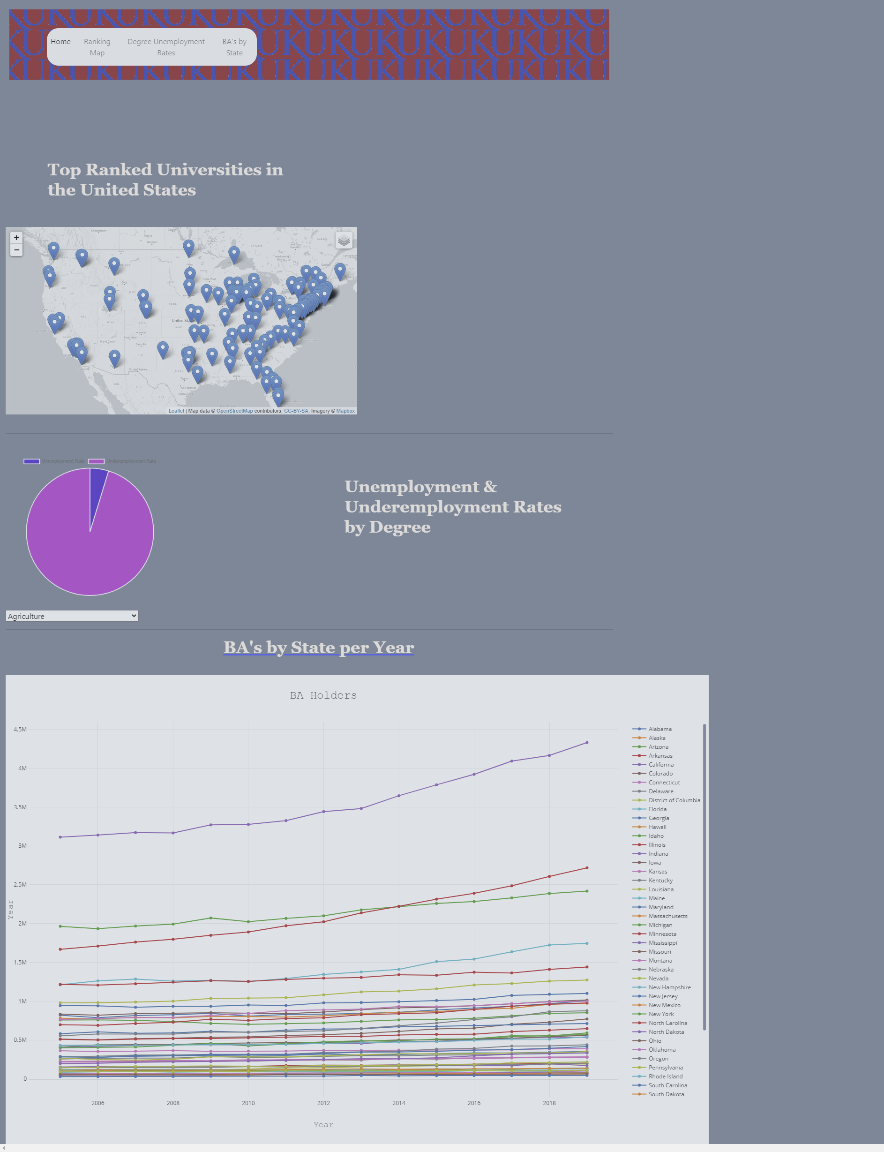
20,5))
DATA ANALYTICS (ONLINE)
QUESTIONS
DATA SUMMARY
CODE/DATA APPROACH
VISUALS
IMPLICATIONS
GROUP 4: PROJECT 2

Slide 7
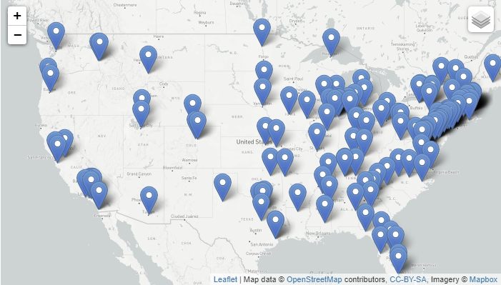
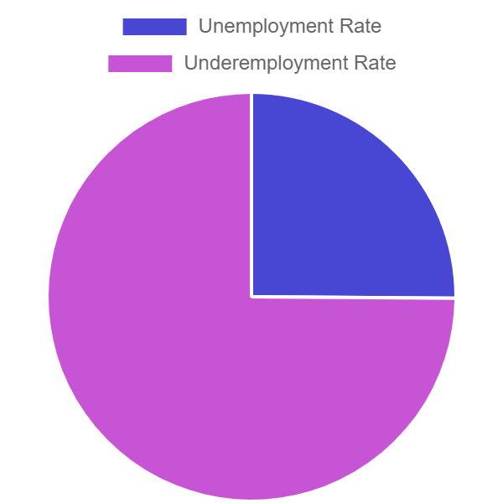
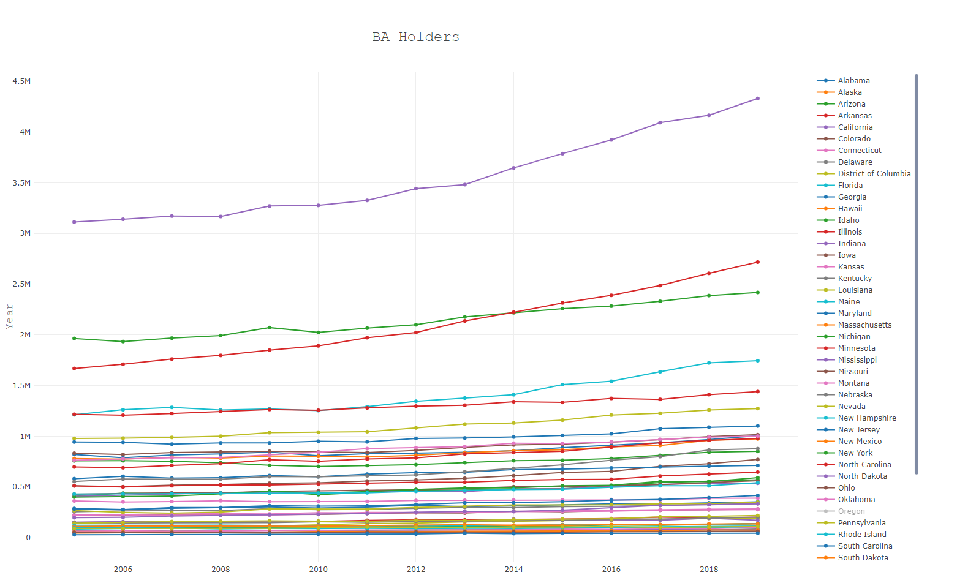

DATA ANALYTICS (ONLINE)
RESULTS
QUESTIONS
DATA SUMMARY
CODE/DATA APPROACH
VISUALS
IMPLICATIONS
GROUP 4: PROJECT 2

Slide 8
DATA ANALYTICS (ONLINE)
RESULTS
QUESTIONS
NATALIE SHAW - GEOMAPPING
DATA SUMMARY
CODE/DATA APPROACH
VISUALS
IMPLICATIONS
GROUP 4: PROJECT 2

Slide 9
DATA ANALYTICS (ONLINE)
RESULTS
QUESTIONS
RICHARD MOSELEY - PIE GRAPH / FLASK
DATA SUMMARY
CODE/DATA APPROACH
VISUALS
IMPLICATIONS
GROUP 4: PROJECT 2

Slide 10
DATA ANALYTICS (ONLINE)
RESULTS
QUESTIONS
KEVIN SMITH - LONGITUDINAL BAR GRAPH
DATA SUMMARY
CODE/DATA APPROACH
VISUALS
IMPLICATIONS
GROUP 4: PROJECT 2

Slide 11

DATA ANALYTICS (ONLINE)
RESULTS
QUESTIONS
ERIC WEBER - HMTL
DATA SUMMARY
CODE/DATA APPROACH
VISUALS
IMPLICATIONS
GROUP 4: PROJECT 2

Slide 12
DATA ANALYTICS (ONLINE)
QUESTIONS
DATA SUMMARY
CODE/DATA APPROACH
QUESTIONS?
VISUALS
IMPLICATIONS
GROUP 4: PROJECT 2

