Slide 1
CPE413 Kablosuz Ağlar
Bilgisayar Mühendisliği Bölümü,
Mühendislik Fakültesi
Dr. Sait DEMİR
saitdemir@karabuk.edu.tr
September 29, 2021
Notes:
https://habbal.gnomio.com/

Slide 2
Outline
Motivasyon ve Ders Amaçları
Ders içeriği
Puanlama
Geçici Program
Notes:
https://habbal.gnomio.com/

Slide 3

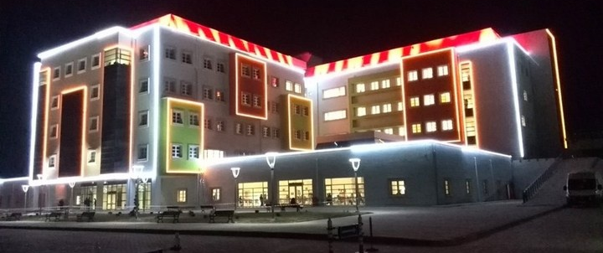
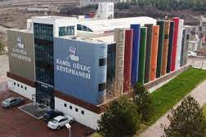
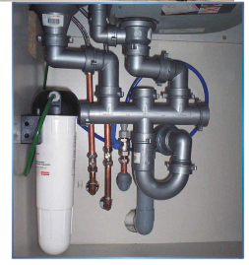
Motivation and Course Objectives
Networking = “Plumbing”
Networking is the “plumbing” of computing
Almost all areas of computing are network-based.
  Distributed computing
  Big Data
  Cloud Computing
  Internet of Things
  Smart Cities
Networking companies are
among the most valued companies
Networking is the backbone of computing
Notes:
https://habbal.gnomio.com/

Slide 4
Motivation and Course Objectives
IMPACT OF WIRELESS ON NETWORKING: (KABLOSUZUN AĞ ÜZERİNE ETKİSİ:)
Not tied to walls/infrastructure (Duvarlara/altyapıya bağlı değil)
  Ad-hoc networking (Geçici ağ)
Error-prone →Traffic Management (Hataya açık →Trafik Yönetimi)
Frequent Disconnections (Sık Bağlantı Kesilmeleri)
  Resource Management (Kaynak yönetimi)
  Quality of Service for multimedia (Multimedya için Hizmet Kalitesi)
Battery operated (Pilli)
  Media access and networking while sleep (Uyku sırasında medya erişimi ve ağ iletişimi)
  Time synchronization (Zaman senkronizasyonu)
Broadcast → Security (Yayın → Güvenlik)
Notes:
https://habbal.gnomio.com/

Slide 5
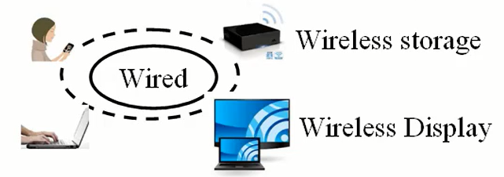
Motivation and Course Objectives
WHY WIRELESS NETWORKING?
Wireless (WiFi) is ubiquitous (Kablosuz (WiFi) her yerde bulunur)
Most of the access (end user connectivity) is wireless
  Smart phones, Tablets, and many laptops (Ultrabooks) have no wired Ethernet connections
Most of telecommunication carriers’ revenue is in wireless (Telekomünikasyon operatörlerinin gelirlerinin çoğu kablosuz)
New Developments:
  5G: 1 Gbps Metropolitan Area Networks
  Vehicular Networking (802.11p)
  Cognitive networks: Sharing unused spectrum
Notes:
https://habbal.gnomio.com/

Slide 6
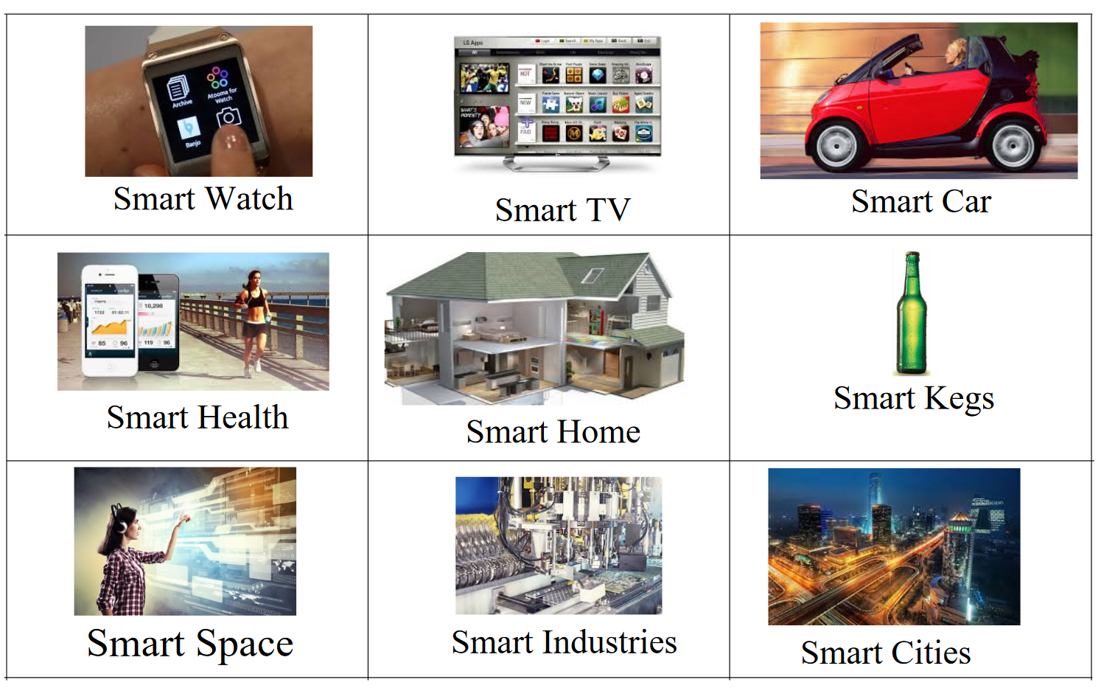
Motivation and Course Objectives
Internet of Things
Notes:
https://habbal.gnomio.com/

Slide 7
Motivation and Course Objectives
COURSE OBJECTIVES:
Understand the fundamental principles, protocols, architectures and topologies of wireless networks.
(Kablosuz ağların temel ilkelerini, protokollerini, mimarilerini ve topolojileri)
Acquire knowledge and necessary skills in designing wireless networks.Kablosuz ağları tasarlama konusunda bilgi ve gerekli becerileri edinir.
Propose real life solution using appropriate wireless network principles and Technologies (Uygun kablosuz ağ ilkelerini ve teknolojilerini kullanarak gerçek hayat çözümü önermek)
Notes:
https://habbal.gnomio.com/

Slide 8
Motivation and Course Objectives
COURSE LEARNING OUTCOMES
explain key concepts of wireless networking
distinguish wireless networks technologies and requirements for various domain applications
design and develop solutions for real world problem using appropriate wireless network technologies
Notes:
https://habbal.gnomio.com/

Slide 9
Course Contents
Week | Topic | Hours
1 | Course Overview | 3
2 | Wireless Networking: Facts, Statistics, and Trends | 3
3 | Wireless Transmission Fundamentals | 3
4 | Wireless Communication Technology | 3
5 | Wireless Local Area Networks – 1 | 3
6 | Wireless Local Area Networks - 2 | 3
7 | Vehicular Wireless Networks | 3
8 | Visa Exam | 3
9 | Introduction to Internet of Things | 3
10 | Wireless Protocols for IoT (Bluetooth ) | 3
11 | Wireless Protocols for IoT (ZigBee) | 3
12 | Cellular Networks | 3
13 | Intro to 5Th Generation Mobile Networks | 3
14 | Current Issues | 3
Notes:
https://habbal.gnomio.com/

Slide 10
Course Contents
How is wireless different from wired communication?
How does WiFi work?
  How is the speed of WiFi increasing from 10 Mbps to 10 Gbps?
  What is the difference between a/b/g/n/ac/ad/…
Which protocols are used in vehicular communications?
How is Bluetooth different from WiFi?
How is ZigBee different from WiFi?
What are the protocols used in IoT?
Why do we need new protocols for IoT?
What is the basic difference between 2G/3G/4G/5G
What new features came in with 4G?
What new techniques enabled 5G?
Notes:
https://habbal.gnomio.com/

Slide 11
Course Contents
All teaching materials
(syllabus, PPTs, reading resources,….)
are available online at:
website : oys.karabuk.edu.tr Course : Wireless Network
Password : CPE 413
Textbook: There is no one book that covers the breadth of the material in this course
There will be a reading list with each lecture.
Notes:
https://habbal.gnomio.com/

Slide 12
Course Assessment
Course work (40%)
  QUIZ and Assignment : 10%
  Visa Exam : 30%
Final Examination (60%)
  QUIZ and Lab exercises : 20%
  Final Exam (Paper-based) : 40%
Notes:
https://habbal.gnomio.com/

Slide 13
Consultation
My Contact Details:
  Office : No. 126, Computer Engineering Department
  E-mail : saitdemir@karabuk.edu.tr (Best way of contact)
  Consultation Time: By appointment only.

Slide 14
Thank You
Q & A
Sait DEMİR
Department of Computer Engineering
Faculty of Engineering, Karabuk University
Email: saitdemir@karabuk.edu.tr

