Slide 1


DELIVERY
PERFORMANCE SLA

Slide 2


Introduction Delivery
Performance SLA
SLA (Service Level Agreement):
A formal agreement between a service provider and a customer that defines the expected level of service. In delivery, it means the order will be delivered within the estimated time.

Slide 3
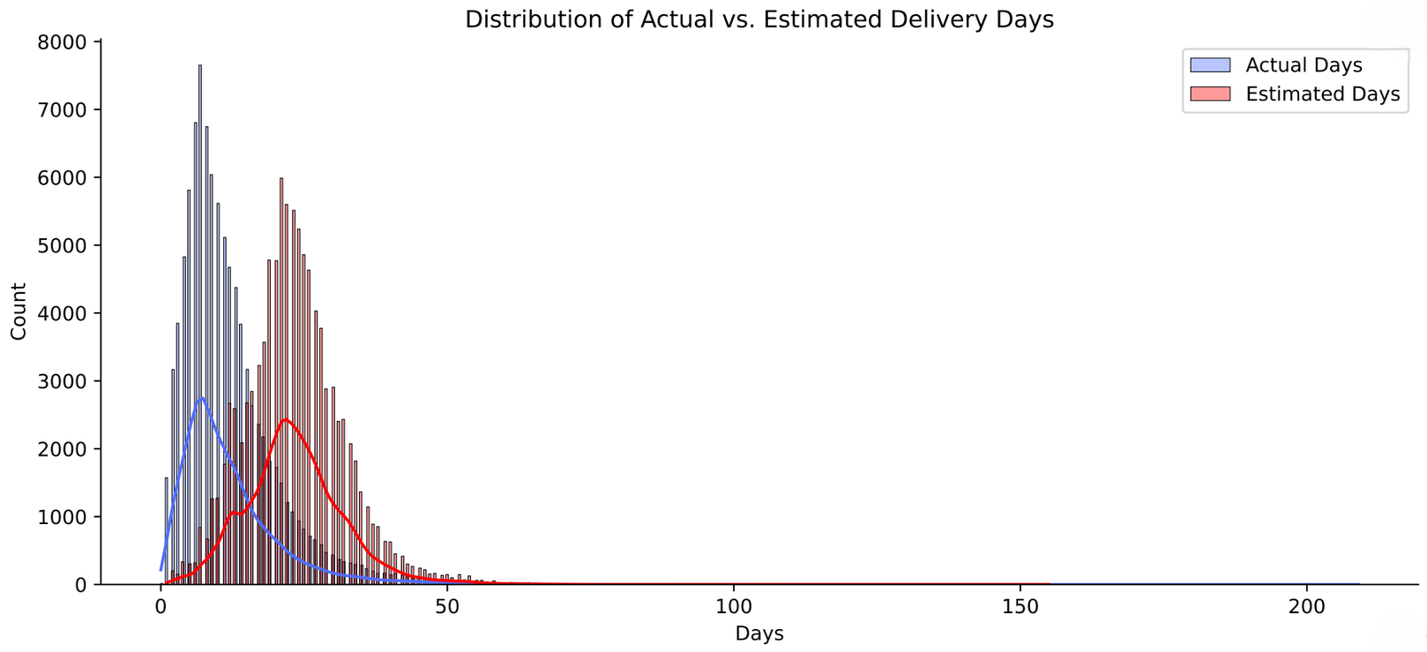
AVERAGE DELAY
~ -11 DAYS
Understanding Data

Slide 4
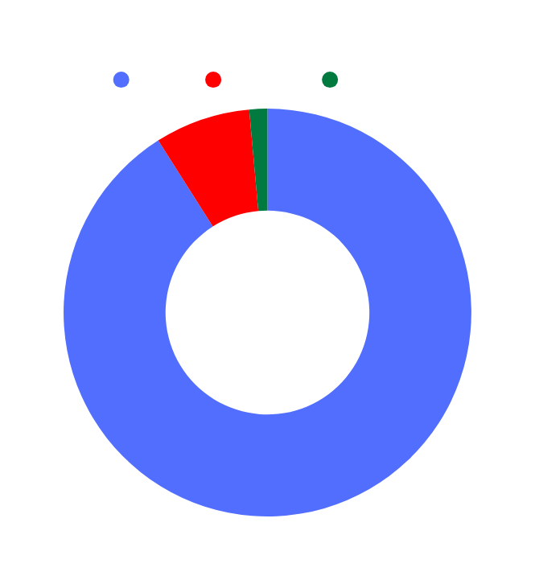
Order Delivery Performance
On Time Orders
Early Orders
Late Orders
7.9%
87788
7308
1380
92.1%
90.99%
7.57%
1.43%

Slide 5

Gap between actual time and expected time
bad estimation
+
good delivery

Slide 6
THANK YOU!

