Slide 1
BE Project 2011-2012 Autonomous Mapping Robot
Team : 2
Ankit Trivedi
Ankita Shrotriya
Rahul Patil
Prathamesh Akolkar

Slide 2
Problem Statement
An Intelligent Autonomous robot (Firebird V Atmega2560)
Scanning (Servo motor, Sharp IR sensor)
Detection of obstacle, Navigation and self-localization
Serial Communication (XBee)
Mapping (Matlab)

Slide 3
Requirements/Task Specifications
Firebird – Requires 1 bot (Atmega2560)
Servo motor (VS-1) – Used for scanning purpose with the resolution of 9°
Sharp IR sensor (GP2D12) – Measures the distance of the obstacle from the bot
XBee (XB24) – Used for serial communication from bot to host PC

Slide 4
Project Plan
ACTIVITY | AUG’11 & SEPT’11 | OCT’11 & NOV’11 | DEC’11 & JAN’12 | FEB’12 & MARCH’12 | APRIL’12
Literature Survey
Study of hardware and software tools
Designing different algorithms
Gathering of hardware requirement
Testing of different algorithms & implementation
Documentation
Report submission

Slide 5
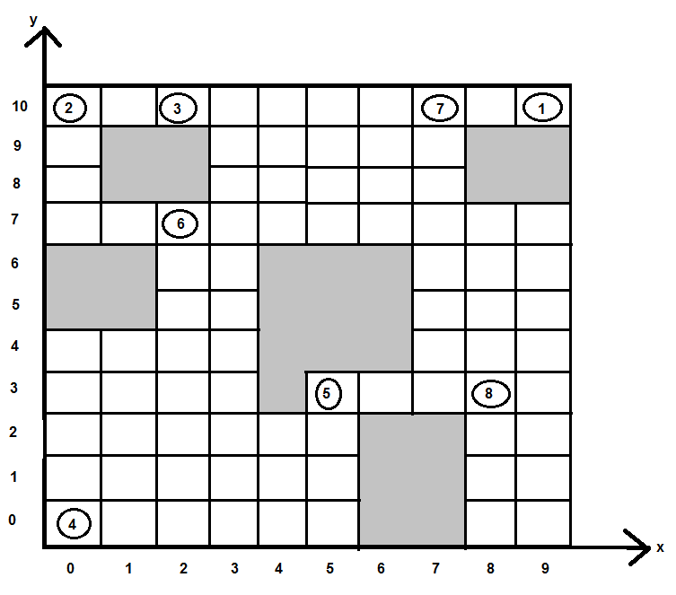
Arena Diagram

Slide 6
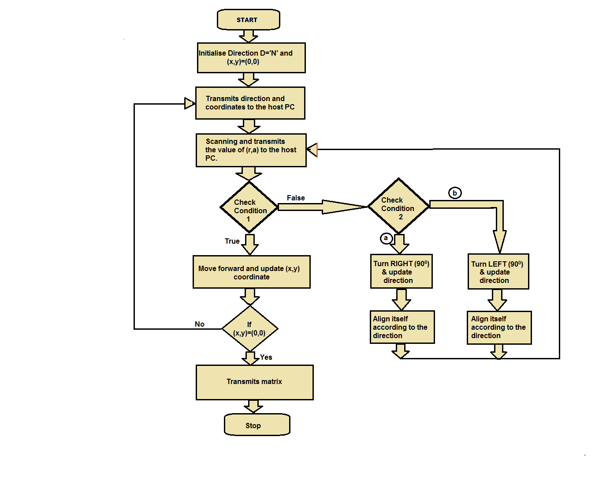
Workflow

Slide 7
Workflow
Bot starts its operation by initializing coordinates (x,y)=(0,0) and direction D=‘N’(North).
180° scanning
Performs scanning and takes 21 samples (r,a).
Transmits (x,y,a,r) to host PC via XBee module(2.4 GHz).
Matrix scanning
Takes 3 samples at 0°, 90° and 180° to determine number of blocks.
Matrix generated
1→ No obstacle(free space)
0→ obstacle
Decides its navigation path accordingly by checking 3 conditions.

Slide 8
Workflow
Check condition 1:
True – move forward, scans, upgrade direction and send the data.
False- checks condition 2.
Check condition 2 :
Case1- turns left by 90, scans, upgrade direction and send the data.
Case2 –turns right by 90 ,scans ,upgrade direction and send the data.
Scans every block until the co-ordinates becomes (0,0).
Transmits the complete matrix.
Ends the operation.

Slide 9
Workflow
L | C | R | Direction of the Robot
0 | 0 | 0 | Right(2) + forward
0 | 0 | 1 | Right + forward
0 | 1 | 0 | Forward
0 | 1 | 1 | Forward
1 | 0 | 0 | Left + forward
1 | 0 | 1 | Left + forward
1 | 1 | 0 | Left + forward
1 | 1 | 1 | Left + forward

Slide 10
Innovations and challenges
To achieve maximum efficiency and resolution.
Using two different scanning techniques simultaneously.
Integrating the samples for each block of an arena.
Real time mapping using Matlab.

Slide 11
Task Completion
NO. | TASK | PROBLEMS | SOLUTION
1. | Range finding, obstacle detection and navigation | Interference of signals | Using only 1 sharp IR sensor
2. | No. of scanning samples | Less no. of samples (13) | Extra hardware required for PWM
3. | Merge of coding | Buffer overload(Spark Atmega16) | Spark V Atmega32
4. | Code implementation in Atmega 32 | Non-compatibility | Firebird V Atmega 2560
5. | Range calculation | Wide beam width | Sharp IR sensor with narrow beam
6. | Alignment | Wheel encoding resolution | Magnetic compass (future)

Slide 12
Review and Test Plan
Two types of operating modes-
Mapping and Scanning 180⁰ scanning
Matrix Generation
Navigation Direction algorithm
(X,Y) algorithm

Slide 13
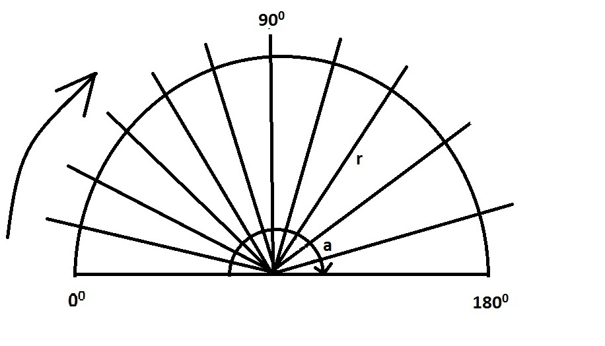
Test Criteria
180⁰ scanning
Sharp sensor mounted on servo.
21 samples of (x,y,r,a) with angle resolution of 9⁰.
Transmits (x,y,r,a) for each sample to the host PC via Xbee.
Such 21 samples are transmitted for each block via serial communication.
Conversion from polar to Cartesian --
p= x+r cos(a)
q= y+r sin(a)

Slide 14
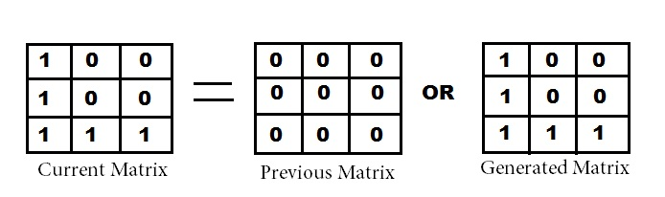
Test Criteria
Matrix scanning:
Selection of three samples → 0⁰ , 90⁰ & 180⁰ degrees.
The range calculated at these angles will be divided by 20 to determine the number of blocks.
Matrix generated
1→ No obstacle(free space)
0→ obstacle
Logical OR of new and previous value.
Transmits complete matrix.

Slide 15
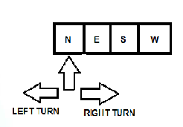
Test Criteria
Direction algorithm-
Predefined pointer called NUM, initially directed at ‘N’.
Whenever robot turns , the pointer will increment or decrement accordingly.
Eg-Turn right → Pointer increment
Turn left → Pointer decrement

Slide 16
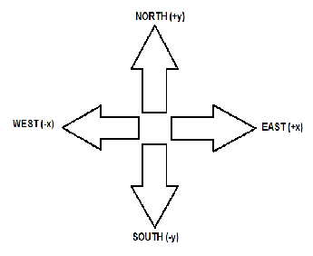
Test Criteria
(X,Y) algorithm-
Depending upon the direction, the robot will calculate its current block position (X,Y).
Eg-
North → Y increments
South → Y decrements
East → X increments
West → X decrements

Slide 17
Reusability features
Magnetic compass - To reduce the positional error.
Sensor with higher range - To increase the range of the sensor for detection of wall or an obstacle more efficiently for the larger area.
Increasing angle resolution of servo shaft - To increase the number of scanning samples taken by servo shaft.

Slide 18
Future Enhancement
Automatic vacuum cleaning
Surveillance security systems
Operating robot by mobile phone (android application)

Slide 19
Thank you!!

