Slide 1
2 Wheel
Self Balancing Bot
Group No 8
Nitish Jhawar 09005032
Vinayak Gagrani 09005035
Tarique Aziz 09005036
Vaibhav Krishan 09005042

Slide 2
The Idea
We intend to implement a two wheel self balancing bot.
The basic idea for a two-wheeled dynamically balancing robot is pretty simple :-
Drive the wheels in the direction that the upper part of the robot is falling.
If the wheels can be driven in such a way as to stay under the robot's center of gravity, the robot remains balanced.
If the center of gravity by construction can be brought below the shaft then the bot will always be balanced
This bot can be very small, robust to collisions and autonomus.

Slide 3
The Idea
This requires two feedback sensors :-
A Tilt or Angle sensor to measure the tilt of the robot with respect to gravity, and
Wheel Encoders to measure the position of the base of the robot.
Four terms are sufficient to define the motion and position of this "inverted pendulum" and thereby balance the robot :-
  the tilt angle and
  its first derivative, the angle velocity, and
  the platform position and
  its first derivative, the platform velocity.
These four measurements are summed and fed back to the platform as a motor voltage, which is proportional to torque, to balance and drive the robot.

Slide 4
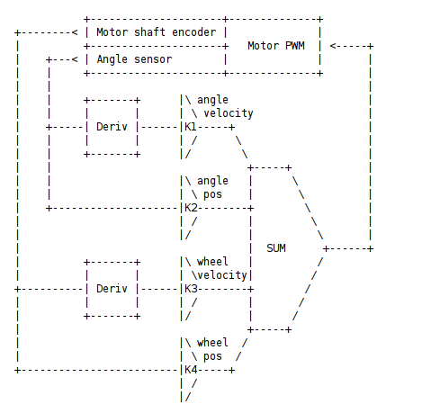
The Idea

Slide 5
Additional Hardware
Piezo-electric gyroscope and ADXL202 accelerometer
The gyroscope and accelerometer are combined with complementary filters to provide an inertial reference sensor.
The accelerometer provides accurate static tilt information, when the robot is not accelerating.
The gyroscope can be integrated to provide accurate dynamic tilt information.
But the integration tends to drift over time. Combining the two sensors provides a robust inertial measurement.

Slide 6
Key Challenges
Measuring the wheel position and
Tilt angle and
Updating the motor voltage to achieve balance.
Constant for the wheel location.
Offsets for movement of bot.

Slide 7
Response
For driving the robot, the desired X offset is summed in with the velocity term.
Steering is accomplished by adding an offset to one motor and subtracting it from the other. This does not effect the balancing mechanism.
The gyroscope and accelerometer are combined with complementary filters to provide an inertial reference sensor.
"Weiner" filter , "Kalman" filter

Slide 8
Where can we fail
The constants and offsets are based on trial and error
They are also specific to the bot dimensions.
The waiting time for the next feedback has to be tweaked accordingly
This all can be deterministic as to how long the bot can move and how long can it balance itself.

