Slide 1
Architecture CA

Slide 2
Problems with big data application

Slide 3
lambda - key features/ architecture.
What is Lambda
Lambda architecture describes a system consisting of three layers: batch processing, speed (or real-time) processing, and a serving layer for responding to queries.

Slide 4
Problems with lambda.

Slide 5
Intro into Kappa
What is “Kappa architecture”?
The Kappa architecture simplifies the Lambda architecture by removing the batch layer and replacing it with a streaming layer.
A batch is a data set with a start and an end (bounded), while a stream has no start or end and is infinite (unbounded)

Slide 6
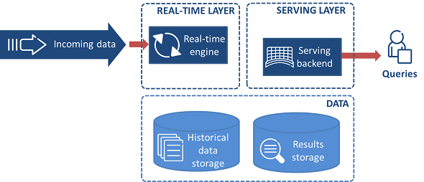
Kappa Architecture

Slide 7
Architecture description
The Lambda Architecture is too complex if you only need to do event processing.
data stream processing or “real-time” processing of “live” discrete events.
Examples - events emitted by devices from the Internet of Things (IoT), social networks, log files or transaction processing systems.

Slide 8
Problems with Kappa
The Kappa Architecture seems to be intriguing due to its simplification in comparison to the Lambda architecture, not everything can be conceptualized as events. For example, company balance sheets, end of the month reports, quarterly publications etc. should not be forced to be represented as events.

Slide 9
Business scenarios
The Lambda Architecture is aimed at applications built around complex asynchronous transformations that need to run with low latency.
A good example would be a news recommendation system that needs to crawl various news sources, process and normalize all the input, and then index, rank, and store it for serving.

Slide 10
Zeta

Slide 11
Q&A

