Slide 1
Architecture CA

Slide 2
Problems with big data application

Slide 3
lambda - key features/ architecture.
What is Lambda
Lambda architecture describes a system consisting of three layers: batch processing, speed (or real-time) processing, and a serving layer for responding to queries

Slide 4
Problems with lambda.

Slide 5
Intro into Kappa
What is “Kappa architecture”?
The Kappa architecture simplifies the Lambda architecture by removing the batch layer and replacing it with a streaming layer.
A batch is a data set with a start and an end (bounded), while a stream has no start or end and is infinite (unbounded)

Slide 6
Architecture description
What is “Kappa architecture”?

Slide 7
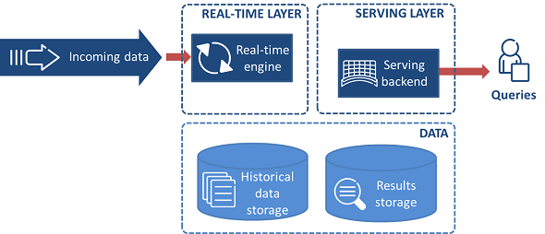
Kappa Architecture

Slide 8
Problems with Kappa

Slide 9
Business scenarios
The Lambda Architecture is aimed at applications built around complex asynchronous transformations that need to run with low latency.
A good example would be a news recommendation system that needs to crawl various news sources, process and normalize all the input, and then index, rank, and store it for serving.

Slide 10
Zeta

Slide 11
Q&A

