Slide 1
Revision: express.Router
09.05.2022

Slide 2

What is express.Router?
express.Router is a class, which you can use to make “modular, mountable route handlers” (Express docs)
A route handler (or router) lets you handle all routes for a particular endpoint. For example, a router for “/birds” can be set up to handle GET, POST, DELETE (and other!) requests made to the “/birds” endpoint (or related routes – e.g. “/birds/about”).
A router lives in its own file (e.g. birds.js) – hence it is modular. You can import the router into index.js and register (“mount”) it using app.use().
When any request to the “/birds” endpoint is received in index.js, the request can now be passed directly to the router for further processing.
Let’s see an example of this, from the Express docs...

Slide 3
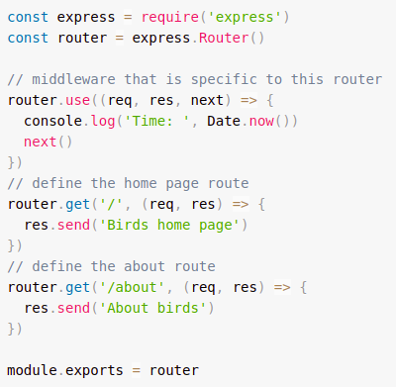
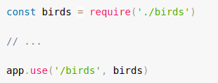
What is express.Router()?
(1) “birds.js”
(1) “birds.js”
(2) “index.js”
(3) The server (index.js) can now use the router in birds.js to handle GET requests to “/birds” and “/birds/about”, as well as call the timeLog middleware function that is specific to the route.

