Slide 1
Backend Module
Part 2: Database Basics
A. SQL databases
16.05.2022

Slide 2
What is a Database?
A collection of data.
As we already saw, a database provides persistent data storage.
This means your data lives in its own "place", a bit like the file system on your computer.
Even if you shut down your computer, when you restart it the files are still there.
You can then read what's in the files, create new files, update what's in the files or delete (the contents of) one or more files.
Soon we will learn about MongoDB – a NoSQL database. But to understand NoSQL, we should first spend some time understanding SQL databases!

Slide 3

What is a SQL database?
SQL is short for “Structured Query Language”.
SQL databases are the most popular type of database in the world.
Basic SQL database definition:
"A database in SQL... is made up of a collection of tables that store a specific set of structured data" - MS SQL Server docs (my emphasis)
We will be creating and querying SQL databases using MySQL, a Database Management System for SQL databases.
But what is a DBMS?

Slide 4
What is a DBMS?
As we discussed earlier, a database is a collection of data.
A Database Management System (DBMS) is a program to let you access and change that data.
MySQL is a DBMS for SQL databases. It is the most popular DBMS in the world (source: https://towardsdatascience.com/top-10-databases-to-use-in-2021-d7e6a85402ba).
You can write queries ("questions"/"commands") in your DBMS to “ask questions” of your DB.
When you run a query, the DBMS (1) goes to the DB, (2) finds answers/does something, and then (3) comes back to you to let you know if it was successful.
Structured Query Language (SQL) is the programming language we use in MySQL to write these queries.

Slide 5
SQL Databases - Key Concepts
SQL Databases:
1. Use tables
2. Use pre-defined schemas
3. Are relational databases
4. Use CRUD operations
“Create, Read, Update, Delete”

Slide 6
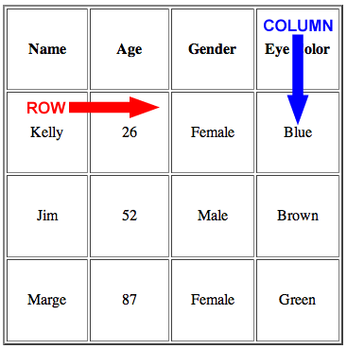
SQL Databases – 1. Tables
SQL Databases use tables. A table contains:
Rows (or “records” or “tuples”) - store information about a single "thing" (e.g. a person)
Columns (or “attributes”) - store
a certain type of information for
each record (e.g. name, date of
birth, city etc.)

Slide 7
SQL Databases – 2. Schemas
A schema is a model for the information stored in the table.
So for an example "employees" table, there will be certain predefined columns - e.g., employee id, name, salary, position. All records in this table will conform to this model.
For example, John Smith, employee ID 1234, is a Junior Software Developer who earns €45,000 per year.
If you want to add a new record to the table, you have to conform to this model. We can't, for e.g. add John Smith's favorite color – there is no column for it to go into!
As all employees share attributes, we can query the table to find out more about our employees:
"Find all employees who earn over €40,000"
"Find all employees who are under 45 years old and work as a Junior Software Developer"

Slide 8
SQL Databases – 3. Relational
SQL databases are relational. This is a key concept in SQL.
You can have more than one table in a database. For example, the business in the last slide could also have a "payroll" table, containing employees' bank details, employment history etc.
If both the employees and payroll tables share an attribute (e.g. “employee id”, it is possible to link them!
So in our database, we could find John Smith's “job title” and his “bank details” even though they each live in different table.
This means the "employee_id" attribute creates a relationship between the tables.
Note 1: Every record in a SQL table must have a unique identifying attribute, e.g. “id”. This is called a primary key.
Note 2: not all databases are relational - as we will see with MongoDB!

Slide 9
SQL Databases – 4. CRUD
We can:
CREATE
READ
UPDATE
DELETE
data from our SQL tables.
More on this soon...!

