Slide 1
Backend Module
Part 3: Database Advanced
C. Mongoose Population
14.06.2022

Slide 2

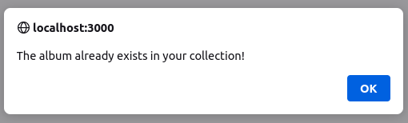
What happens when a user adds an album in the browser?
We have implemeted our new data model and now have two collections – “users” and “albums”.
These two collections are related (see our ER Diagram!)
When the user clicks the button in the browser to add a new album, we now go through three steps…
Note: if there is an error at any time, an error message is displayed to the user in an alert:

Slide 3
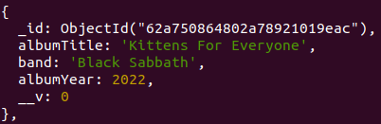
What happens when a user adds an album in the browser?
Step 1: Make fetch request 1
Endpoint = POST “/albums”
Create a new “album” document in the “albums” collection (only if it doesn’t already exist!)
Then send a response back to the frontend containing the id of the user’s new album...

Slide 4
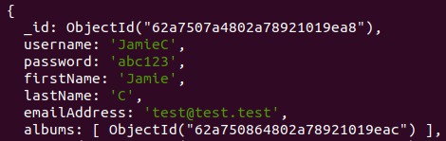
What happens when a user adds an album in the browser?
Step 2: Make fetch request 2
Endpoint = PATCH “/users/:id/albums”
Send the id of the user’s new album in the request body, and add it to their “albums” array.
Then send a response back to the frontend containing the user’s updated “albums” array.

Slide 5
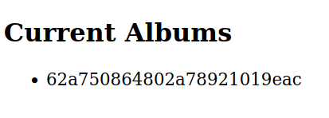
What happens when a user adds an album in the browser?
Step 3: render a list of the user’s album ids
Take the albums array received in the response of fetch request 2...
Use the array to set the frontend “albums” state variable.
.map() the state variable - render a <li> for each album id.

Slide 6
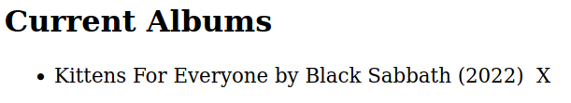
Why create a relationship between users and albums?
Final challenge:
You may have noticed that our new approch does not yet allow us to list the full details of each album (title, year and band) in our React frontend...
To do this, we can create a relationship between the “users” and “albums” collections using document references.

Slide 7
Why create a relationship between users and albums?
Creating a relationship between the “users” and “albums” collections is very useful.
For each album id in a user’s “albums” array, we can use albums collection to “fill in the details” when making a Mongoose query.
To do this, we can take two steps:
Step 1: Create a relationship between the ObjectIds stored in the “User” model’s “albums” array and the “Album” model. We do this using the “ref” option...

Slide 8
Why create a relationship between users and albums?
Step 2: Use Mongoose population!
“Population is the process of automatically replacing the specified paths in the document with document(s) from other collection(s).” (Mongoose docs, emphasis mine)
When making a query, population lets us “fill in” (“populate”) the details of each album using only its id. It lets us “reach across” to the “albums” collection and “bring back” the document corresponding to each id.
“We may populate a single document, multiple documents, a plain object, multiple plain objects, or all objects returned from a query.” (Mongoose docs)
Let’s check out how population works in practice...

