Slide 1
Backend Module
Part 3: Database Advanced
B. References
13.06.2022

Slide 2

New “Album” model - recap
On Thursday, we created a new “Album” model.
Now, whenever a user adds a new album in the browser, a new document is created in the “albums” collection of the “albums-project” database.
The new document contains the album’s title, year, band and _id (plus __v).
But why did we decide to go with this new approach?
First, let’s look at our new data model more carefully using a popular database design tool called an ERD – an Entity Relationship Diagram...

Slide 3
ERD Task
Spend 7 minutes creating a quick ERD for our new data model.
Remember, we currently have two entities:
Users
Albums

Slide 4
Why create a relationship between users and albums?
Now we have separated out user and album documents into separate collections, we need a way of recording which album(s) were added by each user.
As you have seen from our ERD, users can add zero to many albums.
When we only had a “users” collection, we would store the data for each album in a nested document inside the user document’s “albums” array.
But what happens if more than one user adds the same album?

Slide 5
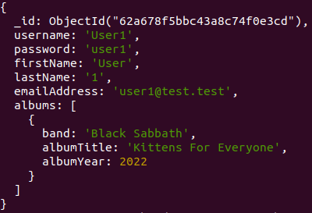

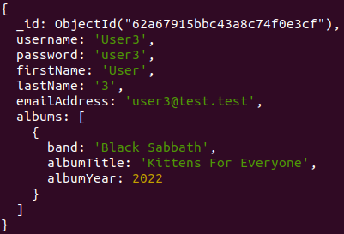
“Users” collection example
User 1
User 2
User 3
Problems:
Repetition
Redundant data

Slide 6
Why create a relationship between users and albums?
To reduce repetition and redundant data, we can create each album only once – as a document in the new “albums” collection.
When a user creates a new album, they will get a reference to that album document (its unique _id key), in their “albums” array.
If another user adds the same album, the album does not need to be created again. Instead, the second user will also get the same unique _id key in their own “albums” array.

Slide 7
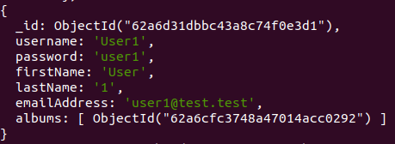
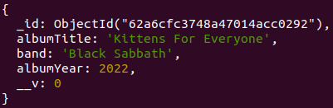
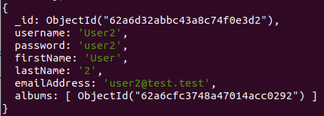
“Album” reference example
Album document (in “albums” collection)
User 1
User 2

