Slide 1
Backend Module
Part 2: Database Basics
B. SQL vs NoSQL (MongoDB) databases
18.05.2022

Slide 2

What is a NoSQL Database?
NoSQL stands for “Not Only SQL”.
NoSQL databases allow you to store unstructured data – no fixed schema for the data is required!
NoSQL databases are non-relational and don’t use SQL.
Instead of tables, NoSQL databases can contain the following data types:
Document stores (store data as “documents”, e.g. in JSON format). MongoDB is a document based database.
Key-value stores (store data as key-value pairs)
Graph stores (store data about networks in a graph format)
Wide-column stores (handle lots of data in the form of columns)

Slide 3
SQL vs MongoDB 1: Scaling
SQL databases are designed to run on a single server.
SQL databases scale vertically. To scale a SQL database (increase capacity), you need to increase the capacity of the server (e.g. buy more memory, or buy a better server). This is not very efficient if your data needs increase a lot!
NoSQL databases are built to run across multiple servers (e.g. via the cloud). This means they can handle much more data than SQL databases.
NoSQL databases scale horizontally. To increase capacity, you just need to add more servers to share the processing.
This means NoSQL databases are a great choice for organizations which need to handle “big data”, as they can be scaled easily, cheaply and with little impact on performance.

Slide 4


SQL vs MongoDB 1: Scaling
If we imagine managing a database is like making a cake…
As we get more and more data (make more and more cake mix)…
Vertical scaling (e.g. a wedding cake) Keep adding more and more to the original cake
Horizontal scaling (e.g. cupcakes) Make as many new cakes as you need!
Image 1 source: https://commons.wikimedia.org/w/index.php?curid=10310913 Image 2 source: https://commons.wikimedia.org/w/index.php?curid=10271855

Slide 5

SQL vs MongoDB 2 - Key Concepts
SQL Databases:
A. Use tables
B. Use pre-defined schemas
C. Are relational databases
D. Use CRUD operations
“Create, Read, Update, Delete”

Slide 6
SQL vs MongoDB 2 - Key Concepts
MongoDB Databases:
A. Do not use tables
B. Do not use pre-defined schemas by default
C. Are not relational databases
D. Use CRUD operations
“Create, Read, Update, Delete”

Slide 7
MongoDB – 2A. No Tables
MongoDB databases use collections.
"A collection is the equivalent of a table in a relational database system" (MongoDB docs, emphasis mine).
A collection is a place you can store MongoDB documents.
Data is stored in MongoDB in a BSON ("Binary JSON") format. This is only readable by machines.
This allows the data to be searched and indexed very quickly, and also reduces the space it requires.
However, you can read and write your data in a JSON format, which makes it much more user friendly!
"Anything you can represent in JSON can be natively stored in MongoDB, and retrieved just as easily in JSON" (MongoDB docs)

Slide 8
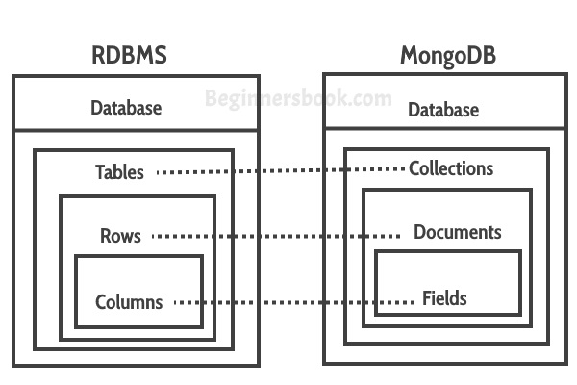
MongoDB – 2A. No Tables
Database Structures (source: BeginnersBook.com)

Slide 9
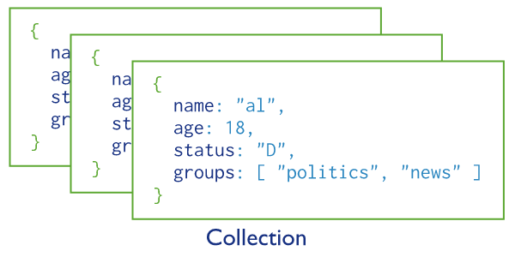
MongoDB – 2A. No Tables
A MongoDB Collection of 3 Documents (source: MongoDB.com)

Slide 10
MongoDB – 2B. No Schemas and 2C. Not Relational
NoSQL databases like MongoDB allow you to expand your database flexibly, without having to conform to a pre-defined schema.
Without a schema, you have the ability to store semi-structured and unstructured data as well as structured data.
This makes NoSQL databases like MongoDB easier to scale (remember Part 1?) and manage. It also makes such databases highly suitable for “big data” companies and those with large storage needs, where the data being managed may not all “fit into the same box”.
It also means that NoSQL databases are better at managing complex data, e.g. JSON data, which can contain objects, lists and other data types, which may not fit easily into the rows and columns of SQL tables.
More information for anyone interested: https://www.mongodb.com/compare/relational-vs-non-relational-databases

Slide 11
MongoDB – 2D. CRUD
Just like in a SQL database, we can:
CREATE
READ
UPDATE
DELETE
data from our MongoDB collections.

