Slide 1
Backend Module
Part 2: Database Basics
MongoDB Revision
24.05.2022

Slide 2

MongoDB: Revision
MongoDB is a NoSQL (“Not Only SQL”) database.
You cannot use SQL (“Structured Query Language”) in a MongoDB database.
In a MongoDB database, data is stored in collections, in the form of JSON documents. No tables/rows here!
MongoDB databases have dynamic schemas – you do not have to define a schema when creating a new collection.
This means you can store structured, semi-structured or unstructured data in a MongoDB collection – unlike in a highly structured SQL table!

Slide 3
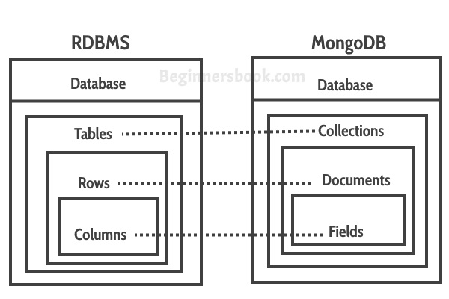
MongoDB: Revision
Database Structures (source: BeginnersBook.com)

Slide 4


MongoDB: Revision
If a SQL table stores data in a similar way to an accounting leger...
… a MongoDB collection stores data in a similar way to a filing cabinet!

Slide 5
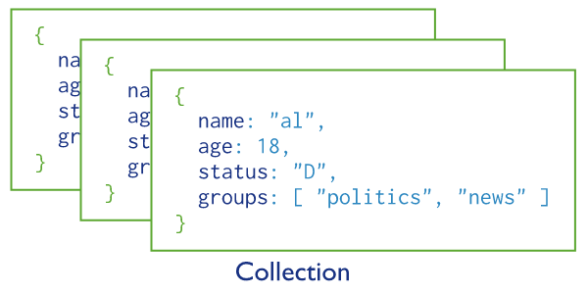
MongoDB: Revision
A MongoDB Collection of 3 Documents (source: MongoDB.com)

Slide 6
MongoDB: Advantages
By default, MongoDB databases are schema-less. This gives flexibility, especially when handling (messy!) real-world data.
It is also easy to adapt your data modelling as your app grows/evolves, without having to manually change schema(s).
However, if you do want to use a schema, or validate data, MongoDB can also support those options – the choice is yours!
MongoDB is fast – a document containing data is quicker to query than the same data spread across several tables.
Indexing can also improve query efficiency in large/complex collections – we will discuss this a little later!
Scalability – horizontal scaling makes MongoDB databases great for storing large amounts of data, which may not all “fit in the same box”.
JSON can contain objects, lists and other data types, which can often better represent “real-world” data than the columns of a SQL table.
Excellent documentation.

Slide 7
MongoDB: CRUD
Just like SQL databases, MongoDB databases support CRUD (Create-Read-Update-Delete) operations.
Some of you may have noticed that CRUD operations correlate well with our RESTful server’s five key HTTP methods…
Create → POST
Read → GET
Update → PUT / PATCH
Delete → DELETE
This will come in useful soon, when we add a MongoDB database to our project and want to query it using our server...
But first, let’s get more familiar with MongoDB!

