Slide 1

Smart battery monitoring system
Presented By:
1. E1-80381 Satish Kumar
2.E1-80408 Ashish Bharadwaj
3.E1-80414 Poonam Devkar
4.E1-Ayisha Khan

Slide 2
Introduction
Batteries are the largest, most expensive, and most important component of our electric vehicle. It is the heart of electric vehicles. It’s very critical that we understand the battery care and charging requirements carefully. Temperature is known to have a big influence on the rate of battery degradation. One of the main reasons that it is so critical is because temperature affects the rate and efficiency of chemical reactions inside a battery. Higher temperatures, generally lead to faster reactions. This often means that the “unwanted” chemical reactions that make batteries degrade happen faster at higher temps.
To meet the above requirement, in this project we have developed a “Smart Battery Monitoring System” which consists of an STM32F407 discovery board and a beagle bone black. This will monitor the battery’s temperature and the current drawing through the battery with the help of temperature DHT22 and current sensor INA219.

Slide 3
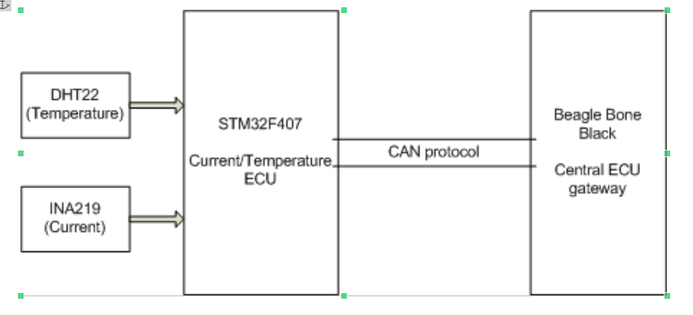
Block DIagram

Slide 4
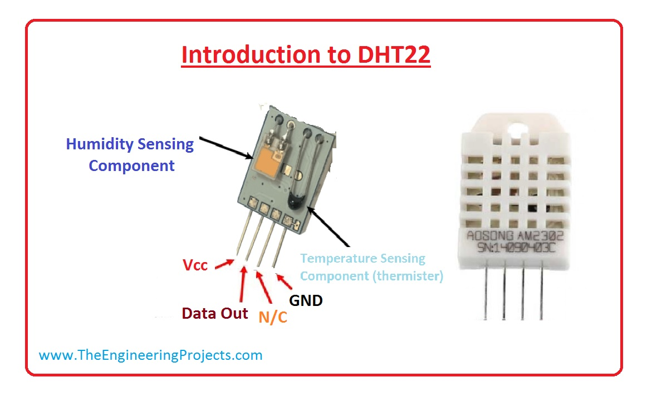
DHT22 Sensor
AM2303 output calibrated digital signal. It utilizes exclusive digital-signal-collecting-technique and humidity sensing technology, assuring its reliability and stability.
Its sensing elements is connected with 8-bit single-chip computer.
Small size & low consumption & long transmission distance (20m) enable AM2303 to be suited in all kinds of harsh application occasions.

Slide 5
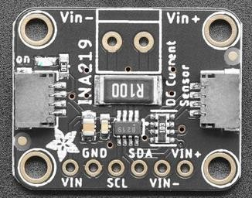
INA219 Current Sensor
The INA219 is a current shunt and power monitor with an I2C- or SMBUS-compatible interface. The device monitors both shunt voltage drop and bus supply voltage, with programmable conversion times and filtering.
A programmable calibration value, combined with an internal multiplier, enables direct readouts of current in amperes.
An additional multiplying register calculates power in watts. The I2C- or SMBUS-compatible interface features 16 programmable addresses

Slide 6
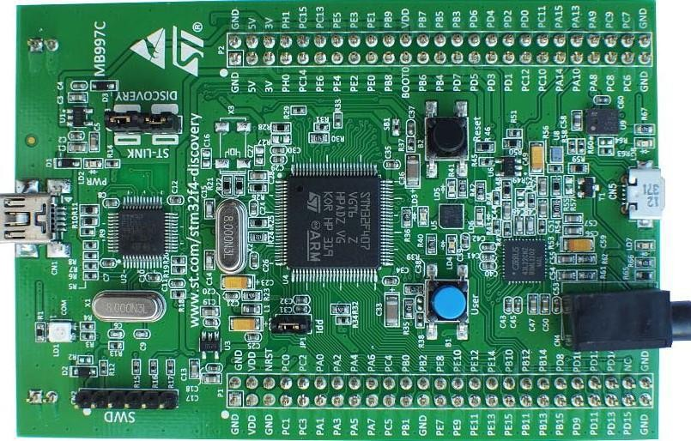
ARM Cortex M4
The ARM Cortex -M4 processor is a high-performance embedded processor with DSP instructions developed to address digital signal control markets that demand an efficient, easy-to-use blend of control and signal processing capabilities.
The processor is highly configurable enabling a wide range of implementations from those requiring floating point operations, memory protection and powerful trace technology to cost sensitive devices requiring minimal area.

Slide 7
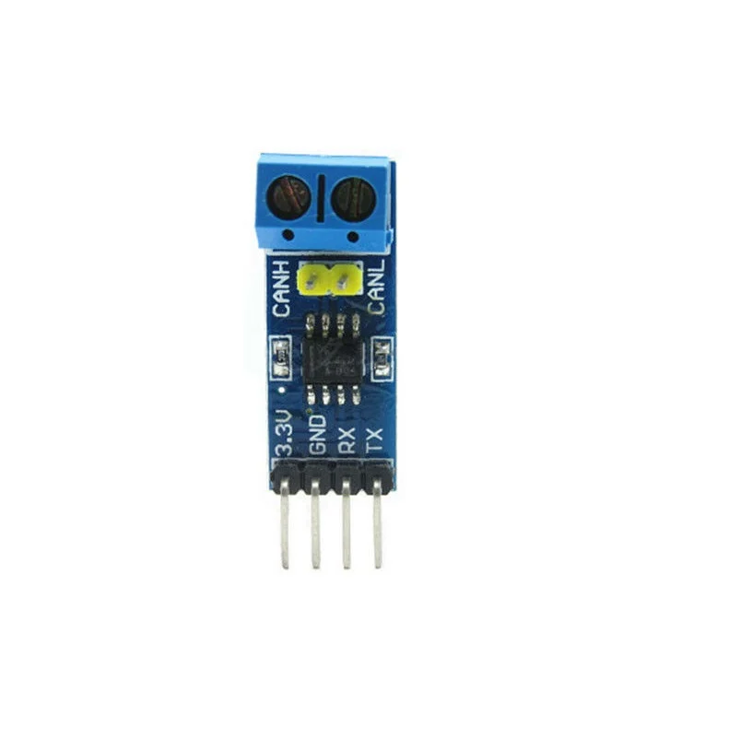
Sn65HVD230 CAN Transceiver
The SN65HVD230 CAN Board is an accessory board that features an on board CAN transceiver SN65HVD230, which is pinout compatible with PCA82C250. It is powered from 3.3V and features ESD protection. The SN65HVD230 CAN Board is ideal for connecting microcontrollers to the CAN network.

Slide 8
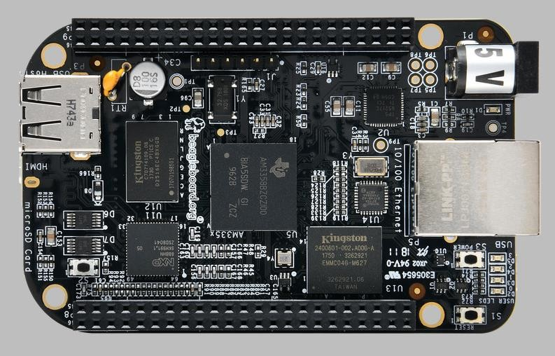
Central-Gateway ECU-Beagle Bone Black
Processor: AM335x 1GHz ARM® Cortex-A8
512MB DDR3 RAM
4GB 8-bit eMMC on-board flash storage
3D graphics accelerator
NEON floating-point accelerator
2x PRU 32-bit microcontrollers
Connectivity
USB client for power & communications
USB host
Ethernet
HDMI
2x 46 pin headers

Slide 9
Physical Connection
As the DHT22 works on single wire data bus, only one wire is required for data transmission. To supply power to the sensor 3V3 is provide to its power pin and ground is connected to discovery board ground. Connection are as follows.
Sensor F407 discovery board
VDD 3V
Data PD11(Port D pin 11)
GND Ground

Slide 10
Physical Connection
INA219 communicates over I2C hence it is attached to I2C1 peripheral of the discovery board. The PULLUP resistor for SDA and SCL are already mounted on the breakout board. Hence no need to connect PULLUP resistor. Again 3V3 is supplied to INA219. Connection are as follows.
Sensor F407 discovery board
VCC 3V
GND Ground
SDA PB7(Port B pin 7)
SCL PB6(Port B pin 6)
VIN+ and VIN- are the input pins thus connected in battery network.

Slide 11
Physical Connection
The STM32F407 has built-in CAN controller, CAN1 is connected on Port B. CAN transceiver is connected to CAN controller pins to complete the physical layer of CAN node. Connection are as follows.
SN65HVD230 F407 discovery board
3.3v 3V3
GND Ground
CTX PB9 (Port B Pin 9)
CRX PB8 (Port B Pin 8)

Slide 12
Physical Connection
CANH and CANL of transceiver is connected to the CANH and CANL of the other transceiver connected to Beagle Bone Black respectively with a twisted pair of wire. Another CAN transceiver is Beagle Bone Black end and connection are as follows.
Beagle Bone Black SN65HVD230
VDD_3V3 3.3V
DGND GND
GPIO_15 CRX
GPIO_14 CTX
For internet connectivity Ethernet Cable is connected to provide internet in our central node/ gateway.

Slide 13
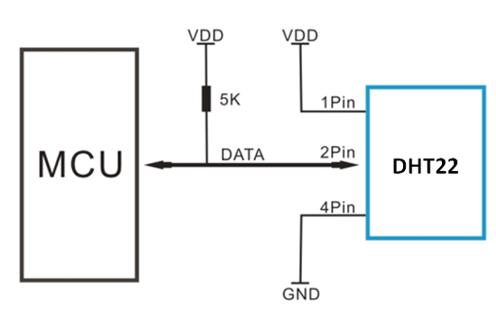
Communication protocol
DHT22 to STMF407 :
To read data from dht22 sensor first we have to provide a low level pulse for at least 18ms. After which the sensor provide 40 bits data on the same single wire.

Slide 14
Communication Protocol
INA219 to STMF407 :
INA219 works on either I2C or the SMBus protocol. I2C (Inter-Integrated Circuit), alternatively known as I2C or IIC, is a synchronous, multi-controller/multi-target (controller/target), packet switched, single- ended, serial communication bus invented in 1982 by Philips Semiconductors.
I2C uses only two bidirectional open-collector or open-drain lines: serial data line (SDA) and serial clock line (SCL), pulled up with resistors. Typical voltages used are +5 V or +3.3 V, although systems with other voltages are permitted.
The I2C reference design has a 7-bit address space, with a rarely used 10-bit extension.
We have used I2C protocol in Fast Mode.

Slide 15
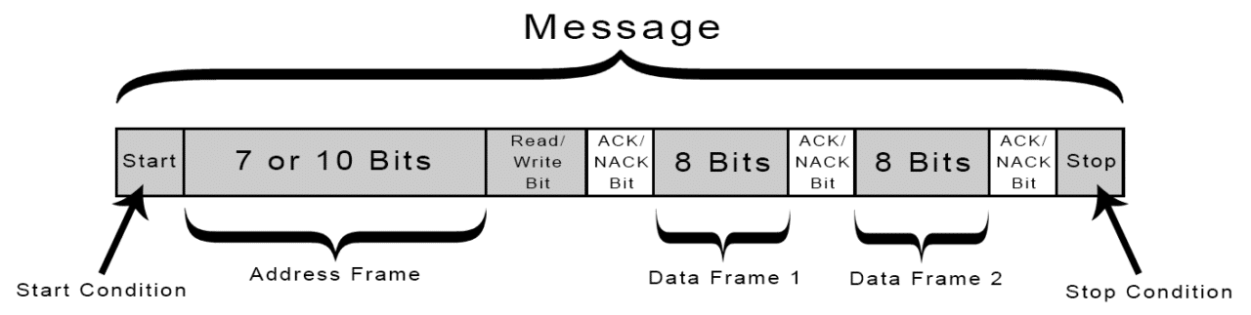
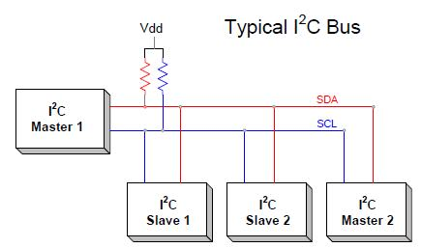
I2C Communication Protocol

Slide 16
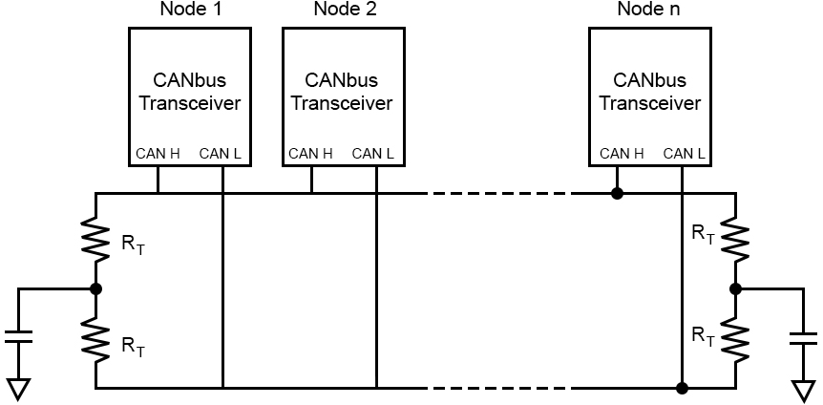
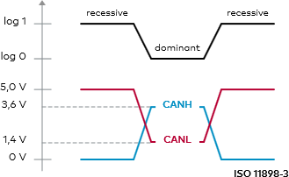
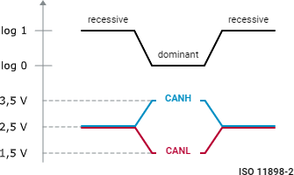
STMF407 to Beagle Bone Black-CAN Protocol

Slide 17
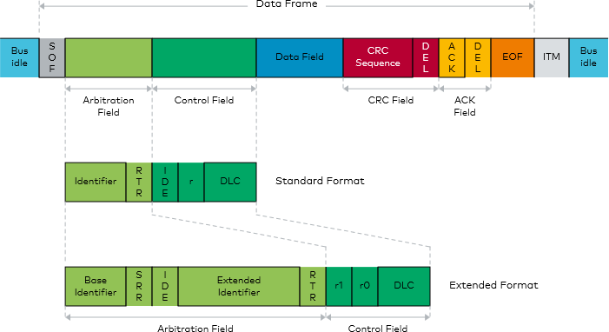
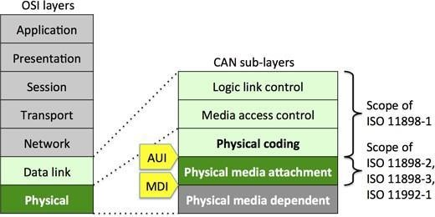
STMF407 to Beagle Bone Black-CAN Protocol

Slide 18
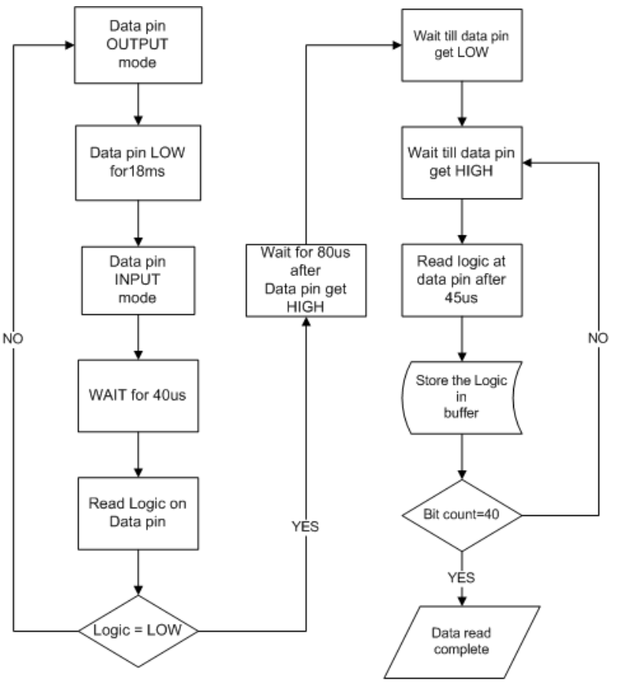
DHT22 data read sequence
Single-bus data is used for communication between STM32F407 and AM2303 (model name of DHT22), total time for one time data read is around 5ms. To save power DHT22 get into sleep mode after transmitting data.
To read data we have to wake up the sensor. This is done by pulling the data line LOW for at least 18ms by the MCU followed my releasing the data bus to HIGH. Sensor will take around 40us to process this wakeup call. Sensor will response by pulling data bus LOW for 80us the HIGH for 80us. This sequence is known as “Presence”, MCU will receive Presence only if the sensor is present on bus.
Falling this means that sensor is not present and we have to re-start the communication by send wakeup call again. After presence sensor send a 40 bit data which comprise of starting 16 bit of humidity data, next 16 bit of temperature data and an 8 bit CRC. After this sensor goes to sleep again.

Slide 19
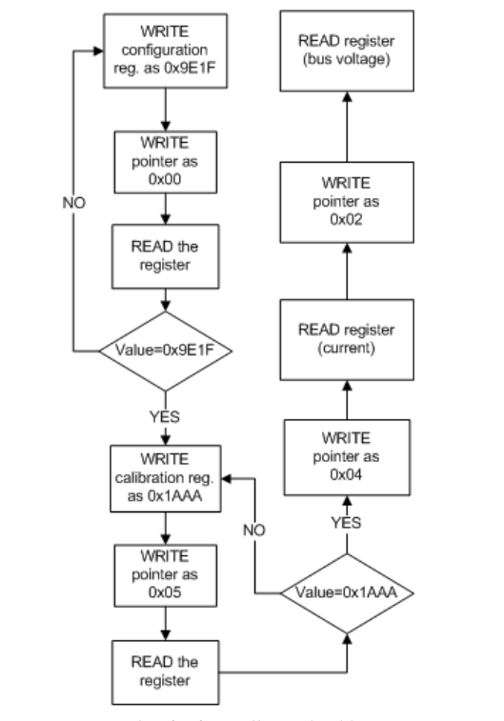
INA219 data read sequence
The MCU communicates with INA219 over I2C protocol in Fast mode i.e. 400kbps. I2C1 peripheral of STM32F407 is connected with sensor. STM32F407 is in master configuration and the sensor is slave.
To read data first, we have to configure then calibrate the sensor. We have to write the value in their respective register. To write data in register we have to specify the address of register also unlike reading register.
1. Setting the configuration register
2.Setting the calibration register

Slide 20
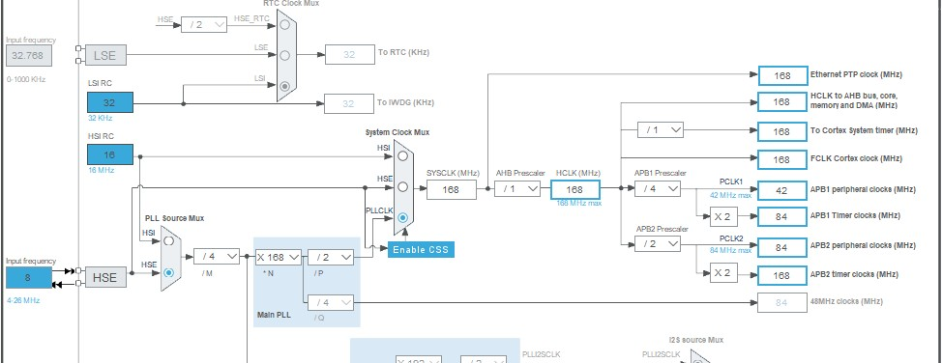
Clock Configuration

Slide 21
Beagle Bone Black to AWS cloud
For managing the data to cloud server, we have used Amazon Web Services. AWS provides many services to
manage data in cloud like storing data, data base, remote server, analysis and many other. AWS also provides
a service for managing IoT based devices called as AWS IoT Core which use to manage our IoT device, their
data management their deployment and all. AWS IoT Core use MQTT protocol in application layer for data
exchange thus also provide a MQTT broker in AWS IoT Core.
Following are the steps to connect our device “Thing” to AWS IoT Core
1.In IoT Core section we have to register our THING.
2.Attach policies to the thing we created.
3.AWS IoT Core then will provide Keys and Certificate for security for Thing.
4.Download the SDK provided by IoT Core.
5.Develop an application code based on the SDK provide to publish data to AWS IoT Core.
6.Once data is being send AWS IoT Core we can apply other AWS service as Rules for further analysis and
data management.

Slide 22
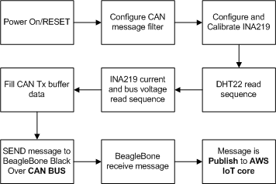
Functional flow
On power ON/RESET of ECU (STM32F407) the ECU will first configure the CAN message filter and start the CAN peripheral. After initializing and configuring CAN filter, configuration of INA219 is done followed by writing the calibration parameters. ECU will collect temperature data from DHT22, current and bus voltage from INA219.
Then it will fill CAN transmit buffer with these data. After this CAN data frame is created with the transmitting header.
Message is transmitted to Central node/Gateway (Beagle Bone Black) over CAN bus. The ECU will loop around the process of collecting data from the sensors, preparing CAN message and transmitting for every 3 minutes.

Slide 23
Future Scope
As we are able to send the temperature and current drawn from EV’s battery to the AWS IoT Core. The data is being received by the AWS IoT Core MQTT broker. As the future scope of the project we can use AWS services for data analysis of the battery’s temperature, current drawn for the purpose of predictive maintenance and increase the battery life.

