Slide 1
Efficient Survivability Approaches and Switch Architectures in Elastic Optical Networks

Slide 2
Outline
Introduction
Scope of our research
Background and Literature survey
Problem definition
Objectives
Methodology
Description of Research Carried Out
Future Plan
References

Slide 3
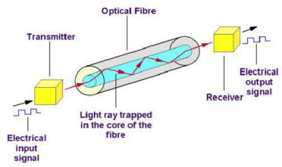
Introduction
The optical fiber provides an excellent medium for transferring huge amounts of data.
Optical transmission system

Slide 4
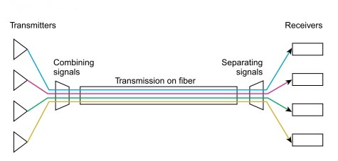
Wavelength division multiplexing
Wavelength w1
Wavelength w2
Wavelength w3
Wavelength w4

Slide 5
WDM consists of three switching paradigms:
Circuit level Transmission
  A lightpath is established to create a logical circuit between two edge nodes across the optical core before any transmission is done.
Packet level Transmission
  Data is transmitted in the form of optical packets (header and payload) across the optical core without conversion
Burst level Transmission
  The data is assembled into a collection of packets called burst. A control message which contains the usual header information including the burst length and arrival time is sent prior to the data burst.

Slide 6
Scope of our research
We focus our research on circuit level transmission.
We have identified two key research areas that received much attention recently.
  1.Elastic optical networks
  2.Survivability

Slide 7
Background: Elastic (flexible) optical networks
This is otherwise called as flexgrid networks.
Finer granular 12.5 GHz flexible grids are used for provisioning lightpaths instead of using the traditional fixed grid with 50 GHz spacing.
The important benefit is to use spectrum more efficiency, hence reduction of blocking is achieved.

Slide 8
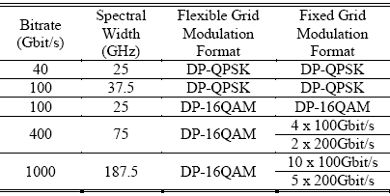
Bitrate vs. Spectral width [Paul Wright, Andrew Lord and Luis Velasco, ONDM, 2013]
Fixed grid with 50 GHz spacing
40 Gbps bitrate
Flexgrid with 12.5 GHz spacing

Slide 9
Literature: Elastic Optical Networks
Following papers present the different spectrum allocation schemes and investigated resource usage efficiency for dynamic traffic in elastic optical networks.
  O. Gerstel et al., IEEE Communications Magazine, Feb. 2012.
  L. Velasco et al., OFC/NFOEC, 2012.
  Stefan Dahlfort, et al., ECOC, 2012.
  K. Christodoulopoulos, et al., Journal of Lightwave Technology, 2011.
  Liangjia Zong, et al., OFC/NFOEC, 2013.

Slide 10
Following papers describe the spectrum allocation schemes and investigated blocking probability for dynamic traffic in elastic optical networks.
  Paul Wright et al., OFC/NFOEC, 2012.
  Stefan Dahlfort, et al., ECOC, 2012.
  G. Shen and Q. Yang, OFC 2011.

Slide 11
Background: Key Components used in Elastic optical networks
Bandwidth Variable Transceiver (BVT)
  It can scale and transmit/receive up to terahertz bandwidth.
Bandwidth Variable Wavelength Selective Switch (BV-WSS)
  It performs wavelength demultiplexing /multiplexing and optical switching functions.
  These devices are based on one of several technologies: optical micro electromechanical systems (MEMS), liquid crystals on silicon (LCOS)[M. Jinno et al., IEEE Communication Magazine, 2009].

Slide 12
Literature: Key Components and Architectures used in Elastic optical networks
Following papers illustrate the key components, architecture and enabling technologies of optical switches in elastic optical networks.
  O. Gerstel et al., IEEE Communications Magazine, Feb. 2012.
  M. Jinno et al., IEEE Communication Magazine, 2009.
  G. Baxter et al., OFC/NFOEC 2006.
  N. Amaya, et al., Optical Communications, 2011.
  C. Rottondi, et al., OSA, 2011.
  Steve Frisken, et al., OFC/NFOEC, 2011.
  Jane M. Simmons, et al., IEEE Photonics Technology Letters, 2013.
  Guoying Zhang, Marc De Leenheer, and Biswanath Mukherjee, OFC/NFOEC, 2012.

Slide 13
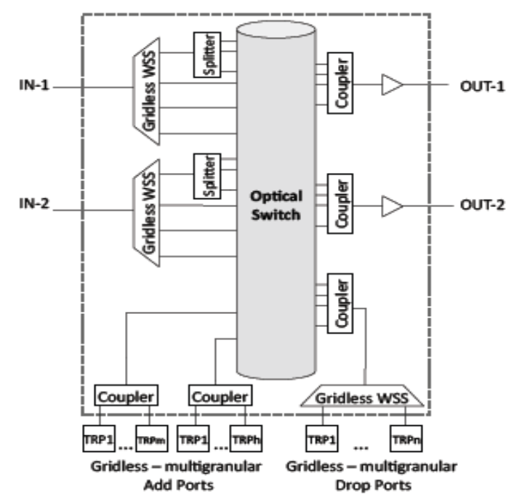
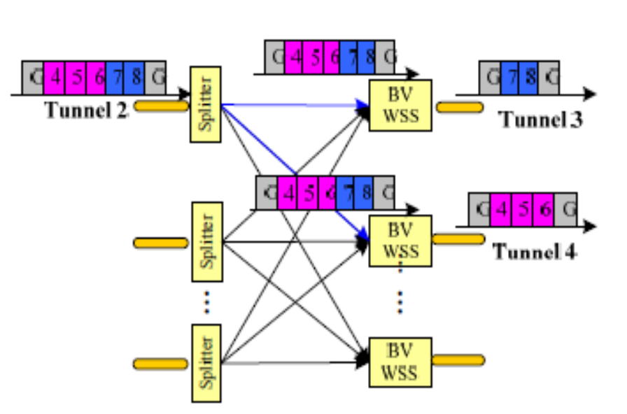
Literature: Possible Switch Architectures for Elastic Optical Networks
(a) Non broadcast and select Architecture (Non-splitters based optical switches such as MEMS) [N. Amaya, et al., Optical Communications, 2011.]
(b) Broadcast and select architecture [Guoying Zhang, Marc De Leenheer, and Biswanath Mukherjee, OFC/NFOEC, 2012.]

Slide 14
Background: Survivability
P1
1
2
3
1
2
P1
B1
P2
B1
P2
B2
B2
4
5
6
4
5
(a)
Dedicated protection
(b)
Shared protection
Short recovery time.
High resource usage
(7 wavelength links)
Long recovery time.
Efficient resource usage
(5 wavelength links)
(c) Pre-configured backup protection with limited sharing (PBPLS)

Slide 15
Literature: Survivability Approaches (Dedicated and Shared) in Elastic optical networks
Following papers investigate resource utilization, blocking probability, power consumption and cost effectiveness of survivability approaches in elastic optical networks.
  X. Shao et al., OFC/NFOEC, 2012.
  E. Palkopoulou, et al., OFC/NFOEC, 2011.
  Menglin Liu, Massimo Tornatore and Biswanath Mukherjee, Journal of Lightwave Technology, 2013.

Slide 16
Literature: Pre-configured backup protection with limited sharing (PBPLS) in fixed grid
P1
A
B
B1
C
D
B2
F
G
P2
Short recovery time.
Shared protection.
(PBPLS) [R. Krishanthmohan, G. Mohan, and K. C. Chua, ICN, 2011].
Due to the power loss, the sharing of backup path is limited

Slide 17
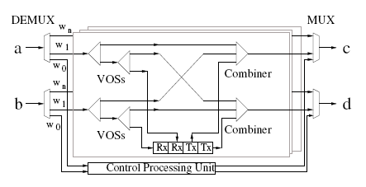
Literature: Switch Architecture for Pre-configured Backup Protection with Limited Sharing
Flexible switch architecture [R. Krishanthmohan, G. Mohan, and K. C. Chua, Computer Communications, 2013.]

Slide 18




Our work
High
High
Elastic (Flexible) optical networks
Conventional WDM fixed grid networks
Efficient Survivability Approaches such as Pre-configured backup protection with limited sharing
Traditional Survivability Approaches such as dedicated protection and shared protection
Our work
Investigated
Low
Low

Slide 19
Problem Definition
In our research work, we considered circuit level optical transmission with efficient survivability approaches (PBPLS) in elastic optical networks.
The problem of our research study is how efficiently dynamic connection requests with survivability requirements can be accommodated in elastic optical networks in order to improve the performance such as reduced blocking and improved resource utilization.

Slide 20
Objectives
To modify existing switch architecture or propose new architectures to support both efficient survivability methods (PBPLS) and elastic optical networks.
To integrate two approaches such as PBPLS and elastic optical networks and to verify performance improvement using simulation based implementation in various network topologies and different traffic load scenarios.
To propose survivability approaches with new spectrum allocation methods for primary and backup paths and to investigate the performance.

Slide 21
Methodology
  Modifying an existing VOS based switch architecture to support elastic optical networks.
  Integrating the benefits gained in both elastic optical networks and survivability methods (PBPLS) to improve the performance in terms of blocking probability and resource efficiency.
  Proposing new spectrum allocation methods in primary and backup paths for further improving the performance.

Slide 22
Description of Research Carried Out
In this direction, we modified an architecture (used in PBPLS) which supports for elastic optical networks.
A
Flex WSS
C
1
I
Coupler
2
VOSs
Combiner
Combiner
B
Flex WSS
3
II
Coupler
D
4
VOSs
BVT
Control Processing Unit
Flex WSS and VOS based switch architecture

Slide 23
We have been working on simulation based implementation in Visual C++ to investigate the performance of combining efficient survivability approach with elastic optical networks.
In our research work we input:
  Dynamic traffic.
  Different data rates such as 10 Gbps, 40 Gbps, 100 Gbps, 400 Gbps, 1000 Gbps.
  Different network topologies such as NSFNET.
Expected output:
  Blocking probability and resource usage.

Slide 24
Future Plan
Activity | 2014 - 2015
 | Jun | Jul | Aug | Sep | Oct | Nov | Dec | Jan
Simulation based implementation and performance study
Proposing survivability approaches with new spectrum allocation methods for primary and backup paths
Simulation based implementation on different spectrum allocation and performance study
Write up thesis

Slide 25
References
[1] Paul Wright, Andrew Lord and Luis Velasco, “The Network Capacity Benefits of Flexgrid”, Conference on Optical Network Design and Modeling, France, pp. 7 – 12, 2013.
[2] O. Gerstel et al., "Elastic optical networking: A new dawn for the optical layer?," IEEE Communications Magazine, vol. 50, no. 2, pp s12 – s20, 2012.
[3] L. Velasco et al., “Elastic spectrum allocation for variable traffic in flexible-grid optical networks,” in Proceedings of OFC/NFOEC, Paper JTh2A.39, 2012.
[4] Stefan Dahlfort, et al., “Split Spectrum Approach to Elastic Optical Networking”, in Proceedings of ECOC Technical Digest OSA 2012.
[5] K. Christodoulopoulos, I. Tomkos, and E.A.Varvarigos, “Elastic bandwidth allocation in flexible OFDM-based optical networks,” Journal of Lightwave Technology, vol. 29, no. 9, pp. 1354–1366, 2011.
[6] Liangjia Zong, et al., “40/100/400 Gb/s Mixed Line Rate Transmission Performance in Flexgrid Optical Networks”, in Proceedings of OFC/NFOEC Technical Digest OSA, 2013.

Slide 26
[7] Paul Wright et al., “Comparison of Optical Spectrum Utilization Between Flexgrid and Fixed Grid on a Real Network Topology”, in Proceedings of OFC/NFOEC Technical Digest OSA, 2012.
[8] G. Shen and Q. Yang, "From coarse grid to mini-grid to gridless: How much can gridless help contentionless?", in Proceedings of OFC 2011, OTuI3, Mar. 2011.
[9] M. Jinno et al., “Spectrum-Efficient and Scalable Elastic Optical Path Network: Architecture, Benefits, and Enabling Technologies,” IEEE Communication Magazine, vol. 47, pp. 66–73, 2009.
[10] G. Baxter et al., "Highly programmable Wavelength Selective Switch based on Liquid Crystal on Silicon switching elements" in Proceedings of OFC/NFOEC 2006, OTuF2, USA, 2006.
[11] N. Amaya, et al., “Experimental Demonstration of a Gridless Multi-granular Optical Network Supporting Flexible Spectrum Switching”, Optical Communications, OSA/OFC/NFOEC ,2011.
[12] C. Rottondi, et al., “On the Benefits of Elastic Transponders in Optical Metro Networks”, Optical Society of America, 2011.

Slide 27
[13] Steve Frisken, et al., “Flexible and Grid-less Wavelength Selective Switch using LCOS Technology”, in Proceedings of OFC/NFOEC OTuM3, 2011.
[14] Jane M. Simmons, et al., “Network Agility Through Flexible Transponders”, IEEE Photonics Technology Letters, vol. 19, no. 5, pp. 309 – 311, Mar. 2013.
[15] Guoying Zhang, Marc De Leenheer, and Biswanath Mukherjee, “Optical Grooming in OFDM-based Elastic Optical Networks”, in Proceedings of OFC/NFOEC, pp. 1- 3, Mar. 2012.
[16] X. Shao et al., “Shared-path protection in OFDM-based optical networks with elastic bandwidth allocation,” in Proceedings of OFC/NFOEC Paper OTh4B.4, 2012.
[17] E. Palkopoulou, et al., “Dynamic Cooperative Spectrum Sharing in Elastic Networks”, in Proceedings of OFC/NFOEC OTuM3, 2011.
[18] Menglin Liu, MassimoTornatore and Biswanath Mukherjee, “Survivable Traffic grooming in Elastic Optical Networks-Shared Protection”, Journal of Lightwave Technology, vol. 31, no. 6, pp. 903 - 909 , Mar. 2013.

Slide 28
[19] R. Krishanthmohan, G. Mohan, and K. C. Chua, “Optical Protection with Pre-configured Backup Paths and Limited Backup Resource Sharing,” in Proceedings of IARIA ICN 2011, Jan. 2011.
[20] R. Krishanthmohan, G. Mohan, and K. C. Chua, “A Flexible Optical Switch Architecture for Efficient Transmission of Optical Bursts,” Computer Communications, vol.36, no.2 pp. 223-241, Jan. 2013.

Slide 29
Thank you

