Slide 1
Performance tuning on ODIN+
John Cai
2014-04-18

Slide 2
Issue
Non peak time
Response time: 500ms
Peak time (Friday afternoon, weekend)
Too slow
CPU 100% for all 4 servers
Newrelic: response time: seconds to minutes

Slide 3
Insights
Any bad code which has overall impact causing the performance issue?
Or load is just too high?

Slide 4
Observe 1
What are webservers doing?
Windbg: deaklock
Performance monitor
IIS: Worker Processes:
Module: session; State: RequestAcquireState
https://jira.englishtown.com/browse/ODIN-1449

Slide 5
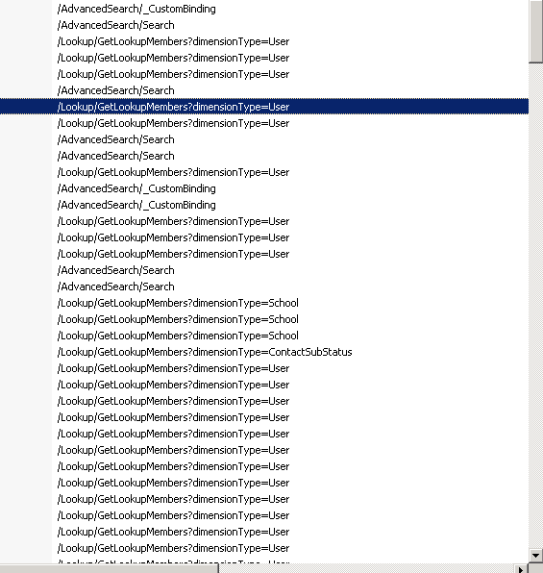

Slide 6
Action 1
Google “IIS hanging RequestAcquireState”
.net 4.5 has an issue
Upgrade live servers to .net4.5.1

Slide 7
Action 2
Add [SessionState(SessionStateBehavior.Disabled)] to LookupController

Slide 8
Observe 2
Newrelic: most time-consuming requests:
GetTeamScheduleView
GetSessionsByGroupId
Common logic: conflict checking

Slide 9
decision
Fix all requests with response time > 1s
Otherwise, try asynchronise Controller

Slide 10
Conflict Checking
Detect teacher/classroom conflict for
Session
Event
LifeClub
NonWorkingDay

Slide 11
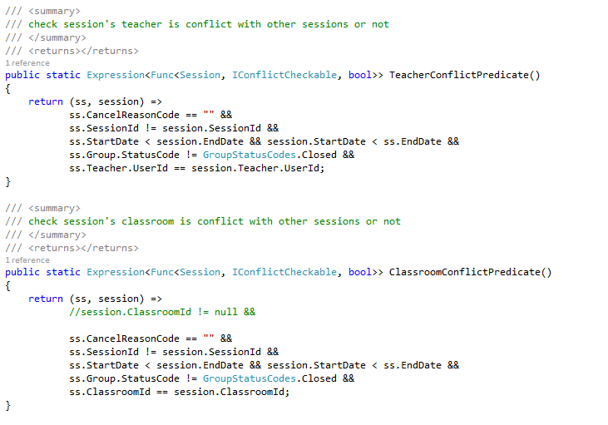
Conflict Sessions

Slide 12
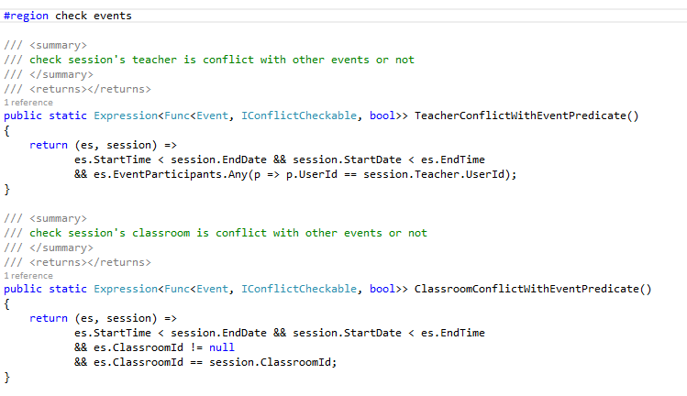
Conflict Events

Slide 13
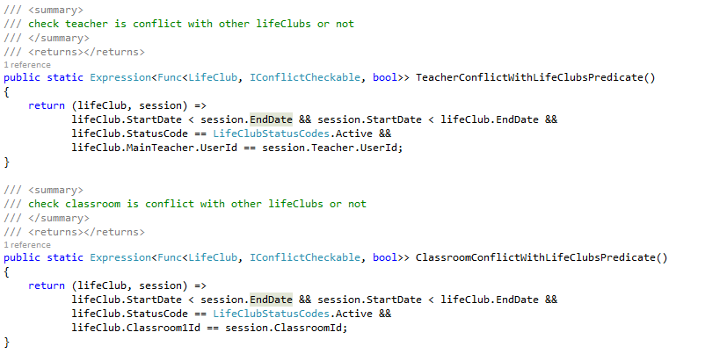
Conflict LifeClubs

Slide 14
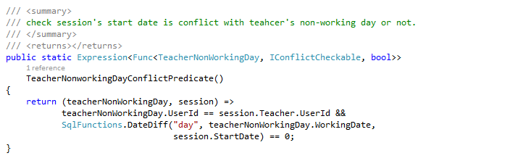
Conflict NonWorkingDay

Slide 15
Insights
Use another data structure(table) to check conflicts against.
Read/write separation
Single Responsibility Principle
Program = data structure + algorithm

Slide 16
Action
Create a data structure: StaffActivity, with only following fields
ClassroomId, UserId, StartTime, EndTime

Slide 17
Thinking
View?
Indexed View?
Table!
How to sync the table?

Slide 18
Sync the StaffActivity Table
Server ways
Trigger in database
Trigger in ODIN+, sending messages to queue, and window service handle the sync.
Truncate the table, and reload the whole table
Add/edit/delete records by different messages.
Discuss with other people, we thought:
1 is slow, we decide to pick 2.

Slide 19
Action
Create the StaffActivity Table.
We init the table with only future data (StartDate > now).
Because it’s not needed to check conflicts for past acivities.
Lesson table: 260W
Future data in StaffActivity: 26W

Slide 20
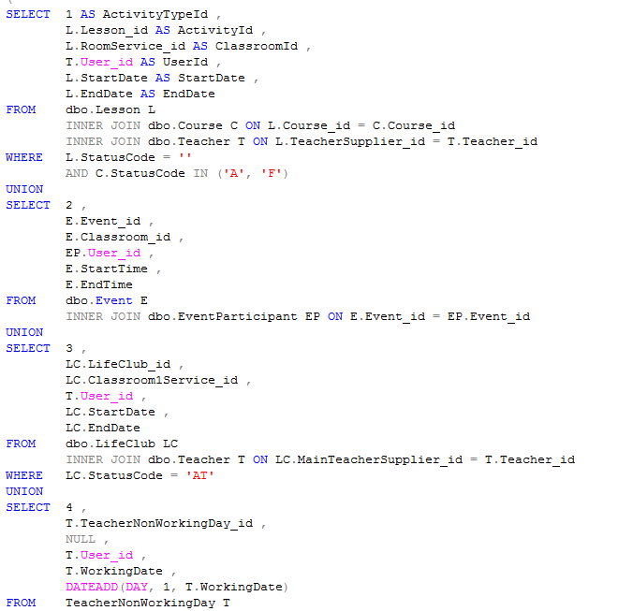
Init the StaffActivityTable

Slide 21
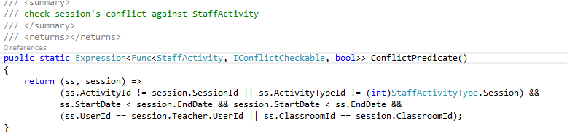
Check against StaffAcitivity

Slide 22
Create index on StaffActivity
Set statistic IO, TIME on
Logic read
Don’t trust recommended index by sql execution plan.
Create index by analyze the execution plan
More on here later…

Slide 23
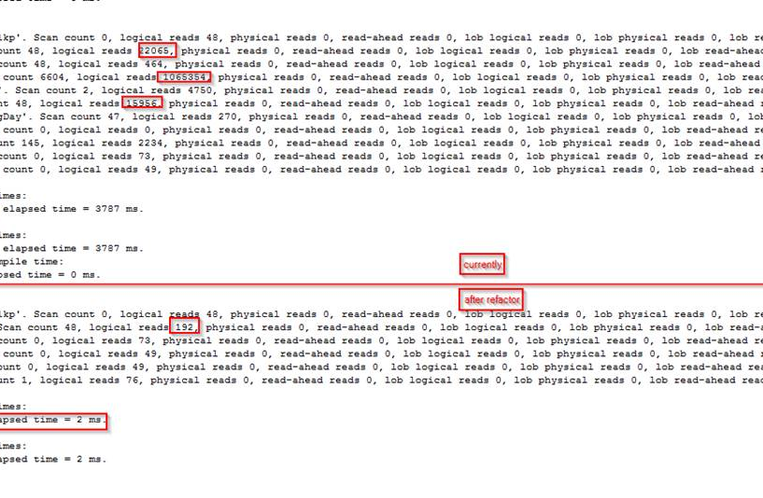
Outcome for sessions tab

Slide 24
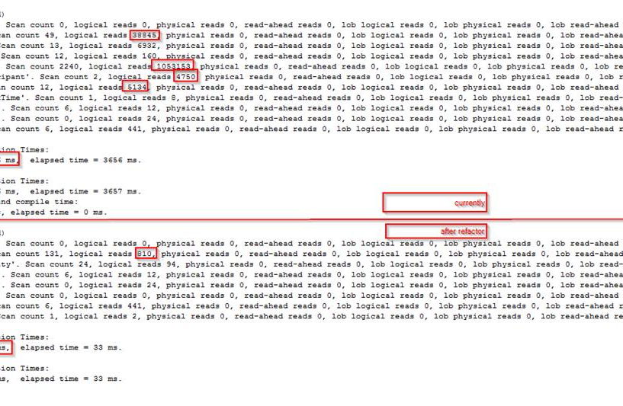
Outcome for schedule

Slide 25
Next: sync
Test the time to refresh the table (truncate and reload): 6s
it means 6s’ delay and processing(the table is not available during the processing)
We can accept 6s’ delay, but cannot accept the downtime of 6s.
Create a table: StaffActivityStaging.
Refresh StaffAcitivityStaging every 10s (no down time)
Merge(sql feature) StaffActivityStaging to StaffActivity.
Can we merge from view to StaffActivity? Yes!

Slide 26
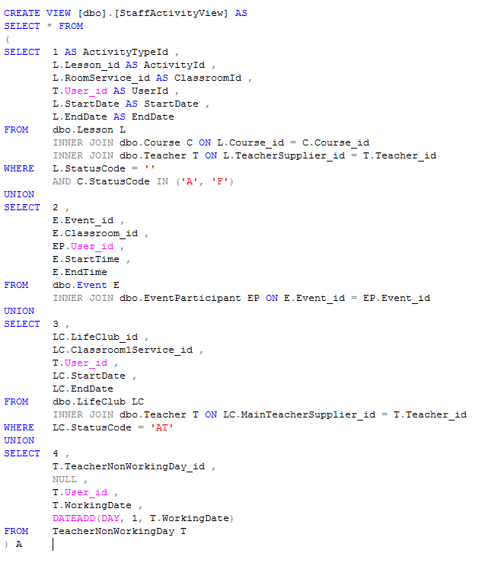
Solution: the view

Slide 27
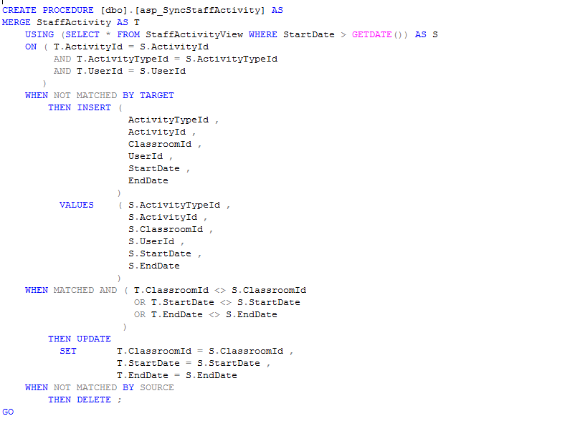
Solution: the SP to sync

Slide 28
Solution: the sql job to run the sp
Create a job to run the sp every 10s
Adjust to every 30s.

Slide 29
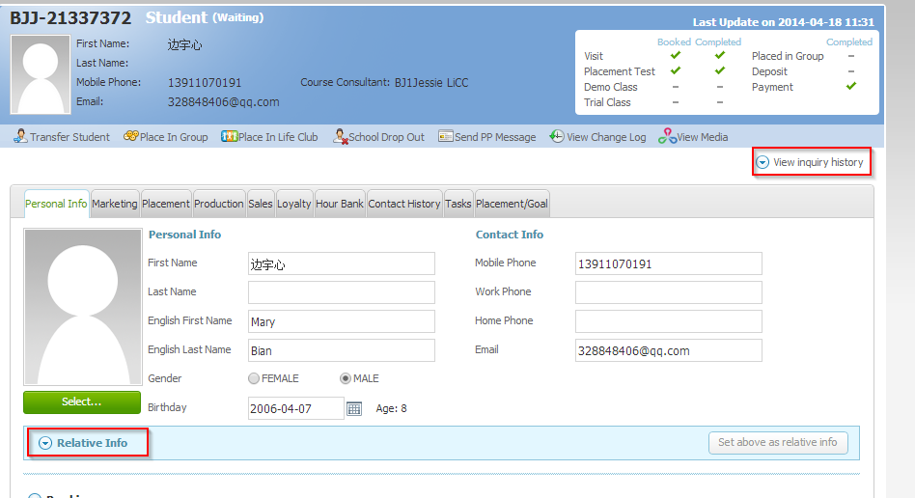
Before release, one more Action

Slide 30
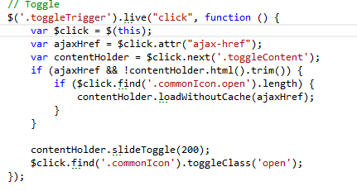
Ajax-load it

Slide 31
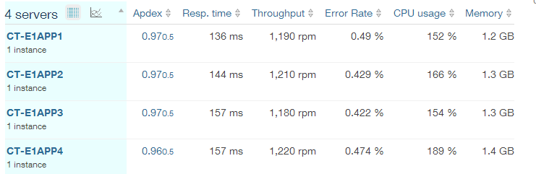
Outcome of Ajax load
Saved 500ms for each request to Contact page.
If 1 minute has 100 requests to contact page, it’s 50 seconds. 50 seconds can serve how many requests?

Slide 32
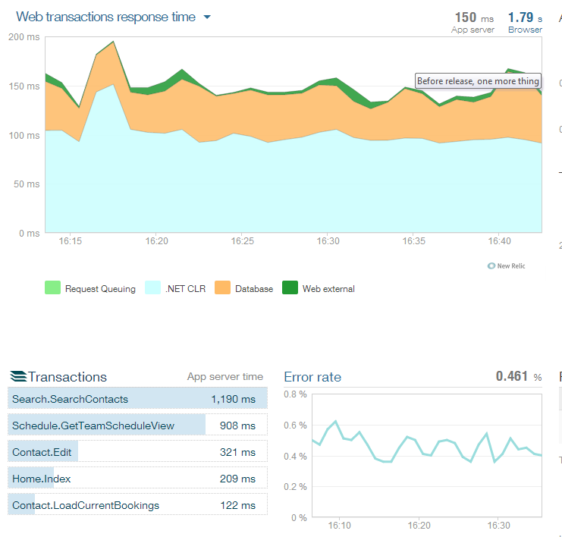
Peak time now

Slide 33
What we learnt
Load test: benchmark for max concurrent load.
Linq to entity cannot be too complex.
Context is the king.
Don’t forget the business logic.
Firmly believe in
logic read can be less than 1000, but creating index.
Will find a way.

Slide 34
Next steps
NoSql as cache layer.
Read/write separation for search/AdvancedSearch

