Slide 1
Embedded Real-Time Systems
Lecture: ARM architecture
Dimitris Metafas, Ph.D.

Slide 2
Program Translation
C program
Compiler
Assembly
Assembly
Assembler
Obj Library
Object
Linker
Executable
Loader
Memory
Source : D. Patterson,J. Hennessey Computer Organization & Design

Slide 3
Translation to Binary
Assembler
  Converts assembly to object code for each module (source file)
  Symbol table for undefined/extern references
Linker
  Searches program libraries to find library routines used by the program
  Resolves external references
Loader
  Loads the executable into memory
  Copies instructions and data from executable to memory
  Copy arguments to the program into stack
  Jumps to a start-up routine which copies program arguments from stack to registers and calls programs main routine

Slide 4
ARM Architecture

Slide 5
ARM
Founded in November 1990
  Spun out of Acorn Computers
Designs the ARM range of RISC processor cores
Licenses ARM core designs to semiconductor partners who fabricate and sell to their customers.
  ARM does not fabricate silicon itself
Also develop technologies to assist with the design-in of the ARM architecture
  Software tools, boards, debug hardware, application software, bus architectures, peripherals etc

Slide 6

ARM partnership model

Slide 7

ARM Powered Products

Slide 8
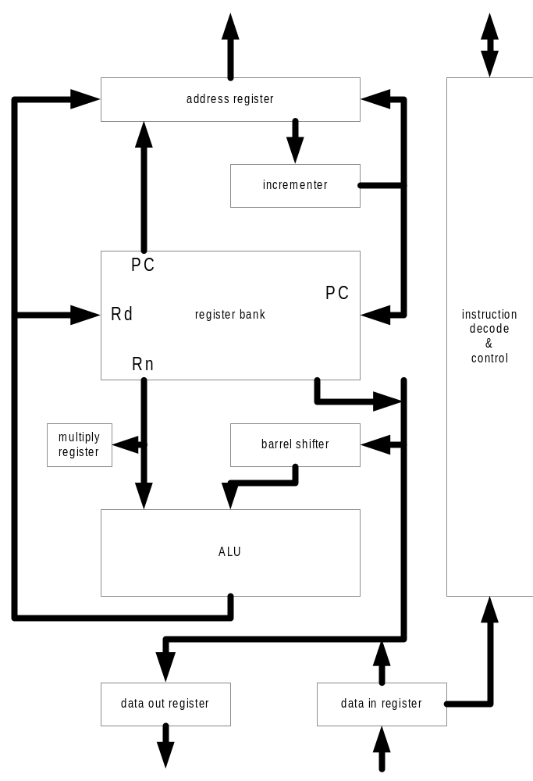
ARM architecture
Address register
Register bank
ALU
Barrel shifter
Data in/out registers

Slide 9
Data Sizes and Instruction Sets
The ARM is a 32-bit architecture.
When used in relation to the ARM:
  Byte means 8 bits
  Halfword means 16 bits (two bytes)
  Word means 32 bits (four bytes)
Most ARM’s implement two instruction sets
  32-bit ARM Instruction Set
  16-bit Thumb Instruction Set
Jazelle cores can also execute Java bytecode

Slide 10
ARM processor
ARM is a Reduced Instruction Set Computer (RISC)
  A large, regular register file
    Any register can be used for any purpose
  A load-store architecture
    Instructions which reference memory just move data, they do no processing
    Processing uses values in registers only
  Fixed-length 32-bit instructions

Slide 11
ARM based System
32 bit RAM
Peripherals
16 bit RAM
Interrupt
Controller
I/O
nIRQ
nFIQ
ARM
Core
8 bit ROM

Slide 12
AMBA bus
Arbiter
Reset
ARM
TIC
Timer
Remap/
Pause
External
ROM
External
Bus
Interface
Bus Interface
Bridge
External
RAM
On-chip
RAM
Interrupt
Controller
Decoder
AHB or ASB
APB
System Bus
Peripheral Bus

Slide 13
ARM architecture development
Improved ARM/Thumb Interworking
CLZ
5TE
Halfword and signed halfword / byte support
System mode
4
Jazelle
Java bytecode
execution
5TEJ
1
2
SA-110
Saturated maths
DSP multiply-accumulate instructions
ARM9EJ-S
ARM926EJ-S
SA-1110
ARM7EJ-S
ARM1026EJ-S
3
ARM1020E
SIMD Instructions
Multi-processing
V6 Memory architecture (VMSA)
Unaligned data support
6
Thumb instruction set
4T
Early ARM architectures
XScale
ARM7TDMI
ARM9TDMI
ARM9E-S
ARM720T
ARM940T
ARM966E-S
ARM1136EJ-S

Slide 14
Application Specific Processors based on ARM core - examples

Slide 15
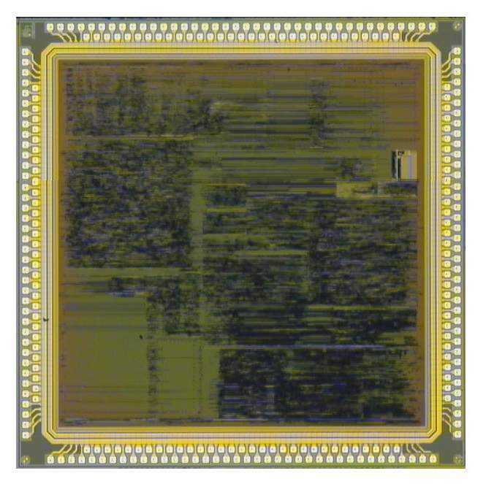
INTRACOM’s ASPIS processor
INTRACOM’s ASPIS processor

Slide 16
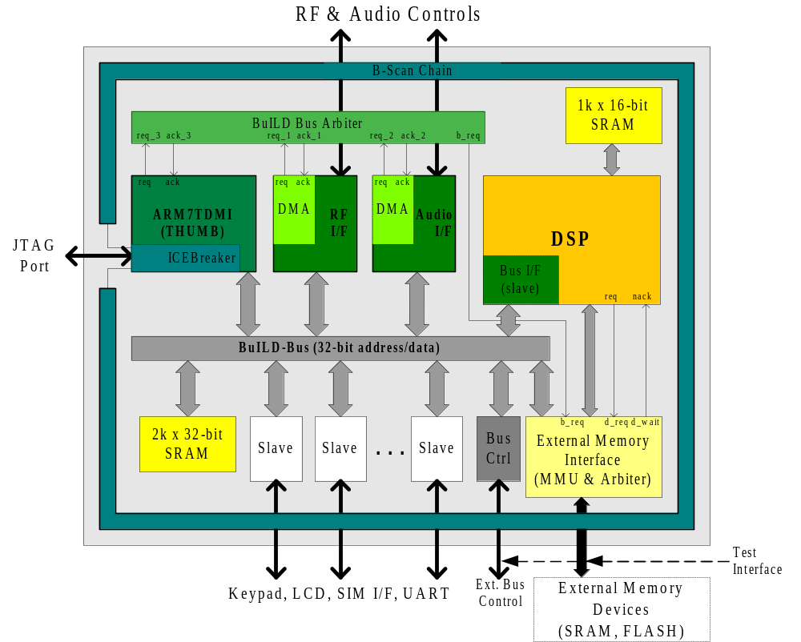
INTRACOM’s ASPIS processor

Slide 17
Application Specific processors design flow

Slide 18
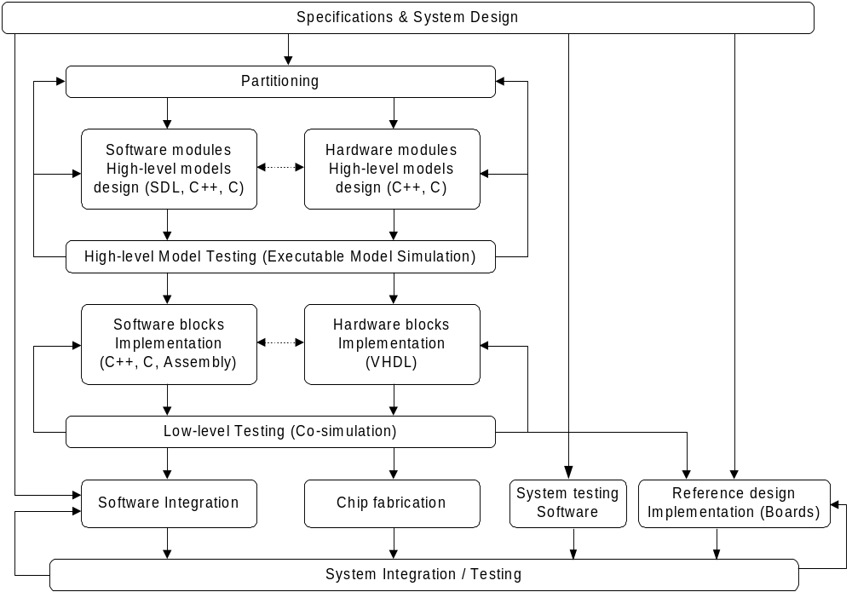
System-on-a-Chip Co-design flow

Slide 19
Cycle-accurate model of the processor
Extended Memory Map Model
Timer
Watchdog
Keypad
LCD
Buzzer
Model
Model
Model
Interface
Model
Model
ARMulator
Interrupt
Audio
RF
ARM
Controller
Interface
Interface
DSP
Core
Model
Model
Model
Model
Model
Instruction mapped
Coprocessor
Model
Extended
Build Bus Model / Bus Arbitration Model
Memory Map
Model
Internal
Static
Models
Memory
RAM
Mirror
Flash
Memory
Memory
Memory

Slide 20

Co-verification
Real-Time software group
VLSI design group
Co-processors
Memory
ARM
Mem-
Mapped
Regs
Processing
&
control
Outer
I/F
interrupt
Primitives
Test suites
VHDL
VHDL ARM model
synthesisable VHDL
SDL, C, ASM
ARM SDT, RTOS
Mentor - Modelsim
RT L VHDL
Netlist - Vital libs

Slide 21
Prototype system boards

Slide 22
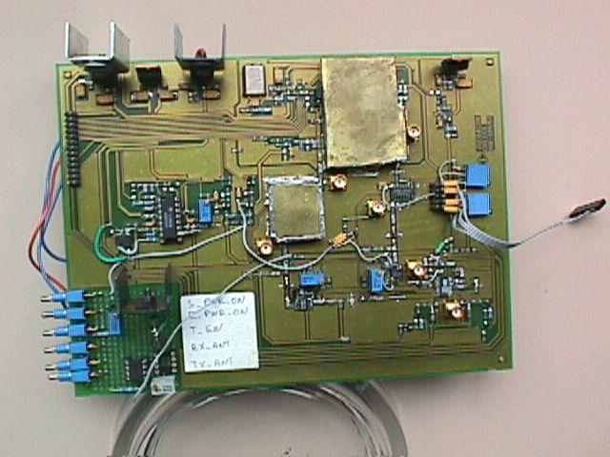
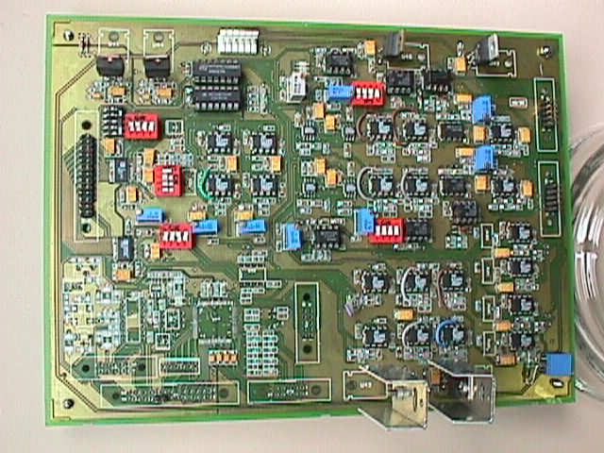
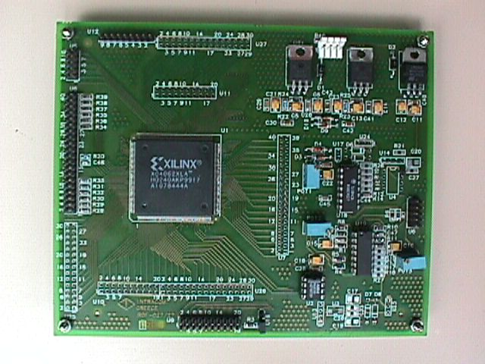
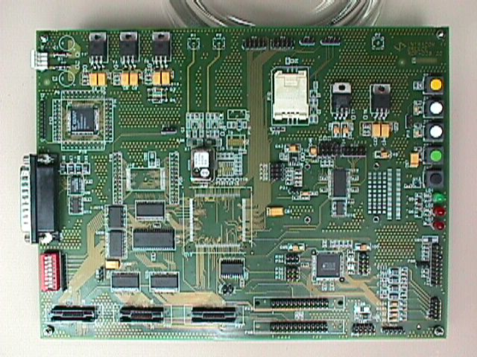
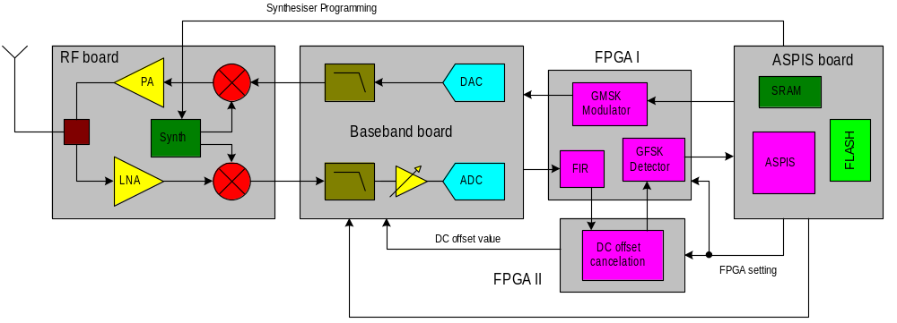
ASPIS boards

Slide 23
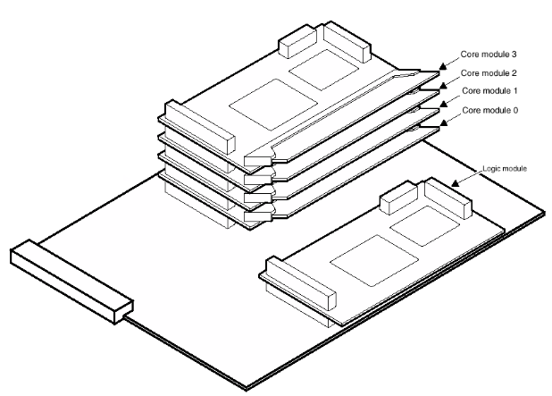
INTRACOM’s WLAN Processor
Local
PCI
Bus
Bus
Channel #1
PCI
irq
Timers, Watchdog,
Auxiliary
Channel #2
DMA
SDRAM
Controller
fiq
POCO, Aux. I/O
Channel #3
Controller
controller
&Bridge
ARM7TDMI/
ARM's DMA channel
I/O
Channel #4
ARM9TDMI
Interrupt Controller
Buffer SRAM
Local Bus #3 (Ext. System Bus)
Local Bus #1 (Protocol/CL)
AHB
AHB
Local/Cache
(Flash) ROM
Bus I/F
Bus I/F
SRAM
Test
Test Controller
AMBA
HIPERLAN/2
Port
Arbiter
Baseband
AmBa AHB (Trunk Bus)
Processor
& Modem
Chip
AHB
Bus I/F
(1)
Local Bus #2 (User Plane)
Bus Isolation
Rate-Matching
Local Bus #2 (User Plane)
Buffers (Tx/Rx)
RF-
Analog
Ctrl
Modem
ARM Integrator platform
Timers, Watchdog,
irq
(Flash) ROM
Local/Cache
I/F
/
ARM's DMA channel
fiq
SRAM
RF
Interrupt Controller
ARM7TDMI/
Front-
ARM9TDMI
End

