Slide 1
EE 319K
Introduction to Microcontrollers
Lecture 1: Introduction, Embedded Systems, ARM Programming

Slide 2
Agenda
Course Description
  Book, Labs, Equipment
  Grading Criteria
  Expectations/Responsibilities
  Prerequisites
Embedded Systems
  Microcontrollers
ARM Architecture
  Instruction Set, Memory Layout
  I/O ports and programming
  Integrated Development Environment (IDE)
Intro to C
Debugging
Notes:
To do this week: get book, order a board, {read chapters 1 and 2 of the book or ebook 2 3 4}, do ws01, HW1, install Keil uVision 4.73 on laptop

Slide 3
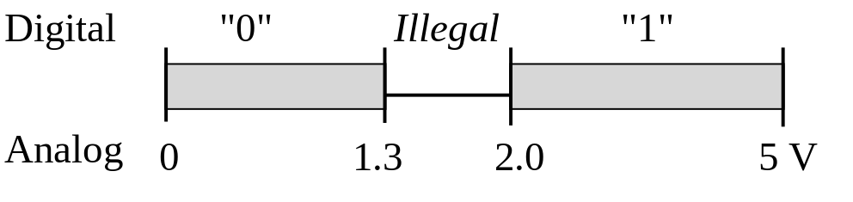
EE306 Recap: Digital Logic
AND, OR, NOT
Flip flops
Registers
Positive logic: Negative logic :
True is higher voltage True is lower voltage
False is lower voltage False is higher voltage

Slide 4
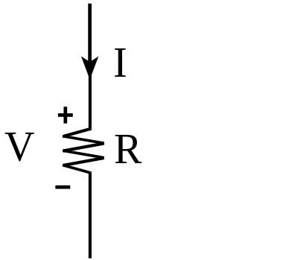
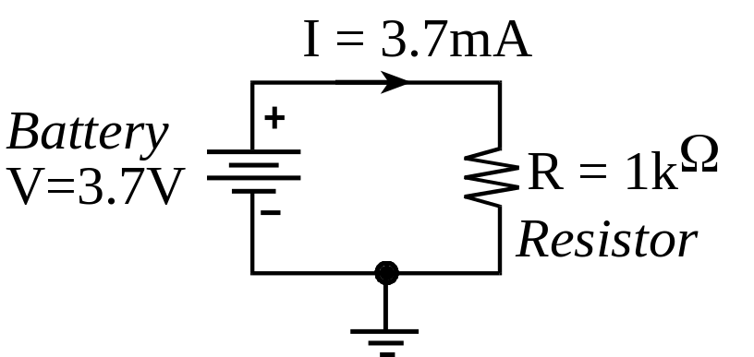
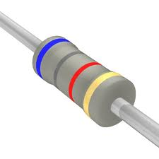
EE302 Recap: Ohm’s Law
V = I * R Voltage = Current * Resistance
I = V / R Current = Voltage / Resistance
R = V / I Resistance = Voltage / Current
P = V * I Power = Voltage * Current
P = V² / R Power = Voltage² / Resistance
P = I² * R Power = Current² * Resistance

Slide 5
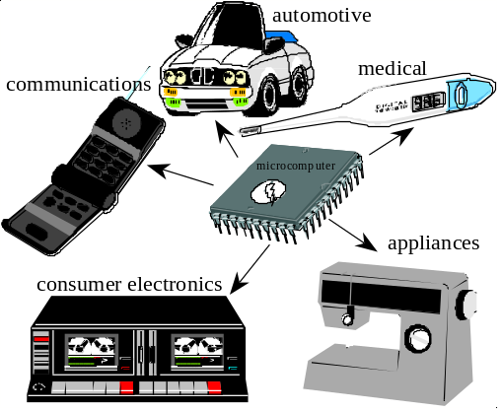
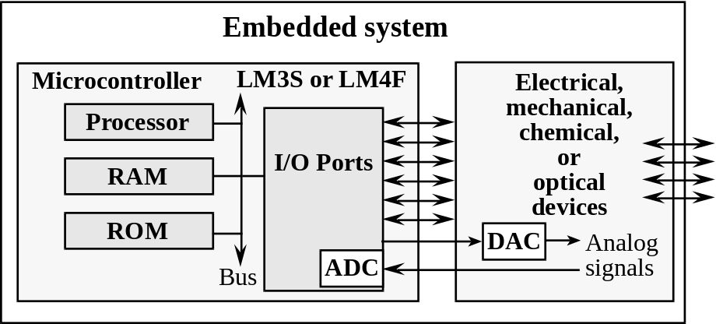
Embedded System
Embedded Systems are everywhere
  Ubiquitous, invisible
  Hidden (computer inside)
  Dedicated purpose
MicroProcessor
  Intel: 4004, ..8080,.. x86
  Motorola: 6800, .. 6812,.. PowerPC
  ARM, DEC, SPARC, MIPS, PowerPC, Natl. Semi.,…
MicroController
  Processor+Memory+
  I/O Ports (Interfaces)
Notes:
Consumer electronics: Washing machine, Exercise equipment, Remote controls, Clocks and watches, Games and toys, Audio/video electronics, Set-back thermostats, Camera, Camcoder, Television, VCR, cable box
Communication systems: Answering machines, Telephones, Fax machines, Radios, Cellular phones, pagers
Automotive systems: Automatic breaking, Noise cancellation, Locks, Electronic ignition, Power windows and seats, Cruise control, Collision avoidance, Climate control, Emission control, Instrumentation
Military hardware: Smart weapons, Missile guidance systems, Global positioning systems, Surveillance systems
Business applications: Cash registers, Vending machines, ATM machines, Traffic controllers, Industrial robots, Bar code readers and writers, Automatic sprinklers, Elevator controllers, RFID systems, Lighting and heating systems
Medical devices: Monitors, Drug delivery systems, Cancer treatments, Pacemakers, Prosthetic devices, Dialysis machines

Slide 6
Embedded Systems
A reactive system continuously
  accepts inputs
  performs calculations
  generates outputs
A real time system
  Specifies an upper bound on the time required to perform the input/calculation/output in reaction to external events

Slide 7
Microcontroller
Processor – Instruction Set
  CISC vs. RISC
Memory
  Non-Volatile
    ROM
    EPROM, EEPROM, Flash
  Volatile
    RAM (DRAM, SRAM)
Interfaces
  H/W: Ports
  S/W: Device Driver
  Parallel, Serial, Analog, Time
I/O
  Memory-mapped vs. I/O mapped
Notes:
Processor
There are two classifications of computers: complex instruction set computer (CISC) and reduced instruction set computer (RISC). In reality, there is a spectrum of architectures that we can classify as CISC or RISC. We make these general observations when deciding whether to call a computer CISC or RISC:
Complex instruction set computers (CISC)
Early computers offered CPUs that were much faster than available memories.
Fetching instructions limited performance
A single complex instruction could perform many operations
Example: Find the zeros of a polynomial
Complex instructions require many processor clock cycles to complete and most instructions can access memory
A program running on a CISC computer employed a relatively small number of complex instructions
High code density, many instruction types w/ varying length, fewer and specialized registers, many addressing modes
Complexity is embedded in the processor hardware (overhead)
Examples: Intel (x86), Freescal 9S12
Reduced Instruction Set Computers (RISC)
Memories match CPU speed
No large penalty for instruction fetch
Instructions simplified
Example: dedicated load/store instructions, regular instructions can not access memory but only registers
Single processor clock cycle per instruction (pipelined)
A program running on a RISC computer employs a relatively larger number of simplified instructions
Reduced code density, few instructions w/ fixed delay (pipeline!), many identical general-purpose registers, few addressing modes
Complexity exists in the assembly code generated by the programmer or compiler, hardware is simple (low overhead/low power)
Examples: LC3, MIPS, ARM, SPARC, PowerPC
Which architecture is best is beyond the scope of this class, but it is important to recognize the terminology. It is very difficult to compare the execution speed of two computers, especially between a CISC and a RISC. One way to compare is to run a benchmark program on both, and measure the time it takes to execute.
Time to execute benchmark = Instructions/program * Average cycles/instruction * Seconds/cycle For example, the 50 MHz ARM Cortex M has one bus cycle every 20ns. One average it may require 1.5 cycles per instruction. If the benchmark program executes 10,000,000 assembly instructions, then the time to execute the benchmark will be 0.3 seconds.
Memory:
EPROMs are Erasable Programmable ROMs. The mechanism used to erase and write is UV light
EEPROMs are Electrically Erasable
Flash memory is like EEPROM however writes are performed in large blocks as opposed to single bytes. Cheaper hence popular
DRAMs require a periodic refresh SRAMs don’t. Both are volatile therefore are lost when powered down.
Interfaces:
Parallel - binary data is available simultaneously on groups of lines
Serial - binary data is available one bit at a time on a single line
Analog - data is encoded as a variable voltage
Time - data is encoded as a period, frequency, pulse width or phase shift
I/O
Memory-mapped I/O
I/O ports/registers appear as addresses on common bus with memory
I/O ports/registers are accessed as though they are locations in memory
Employed on the ARM, Freescale and TI processors
I/O-mapped I/O
I/O ports/registers have separate control signals from those used with memory
Special instructions are used to access I/O ports/registers
Employed on Intel x86 processors

Slide 8
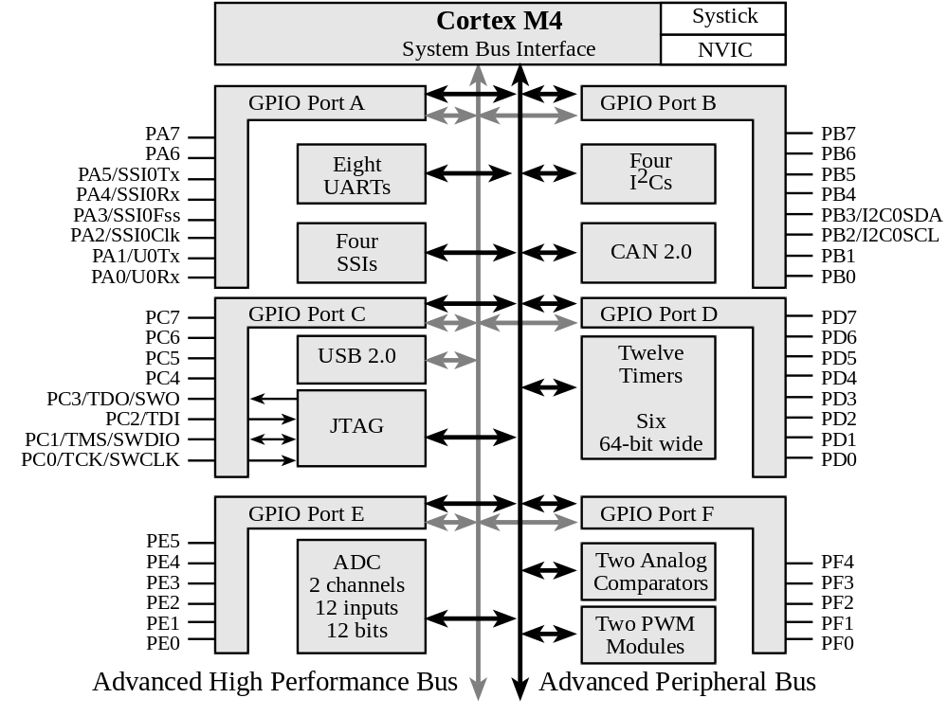
Texas Instruments TM4C123
ARM Cortex-M4
+ 256K EEPROM
+ 32K RAM
+ JTAG
+ Ports
+ SysTick
+ ADC
+ UART

Slide 9
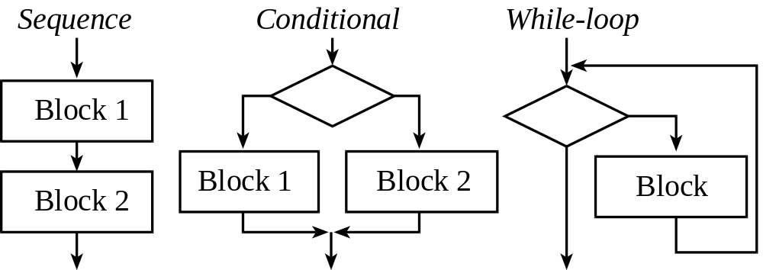
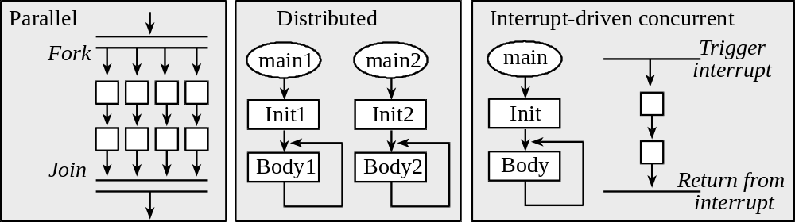
Structured Programming
Common Constructs (as Flowcharts)
Notes:
The Fork-Join construct is used in Parallel programming. This is different from multi-threading used in concurrent (Distributed) programming. In multi-threading there may be multiple threads that are active but at any given instant only one of them is being executed.
In desktop systems that have multiple cores and parallel computers with several processors, multiple threads can be simultaneously executed.

Slide 10
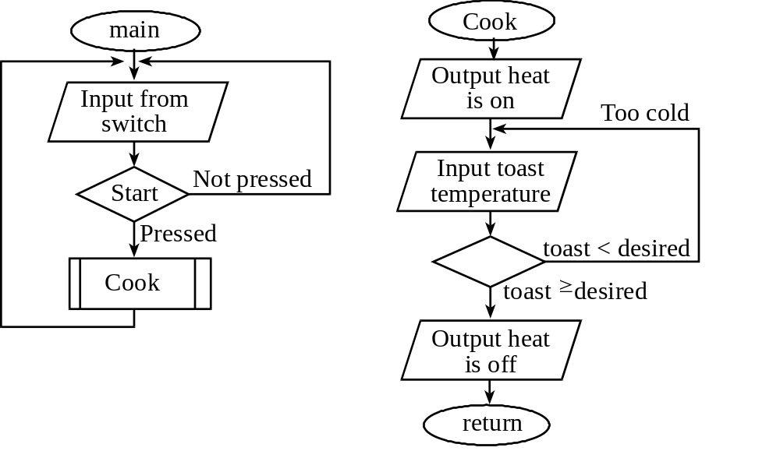
Flowchart
Toaster oven:
Coding in assembly and/or high-level language (C)

Slide 11
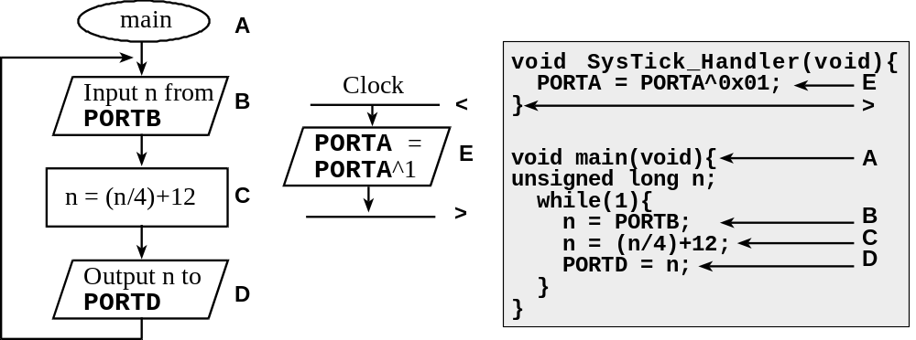
Flowchart
Example 1.3. Design a flowchart for a system that performs two independent tasks. The first task is to output a 20 kHz square wave on PORTA in real time (period is 50 ms). The second task is to read a value from PORTB, divide the value by 4, add 12, and output the result on PORTD. This second task is repeated over and over.
Notes:
< : Hardware Interrupt causing the main program to be suspended and the corresponding ISR to execute
> : Return from Interrupt causing the control to be returned to the point where the main program was suspended.
The execution sequence of this simple system might be something like: ABCDB<E>CDBC<E>DBCD<E>BCD…
We say this code is multi-threaded because we have two threads: The foreground thread computes the primes and the background thread issues a pulse. They are both active at the same time.

Slide 12
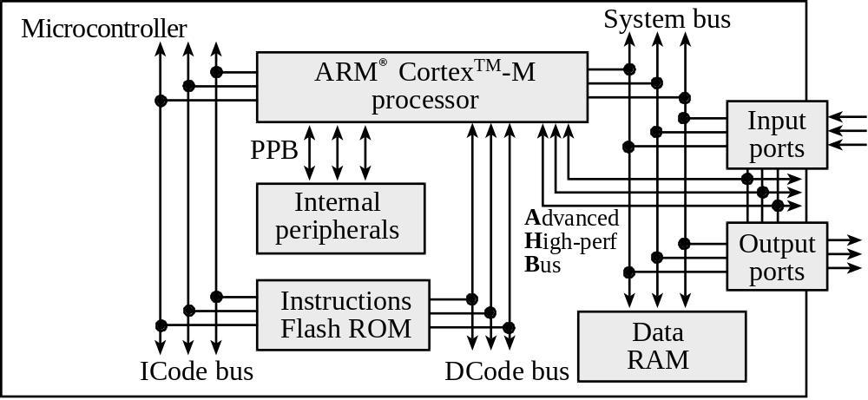
ARM Cortex M4-based System
ARM Cortex-M4 processor
Harvard architecture
  Different busses for instructions and data
RISC machine
  Pipelining effectively provides single cycle operation for many instructions
  Thumb-2 configuration employs both 16 and 32 bit instructions
Notes:
The LC3 computer from EE 306 had an address space of 64Ki and an addressability of 16-bit for a total of 128KiB. The Memory Address Register (MAR) is 16 bits and the Memory Data Register (MDR) is also 16-bits.
Vs.
On the ARM, the MAR is still 32-bits. Total addressable memory is 4GiB. It has flexible addressability (bit,byte-8bits,halfword-16bits,word-32bits)

Slide 13
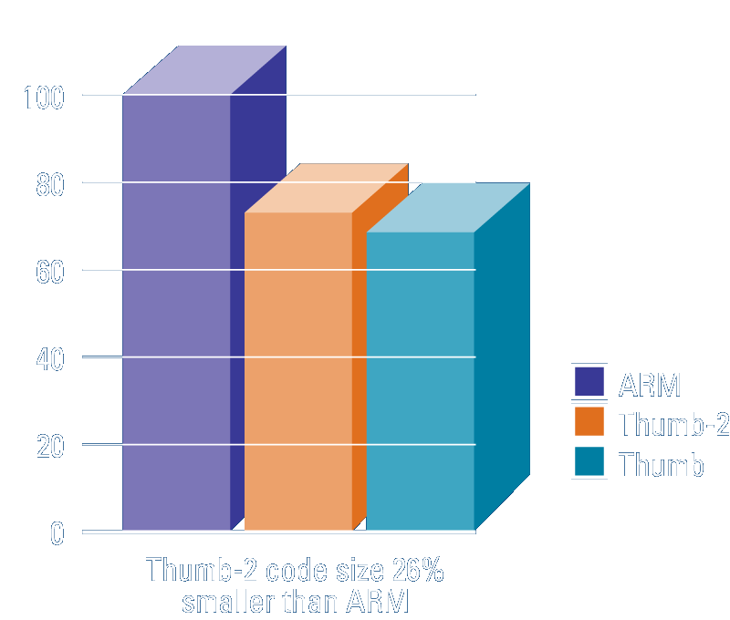
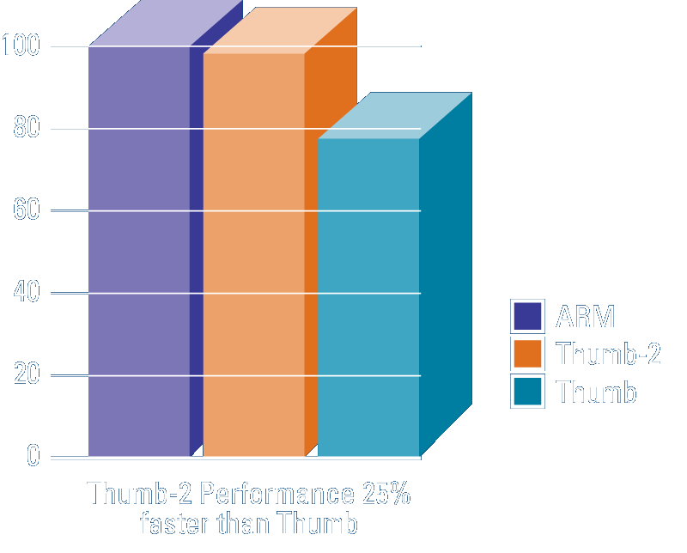
ARM ISA: Thumb2 Instruction Set
Variable-length instructions
  ARM instructions are a fixed length of 32 bits
  Thumb instructions are a fixed length of 16 bits
  Thumb-2 instructions can be either 16-bit or 32-bit
Thumb-2 gives approximately 26% improvement in code density over ARM
Thumb-2 gives approximately 25% improvement in performance over Thumb

Slide 14
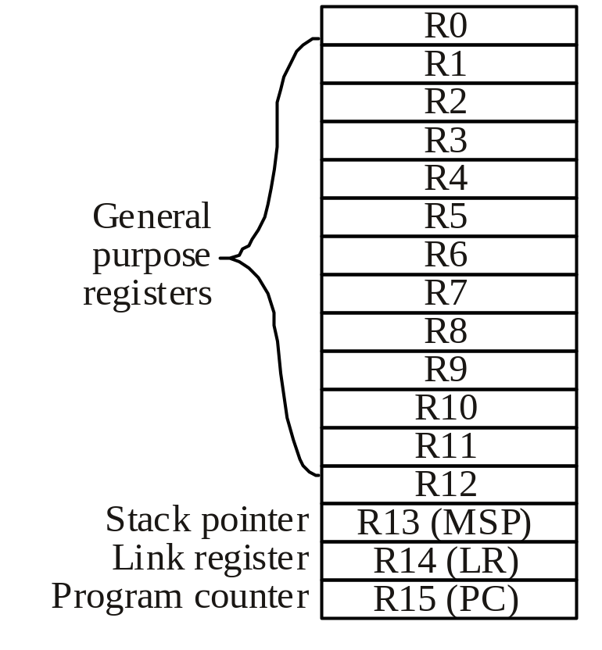
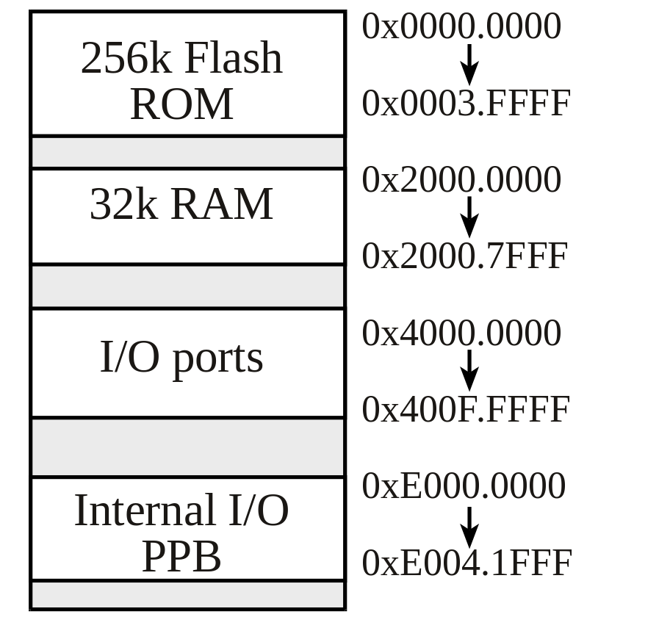
ARM ISA: Registers, Memory-map
Condition Code Bit s Indicates
N negative Result is negative
Z zero Result is zero
V overflow Signed overflow
C carry Unsigned overflow
TI TM4C123
Microcontroller
Notes:
The PC points to the address of the current instruction (Program Counter)
The Link Register is akin to Register R7 in LC3 used to store the return address on subroutine calls.
The stack is a temporary storage implemented in the RAM. We push and pop elements onto and off the stack as we desire. The stack pointer (SP) keeps track of the current location of the “top” of the stack.
The CC (condition-code) bits contains codes that reflect the results of the most recent instruction. Many “branch” type instructions “test” these bits for their operation. The Program Status Register (PSR) has them.

Slide 15
Input/Output: TM4C123
6 General-Purpose I/O (GPIO) ports:
Four 8-bit ports (A, B, C, D)
One 6-bit port (E)
One 5-bit port (F)

Slide 16
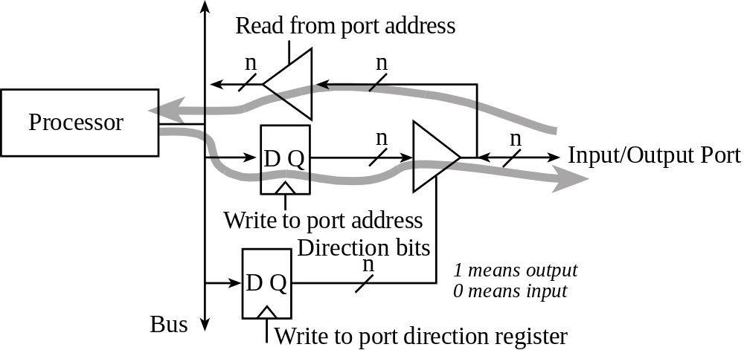
I/O Ports and Control Registers
GPIO_PORTF_DATA_R
GPIO_PORTF_DIR_R
The input/output direction of a bidirectional port is specified by its direction register.
GPIO_PORTF_DIR_R , specify if corresponding pin is input or output:
  0 means input
  1 means output

Slide 17
I/O Ports and Control Registers
Address | 7 | 6 | 5 | 4 | 3 | 2 | 1 | 0 | Name
400F.E608 | - | - | GPIOF | GPIOE | GPIOD | GPIOC | GPIOB | GPIOA | SYSCTL_RCGCGPIO_R
4002.53FC | - | - | - | DATA | DATA | DATA | DATA | DATA | GPIO_PORTF_DATA_R
4002.5400 | - | - | - | DIR | DIR | DIR | DIR | DIR | GPIO_PORTF_DIR_R
4002.5420 | - | - | - | SEL | SEL | SEL | SEL | SEL | GPIO_PORTF_AFSEL_R
4002.551C | - | - | - | DEN | DEN | DEN | DEN | DEN | GPIO_PORTF_DEN_R
Initialization (executed once at beginning)
  Turn on clock in SYSCTL_RCGC2_R
  Delay for clock to stabilize
  Set DIR to 1 for output or 0 for input
  Clear AFSEL bits to 0 to select regular I/O
  Set DEN bits to 1 to enable data pins
Input/output from pin
  Read/write GPIO_PORTF_DATA_R
Notes:
The lines marked in red are “leagacy code” the next slide shows what the new way is.
If we are using portF pin 0 or portD pin 7, we have to perform an additional step to unlock these ports by writing the following:
GPIO_PORTF_LOCK_R = 0x4C4F434B; // *) unlock GPIO Port F
GPIO_PORTD_LOCK_R = 0x4C4F434B; // *) unlock GPIO Port D

Slide 18
I/O Ports and Control Registers
Address | 7 | 6 | 5 | 4 | 3 | 2 | 1 | 0 | Name
400F.E608 | - | - | GPIOF | GPIOE | GPIOD | GPIOC | GPIOB | GPIOA | SYSCTL_RCGCGPIO_R
4002.53FC | - | - | - | DATA | DATA | DATA | DATA | DATA | GPIO_PORTF_DATA_R
4002.5400 | - | - | - | DIR | DIR | DIR | DIR | DIR | GPIO_PORTF_DIR_R
4002.5420 | - | - | - | SEL | SEL | SEL | SEL | SEL | GPIO_PORTF_AFSEL_R
4002.551C | - | - | - | DEN | DEN | DEN | DEN | DEN | GPIO_PORTF_DEN_R
Initialization (executed once at beginning)
  Turn on clock in SYSCTL_RCGCGPIO_R
  Wait for clock to stabilize
  Set DIR to 1 for output or 0 for input
  Clear AFSEL bits to 0 to select regular I/O
  Set DEN bits to 1 to enable data pins
Input/output from pin
  Read/write GPIO_PORTF_DATA_R
Notes:
If we are using portF pin 0 or portD pin 7, we have to perform an additional step to unlock these ports by writing the following:
GPIO_PORTF_LOCK_R = 0x4C4F434B; // *) unlock GPIO Port F
GPIO_PORTD_LOCK_R = 0x4C4F434B; // *) unlock GPIO Port D

Slide 19
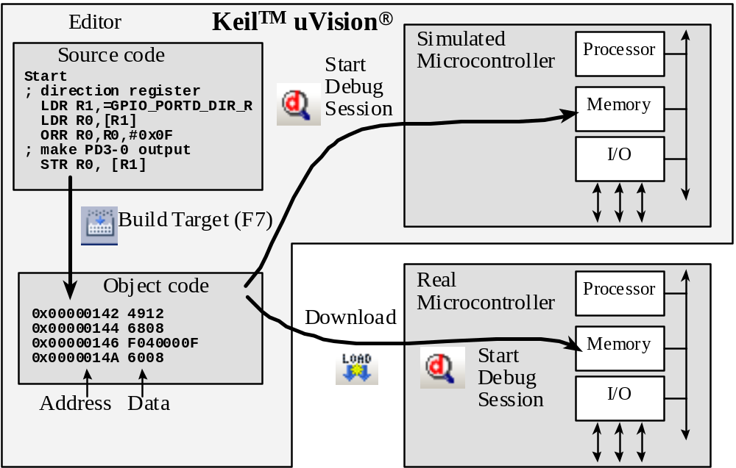
SW Development Environment

Slide 20
Introduction to C
C is a high-level language
  Abstracts hardware
  Expressive
  Readable
  Analyzable
C is a procedural language
  The programmer explicitly specifies steps
  Program composed of procedures
    Functions/subroutines
C is compiled (not interpreted)
  Code is analyzed as a whole (not line by line)

Slide 21
Why C?
C is popular
C influenced many languages
C is considered close-to-machine
  Language of choice when careful coordination and control is required
  Straightforward behavior (typically)
Typically used to program low-level software (with some assembly)
  Drivers, runtime systems, operating systems, schedulers, …

Slide 22
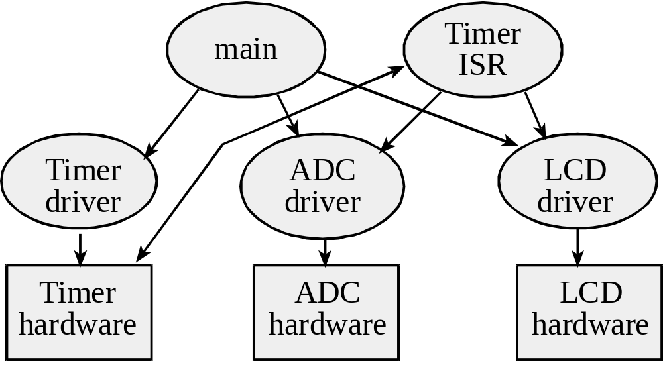
Introduction to C
Program structure
  Subroutines and functions
Variables and types
Statements
Preprocessor
DEMO

Slide 23
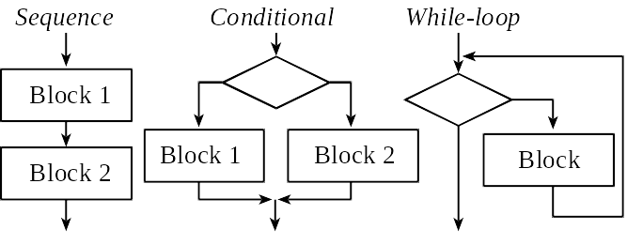
C Program (demo)
Preprocessor directives
Variables
Functions
Statements
Expressions
Names
Operators
Comments
Syntax

Slide 24
Important Notes
C comes with a lot of “built-in” functions
  printf() is one good example
  Definition included in header files
  #include<header_file.h>
C has one special function called main()
  This is where execution starts (reset vector)
C development process
  Compiler translates C code into assembly code
  Assembler (e.g. built into uVision4) translates assembly code into object code
  Object code runs on machine

Slide 25
C99 standard
C99 standard Legacy
int8_t signed 8-bit char
uint8_t unsigned 8-bit unsigned char
int16_t signed 16-bit short
uint16_t unsigned 16-bit unsigned short
int32_t signed 32-bit long
uint32_t unsigned 32-bit unsigned long
char 8-bit ASCII characters char

Slide 26
Logic Operations
A | B | A&B | A|B | A^B | A&(~B) | A|(~B)
0 | 0 | 0 | 0 | 0 | 0 | 1
0 | 1 | 0 | 1 | 1 | 0 | 0
1 | 0 | 0 | 1 | 1 | 1 | 1
1 | 1 | 1 | 1 | 0 | 0 | 1

Slide 27
Common Use
Friendly software modifies just the bits that need to be.
The or operation to set bits 1 and 0 of a register, the other six bits remain unchanged.
GPIO_PORTD_DIR_R |= 0x03; // PD1,PD0 outputs
The exclusive or operation can also be used to toggle bits.
GPIO_PORTD_DATA_R ^= 0x80; // toggle PD7
The and operation to extract, or mask, individual bits:
Pressed = GPIO_PORTA_DATA_R & 0x10;
//true if the PA6 switch pressed
Shift operations
  Right shift: >>
  Left Shift: <<

Slide 28
Debugging
Aka: Testing, Diagnostics, Verification
Debugging Actions
  Functional debugging, input/output values
  Performance debugging, input/output values with time
  Tracing, measure sequence of operations
  Profiling,
    measure percentage for tasks,
    time relationship between tasks
  Performance measurement, how fast it executes
  Optimization, make tradeoffs for overall good
    improve speed,
    improve accuracy,
    reduce memory,
    reduce power,
    reduce size,
    reduce cost
Notes:
Debugging principles
Control and observability
Can’t see everything; need to be smart when debugging

Slide 29
Debugging Intrusiveness
Intrusive Debugging
  degree of perturbation caused by the debugging itself
  how much the debugging slows down execution
Non-intrusive Debugging
  characteristic or quality of a debugger
  allows system to operate as if debugger did not exist
  e.g., logic analyzer, ICE, BDM
Minimally intrusive
  negligible effect on the system being debugged
  e.g., dumps(ScanPoint) and monitors
Highly intrusive
  print statements, breakpoints and single-stepping
Notes:
Minimally intrusive
Dumps execute faster (<1us) compared to print statements (10ms)

Slide 30
Debugging Aids in Keil
Interface
Breakpoints
Registers including xPSR
Memory and Watch Windows
Logic Analyzer, GPIO Panel
Single Step, StepOver, StepOut, Run, Run to Cursor
Watching Variables in Assembly
EXPORT VarName[DATA,SIZE=4]
Command Interface (Advanced but useful)
WS 1, `VarName,0x10
LA (PORTD & 0x02)>>1
Notes:
Commands given:
1:
WS 1, `VarName,0x10
Puts the variable called VarName in the first watch window
2:
LA (PORTD & 0x02)>>1
Puts port D pin 2 in logic anlayzer

Slide 31
… Debugging
Instrumentation: Code we add to the system that aids in debugging
  E.g., print statements
  Good practice: Define instruments with specific pattern in their names
  Use instruments that test a run time global flag
    leaves a permanent copy of the debugging code
    causing it to suffer a runtime overhead
    simplifies “on-site” customer support.
  Use conditional compilation (or conditional assembly)
    Keil supports conditional assembly
    Easy to remove all instruments
Visualization: How the debugging information is displayed
Notes:
Black box testing
Control inputs, observe outputs
White box testing
0) pick the most likely place of failure
1) desk check: conceive of what you expect will happen at each step
2) breakpoint at the start of the place
3) single step (or step over)
4) compare what actually happened to what you wanted to have happen

