Slide 1
ARM Processor cores
Prardiva Mangilipally
ELEC8200-001: Mangilipally: ARM Core
Fall 2008

Slide 2
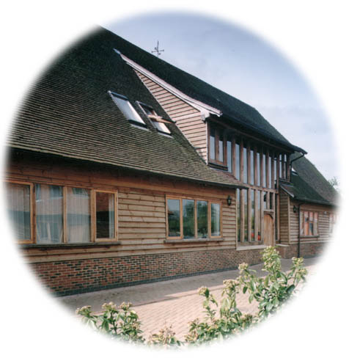
ARM Ltd
Founded in November 1990
  Spun out of Acorn Computers
Designs the ARM range of RISC processor cores
Licenses ARM core designs to semiconductor partners who fabricate and sell to their customers.
  ARM does not fabricate silicon itself
Also develop technologies to assist with the design-in of the ARM architecture
  Software tools, boards, debug hardware, application software, bus architectures, peripherals etc
ELEC8200-001: Mangilipally: ARM Core
Fall 2008
Notes:
The ARM processor core originates within a British computer company called Acorn. In the mid-1980s they were looking for replacement for the 6502 processor used in their BBC computer range, which were widely used in UK schools. None of the 16-bit architectures becoming available at that time met their requirements, so they designed their own 32-bit processor.
Other companies became interested in this processor, including Apple who were looking for a processor for their PDA project (which became the Newton). After much discussion this led to Acorn’s processor design team splitting off from Acorn at the end of 1990 to become Advanced RISC Machines Ltd, now just ARM Ltd.
Thus ARM Ltd now designs the ARM family of RISC processor cores, together with a range of other supporting technologies.
One important point about ARM is that it does not fabricate silicon itself, but instead just produces the design - we are an Intellectual Property (or IP) company. Instead silicon is produced by companies who license the ARM processor design.

Slide 3
Intoduction
Leading provider of 32-bit embedded RISC
microprocessors, 75% of market
High performance
Low power consumption
Low system cost
Solutions for
Embedded real-time systems for mass storage,
automotive, industrial and networking applications
Secure applications - smartcards and SIMs
Open platforms running complex operating systems
ELEC8200-001: Mangilipally: ARM Core
Fall 2008

Slide 4
2/3
ARMv1
First version of ARM processor
26-bit addressing, no multiply / coprocessor
ARMv2
ARM2, First commercial chip
Included 32-bit result multiply instructions /
coprocessor support
ELEC8200-001: Mangilipally: ARM Core
Fall 2008

Slide 5
3/3
ARMv2a
ARM3 chip with on-chip cache
Added load and store
cache management
ARMv3
ARM6, 32 bit addressing, virtual
memory support
ELEC8200-001: Mangilipally: ARM Core
Fall 2008

Slide 6
ARM Processor Core
Current low-end ARM core for applications like digital mobile phones
TDMI
  T: Thumb, 16-bit instruction set
  D: on-chip Debug support, enabling the processor to halt in response to a debug request
  M: enhanced Multiplier, yield a full 64-bit result, high performance
  I: EmbeddedICE hardware
Von Neumann architecture
3-stage pipeline
ELEC8200-001: Mangilipally: ARM Core
Fall 2008

Slide 7
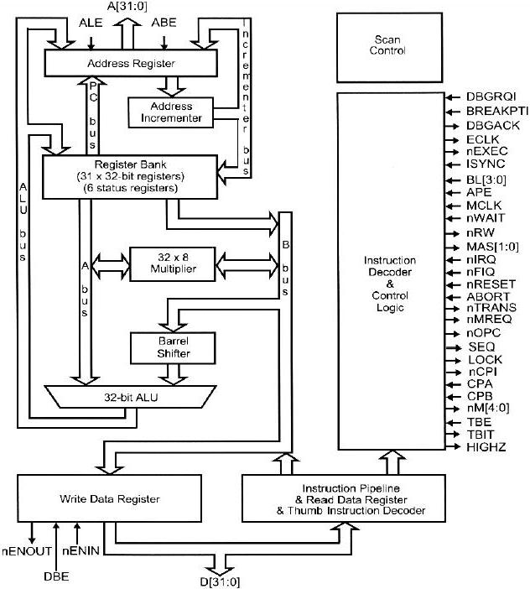
ARM Core Diagram
ELEC8200-001: Mangilipally: ARM Core
Fall 2008

Slide 8
The Registers
ARM has 37 registers all of which are 32-bits long.
  1 dedicated program counter
  1 dedicated current program status register
  5 dedicated saved program status registers
  30 general purpose registers
The current processor mode governs which of several banks is accessible. Each mode can access
  a particular set of r0-r12 registers
  a particular r13 (the stack pointer, sp) and r14 (the link register)
  the program counter, r15 (pc)
  the current program status register, cpsr
Privileged modes (except System) can also access
  a particular spsr (saved program status register)
ELEC8200-001: Mangilipally: ARM Core
Fall 2008
Notes:
The ARM architecture provides a total of 37 registers, all of which are 32-bits long. However these are arranged into several banks, with the accessible bank being governed by the current processor mode. We will see this in more detail in a couple of slides. In summary though, in each mode, the core can access:
a particular set of 13 general purpose registers (r0 - r12).
a particular r13 - which is typically used as a stack pointer. This will be a different r13 for each mode, so allowing each exception type to have its own stack.
a particular r14 - which is used as a link (or return address) register. Again this will be a different r14 for each mode.
r15 - whose only use is as the Program counter.
The CPSR (Current Program Status Register) - this stores additional information about the state of the processor:
And finally in privileged modes, a particular SPSR (Saved Program Status Register). This stores a copy of the previous CPSR value when an exception occurs. This combined with the link register allows exceptions to return without corrupting processor state.

Slide 9
DIFFERENT STATES
When the processor is executing in ARM state:
  All instructions are 32 bits wide
  All instructions must be word aligned
When the processor is executing in Thumb state:
  All instructions are 16 bits wide
  All instructions must be halfword aligned
When the processor is executing in Jazelle state:
  All instructions are 8 bits wide
  Processor performs a word access to read 4 instructions at once
ELEC8200-001: Mangilipally: ARM Core
Fall 2008
Notes:
ARM is designed to efficiently access memory using a single memory access cycle. So word accesses must be on a word address boundary, halfword accesses must be on a halfword address boundary. This includes instruction fetches.
Point out that strictly, the bottom bits of the PC simply do not exist within the ARM core - hence they are ‘undefined’. Memory system must ignore these for instruction fetches.
In Jazelle state, the processor doesn’t perform 8-bit fetches from memory. Instead it does aligned 32-bit fetches (4-byte prefetching) which is more efficient. Note we don’t mention the PC in Jazelle state because the ‘Jazelle PC’ is actually stored in r14 - this is technical detail that is not relevant as it is completely hidden by the Jazelle support code.

Slide 10
Thumb
Thumb is a 16-bit instruction set
  Optimised for code density from C code (~65% of ARM code size)
  Improved performance from narrow memory
  Subset of the functionality of the ARM instruction set
Core has additional execution state - Thumb
  Switch between ARM and Thumb using BX instruction
31
ADDS r2,r2,#1
0
For most instructions generated by compiler:
Conditional execution is not used
Source and destination registers identical
Only Low registers used
Constants are of limited size
Inline barrel shifter not used
32-bit ARM Instruction
15
ADD r2,#1
0
16-bit Thumb Instruction
ELEC8200-001: Mangilipally: ARM Core
Fall 2008
Notes:
The Thumb instruction set was designed by looking at the instructions produced by the ARM C compiler from real application code to see which instructions were most often used. This subset of instructions was then compressed into 16-bit opcodes to give better code density and better performance from narrow memory
A Thumb compatible processor is still a 32-bit processor, but it has the ability to execute either sections of ARM code or sections of Thumb code. The two instruction sets cannot be interleaved though, a special form of branch has to be used to change “state”.
The diagram then shows the way that a typical 32-bit ARM instruction might be “compressed” into a 16-bit Thumb one.

Slide 11
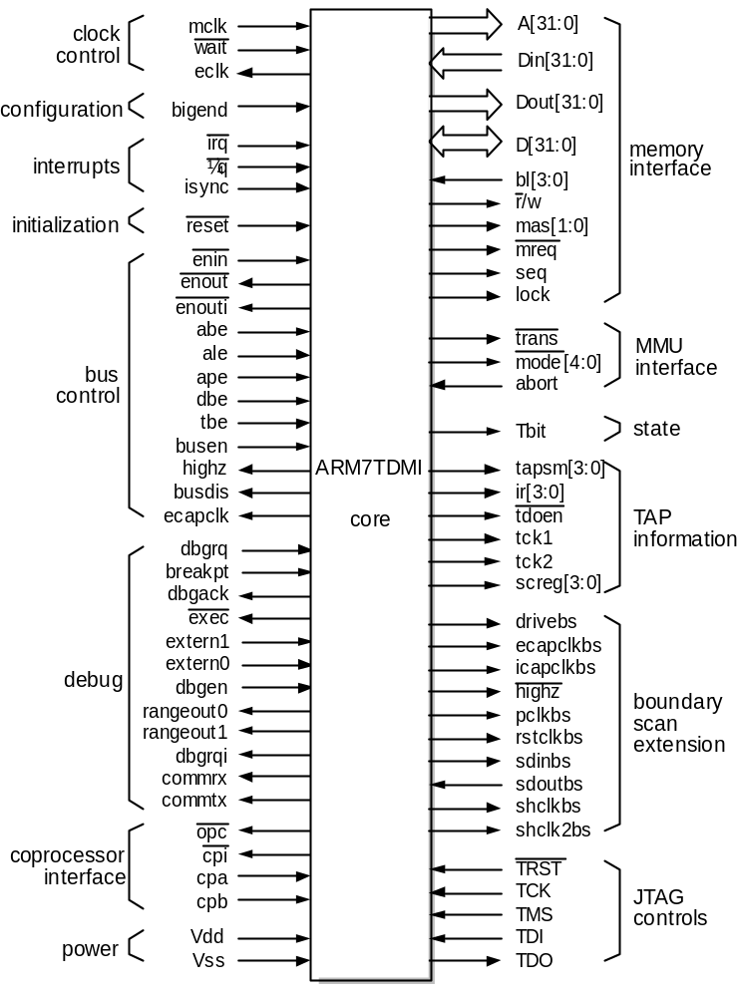
ARM Interface Signals (1/4)
ELEC8200-001: Mangilipally: ARM Core
Fall 2008

Slide 12

ARM Interface Signals (2/4)
Clock control
  All state change within the processor are controlled by mclk, the memory clock
  Internal clock = mclk AND \wait
  eclk clock output reflects the clock used by the core
Memory interface
  32-bit address A[31:0], bidirectional data bus D[31:0], separate data out Dout[31:0], data in Din[31:0]
  seq indicates that the memory address will be sequential to that used in the previous cycle
ELEC8200-001: Mangilipally: ARM Core
Fall 2008

Slide 13
ARM Interface Signals (3/4)
Interrupt
  \fiq, fast interrupt request, higher priority
  \irq, normal interrupt request
  isync, allow the interrupt synchronizer to be passed
Initialization
  \reset, starts the processor from a known state, executing from address 00000000₁₆
ARM characteristics
ELEC8200-001: Mangilipally: ARM Core
Fall 2008

Slide 14
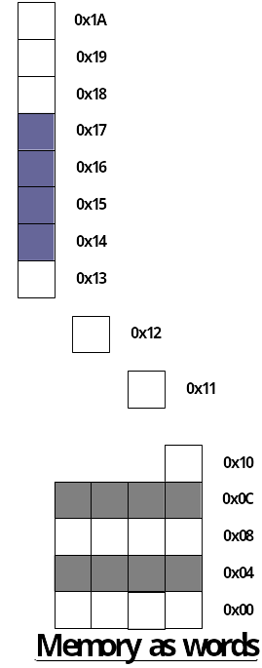
Memory Access
The ARM is a Von Neumann, load/store architecture, i.e.,
  Only 32 bit data bus for both inst. And data.
  Only the load/store inst. (and SWP) access memory.
Memory is addressed as a 32 bit address space
Data type can be 8 bit bytes, 16 bit half-words or 32 bit words, and may be seen as a byte line folded into 4-byte words
ELEC8200-001: Mangilipally: ARM Core
Fall 2008

Slide 15
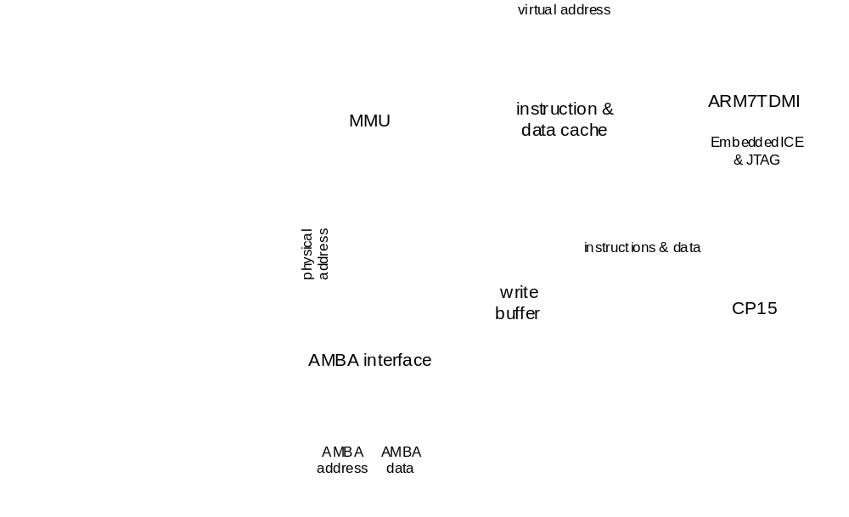
Processor Core Vs CPU Core
Processor Core
  The engine that fetches instructions and execute them
  E.g.: ARM7TDMI, ARM9TDMI, ARM9E-S
CPU Core
  Consists of the ARM processor core and some tightly coupled function blocks
  Cache and memory management blocks
  E.g.: ARM710T, ARM720T, ARM74T, ARM920T, ARM922T, ARM940T, ARM946E-S, and ARM966E-S
ARM710T
ELEC8200-001: Mangilipally: ARM Core
Fall 2008

Slide 16
References
www.arm.com
www.electronicdesign.com/Articles/ArticleID/16595/16595.html
www2.electronicproducts.com/ARM_processor_core_achieves_new_heights_in_performance_efficiency-article-poyjh02-jan200
en.wikipedia.org/wiki/ARM_architecture
ELEC8200-001: Mangilipally: ARM Core
Fall 2008

Slide 17
Thank you
ELEC8200-001: Mangilipally: ARM Core
Fall 2008

