Slide 1
LDR Sensor Module
Light Dependent Resistor Module Overview and Features

Slide 2
Description
- Detects presence and intensity of ambient light
- Digital Output (D0): HIGH when light is present, LOW when dark
- Analog Output (A0): Varies with light intensity
- Sensitivity adjustable via onboard potentiometer

Slide 3
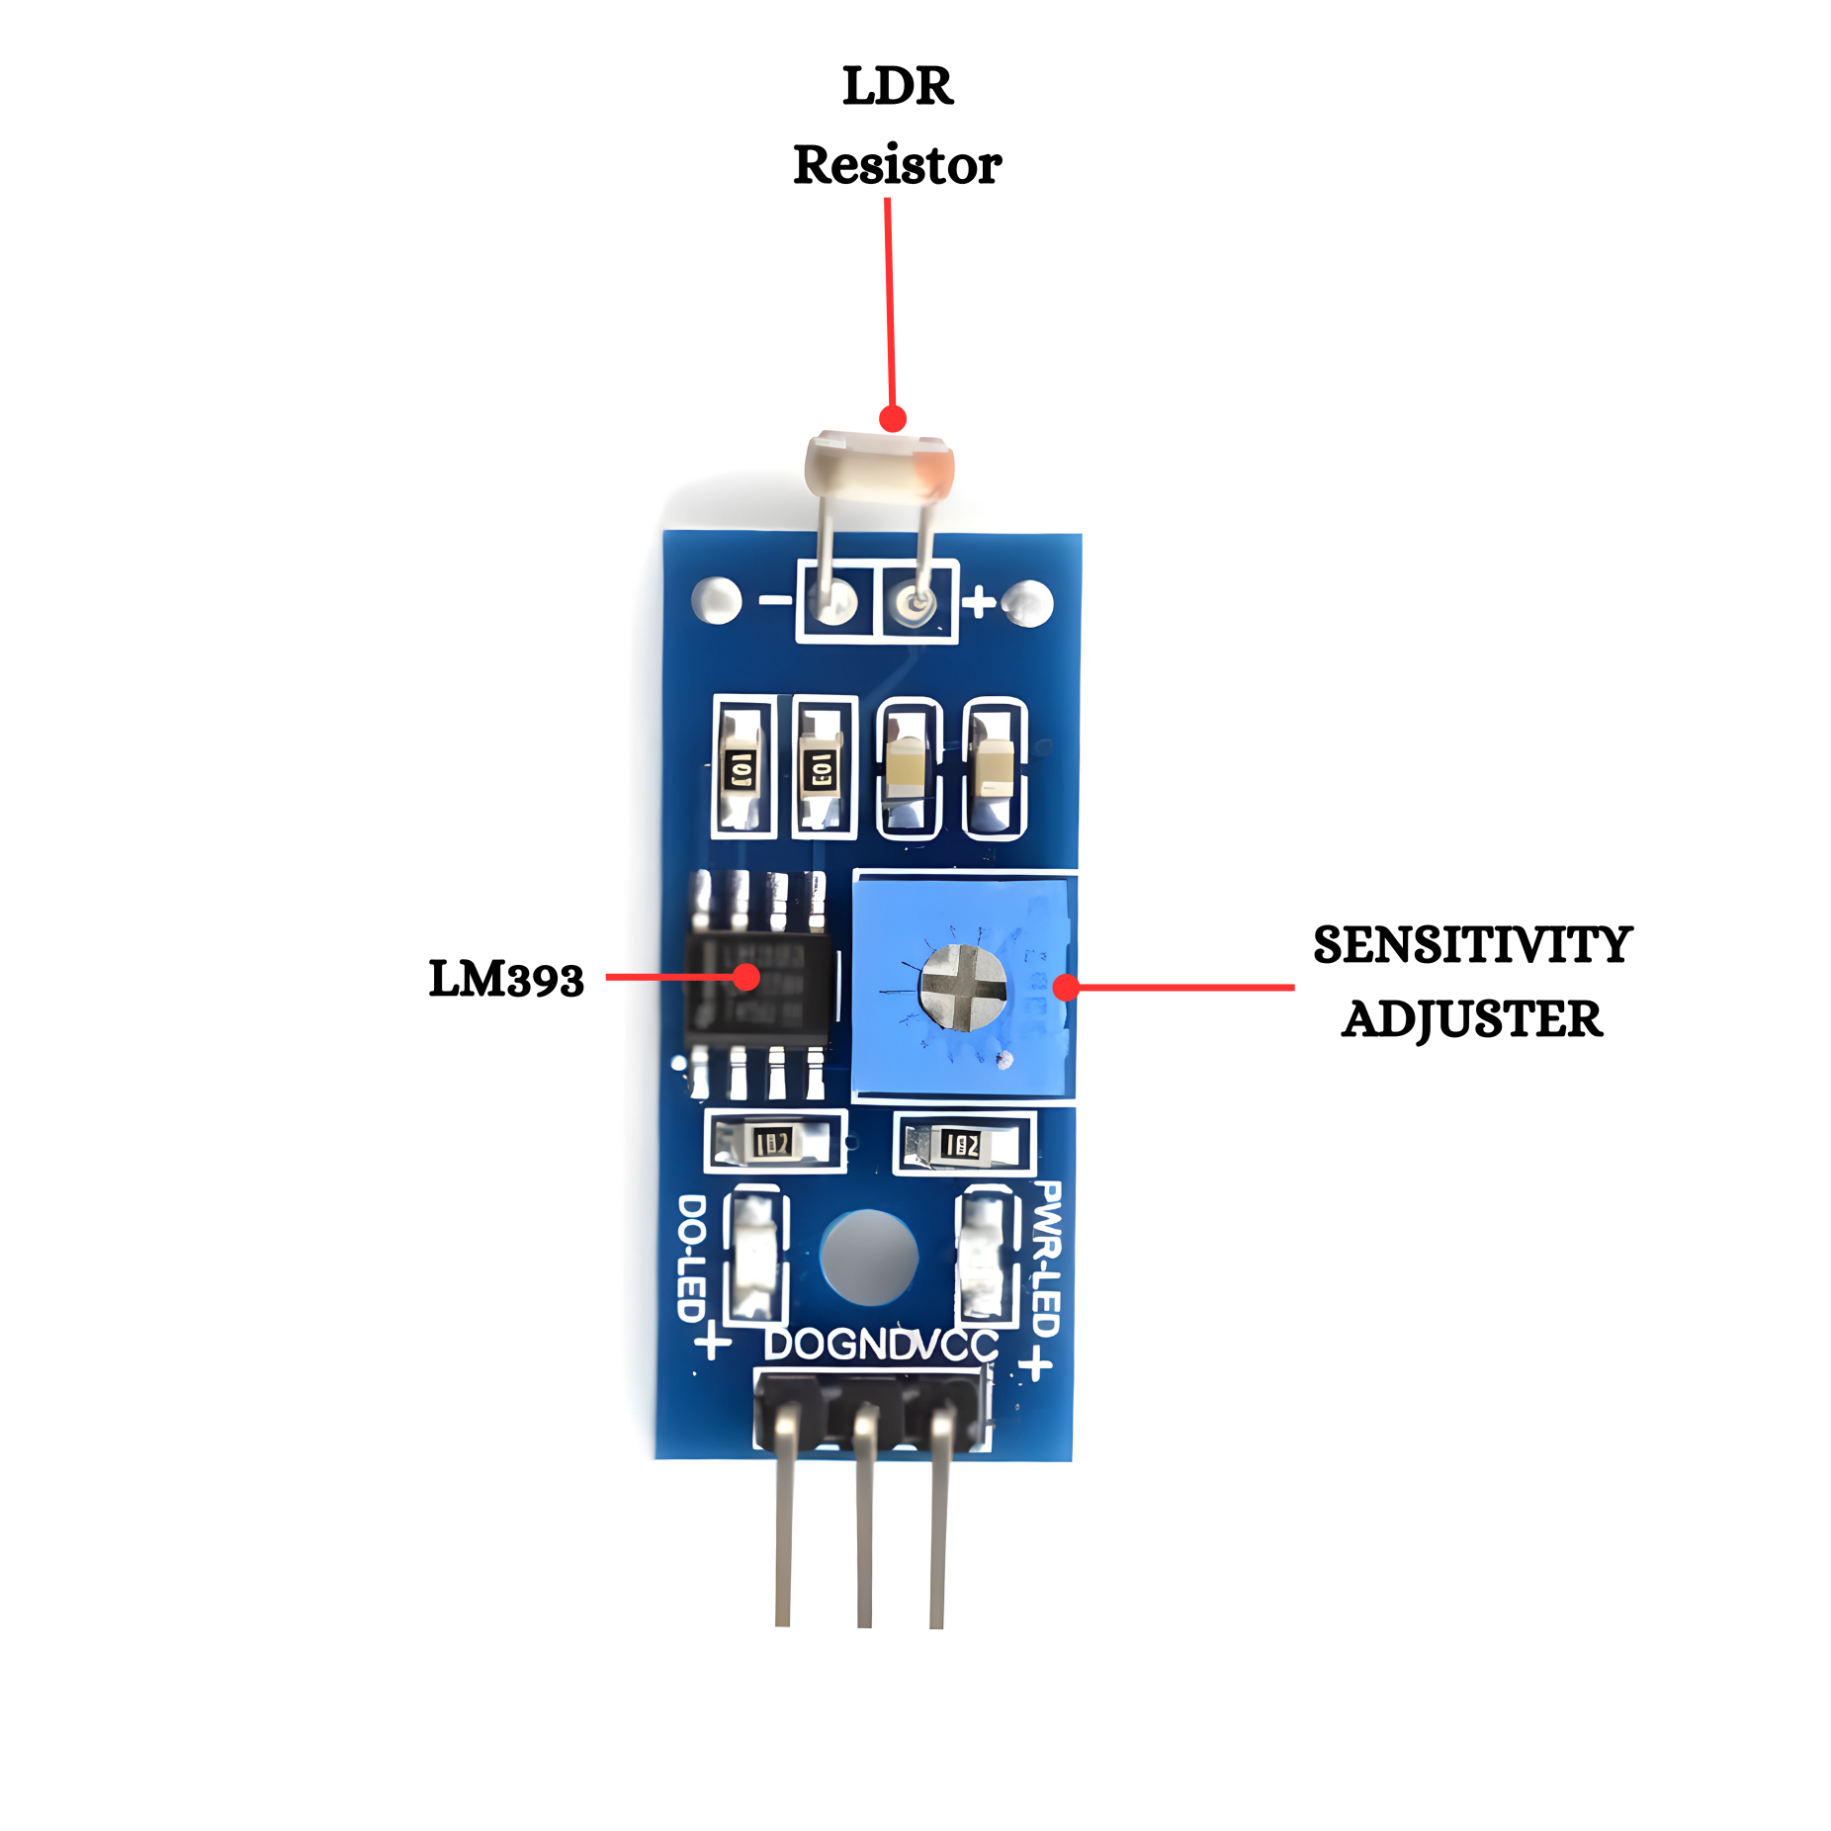
Key Features
✅ Detects brightness and light intensity.
✅ Adjustable sensitivity (blue potentiometer).
✅ Dual outputs: Analog (A0) and Digital (D0).
✅ LM393 comparator for stable switching.
✅ Power (red) and Digital Output (green)
indicators.
✅ Operating Voltage: 3.3V – 5V.

Slide 4
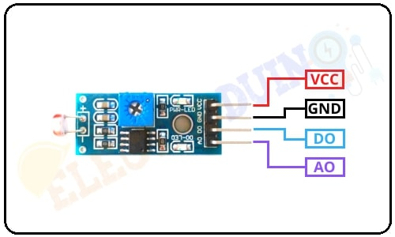
Pinout & Connections
🔌 VCC - Power Supply (3.3V–5V).
🔌 GND – Ground.
🔌 A0 - Analog Output (to ADC pin).
🔌 D0 - Digital Output (to GPIO pin).

Slide 5
How It Works
- Photoresistor changes resistance with light.
- Bright light → Low resistance → High A0 voltage.
- Darkness → High resistance → Low A0 voltage.
- D0 Output:
• Light < threshold → D0 = HIGH.
• Light > threshold → D0 = LOW.
- Potentiometer sets threshold level.
-Minimum Range = When it's dark (ADC value is low, near 0).
-Maximum Range = When it's bright (ADC value is high, near 4095).

Slide 6
Applications
1. Street Light Automation:
Use: Automatically turns ON streetlights at night and OFF during the day.
How: LDR senses darkness → microcontroller turns on light.
Industry Benefit: Saves electricity and avoids manual operation.
2. Automatic Room Light Control:
Use In smart homes and offices, lights turn ON when it's dark.
How: If LDR detects low light + motion sensor detects movement → light is switched ON.
Industry Benefit: Convenience + energy efficiency.
3. Solar Panel Tracking Systems:
Use To detect sunlight direction and adjust solar panel angles.
How: Multiple LDRs compare light intensity to rotate panels toward the sun.
Industry Benefit: Increases energy generation.
4. Brightness Control in Mobiles and Tvs:
UseAdjust screen brightness based on ambient light.
How: LDR senses light → software increases or decreases brightness.
Industry Benefit: Battery saving and better visibility.
5. Industrial Machines:
Use Detect whether safety enclosures are open (light entered) or closed (dark).
Industry Benefit: Ensures operator safety and automatic machine shutdown.
6. Agriculture Monitoring Systems:
Use Measures sunlight exposure for crops.
How: LDR sends light data → logged and analyzed to control shade systems or irrigation.
Industry Benefit: Helps in smart farming and better crop yield.

