Slide 1

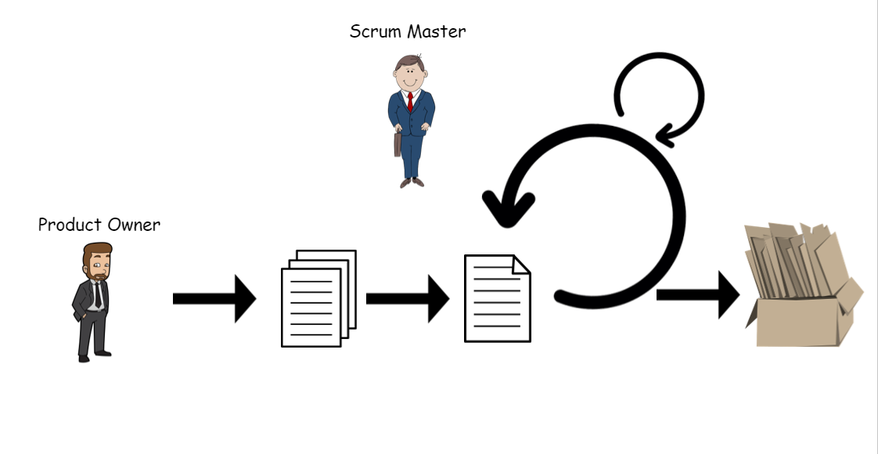






Development Team
Sprint Review
Demonstrating what the team accomplished during the sprint.
Inputs from executives, costumers, users, stakeholders
Daily
Stand up
Scrum
Master
1-4 Week Sprint
Product
Increment
(Finished Work)
Sprint
Planning
Meeting
(Goal, Scope, Selecting stories)
Product
Owner
Product
Backlog
(Ranked list of
what is required)
Sprint
Backlog
(Selected stories to complete during the Sprint)
Sprint Retronspective
What went well?
What went wrong?
Improvement Areas?

