Slide 1
Sales data

Slide 2
Introducing dataset
Segment: sectors
Country: Five countries taken- Germany, France, Mexico, USA, Canada
Product: Product purchased
Qty: total items purchased
Gross sales: sales price without deducting discount
SP: selling price after discount
COGS: cost of goods sold
Date: date of purchase

Slide 3
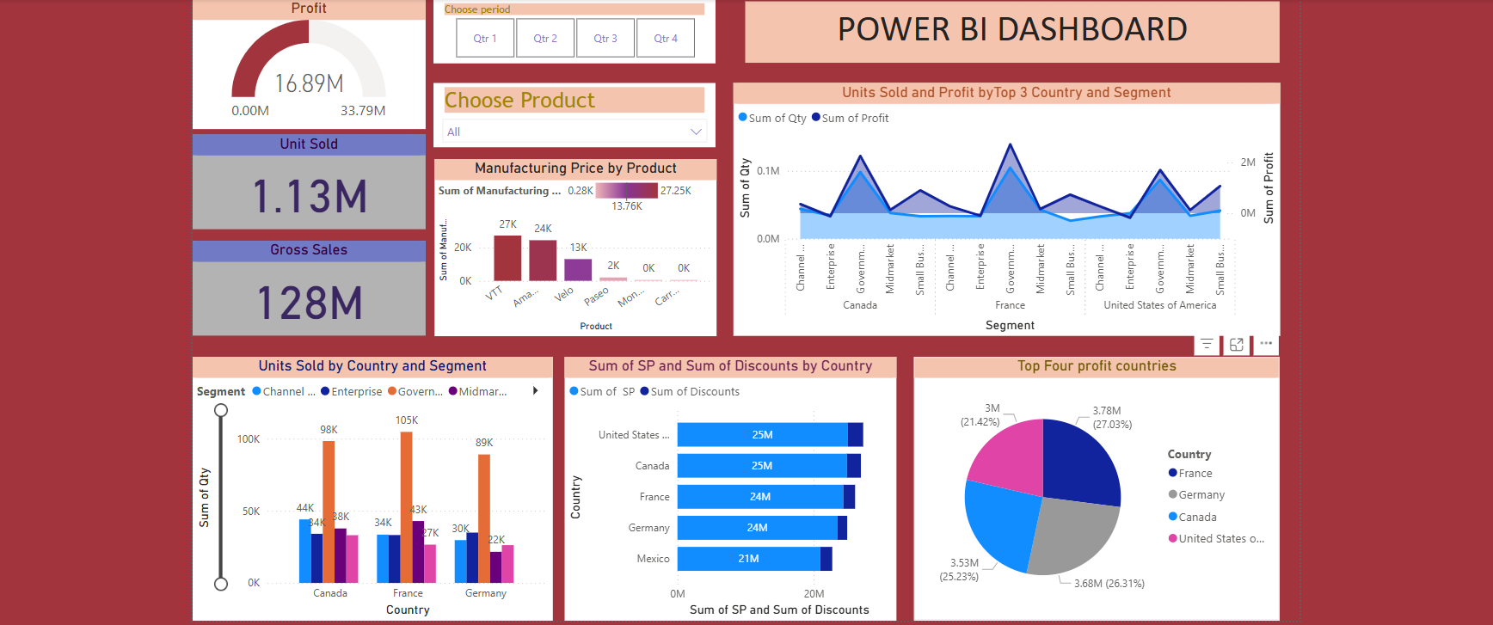
Dashboard

Slide 4
Conclusion
Unit sold: 1.13M
Gross sales: 128M
Sales Price: 119M
Profit: 16.89M
Top profit countries: France, Germany, Canada, USA
Profit segment: Government
Quarter four have high profit sales

