Slide 1
Making a Subset-Difference
Understanding the Crypto that enables AACS
Notes:
Talk Description: (25 mins)
Short description of AACS (3 mins)
Cryptographic aims ( 3mins)
Explain the broadcast encryption problem (2 mins)
Explain which bits are encrypted. (1 min)
Subset Difference Tree (18 mins)
Basic structure (8 mins)
Truck analogy ala Doom9
Improved Layer graphic
Revocation Examples (6 mins)
Given a small set, how demonstrate revoking particular users
Cryptographic implementation (4 mins)
AES based hashing (1min)
Media Key Block description and find your MK (3 mins)
Codebase on github. (1 min)

Slide 2
Disclaimer
This is based on my understanding of the AACS specification document
I have not had to fully implement it
I have not seen code for an implementation of it
I’m presenting this because I couldn’t find material to learn from.
If you know better or want to correct me, please feel free to shout up or contact me afterwards

Slide 3
What am I covering?
Brief description of AACS
Explanation of the Subset-Difference tree
  Structuring of the key system
  How it enables “efficient revocation of non-contiguous sets”
A reference codebase
Some things to help you when reading the specification
  (if I talk too fast)

Slide 4
What is AACS?
Advanced Access Content System
Started 2004, the final 0.9 revision is from Oct 2012
Anti piracy system for the “new” Blu rays and HD DVDs
  Improvement on the Content Security System (CSS) of DVDs
Collaboration of a number of big players:
  Intel, IBM, Microsoft, Panasonic, Sony, Toshiba, The Walt Disney Company, Warner Bros.
Notes:
What:
When:2004 is when the AACS LA consortium was formed
Why: Because CSS was very broken (DVDDecrypt)
Who: List above:
Side note: the AACS LA website aacsla.com seems dodgy as hell now, it wasn’t as bad earlier this year

Slide 5
Cryptographic Aims of AACS
Protect media from being accessed by un-licensed devices
Allow revocation of a device’s access
Revocation of Stateless Receivers
Should not significantly impact space available on the disc
Coalition resistant:
  a coalition of all revoked devices cannot access the media
Notes:
-- Here by 3 minutes
Revocation without updating the receiver. Revocation without consent
In media discs, space used for security is space not being used for content

Slide 6
Revocation of Stateless Receivers
“Revocation and Tracing Schemes for Stateless Receivers” Dalit Naor, Moni Naor, Jeff Lotspiech.
We do not assume any device can be remotely updated
  This accounts for malicious “non-patch” strategies
Con: We cannot retroactively revoke access
  Devices will still be able to decrypt any data recorded prior to the revocation
Notes:
What do we mean when we talk about stateless receivers?
It’s an interesting problem that we should be able to enable a set of devices to be able to decrypt a given piece of data, but that we can revoke access to latest data broadcasts later without relying on a change of receiver state.
That is the device does not not need to contain any read/writable memory and thus all encryption information is stored within the broadcast itself

Slide 7
How the media is encrypted in a brief 3 point slide
Each Title (piece of content) is encrypted with a “Title Key”
  AES-CBC of the content
A disc’s Title Keys are encrypted with the “Media Key”
The Media key can be derived by a device from it’s factory-given set of device keys.
  Unless it’s been revoked.
Notes:
”Titles” include things like menus, bonus content, etc. Each is individually encrypted on the disc
A studio may even enforce that certain titles require external keys be found on the internet (available on “Enhanced devices”)

Slide 8
Subset-Difference Tree
Notes:
Subset Difference Tree (18 mins)
Basic structure (8 mins)
Truck analogy ala Doom9
Improved Layer graphic
Revocation Examples (6 mins)
Given a small set, how demonstrate revoking particular users
Cryptographic implementation (4 mins)
AES based hashing (1min)
Media Key Block description and find your MK (3 mins)

Slide 9
The “arnezami” (of Doom9) description:
Trucks in a carpark.
Each Device is a Truck with a trailer, in a crazy car park/road system
A given truck has a fixed starting point.
A truck cannot reverse, nor can it take corners < 90°
At certain locations there are codes, which open one of the crates in your trailer.
https://web.archive.org/web/20070303012909/https://forum.doom9.org/showthread.php?t=122363

Slide 10
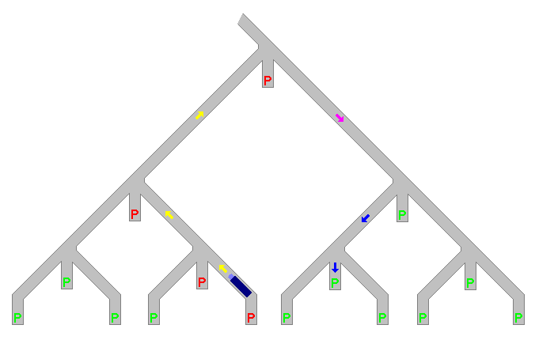
A truck cannot reverse, nor can it take corners < 90°
At certain locations there are codes, which open one of the crates in your trailer.
Notes:
Paste in graphics from Doom9 thread
Forward, right 90, right 90, right 90, left 45.

Slide 11
Explanation
The Truck is your Device
The crates in your trailer are the (encrypted) Media Key Data entries, given to you by the disc.
The codes at parking locations are Processing Keys.
The prize in the crate is the Media Key
A junction is a node
You don’t actually go up the tree, only down from certain spots.

Slide 12
A truck cannot reverse, nor can it take corners < 90°
At certain locations there are codes, which open one of the crates in your trailer.
Junction “A”
Junction “B”
Junction “A” Processing key

Slide 13
How does it work?
Each node’s key is derived from keys higher in the tree
  Each node’s key is hashed three times, giving the next node to the left, the processing key, and the next node to the right.
You get every key that’s one decision different to the path to your device node
  Thus you can thus figure out any keys not on your path to the root.
Key X
#2
#1
Key Y(P)
#3
Key Y(L)
Key Y(R)
Notes:
<Add graphic describing which keys you get>

Slide 14
“every key that’s one decision different to my path”?

Slide 15
Revocation
To revoke a node or subset of nodes,
we encode the media key with a processing key that they cannot access
Notes:
Examples of revocations using the diagram

Slide 16
Notes:
Give Examples of revocations using the diagram:
‘But suppose we want to revoke both of these nodes on either side of the tree’

Slide 17
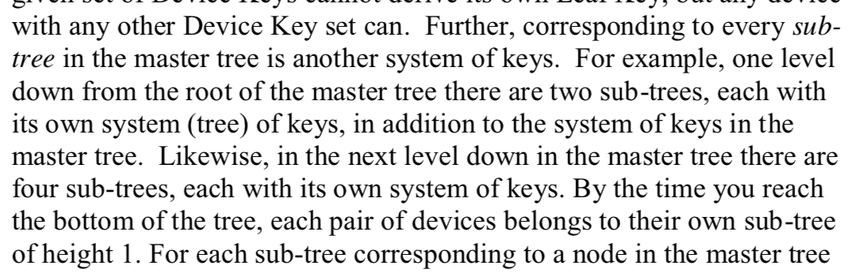
The Subset difference is like ogres
(which are like onions)
Non-contiguous revocations require layers
For each level, there is another sub tree of n-1 height

Slide 18
How does this help?
We can do one encryption in each tree, which will revoke a subset of nodes
In a lower set, we can re-enable some nodes and revoke a smaller subset.

Slide 19
Revocation in layers
0
Subset rooted at level 0,
with revocation at a depth 2.
2
4
Subset rooted at level 4,
on the path X,
with revocation at a depth 1.
5
Notes:
Give examples of revocations based on layers and which bits are used.
You essentially revoke at the highest level required to hit both edges, then provide other subsets to enable the ones in-between.

Slide 20
Now with 0x64% more bit patterns
Paths through the tree are defined in a series of bits
  ‘0’ means go left, ‘1’ means go right
  A node with a path of 0010 means, from the root, “left, left, right, left”
0
1
0
0
1
1
0
0
00
1
1
1
1
0
0
0
000
001
111
Notes:
I just want to go through a quick bit of syntax, because it’ll help us in further diagrams / discussions

Slide 21
Examples
Hand crafted, artisanal, non-organic

Slide 22
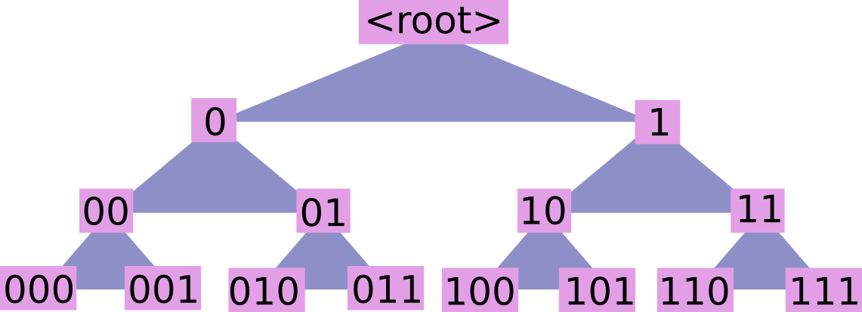
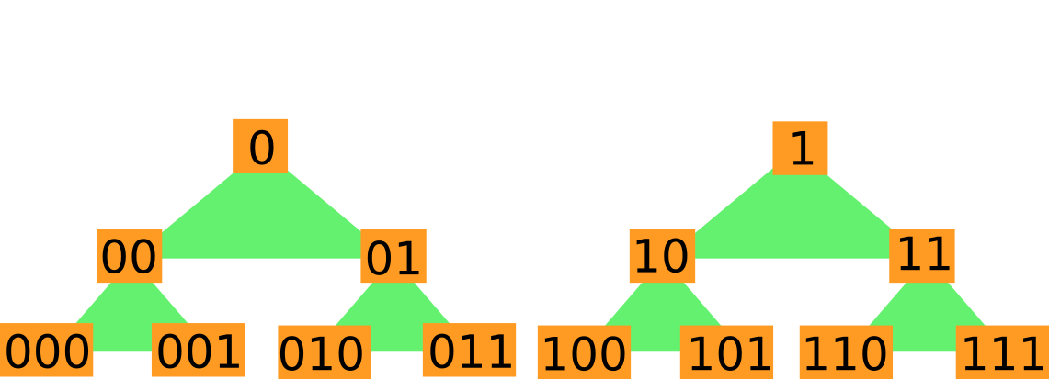
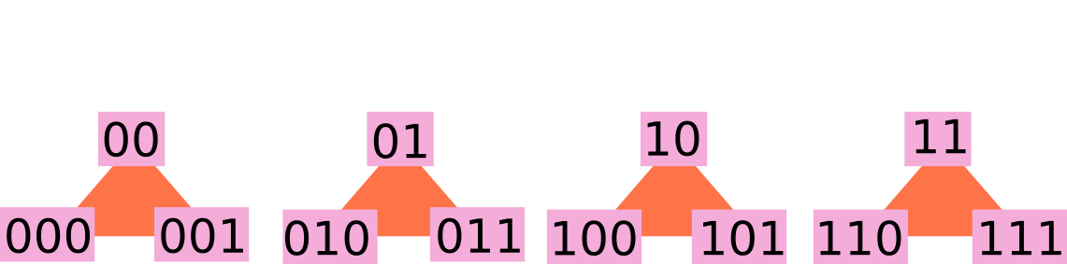
Example Revocations
A
Revoke:
000
B
Encrypt with:
A-000
C

Slide 23
Example Revocations
A
Revoke:
000
001
B
Encrypt with:
A-00
C

Slide 24
Example Revocations
A
Revoke:
000
011
B
Encrypt with:
A-0
C-000
C-011
C
Notes:
First we revoke the largest subset containing the devices.
Then we re-enable the correct devices only.
It’s worth noting that the specification does not indicate how the revocation is handled, so this is just personal solving
There may be a more efficient set of nodes to encrypt with

Slide 25
Example Revocations
A
Revoke:
000
011
101
B
Encrypt with:
B-01
B-101
C

Slide 26
https://github.com/E314c/AACS
A reference implementation of the subset difference parts of the AACS specification.
Please feel free to example implementations in other languages and submit a PR so that more people can read and understand the system
C
JS
Notes:
So I went and coded up parts of the AACS system
Mainly just the subset difference tree you can see how a media key is derived
The rest is just “you’ve got the key, now just decrypt the content you want to play in CBC mode”

Slide 27
Queries?
Or shall I go onto content?

Slide 28
Bonus material

Slide 29
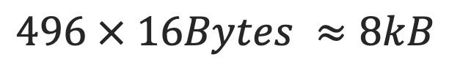
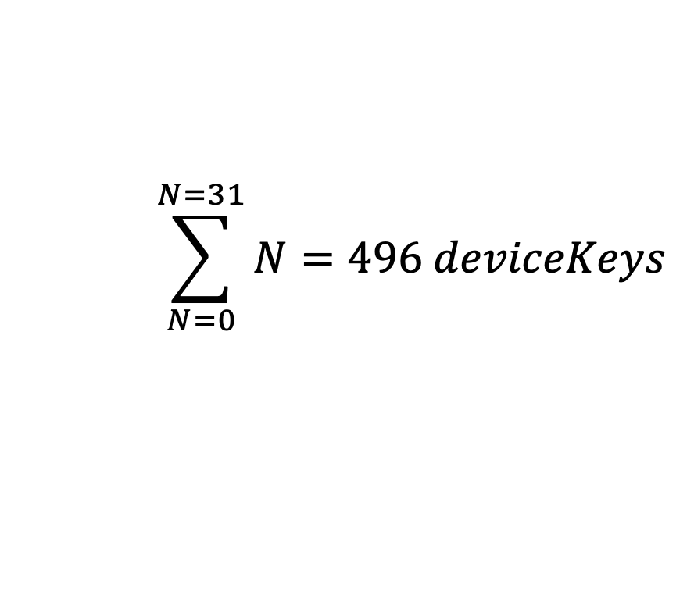
Space requirements
UV numbers are specified as 32 bits
  so there’s 31 layers of nodes
A device gets N keys from a tree of depth N
$$\sum_{N=0}^{N=31}{N=496 deviceKeys}$$
$$496 × 16Bytes ≈8kB$$

Slide 30
My node, in the middle of my tree
Masks ”U” and “V” are used to define valid paths in a subset difference
  The masks represent which bits must match to be part of that path
  U is the ancestor path, the mask of U indicates which layer and path the root of this subset is on
  V is the difference path, the mask of V indicates paths under U that are not valid (have been revoked)
U mask:
1110 000
V mask:
1111 1100
1 | 0 | 0 | 1 | 1 | 0 | 0 | 0
Notes:
So the example given is for the node in the 4th tree, along a path of 100 from master tree.
It then revokes anything in the 4th tree below ‘1001 10’

Slide 31
Confusing storage
Node numbers are stored with an additional ‘1’ bit set on the end
  To indicate the end of the ‘path’ to that node
  Allows you to store the path and also derive it’s v_mask
    Referred to as a ‘UV number’
  The UV number of a device is a “device node number”
The UV Number of node @ ‘1001’ in a master tree of depth 7
1 | 0 | 0 | 1 | 1 | 0 | 0 | 0
A device node number @ ‘1001100’ in a master tree of depth 7
1 | 0 | 0 | 1 | 1 | 0 | 0 | 1
Notes:
Extra notes to help if you’re looking at the spec:
A device node number represents node and v_mask,

Slide 32
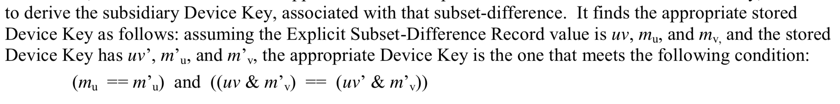

I’m wrong or the spec is wrong
Verifies it’s the same sub-tree depth
Attempts to check that upper part of key and subset match. (Key can derive node under it)
Problem:
Key path: 01
  UV = 0110
Subset exclusion: 0
  UV = 0100
$$\left(0000==0000\right) \&\& (\left(0100 \& 1100\right)==\left(0110 \& 1100\right))$$
true$\&\& (\left(01\right)==\left(01\right))$
But path ’01’ is revoked by subset ‘0’

