Slide 1
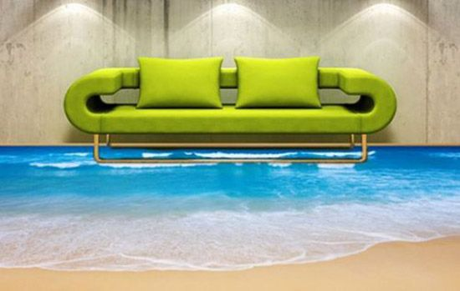
3D Floors, Ceilings and Walls
Unique and Bright Interior

Slide 2
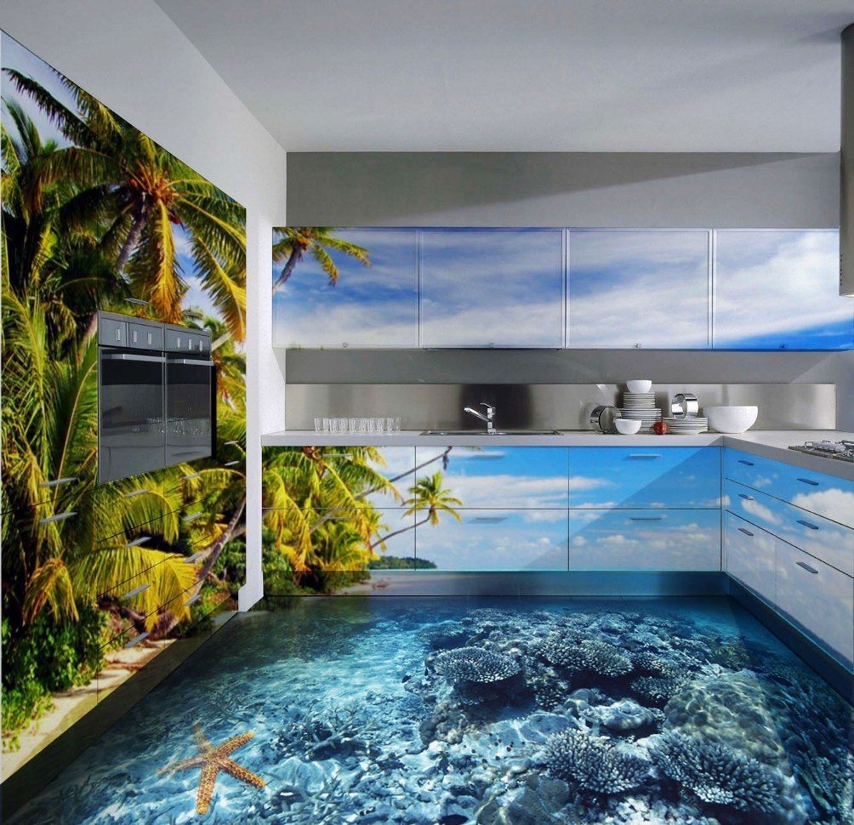
“The dawn of a new industrial revolution”
Modern interior trends
Very strong and Ecologically safe material

Slide 3
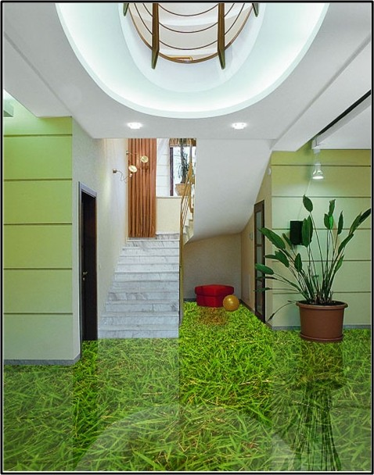
Most Innovative Designs
Bring another dimension to your life.
Create your own place you dream of

Slide 4
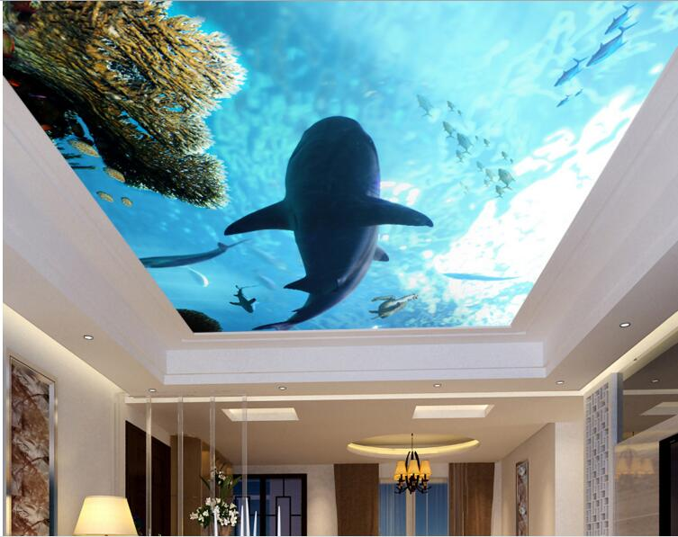
High Performance
Life time is dozens of years
Eco friendly,
safe and healthy
Strong and
wear-resistant

Slide 5
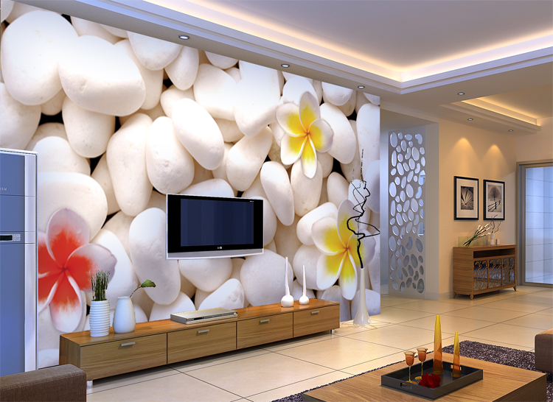
Be first. Step on!
Revolution in Renovation Industry:
Unique, Healthy and Strong

