Slide 1










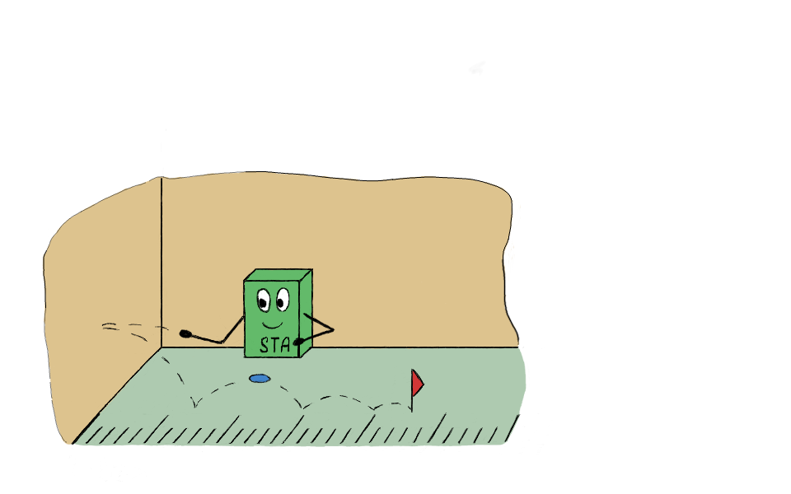
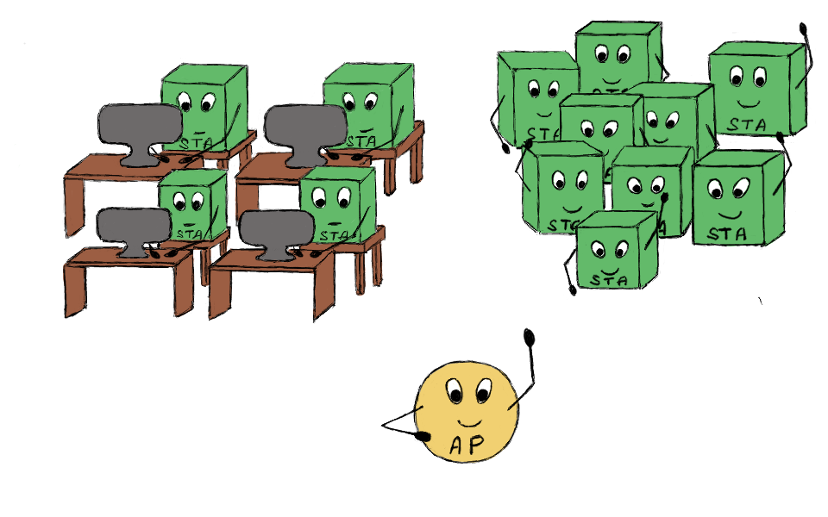

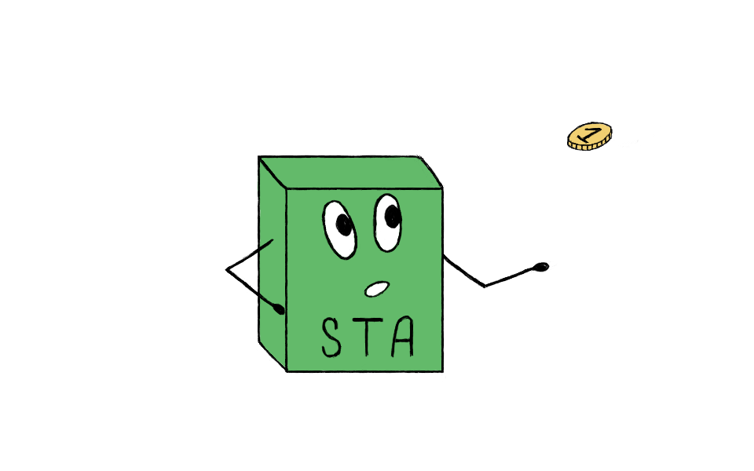
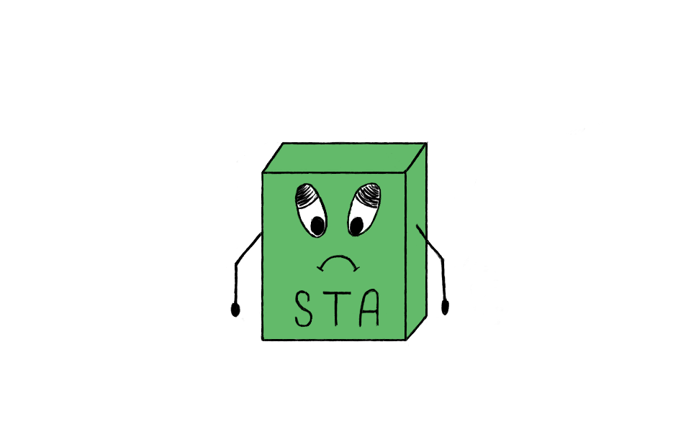
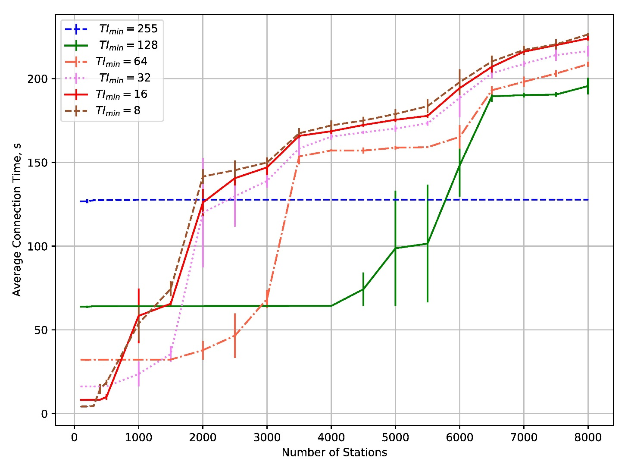
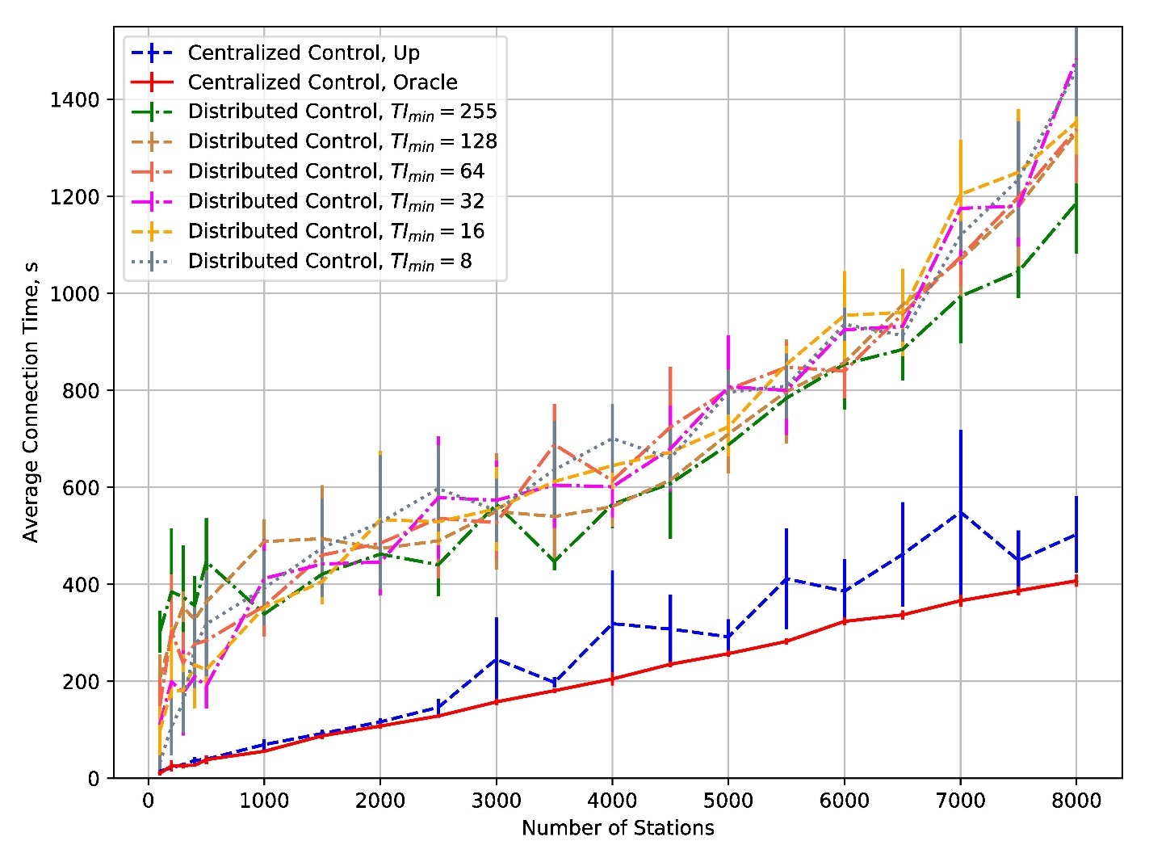
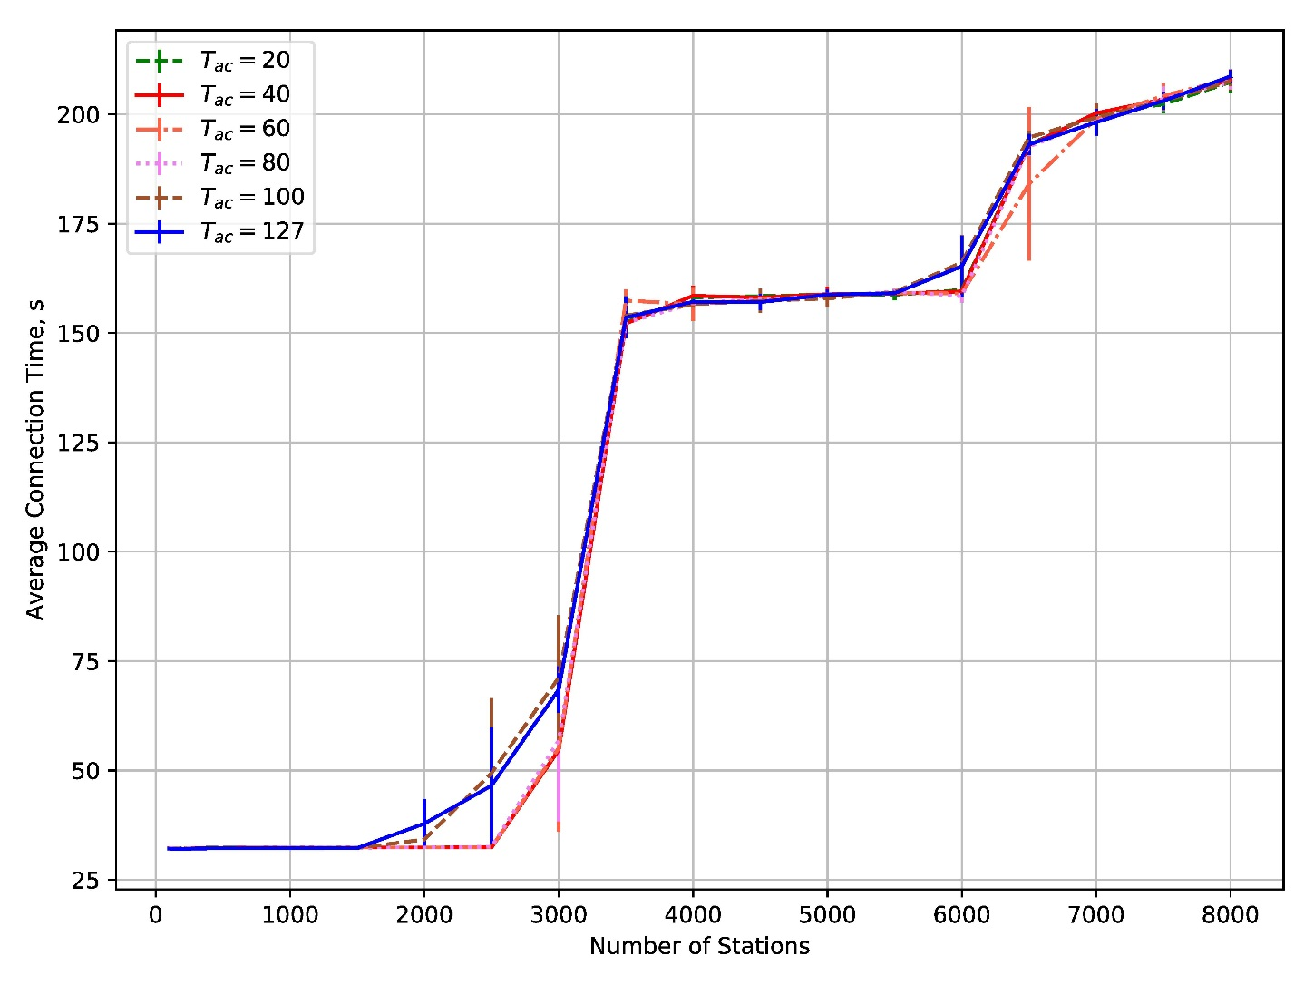
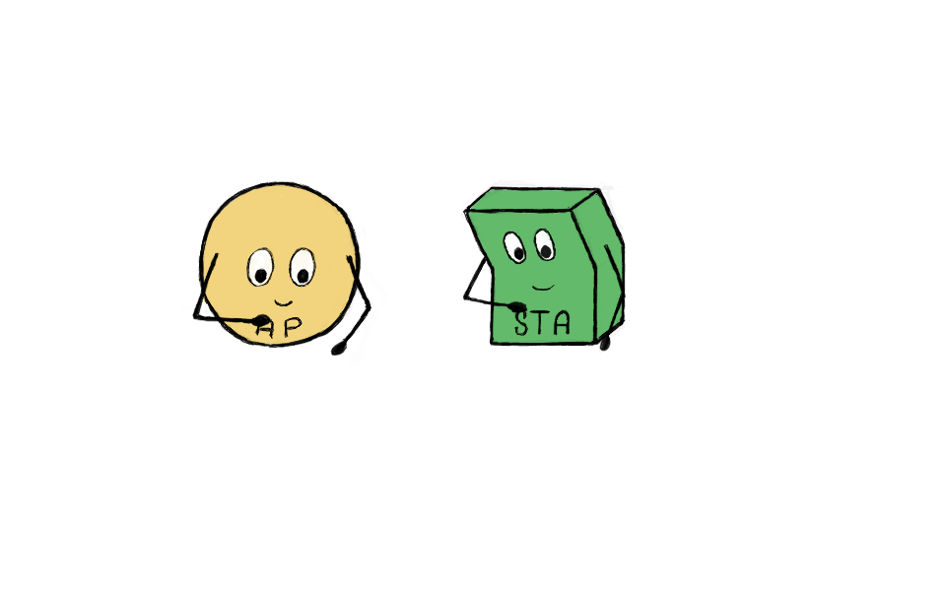

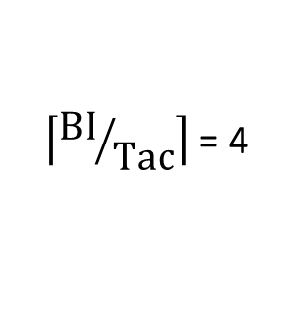
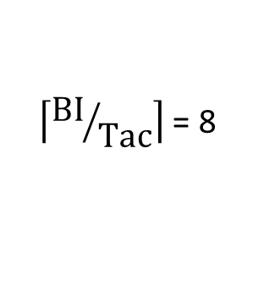
Comparison of Link Setup Protocols for M2M Communications Based on Wi-Fi
Ekaterina Stepanova
IITP RAS, MIPT
stepanova@iitp.ru
Dmitry Bankov
IITP RAS, MIPT
bankov@iitp.ru
Evgeny Khorov
IITP RAS
khorov@iitp.ru
Simple Wi-Fi
Network
Smart Home
Wi-Fi Network
Problem
Task
Performance of random channel access decreases with increasing number of connecting STAs
It leads to long connection time
Limit the average number of simultaneously connecting STAs
Distributed Connection Control Protocol
Scenario
beacon
beacon
Slot 0
Slot 1
…
Slot L
Slot 0
…
t
BI
t+1
Time
Parameters
TImin, TImax, Tac
Saturated STAs
Simultaneously connecting STAs
BEACON
BI = beacon interval
Centralized Connection Control Protocol
Start of connection
BI
Slot
Request transmission
threshold
Numerical Results
1
Varying the TImin Parameter for the Distributed Connection Control Protocol
0
1023
0
1023
TImin specifies the time interval during which the STA sends the first connection request
1
BI
TImin = 8
BI
0
1023
Numerical Results
TImin = 4
Comparison of the Protocols Efficiency in the Scenario with Hidden STAs
There is no value of TImin that minimizes the average connection time for all possible numbers of connecting STAs
We should set large TImin to connect a large number of STAs and vice versa
The centralized connection control protocol joint with the algorithm proposed in our paper* is much more efficient than the distributed connection control protocol
Varying the Tac Parameter for the Distributed Connection Control Protocol
Tac determines the number of connection slots in the BI
Slot
$\left\lceil {\text{BI}}/{\text{Tac}}\right\rceil$ = 8
Slot
BI
$\left\lceil {\text{BI}}/{\text{Tac}}\right\rceil$ = 4
*Dmitry Bankov, Evgeny Khorov, Andrey Lyakhov, Ekaterina Stepanova / Fast Centralized Authentication in Wi-Fi HaLow Networks // Communications (ICC), 2017 IEEE International Conference on / IEEE. — 2017.
Changing Tac has almost no effect on the connection time
ITaS

