Slide 1








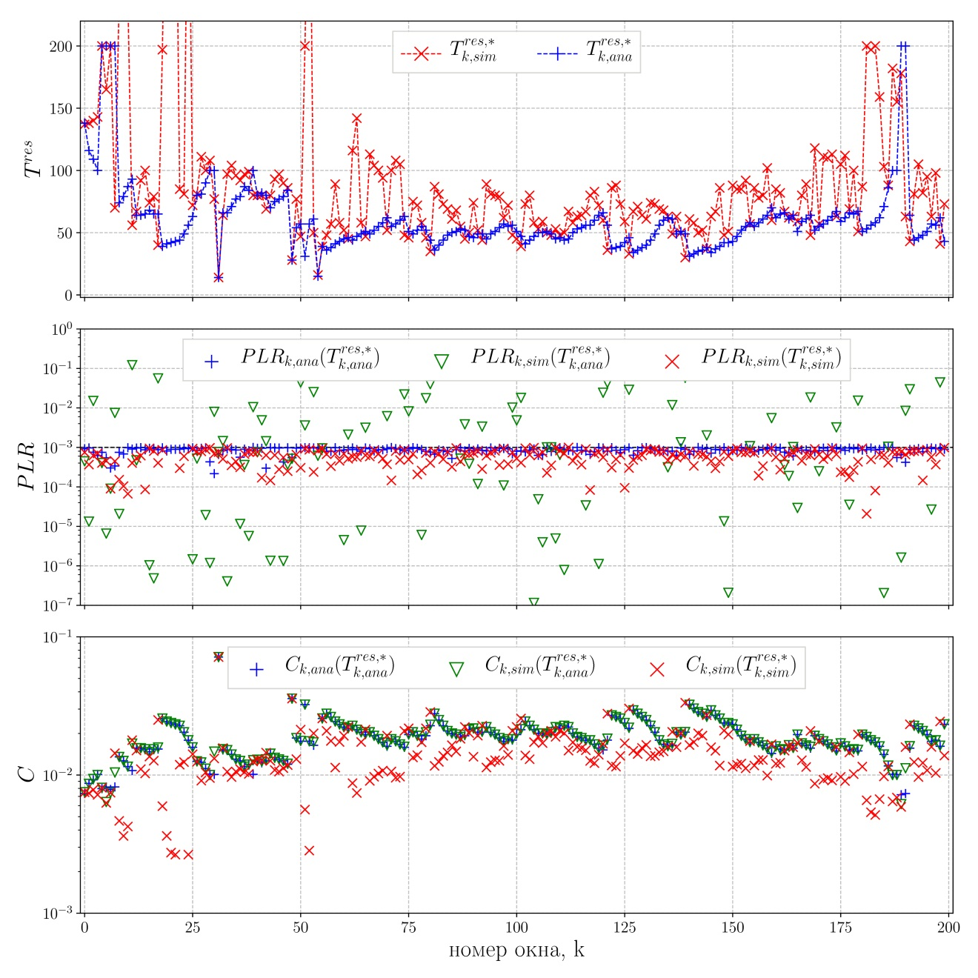
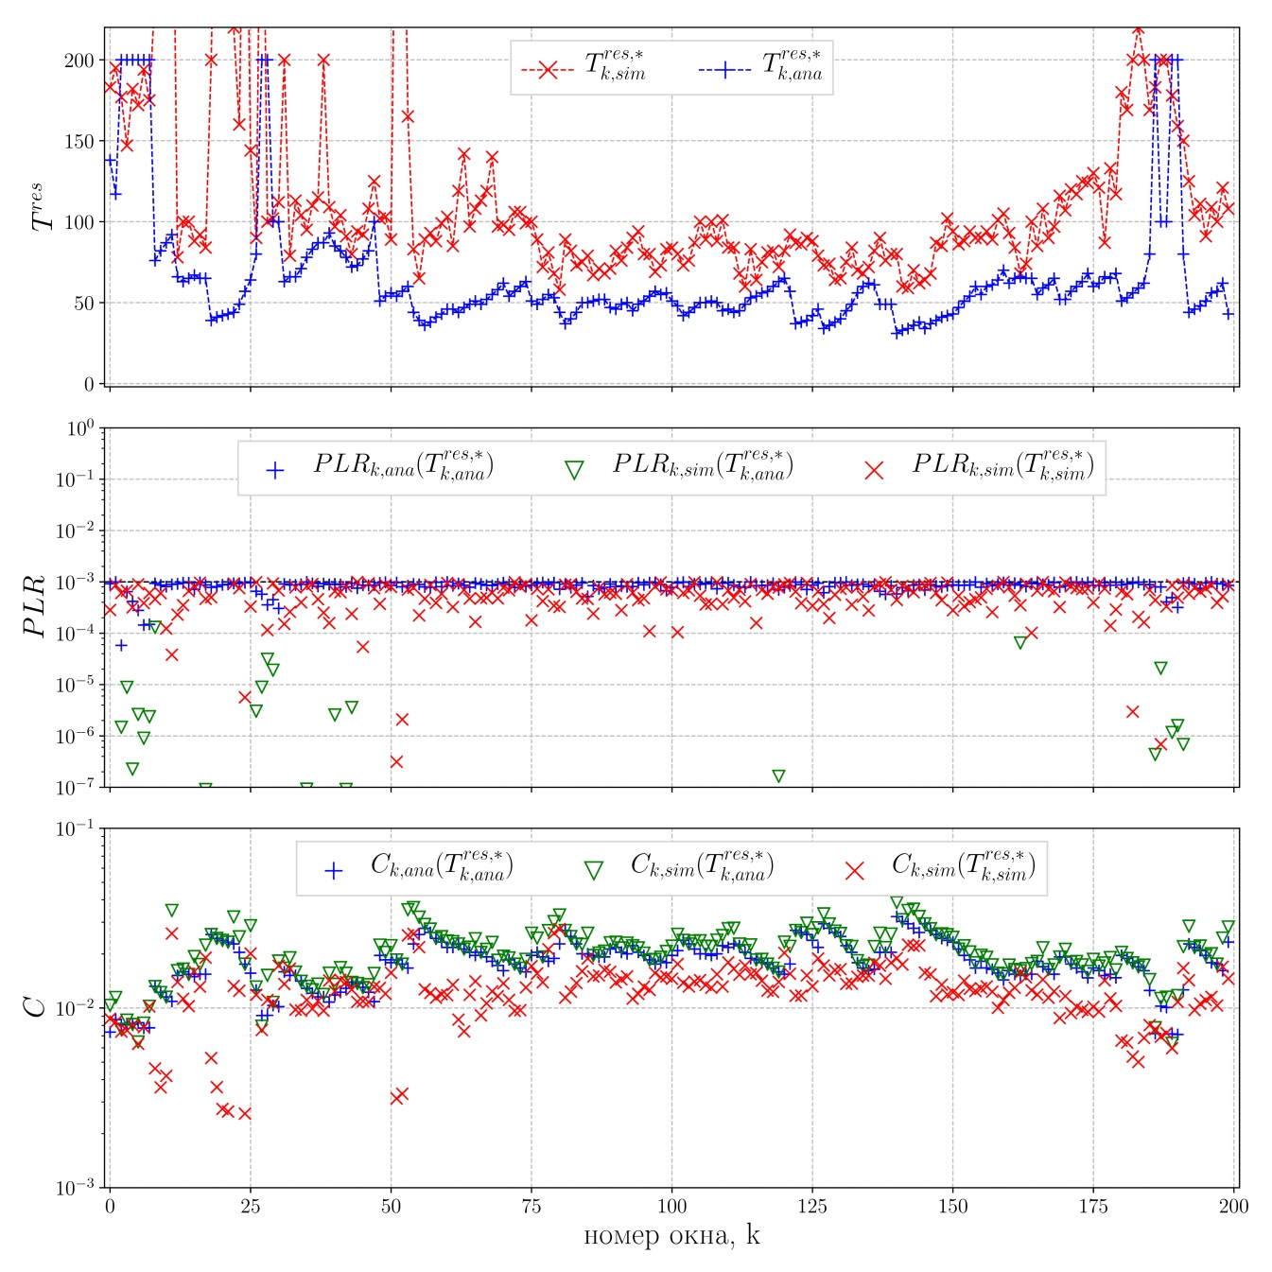





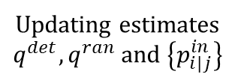

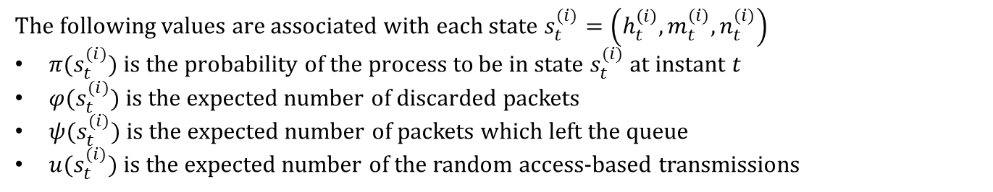




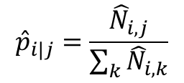




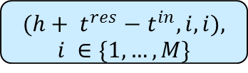















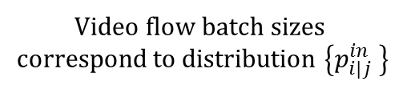

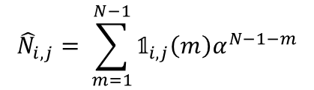

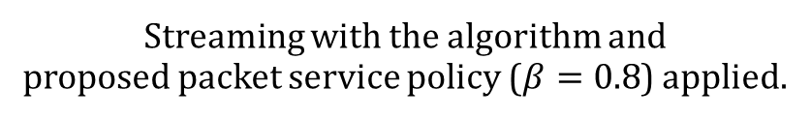








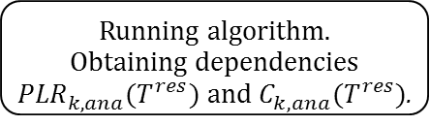
















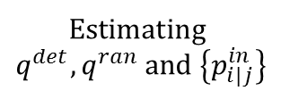





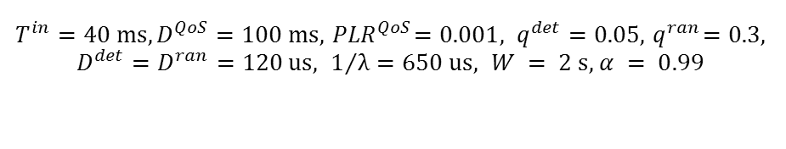



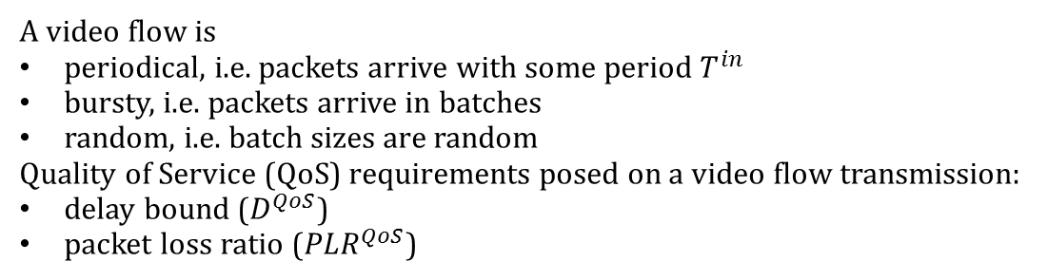


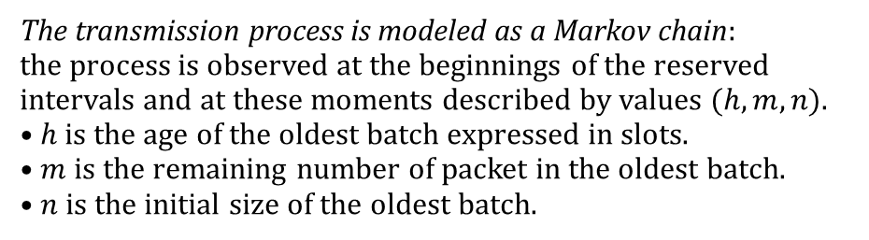


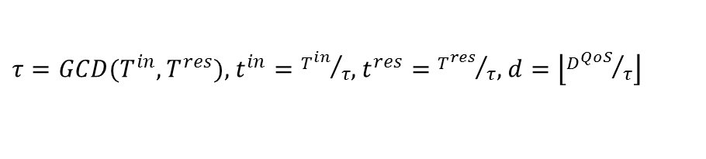


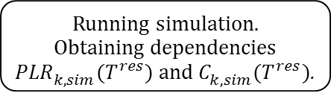



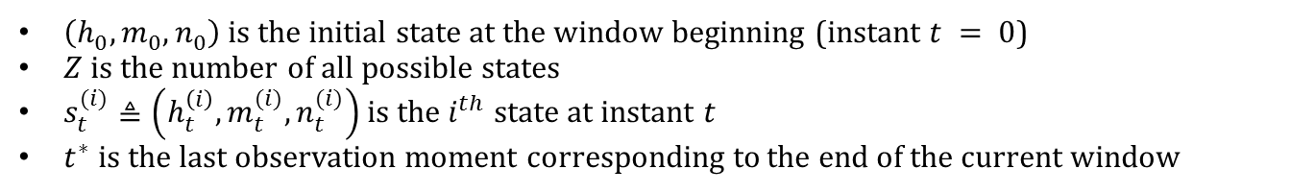



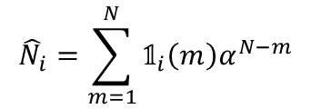



Dynamic Algorithm for Choosing Parameters of Real-time
Video Streaming over Wi-Fi Networks
Alexander Ivanov, Alipasha Babaev, Evgeny Khorov
{a.ivanov, babaev, khorov}@iitp.ru
Wi-Fi Channel Access Methods
Random Channel Access Method
Deterministic Channel Access Method
Heterogeneous Channel Access Method
Random channel access in Wi-Fi is supported by all stations (STAs). It is represented by DCF (Distributed Coordination Function) and EDCA (Enhanced Distributed Channel Access). Both these methods are derivatives of CSMA (Carrier Sense Multiple Access).
Using DCF or EDCA Wi-Fi STAs transmit at random time moments.
Deterministic Channel Access Methods allows a Wi-Fi station to reserve
a sequence of periodic time intervals of equal duration for its data transmissions.
This sequence is called a periodic reservation.
A periodic reservation is described by period $T^{res}$ of the reserved intervals and their duration $D^{res}$.
Deterministic channel access methods are reliable but inflexible.
Random channel access methods are flexible but unreliable.
Heterogeneous channel access consists in joint usage of both deterministic and random channel access methods.
Question: what values of $T^{res}$and $D^{res}$to choose?
Periodic reservation
STA1
$$T^{res}$$
$$T^{res}$$
$$T^{res}$$
$$T^{res}$$
STA2
$$D^{res}$$
$$D^{res}$$
$$D^{ran}$$
STA1
STA2
Hidden station effect
Frequent collisions
Reservations of neighboring STAs do not overlap
Protection from interference and collisions
Video Flows
Problem Statement
Video flow packets
Upper layers
Unreliable wireless
channel
Transmission failure with probability $q^{ran}$
Problem: An algorithm for adaptive reservation parameters choice is required which being applied will allow us to satisfy the QoS requirements of the video flow while keeping the percentage of the occupied channel time as low as possible.
Channel load $C$ is the percentage of the occupied channel time.
Solution: We propose an algorithm which is based on a specifically developed mathematical model of the considered transmission process. The model allows one to find $PLR$ and $C$ as functions of $T^{res}$.
Video
flow
$$T^{res}$$
$$T^{in}$$
$$T^{in}$$
time
MAC Layer
Exponentially distributed random
variable with mean $1/λ$
Transmission failure with probability $q^{det}$
A video flow is
periodical, i.e. packets arrive with some period $T^{in}$
bursty, i.e. packets arrive in batches
random, i.e. batch sizes are random
Quality of Service (QoS) requirements posed on a video flow transmission:
delay bound ($D^{QoS}$)
packet loss ratio (${PLR}^{QoS}$)
PHY Layer
$$D^{ran}$$
Random access
intervals
Model assumption about video flow batch sizes
FIFO
service policy
One transmission attempt
per reserved or random
access interval
Only those packets which become outdated by the next reserved interval are transmitted using the random access method!
$$p_{i|j}^{in}$$
Algorithm
$i$ packets
Video flow batch sizes
correspond to distribution $\left\{p_{i|j}^{in} \right\}$
$j$ packets
Algorithm consists of two stages:
Stage 1. Initialization. Initial estimates for probabilities $q^{det},q^{ran}$and distribution $\left\{p_{i|j}^{in}\right\}$ are obtained.
Stage 2. Main loop. Transmission process is divided into windows of duration $W$. At the end of each window 1) the statistics is updated, 2) new reservation period $T^{res,∗}$ is found for the next window. After that real transmission is performed in the next window with reservation period $T^{res,∗}.$
At stage 2 reservation period $T^{res,∗}$ is found using the developed mathematical model. The model also provides predictions for values ${PLR}^{∗}$ and $C^{∗}$ of packet loss ratio and channel load in the next window (if $T^{res,∗}$ is set as the reservation period).
Reserved intervals
$$T^{in}$$
time
Mathematical Model
packets
slots
reserved intervals
$\left(h_{0}^{},m_{0}^{},n_{0}^{}\right)$ is the initial state at the window beginning (instant $t = 0$)
$Z$ is the number of all possible states
$s_{t}^{(i)}≜\left(h_{t}^{\left(i\right)},m_{t}^{(i)},n_{t}^{(i)}\right)$ is the $i^{th}$ state at instant $t$
$t^{∗}$is the last observation moment corresponding to the end of the current window
$$t^{in}∙τ$$
$$\left(h_{0}^{},m_{0}^{},n_{0}^{}\right)$$
Setting reservation period $T^{res,∗}$ found by the algorithm
$$t$$
$t$+1
$$t^{res}∙τ$$
$t$+2
$$τ$$
$t$+3
$t$+4
time
$$\left(h_{1}^{\left(1\right)},m_{1}^{(1)},n_{1}^{(1)}\right)$$
$$\left(h_{1}^{\left(2\right)},m_{1}^{(2)},n_{1}^{(2)}\right)$$
. . .
$$\left(h_{1}^{\left(Z\right)},m_{1}^{(Z)},n_{1}^{(Z)}\right)$$
Stage 1
Initialization
Stage 2
Main cycle
$τ=GCD(T^{in},T^{res})$, $t^{in}={T^{in}}/τ$, $t^{res}={T^{res}}/τ$, $d=\left\lfloor {D^{QoS}}/τ\right\rfloor$
$$\left(h_{2}^{\left(1\right)},m_{2}^{(1)},n_{2}^{(1)}\right)$$
$$\left(h_{2}^{\left(2\right)},m_{2}^{(2)},n_{2}^{(2)}\right)$$
. . .
$$\left(h_{2}^{\left(Z\right)},m_{2}^{(Z)},n_{2}^{(Z)}\right)$$
The transmission process is modeled as a Markov chain:
the process is observed at the beginnings of the reserved
intervals and at these moments described by values $(h, m, n).$
$•h$ is the age of the oldest batch expressed in slots.
$•m$ is the remaining number of packet in the oldest batch.
$•n$ is the initial size of the oldest batch.
Window 1
Window 2
$$\left(h_{…}^{\left(1\right)},m_{…}^{(1)},n_{…}^{(1)}\right)$$
$$\left(h_{…}^{\left(2\right)},m_{…}^{(2)},n_{…}^{(2)}\right)$$
. . .
$$\left(h_{…}^{\left(Z\right)},m_{…}^{(Z)},n_{…}^{(Z)}\right)$$
Beginning of the transmission
$$W$$
$$W$$
Markov chain transitions
End of stage 1
Stage 2
End of window 1
$$h<0$$
$$\left(h_{t^{∗}}^{\left(1\right)},m_{t^{∗}}^{(1)},n_{t^{∗}}^{(1)}\right)$$
$$\left(h_{t^{∗}}^{\left(2\right)},m_{t^{∗}}^{(2)},n_{t^{∗}}^{(2)}\right)$$
. . .
$$\left(h_{t^{∗}}^{\left(Z\right)},m_{t^{∗}}^{(Z)},n_{t^{∗}}^{(Z)}\right)$$
E$stimating$
$q^{det},q^{ran}$ and $\left\{p_{i|j}^{in}\right\}$
Updating estimates
$q^{det},q^{ran}$ and $\left\{p_{i|j}^{in}\right\}$
$$(h, m, n)$$
$$h≥0$$
$$(h+ t^{res}, m, n)$$
The following values are associated with each state $s_{t}^{(i)}=\left(h_{t}^{\left(i\right)},m_{t}^{(i)},n_{t}^{(i)}\right)$
$π(s_{t}^{(i)})$ is the probability of the process to be in state $s_{t}^{(i)}$ at instant $t$
$φ(s_{t}^{(i)})$ is the expected number of discarded packets
$ψ(s_{t}^{(i)})$ is the expected number of packets which left the queue
$u(s_{t}^{(i)})$ is the expected number of the random access-based transmissions
$$m>1$$
$$0 ≤h≤d − t^{res}$$
$$h> d − t^{res}$$
Exponential averaging
$$m=1$$
$$b_{1}$$
$$b_{3}$$
$$b_{N−3}$$
$$b_{N−2}$$
end
of window
failure
$$(h+ t^{res}, m, n)$$
failure
success
$$p_{i|n}^{in}$$
Values of $π, φ, ψ,u$are calculated recurrently:
$$π{(s}_{t+1}^{\left(i\right)})=\sum_{k=1}^{Z}{π(s_{t}^{\left(k\right)})p(s_{t+1}^{\left(i\right)}|s_{t}^{\left(k\right)})\text{ ,}}$$
$$χ(s_{t+1}^{\left(i\right)})=\sum_{k=1}^{Z}{\frac{p(s_{t+1}^{\left(i\right)}|s_{t}^{\left(k\right)})π(s_{t}^{(k)})}{π(s_{t+1}^{(i)})}}\left(∆χ(s_{t+1}^{\left(i\right)}|s_{t}^{\left(k\right)})+χ(s_{t}^{\left(k\right)})\right),χ \text{is} \text{one} \text{of} φ, ψ,u\text{.}$$
$$PLR\left(T^{res}\right)=\sum_{i=1}^{Z}{π(s_{t^{∗}}^{\left(i\right)})}\frac{φ(s_{t^{∗}}^{\left(i\right)})}{ψ(s_{t^{∗}}^{\left(i\right)})},$$
$$C\left(T^{res}\right)=\sum_{i=1}^{Z}{\frac{π(s_{t^{∗}}^{\left(i\right)})}{T^{res}}}\left(D^{res}+ D^{ran}\frac{u(s_{t^{∗}}^{\left(i\right)})}{t^{∗}}\right).$$
$$b_{2}$$
$$b_{N−1}$$
$$b_{N}$$
$$q^{det}$$
$$q^{det}$$
${(1−q}^{det}$)$p_{i|n}^{in}$
success
$$(h+ t^{res}, m−1, n)$$
$(h+ t^{res}−t^{in}, i, i)$,
$$i ∈\{1, …, M\}$$
$$𝟙_{i}\left(m\right) =\left[b_{m}=i\right]$$
$$𝟙_{i,j}\left(m\right)=[b_{m+1}=i ∧ b_{m}=j]$$
$${1−q}^{det}$$
$${\hat{N}}_{i}=\sum_{m=1}^{N}{{𝟙_{i}\left(m\right)α}^{N−m}}$$
$${\hat{N}}_{i,j}= \sum_{m=1}^{N−1}{{𝟙_{i,j}\left(m\right)α}^{N−1−m}}$$
Detailed explanation of the transitions and the subsequent calculations is provided in the corresponding ITaS 2017 paper.
$${\hat{p}}_{i}=\frac{{\hat{N}}_{i}}{\sum_{k}{{\hat{N}}_{k}}}$$
$${\hat{p}}_{i|j}=\frac{{\hat{N}}_{i,j}}{\sum_{k}{{\hat{N}}_{i,k}}}$$
Numerical Results
A real video flow corresponding to “Dallas” serial is streamed using the proposed algorithm with the following parameters:
Simulation setup
Window $k$
Streaming with the algorithm and
proposed packet service policy ($β=0.8$) applied.
$T^{in}=40 ms, D^{QoS}=100 ms, { PLR}^{QoS}=0.001, q^{det}=0.05, { q}^{ran}=0.3$, $D^{det}=D^{ran}=120 us, 1/λ=650 us, W = 2 s$, $α = 0.99$
Running algorithm.
Obtaining dependencies
${PLR}_{k,ana}^{}(T^{res})$ and $C_{k,ana}^{}(T^{res})$.
QoS requirements are satisfied in all windows!
Window $k$ended
$$k=k+1$$
Reservation period for window $k$ found
Packet burst
Running simulation.
Obtaining dependencies ${PLR}_{k,sim}^{}(T^{res})$ and $C_{k,sim}^{}(T^{res})$.
QoS requirements violation in window $k$!
Proposed Service Policy
Additional queue
Window $k$
Main queue
${PLR}_{k,ana}^{}(T^{res})$ and $C_{k,ana}^{}(T^{res})$ are dependen- cies of PLR and $C$on $T^{res}$ found using mathe-matical model. $T_{k,ana}^{res, ∗}$is the reservation period proposed by the algorithm.
${PLR}_{k,sim}^{}(T^{res})$ and $C_{k,sim}^{}(T^{res})$ are dependen- cies of PLR and $C$on $T^{res}$ found using simulation. $T_{k,sim}^{res, ∗}$is the reservation period proposed by the algorithm.
$β$ percentile of distribution $\left\{p_{i}^{in}\right\}$
Main queue. Packets served in the same way as before:
the random access is used only for expiring packets.
Additional queue. Packets are transmitted immediately using the random access method.
Window number, $k$
Window number, $k$

