Slide 1

E3SM All-Hands Tutorial
Introduction
This work was performed under the auspices of the U.S. Department of Energy by Lawrence Livermore National Laboratory under Contract DE-AC52-07NA27344 IM Release Number LLNL-PRES-XXXXXX

Slide 2
Agenda
Part 1: Running and changing an EAMxx case
Runtime options, i.e. namelist options
Controlling output
Using nco tools with EAMxx output
Part 2: Adding a new process to EAMxx
The EAMxx – Process interface
Registering a new process with EAMxx
Run with new process
Part 3: Unit testing
Building and running EAMxx unit tests
Developing new tests (both unit and for CIME runs)
Part 4: Advanced Topics

Slide 3


Adding a new process to EAMxx
The key parts of an EAMxx - Process interface
Adding a new process to Cmake
Adding runtime options

Slide 4
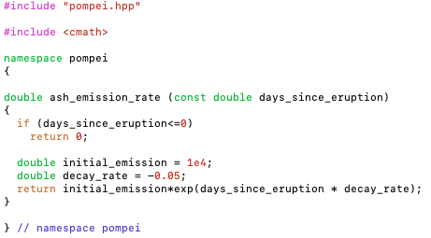
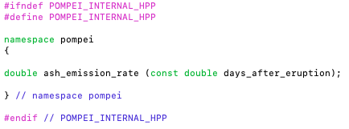
Our process: Practicing On Manually Adding Processes to EAMxx Interfaces (POMPEI)
Simple implementation of a volcano injecting a new tracer “ash” into the atmosphere.

Slide 5



Adding a process to EAMxx
Process we want to add
Interface layer
EAMxx
Set Grid
Initialization
Runstep
Finalization

Slide 6
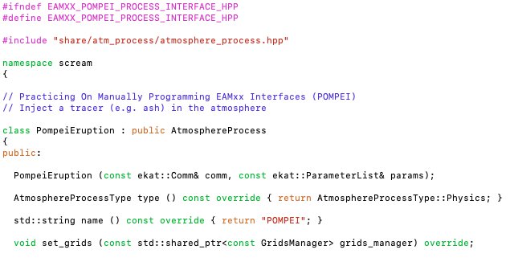
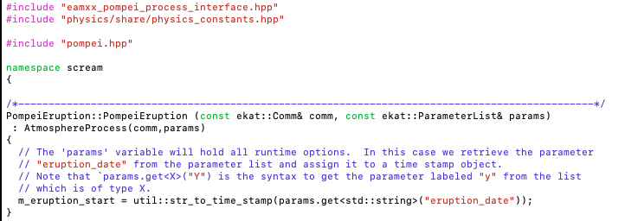
The EAMxx interface
Navigate to `eamxx-tutorial-2025/source/pompei` and open the files `eamxx_pompei_process_interface.*pp`.

Slide 7
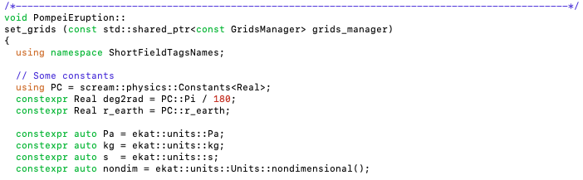
set_grids

