Slide 1
E4S: Ecosystem for Science
Release 26.11
Release 26.11 notes
November 16, 2026
High Performance Software Foundation
E4S Team
https://e4s.io

Slide 2
E4S 26.11: What’s New?
E4S, an HPSF project, is the open-source, community-driven HPC-AI Software Ecosystem for Science. This curated, Spack based collection of scientific libraries and tools forms the foundation of some of the world’s most advanced scientific applications.
Apache Guacamole remote desktop [https://guacamole.apache.org/], providing browser-based access to graphical tools inside E4S containers, including visualization tools such as ParaView and VisIt. See the E4S Guacamole guide [https://e4s.io/guacamole/]
Expanded agentic-AI tools, including the Hermes Agent desktop [https://hermes-agent.nousresearch.com/], the pi coding agent, Atlas UI 3, OpenCode, Ollama, and the Orca IDE, joining the Model Context Protocol (MCP), SGLang, LangChain, LangGraph, Agent2Agent (A2A), OpenAI, Anthropic, and Google Python APIs and Gemini CLI tools introduced in earlier releases
GPU communication runtimes NVIDIA Collective Communications Library (NCCL), NVIDIA Inference Xfer Library (NIXL), and NVIDIA NVSHMEM, which support multi-GPU and multi-node training and high-throughput, disaggregated LLM inference. Other new tools include:
  NVIDIA BioNeMo Inference Runtime (IR) for high-throughput biomolecular structure prediction inference
  FFTX with SPIRAL code generation, DIY, Kokkos Tools, Kokkos FFT, TAU Commander, SALT-FM, Chapel
Adaptive Computing’s Heidi AI web-based platform for multi-user, multi-node, ParaTools Pro for E4STM with Ubuntu 26.04 LTS and Rocky Linux 9.8 images on AWS, Microsoft Azure, Google Cloud, OCI, and IBM Cloud.
      https://adaptivecomputing.com/ and https://paratoolspro.com

Slide 3




E4S: Ecosystem for Science
About E4S
https://e4s.io
E4S is an ecosystem for science and a community effort to provide open-source software packages for developing, deploying and running scientific applications on HPC platforms. It provides an Extreme-scale Scientific Software Stack.
E4S has built a comprehensive, coherent software stack that enables application developers to productively develop highly parallel applications that effectively target diverse exascale architectures.
E4S provides a curated, Spack based software distribution of 125+ HPC (TAU, Trilinos, PETSc,OpenFOAM, Gromacs, Nek5000, LAMMPS, CP2K, Quantum Espresso), EDA (e.g., Xyce), and ML packages (e.g., DSPy, Atlas UI 3, Hypothesis, Vllm, HuggingFace CLI, TensorFlow, PyTorch, OpenCV, TorchBraid, Pandas, JAX, LBANN optimized for GPUs where available).
Base images and full featured containers (with GPU support).
Commercial support for E4S through ParaTools, Inc. for installation, maintaining an issue tracker, and ECP AD engagement.
E4S for clouds: Adaptive Computing’s Heidi with ParaTools Pro for E4STM image for AWS, GCP, IBM Cloud, Azure, OCI.
With E4S Spack binary build caches, E4S supports both bare-metal and containerized deployment for GPU based platforms.
  x86_64, aarch64 (ARM64), and ppc64le (IBM Power 10) with support for CPUs and GPUs from NVIDIA, AMD, and Intel
    Container images on DockerHub and E4S website of pre-built binaries of ECP ST products.
e4s-chain-spack.sh to chain two Spack instances allows us to install new packages in home directory and use other tools.
e4s-cl container launch tool allows binary distribution of applications by swapping MPI in the containerized app w/ system MPI.
e4s-alc is an à la carte tool to customize container images by adding system and Spack packages to an existing image.
E4S 26.11 released on November 16, 2026: https://e4s.io/talks/E4S_26.11.pdf
Notes:
LOCAL LAB POC: Michael Heroux (maherou@sandia.gov)
TALKING POINTS:
PESO is a five-year post-ECP software-ecosystem stewardship and advancement project. In partnership with the Consortium for the Advancement of Scientific Software (CASS), PESO will establish and steward a sustainable scientific software ecosystem comprising libraries and tools that deliver the latest high-performance algorithms and capabilities for DOE mission-critical applications.
PESO will enable applications to realize 100X improvement in both high-end capabilities and energy efficiency by leveraging accelerator devices
PESO will emphasize software product quality, the continued fostering of software product communities, and the delivery of products, working with CASS
METADATA:
Name of the associated awarded project:
PI name(s): Michael Heroux (Sandia), Lois Curfman McInnes (Argonne)
Name of the program manager: William Spotz, Software Stewardship and Advancement
CITATIONS:
The notes section should also include full citations (including the DOI) to any important and associated publications, datasets or code developed as part this work.
N/A
AWARDS:
N/A
REPRODUCIBILITY:
N/A.
BACKGROUND AND CONTEXT INFORMATION:
N/A

Slide 4
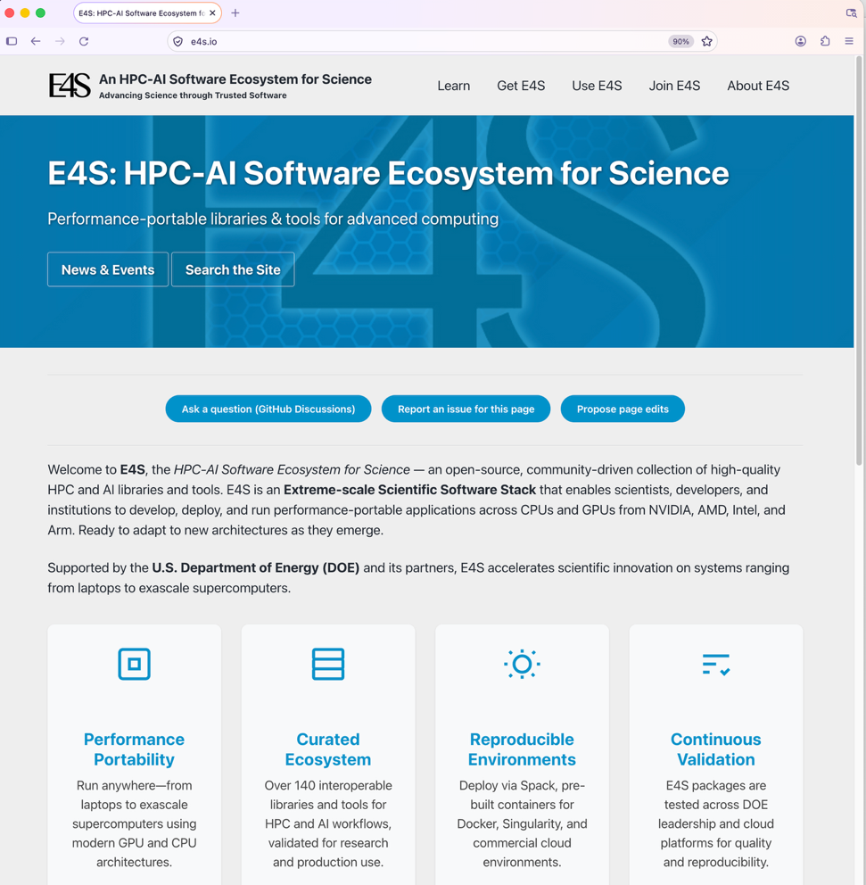
Updated E4S website https://e4s.io

Slide 5
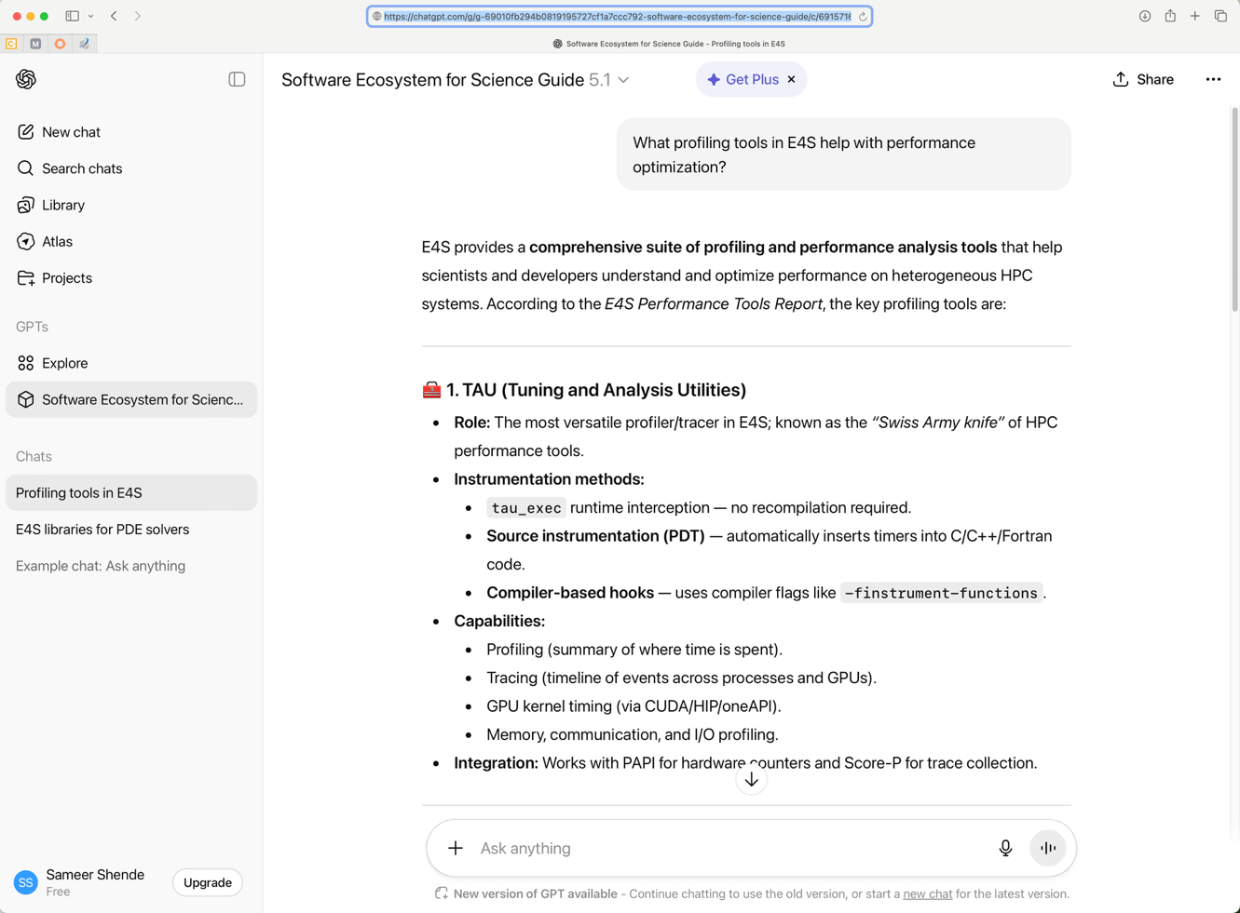
E4S Bot trained on E4S content on OpenAI’s ChatGPT

Slide 6
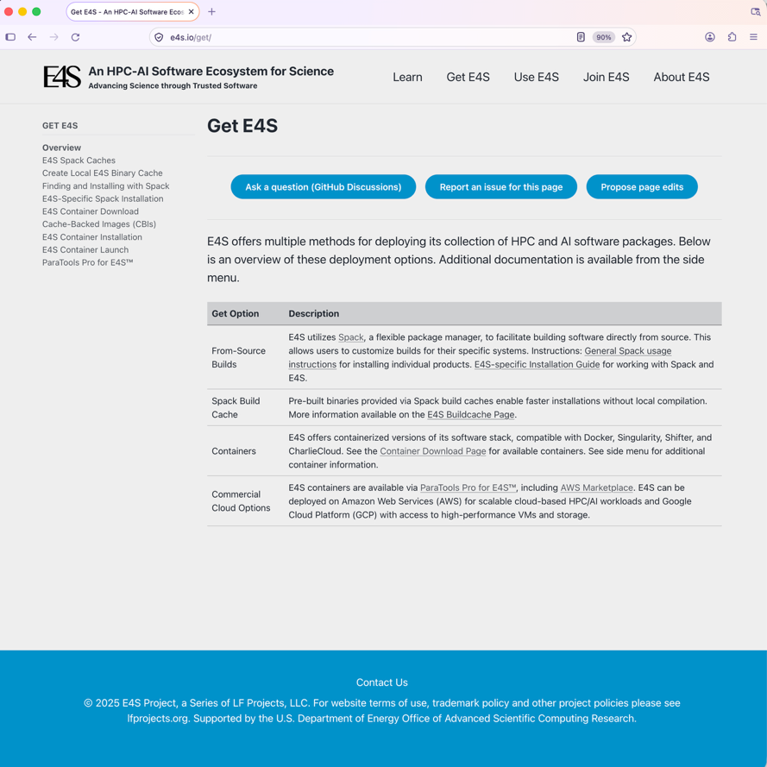
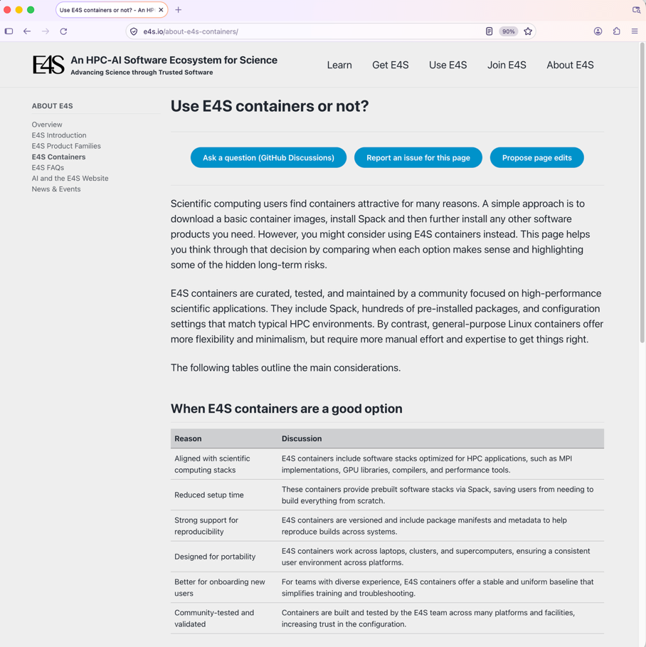
Using E4S

Slide 7
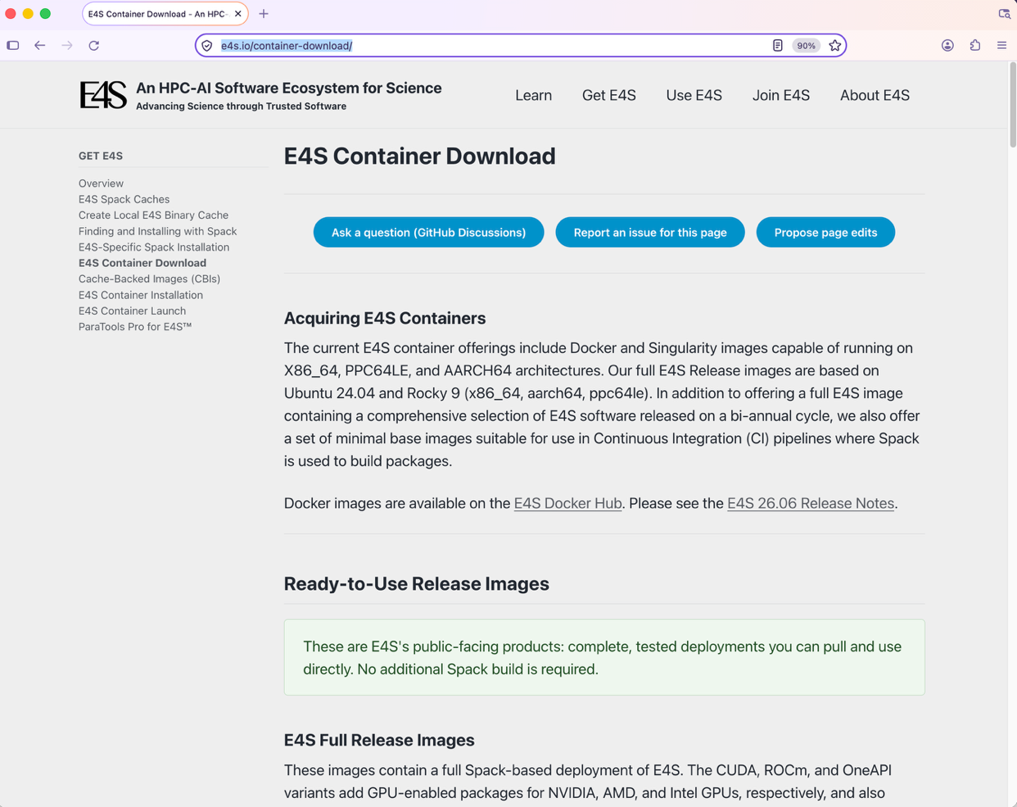
Download E4S Containers: Rocky Linux 9.8 and Ubuntu 24.04 LTS
Docker and Singularity
ARM64 (aarch64),
x86_64, and ppc64le
Support for GPUS:
  NVIDIA
  AMD
  Intel
GPU Runtimes:
  CUDA 13.0
  ROCm 7.2.4
  oneAPI 2026.1
Languages:
  C/C++/Fortran
  Python
  Rust
  Julia
  Chapel ...
OSes:
  Rocky Linux 9.8
  Ubuntu 24.04 LTS

Slide 8
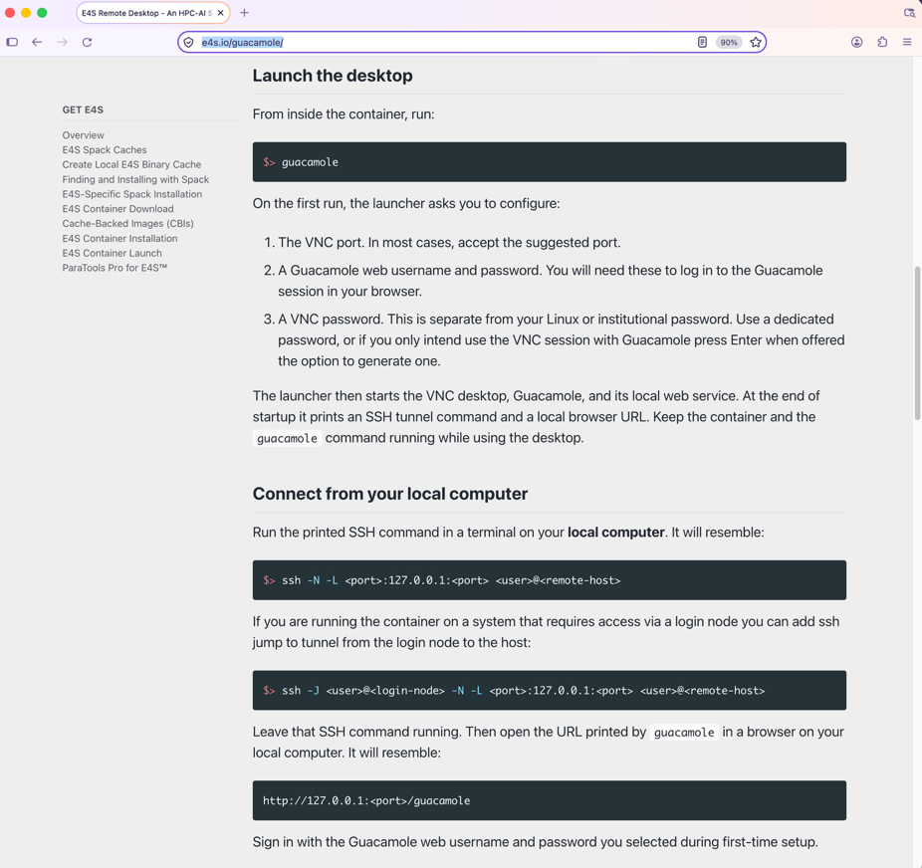
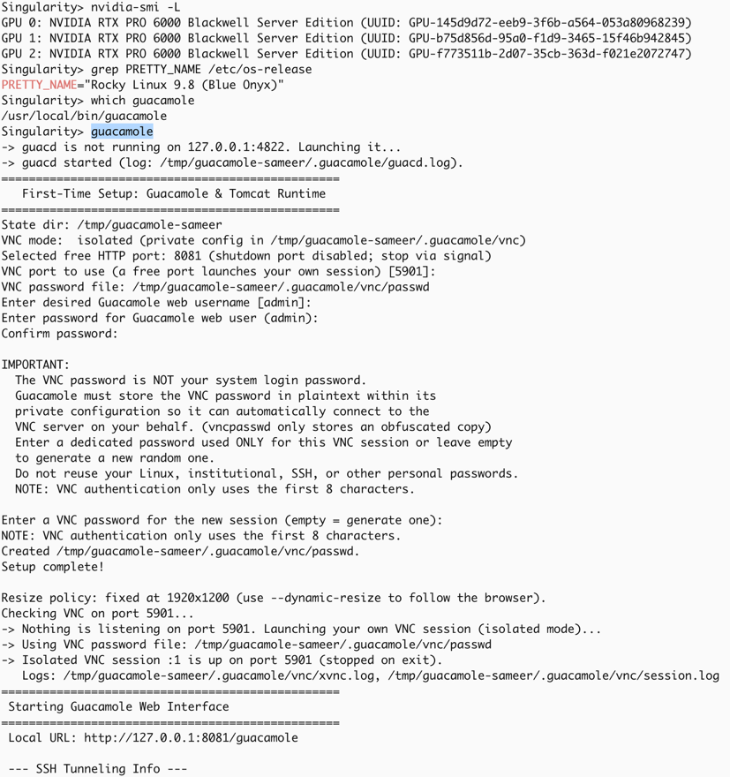
Apache Guacamole® clientless remote desktop in E4S containers

Slide 9
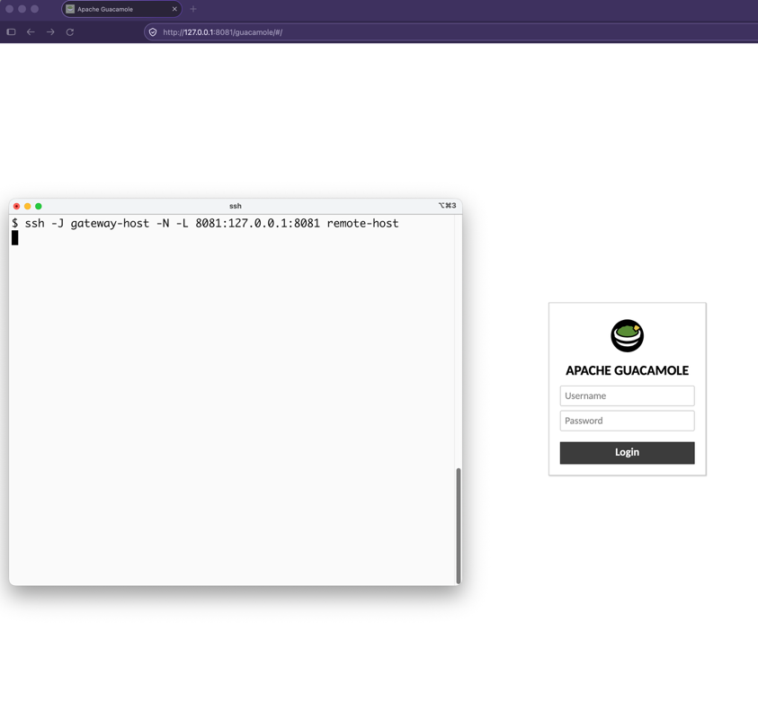
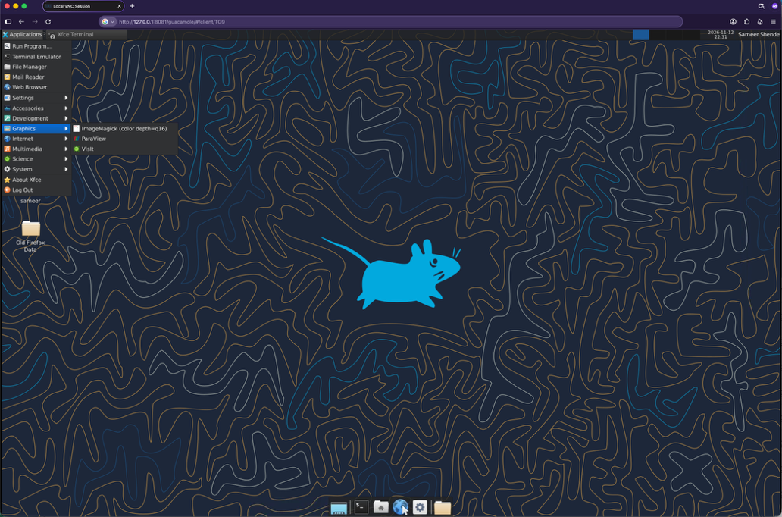
Using Apache Guacamole® with an ssh tunnel and an HTML5 web browser
% firefox http://127.0.0.1:8081/guacamole

Slide 10
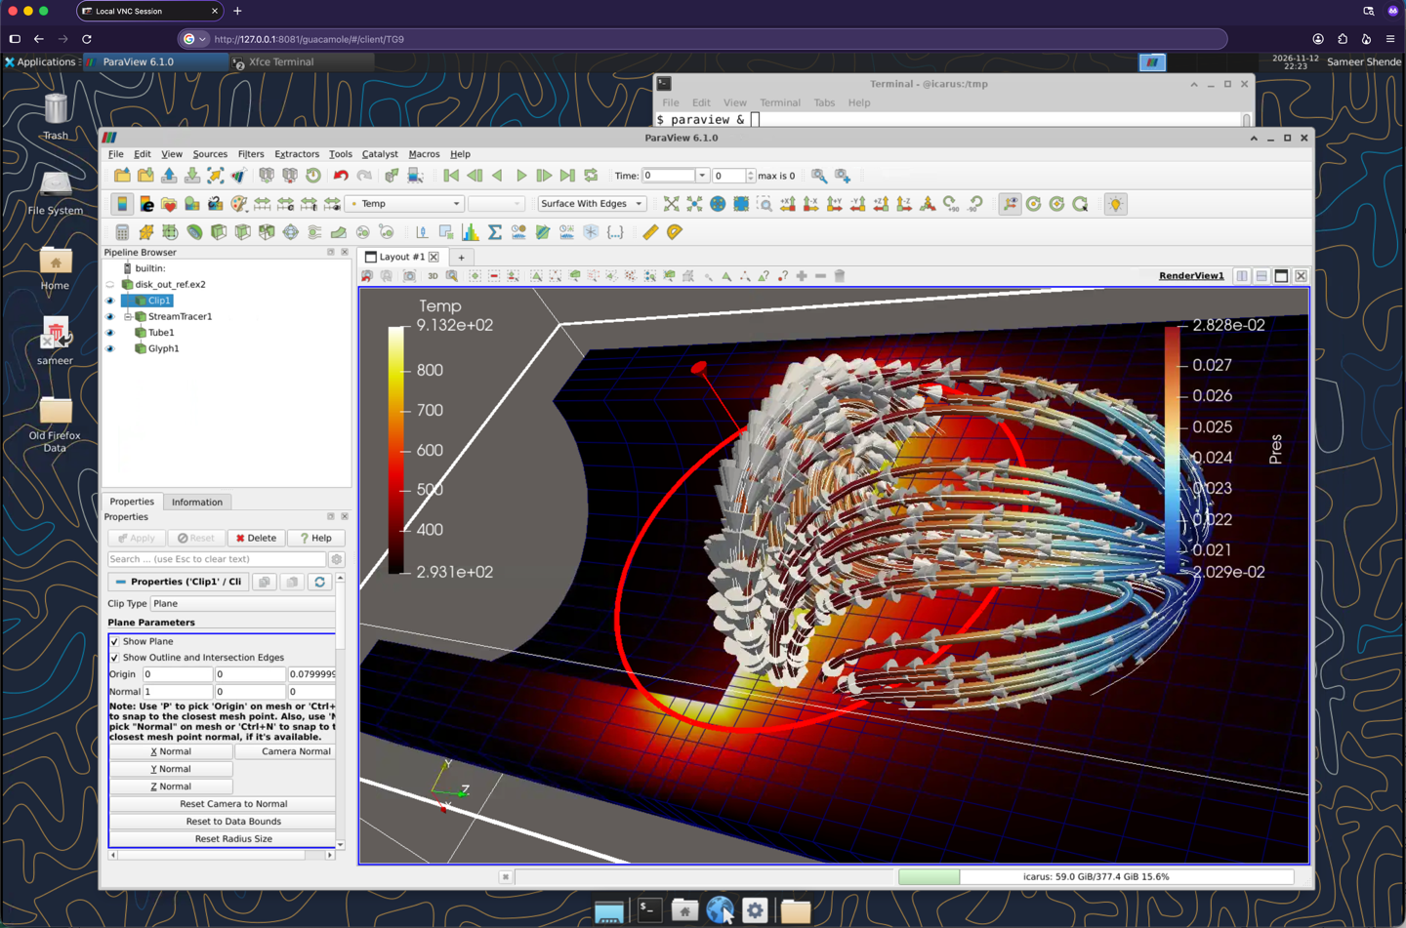
Visualization tools included in E4S: ParaView

Slide 11
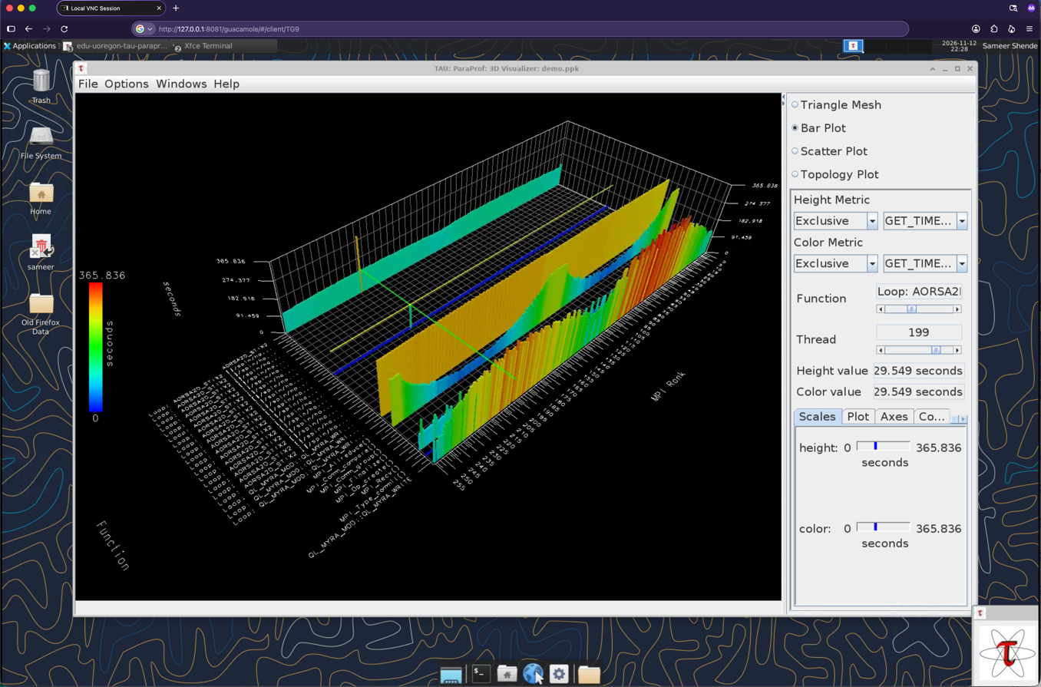
Visualization tools included in E4S: TAU Performance System®
TAU’s ParaProf profile browser using Apache Guacamole® remote desktop

Slide 12
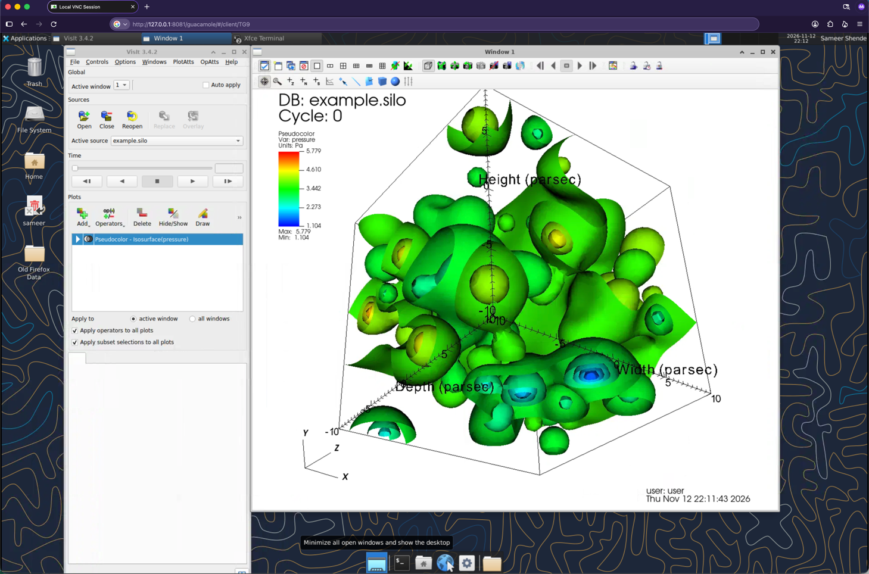
VisIt Visualizer

Slide 13
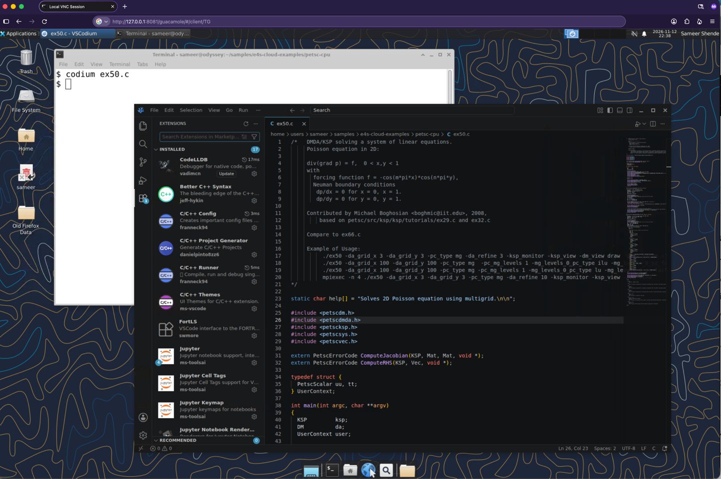
IDE tools included in E4S: Codium

Slide 14
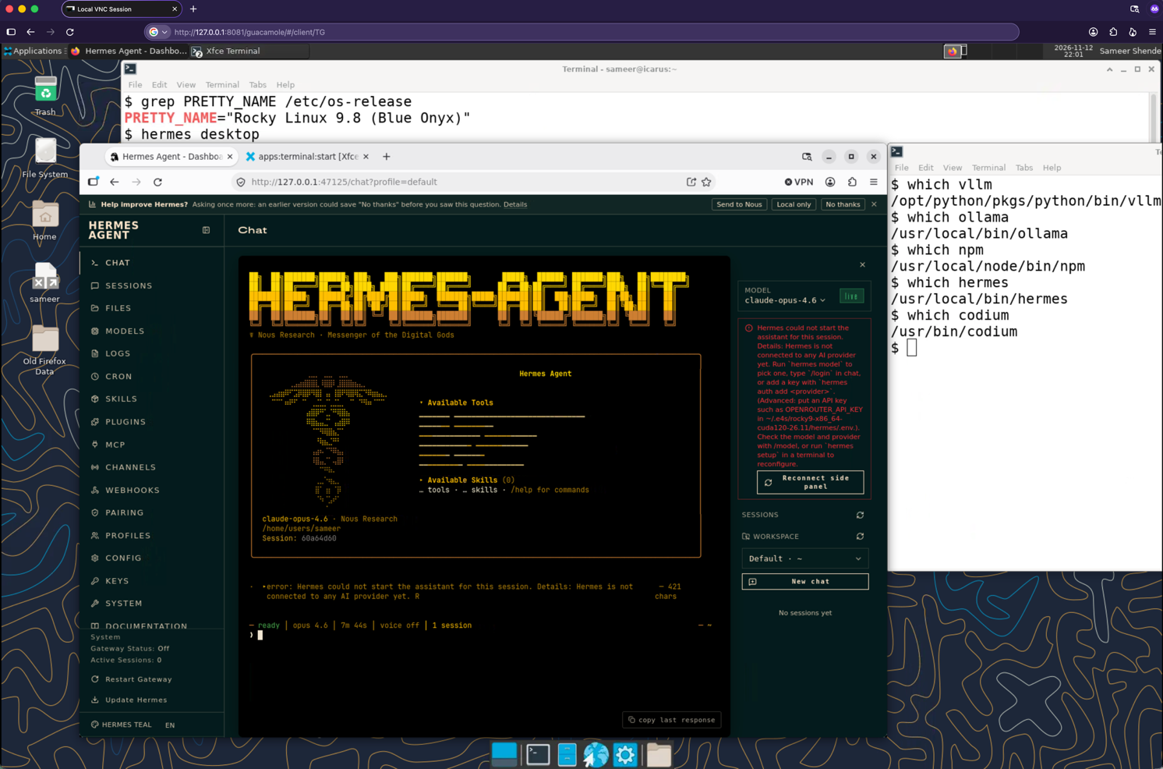
Hermes Agent

Slide 15
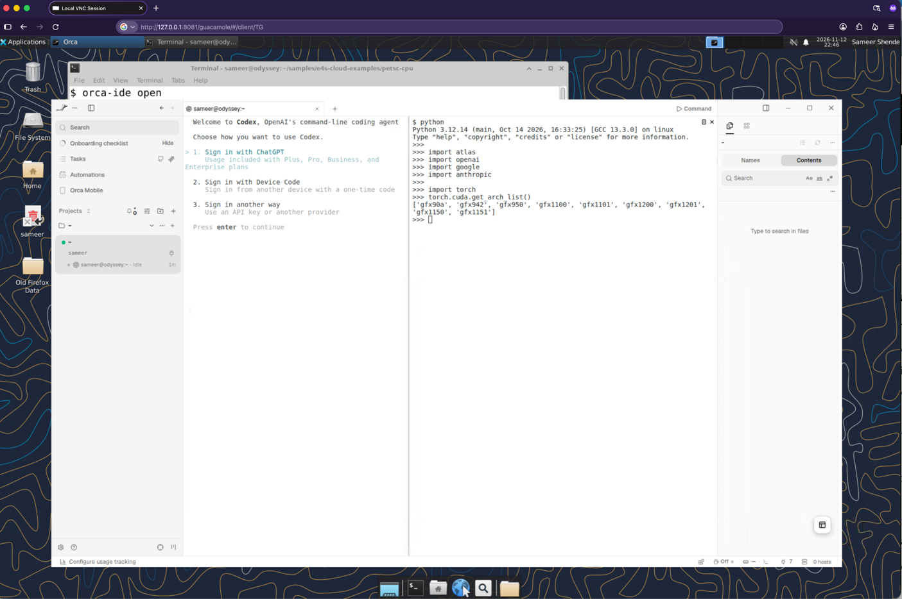
Agentic AI: Orca IDE

Slide 16
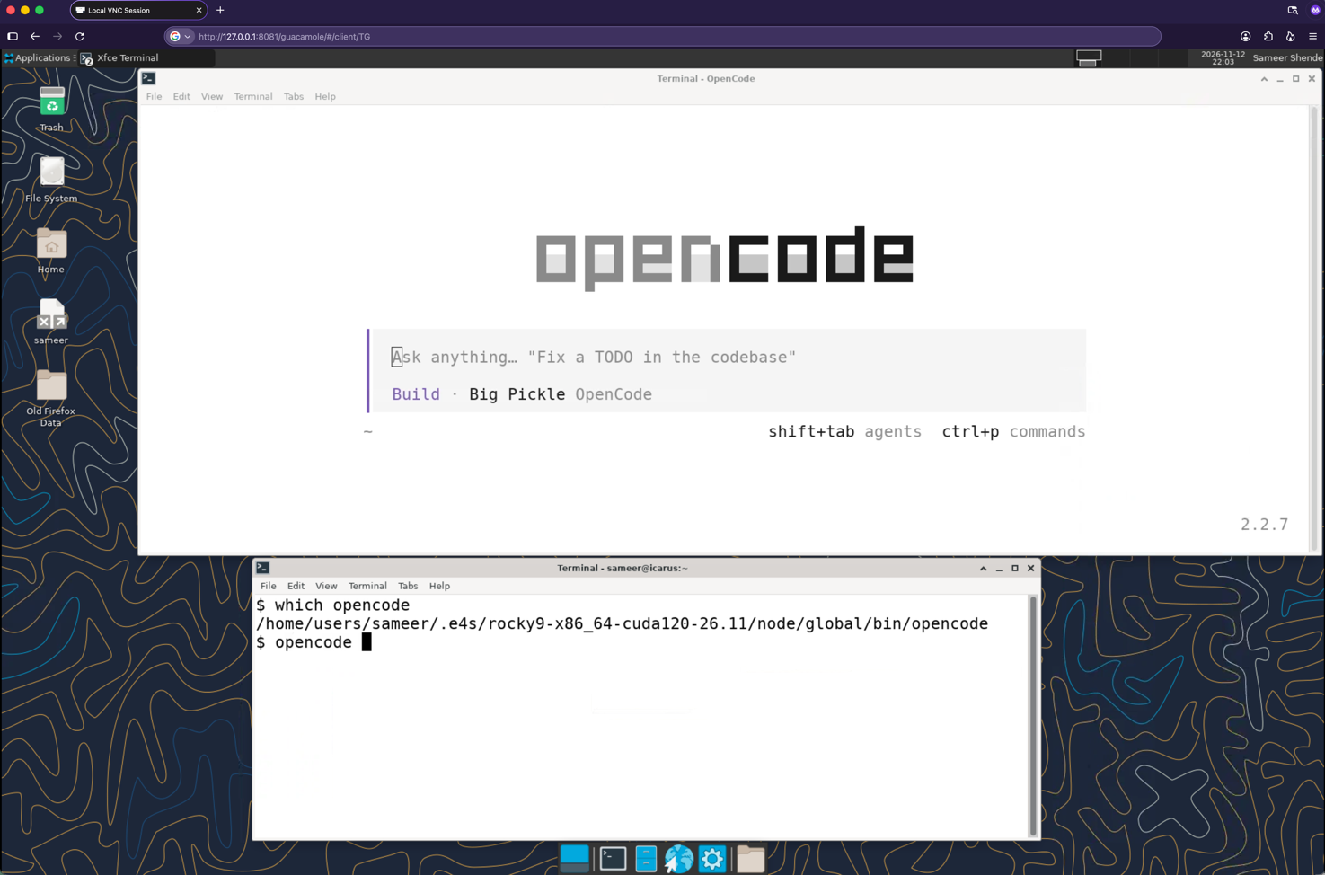
OpenCode: The open source coding agent

Slide 17
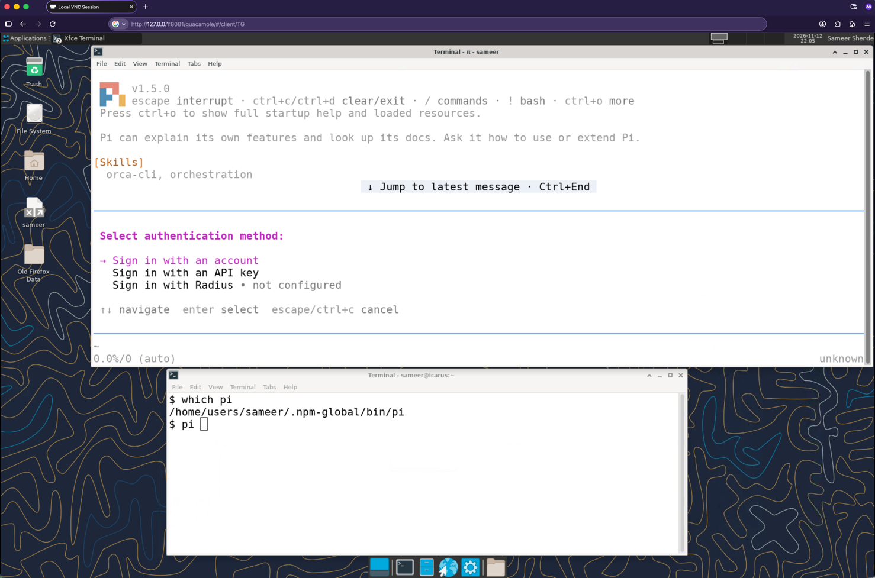
Pi Minimal Agent Harness for coding

Slide 18
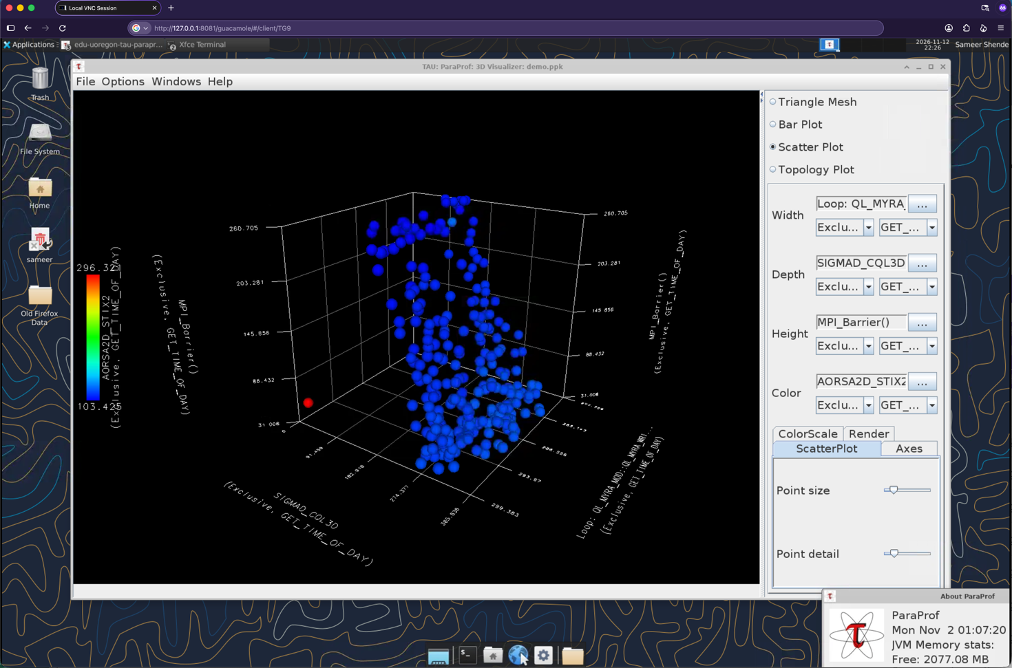
Performance Evaluation Tools: TAU Performance System®

Slide 19
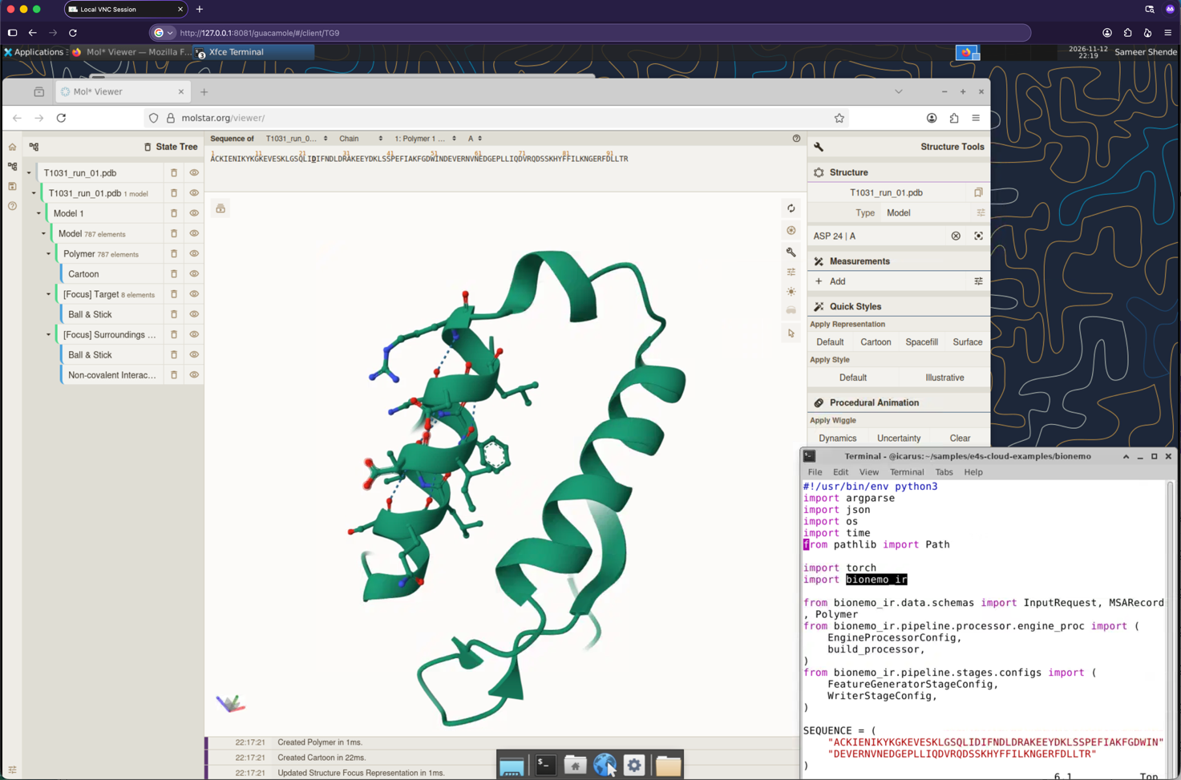
NVIDIA BioNeMo Inference Runtime for predicting 3D structure of proteins

Slide 20
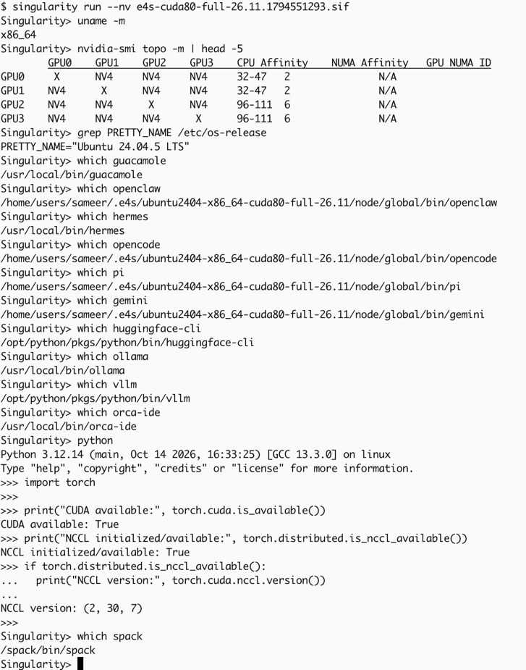
Using E4S 26.11 Container Images: Full featured CPU+GPU image
Launch container image with singularity --nv argument to use NVIDIA GPUs

Slide 21
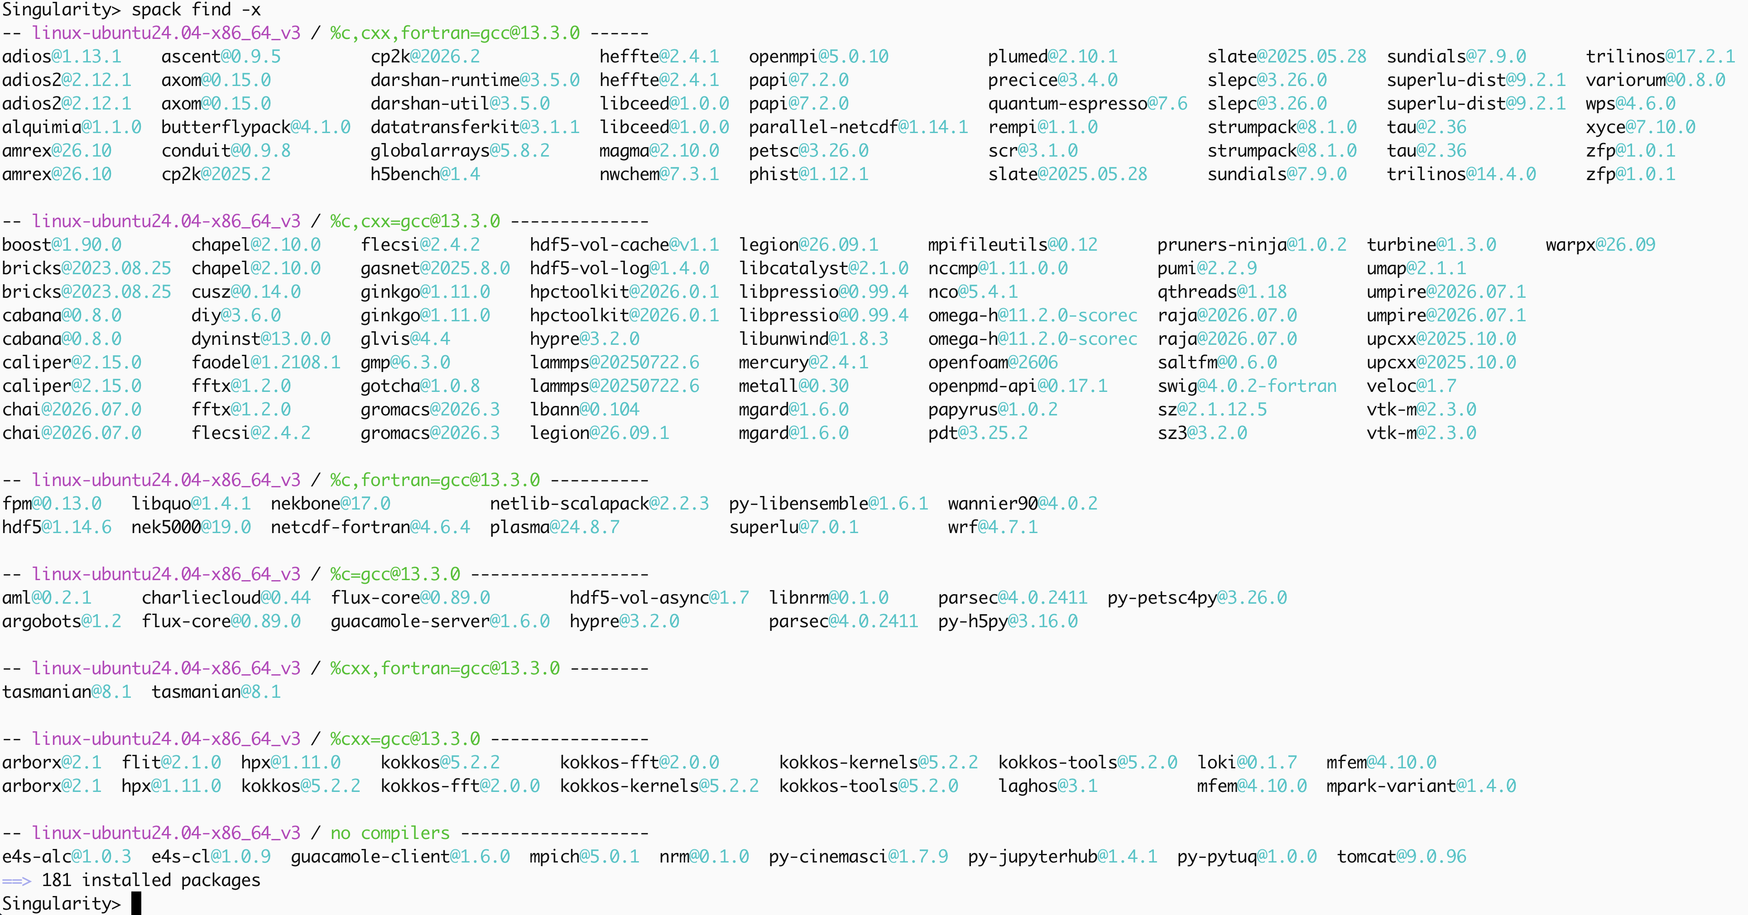
E4S 26.11 Linux x86_64 CPU+GPU image Ubuntu 24.04 LTS packages
Full featured NVIDIA A100 GPU x86_64 CPU image

Slide 22
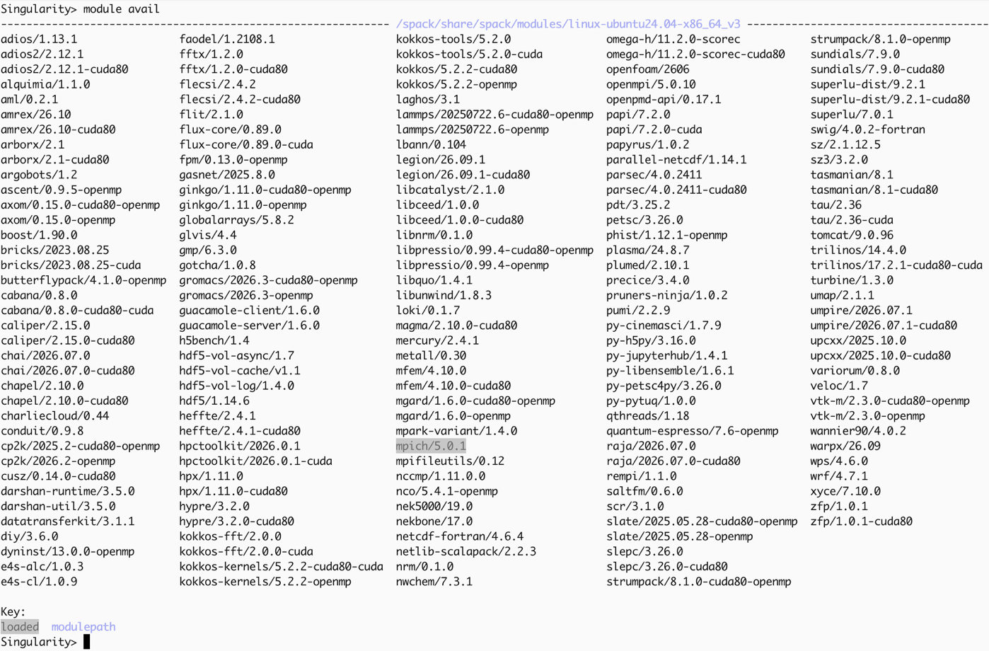
E4S 26.11 Linux x86_64 CPU+GPU image Ubuntu 24.04 LTS packages
Full featured NVIDIA A100 GPU x86_64 CPU image

Slide 23
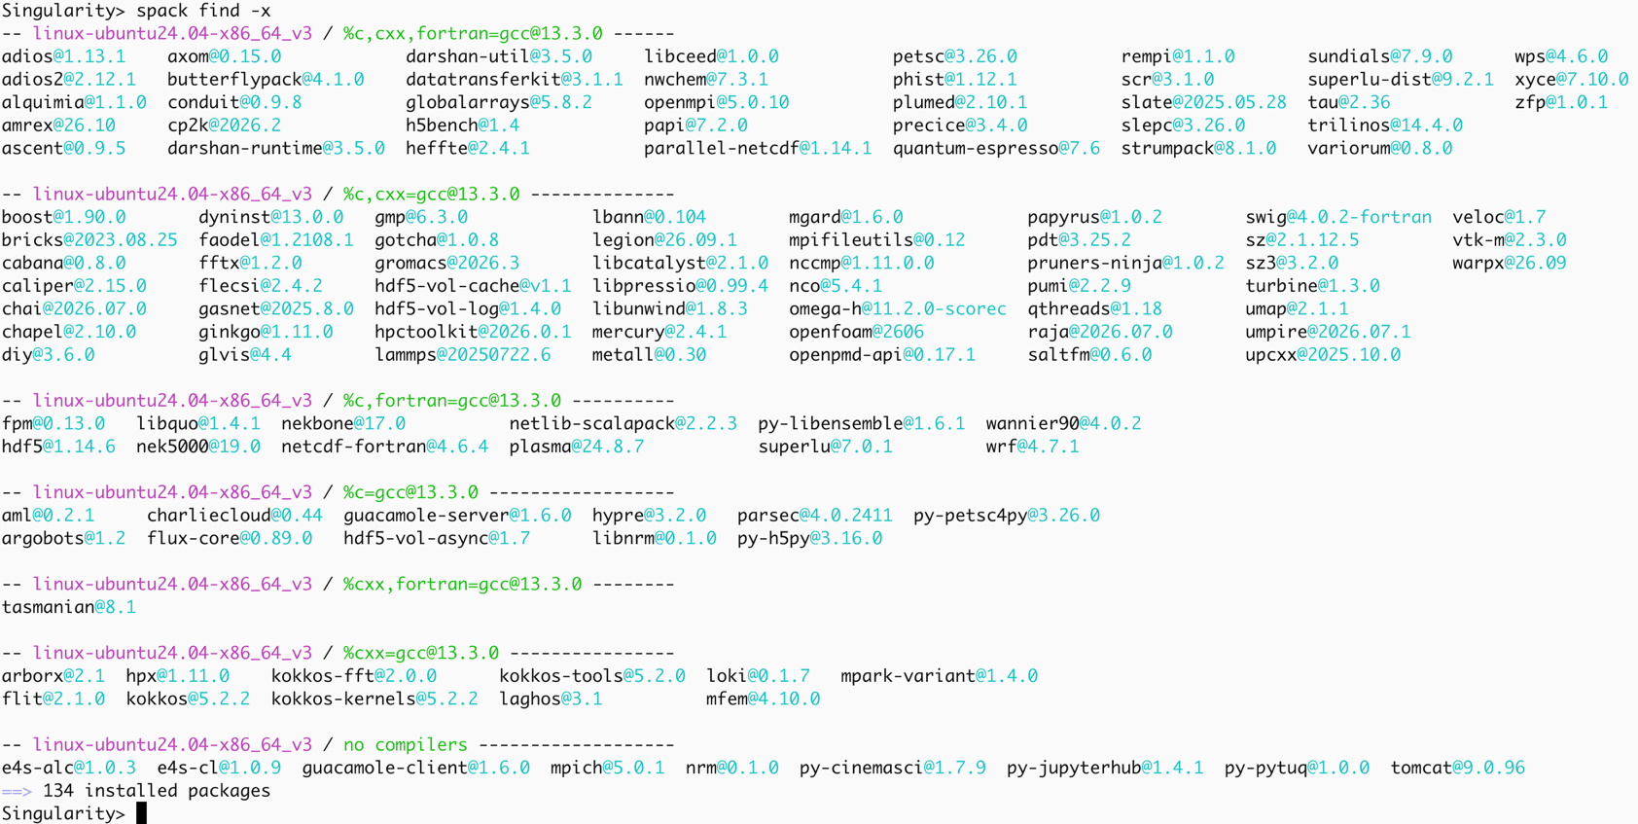
E4S 26.11 Linux x86_64 CPU image Ubuntu 24.04 LTS packages

Slide 24
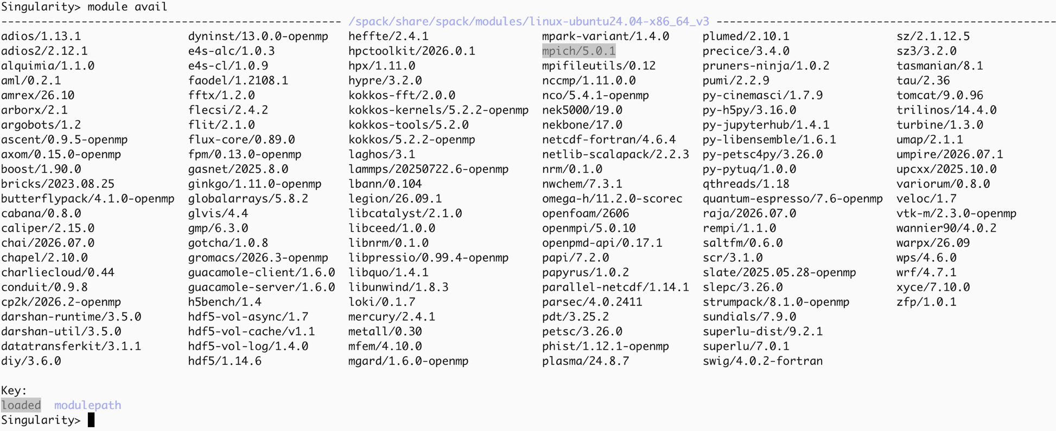
E4S 26.11 Linux x86_64 CPU image Ubuntu 24.04 LTS packages

Slide 25
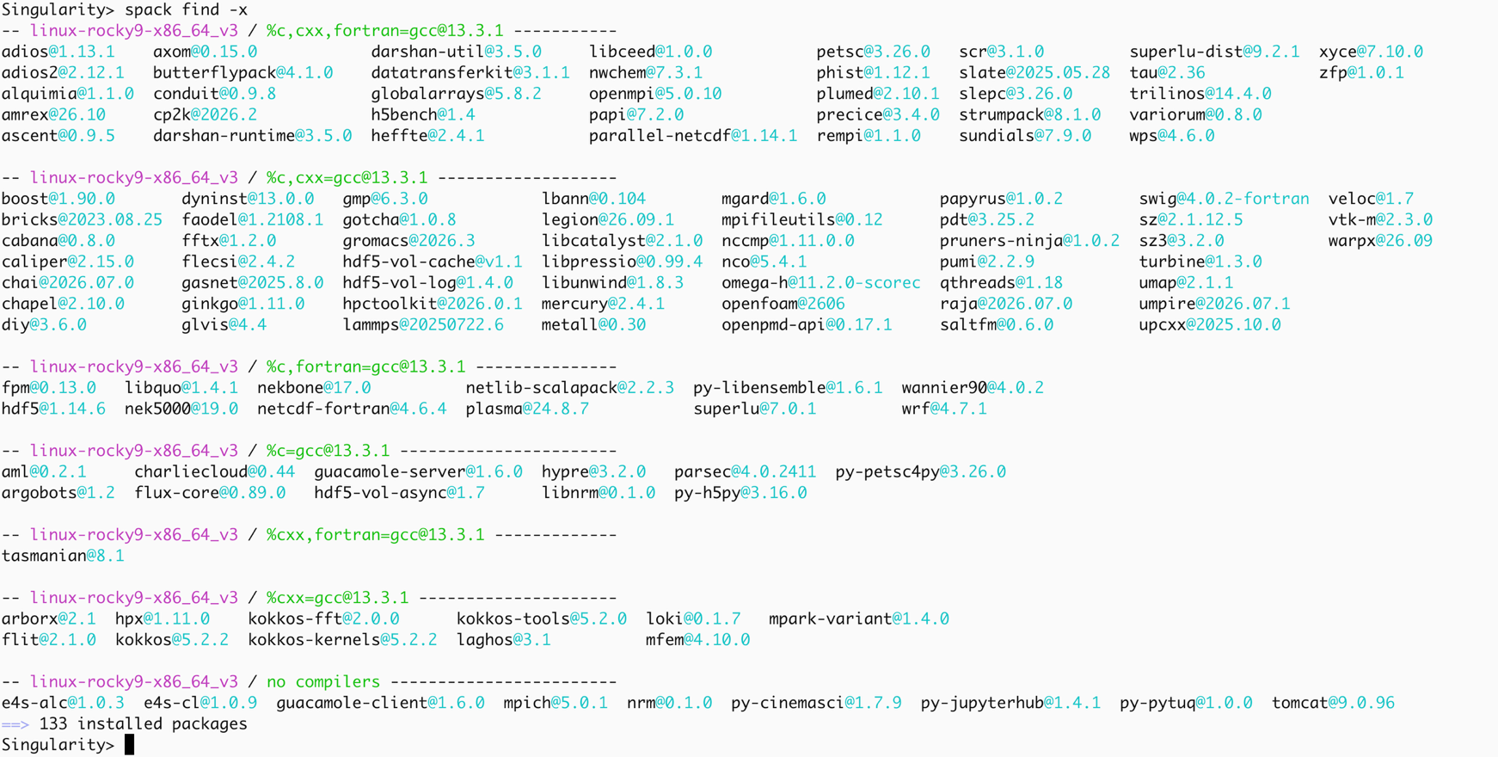
E4S 26.11 Linux x86_64 CPU image Rocky Linux 9.8 packages

Slide 26
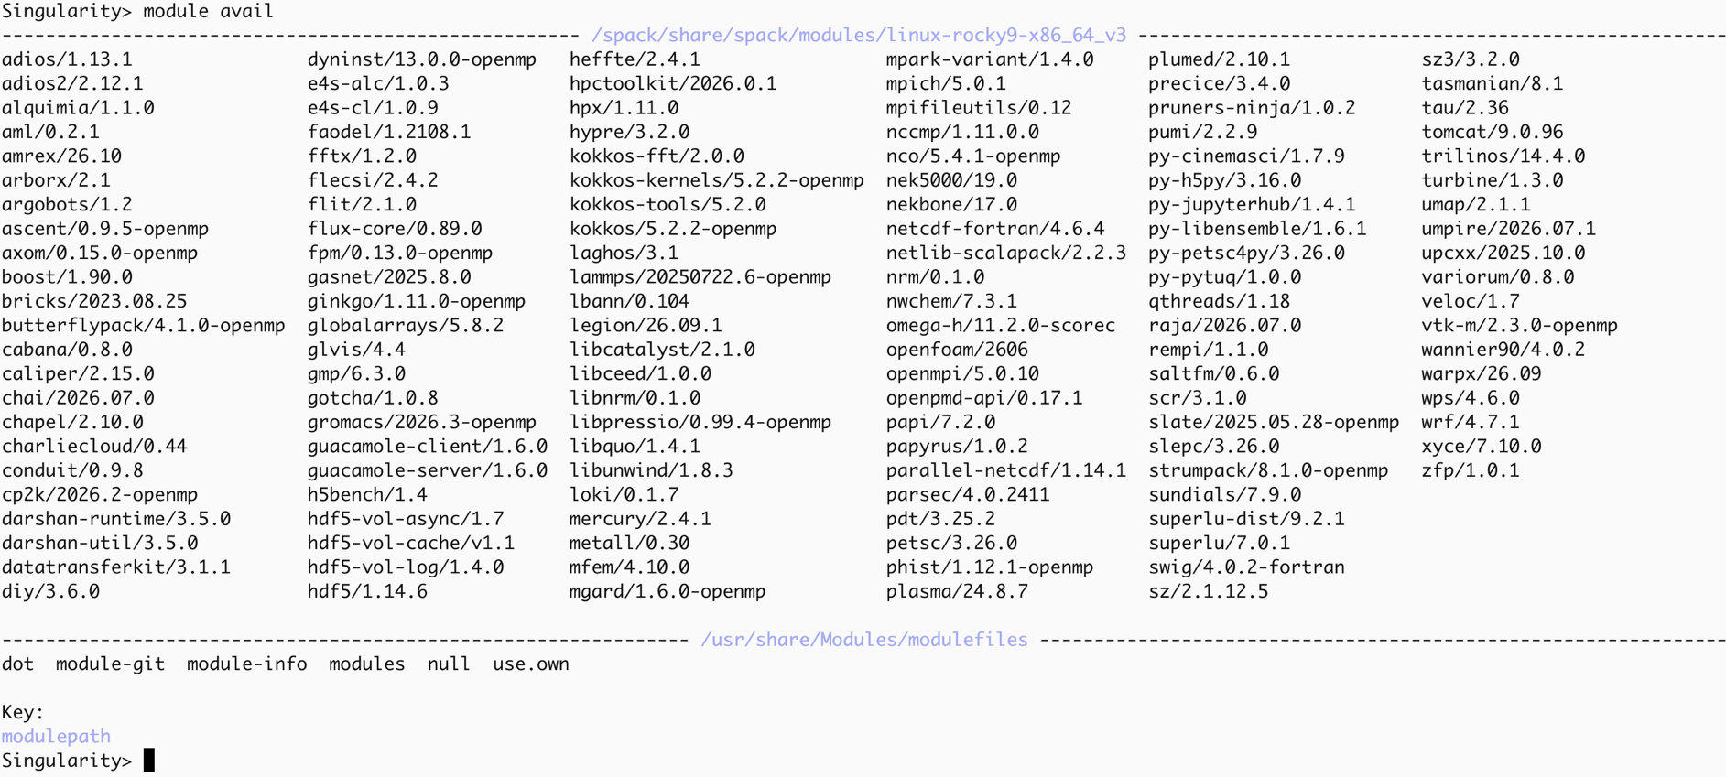
E4S 26.11 Linux x86_64 CPU image Rocky Linux 9.8 packages

Slide 27
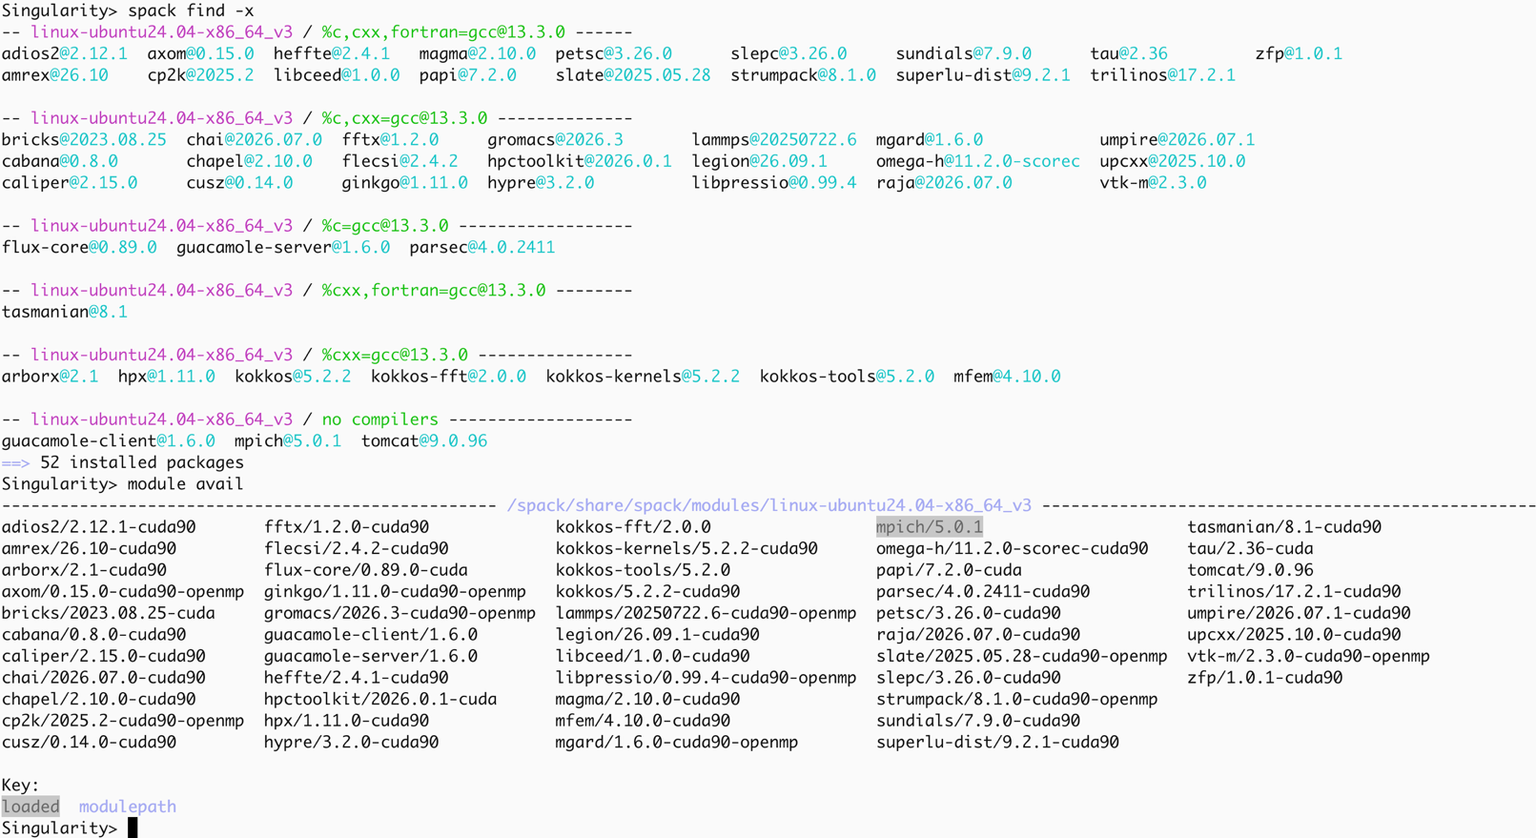
E4S 26.11 Linux x86_64 GPU image Ubuntu 24.04 LTS packages
GPU image optimized for size by GPU type: NVIDIA H200 (cuda90)

Slide 28
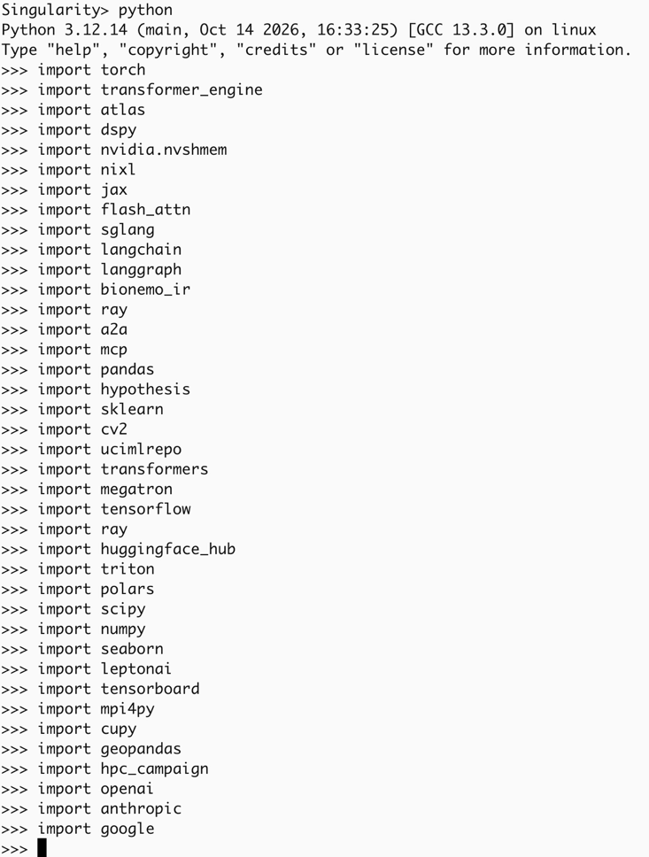
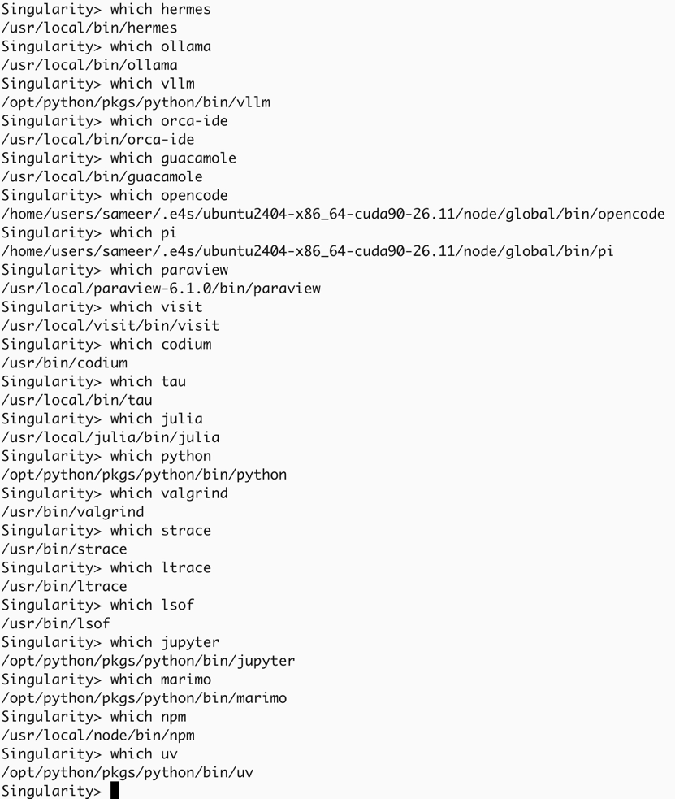
E4S Tools: Python and system tools

Slide 29
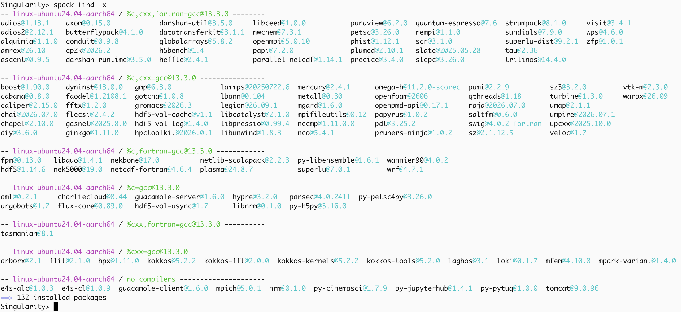
E4S 26.11 Linux aarch64 CPU image Ubuntu 24.04 LTS packages

Slide 30
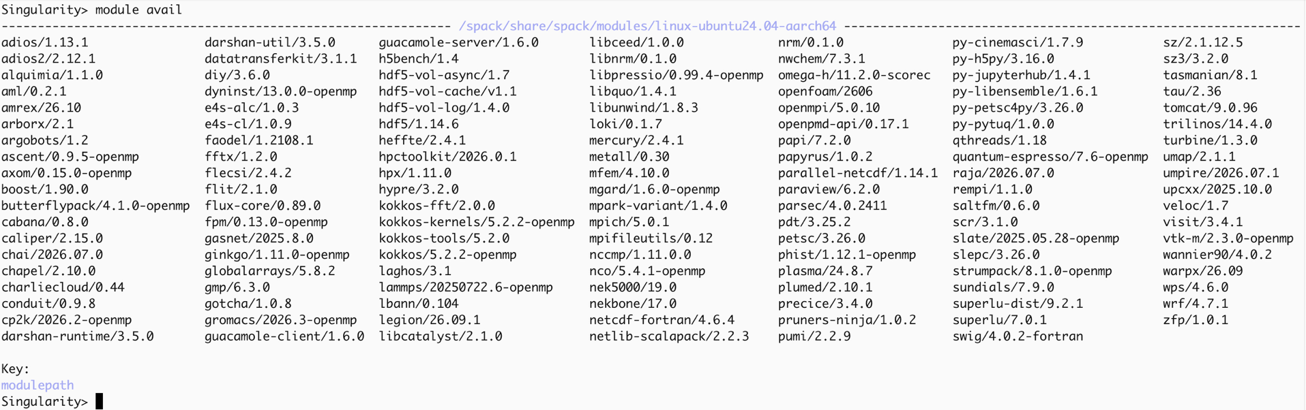
E4S 26.11 Linux aarch64 CPU image Ubuntu 24.04 LTS packages

Slide 31
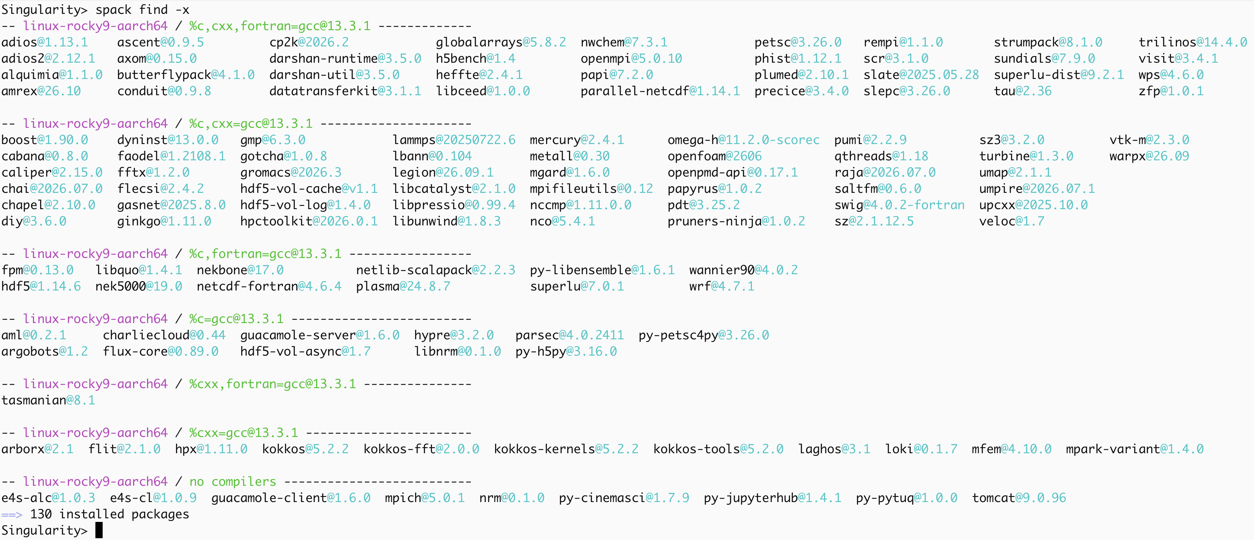
E4S 26.11 Linux aarch64 CPU image Rocky Linux 9.8 packages

Slide 32
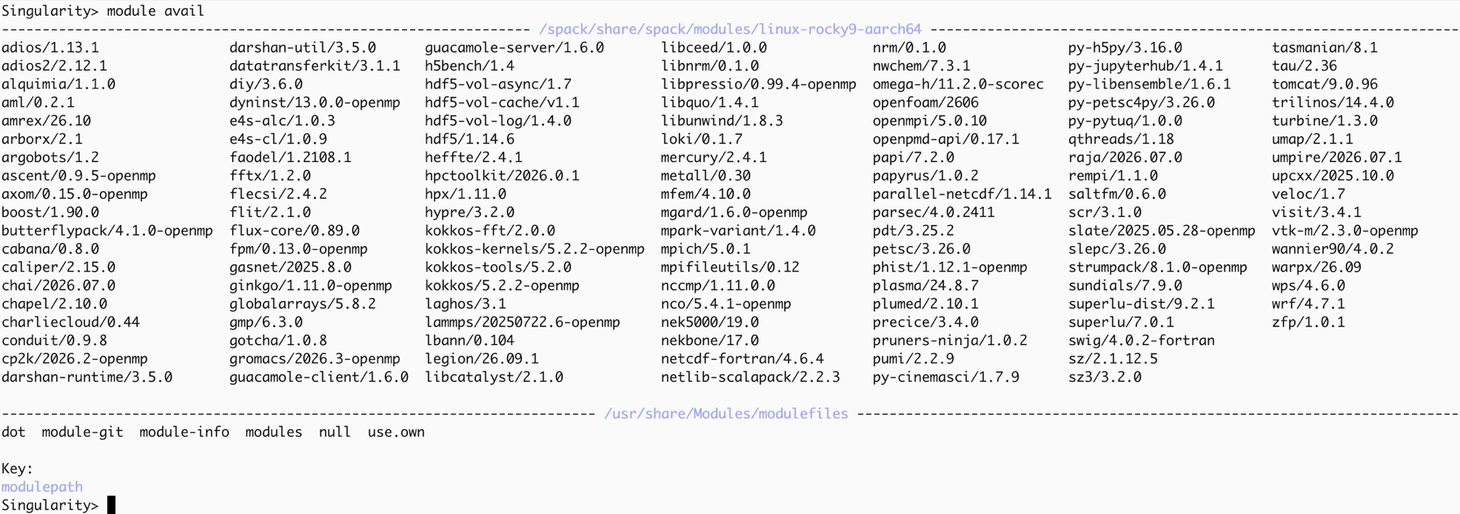
E4S 26.11 Linux aarch64 CPU image Rocky Linux 9.8 packages

Slide 33
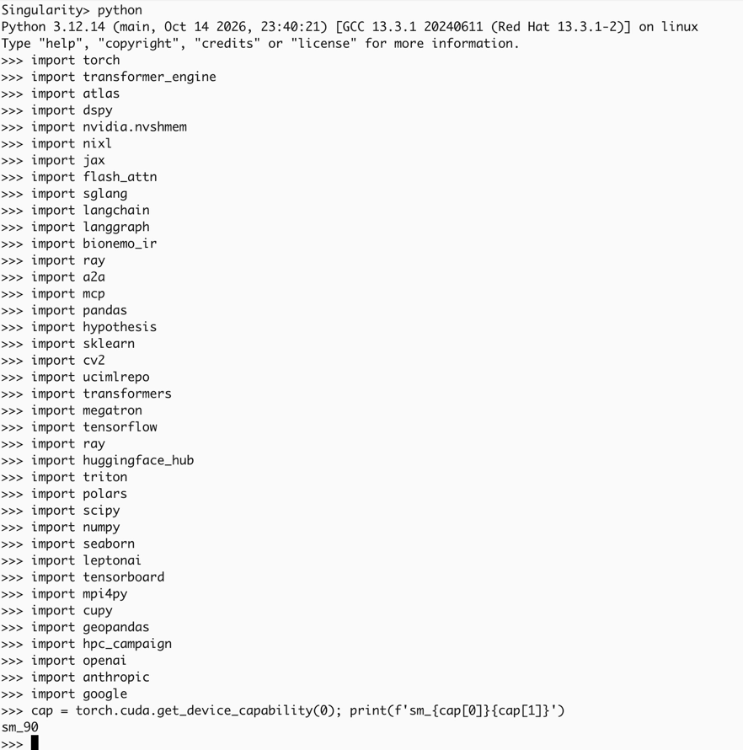
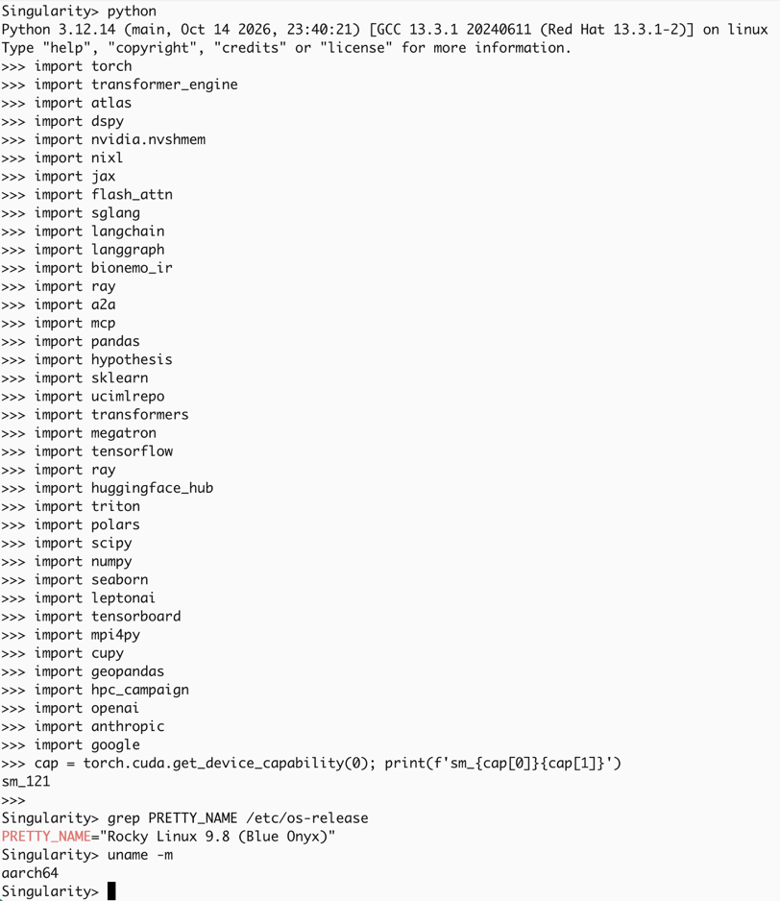
E4S 26.11 GPU image aarch64 Python packages
NVIDIA Grace Hopper
NVIDIA Grace Blackwell

Slide 34
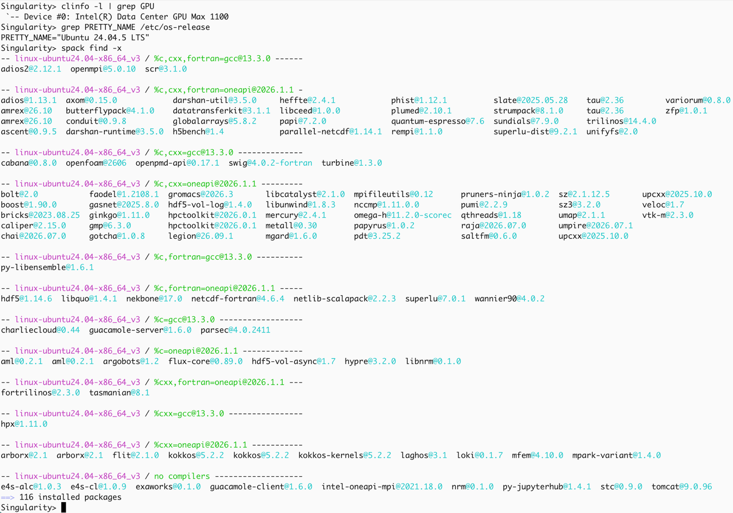
E4S 26.11 Intel oneAPI GPU image Ubuntu 24.04 LTS packages

Slide 35
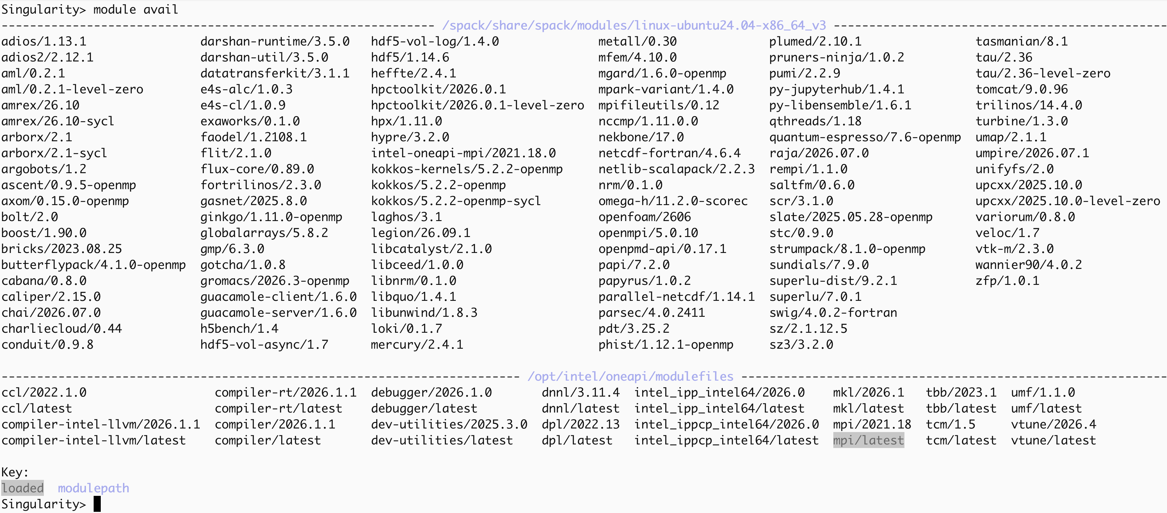
E4S 26.11 Intel oneAPI GPU image Ubuntu 24.04 LTS packages

Slide 36
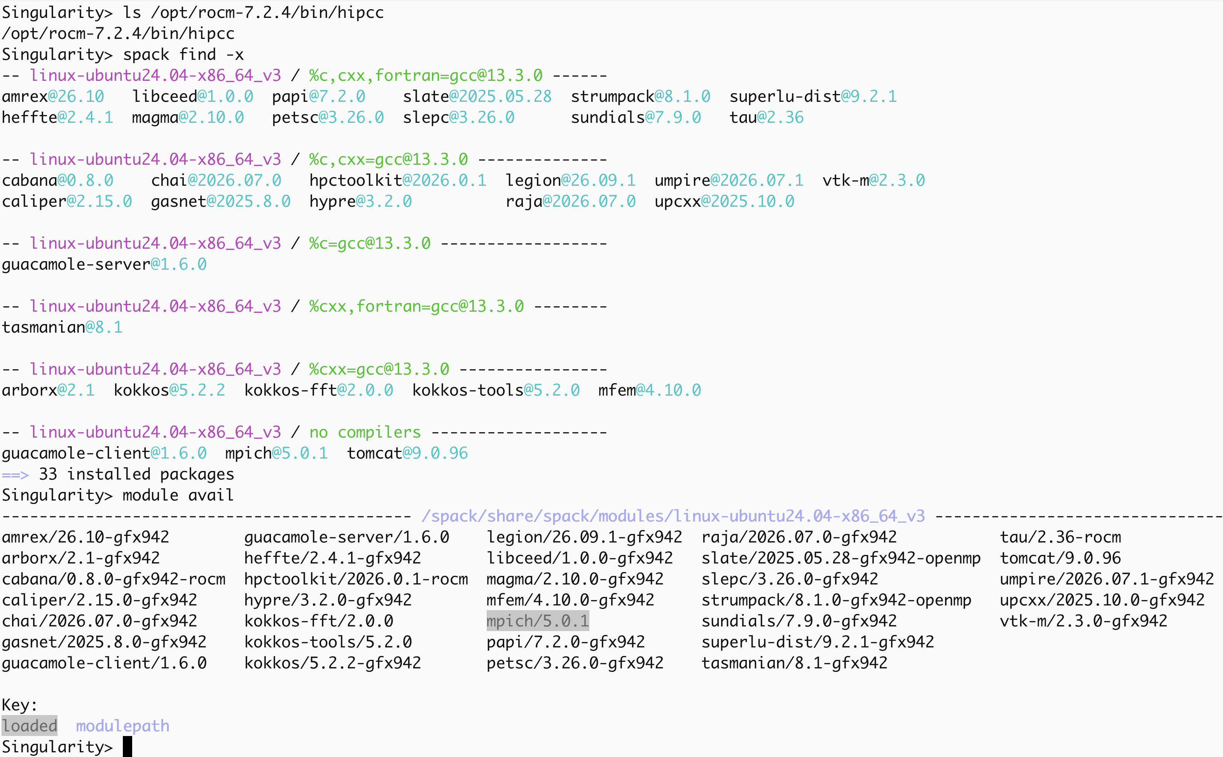
E4S 26.11 AMD ROCm 7.2.4 GPU image Ubuntu 24.04 LTS

Slide 37
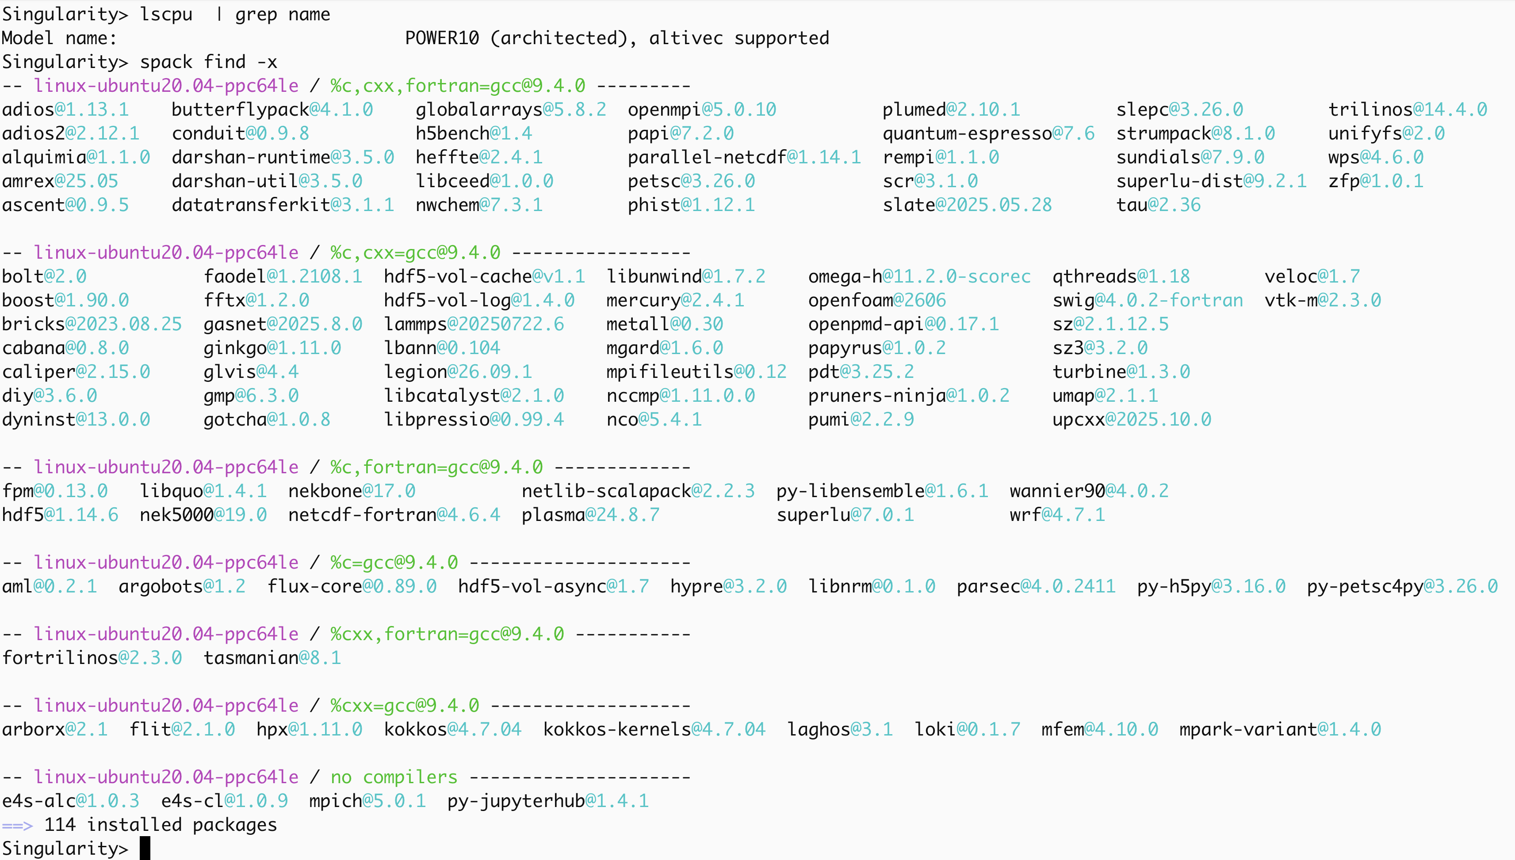
E4S 26.11 ppc64le CPU Ubuntu image

Slide 38
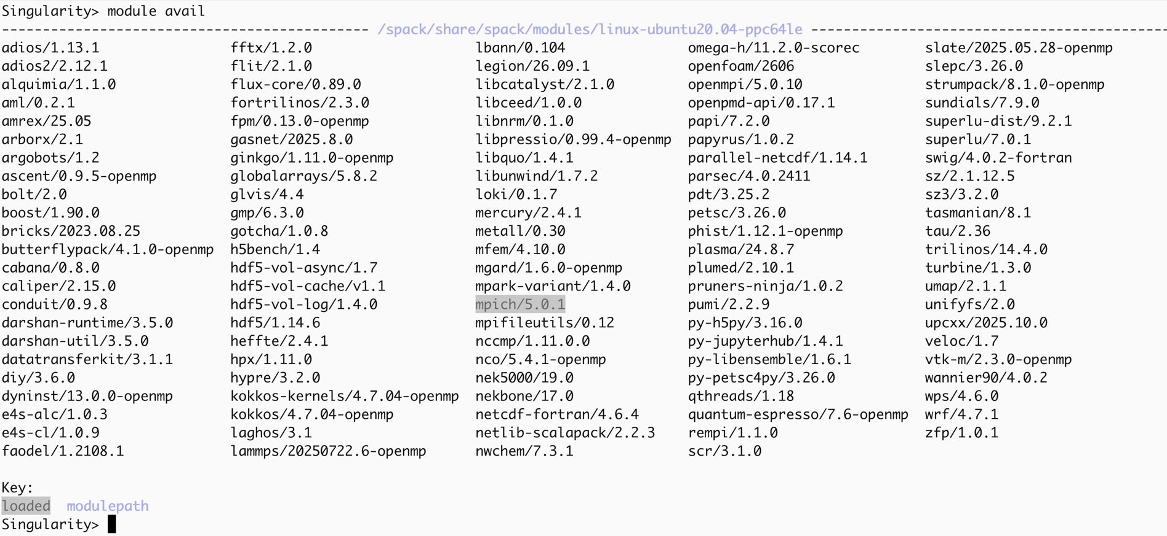
E4S 26.11 ppc64le CPU Ubuntu image

Slide 39
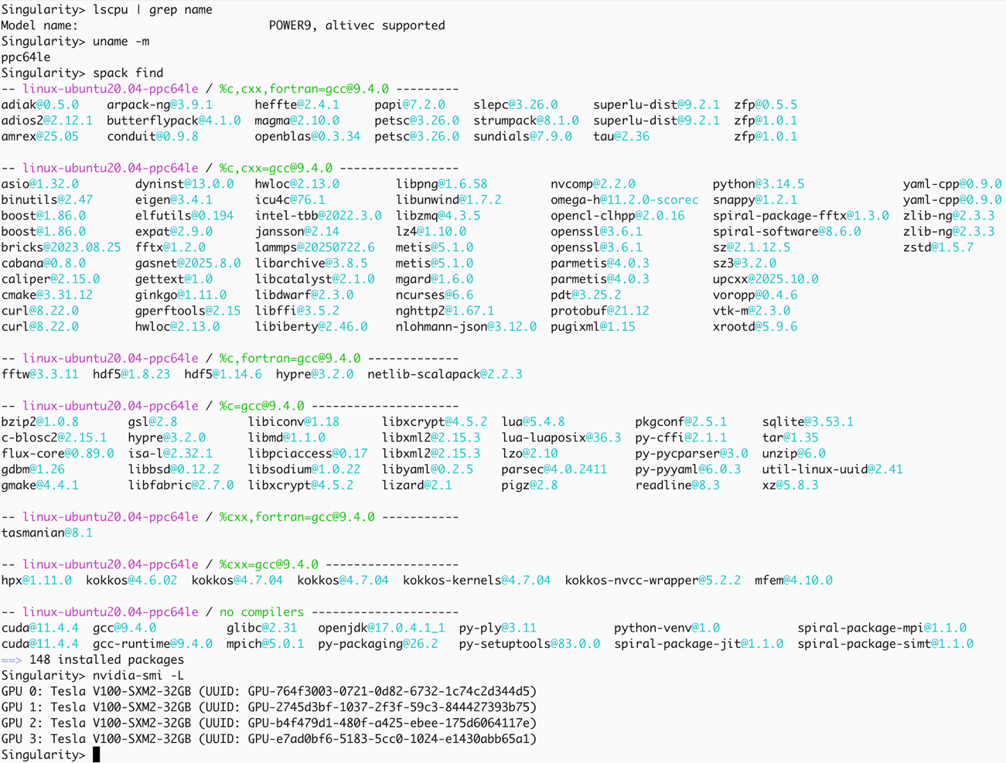
E4S 26.11 ppc64le GPU Ubuntu image

Slide 40
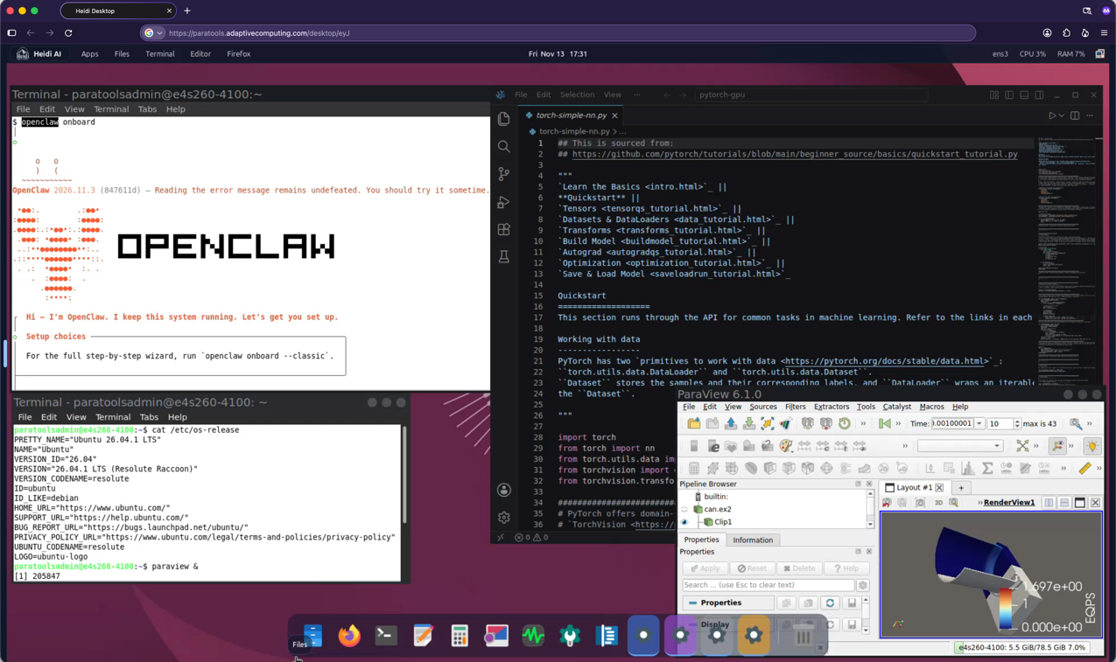
ParaTools Pro for E4STM: HPC-AI Software Ecosystem on Clouds
Adaptive Computing’s Heidi AI web-based platform for multi-user, multi-node, ParaTools Pro for E4STM image with
Ubuntu 26.04 LTS and Rocky Linux 9.8 images on AWS, Microsoft Azure, Google Cloud, OCI, and IBM Cloud.
      https://adaptivecomputing.com/ and https://paratoolspro.com

Slide 41



Acknowledgment
This material is based upon work supported by the U.S. Department of Energy, Office of Science, Office of Advanced Scientific Computing Research, Next-Generation Scientific Software Technologies program, under contract numbers DE-AC02-06CH11357, DE-AC05-00OR22725,
DOE SBIR DE-SC0022502, Sandia National Laboratories Contract PO 2542488, and NSF OAC award 2311831.
https://science.osti.gov/ascr
https://pesoproject.org
https://ascr-step.org
https://hpsf.io
https://www.energy.gov/technologytransitions/sbirsttr

Slide 42


