Slide 1
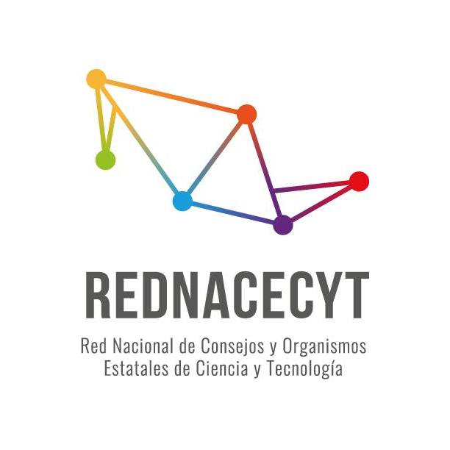

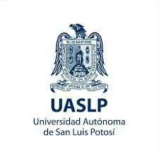



CONDITIONS THAT INCREASE THE VULNERABILITY OF NAHUA WOMEN TO OBSTETRIC VIOLENCE
Hernández Hernández Eduarda-Mexico / Dre. Zapata Daniela totur of REDNACECYT
INTRODUCTION
METHODOLOGY
ARTIFICIAL INTELLIGENCE / ALGORITHMS
Indigenous women face various types of violence, with obstetric violence being particularly common. To address this problem some Mexican states classify it as a crime.
Indigenous populations are especially vulnerable to this type pf violence due to limited access to health services, due to both geographic and cultural barriers, and the normalization of discrimination and social mistreatment.
This was a qualitative study using convenience sampling in four communities of the Huasteca Potosina region due to the COVID-19 health pandemic. First, women who met the selection criteria were identified. Subsequently, personal visits to their homes were made, adhering to all preventive measures recommended by health authorities. The lead researcher ensured that all these preventive measures were followed.
A digital platform that highlights obstetric violence through the voices of indigenous women can help increase visibility of this issue.
RELEVANT LITERATURE
RESULTS
Obstetric violence: women’s perceptions during childbirth care in two rural hospitals in the Nahua-Mixteca region (In Spanish). I.G. Martínez-Velasco et al. 2024.
Connecting with the body and inner wisdom: analysis of experiences of obstetric violence and collective healing in San Pedro Cholula, Puebla (In Spanish). Ramírez Arjona 2024..
RESEARCH GOALS
Delays in care do not only occur during prenatal care but also at the most vulnerable moment for women: childbirth. At this critical time, delays in care are perceived and experienced as a denial of care and even as an act of abandonment.
Feeling unprotected during this experience is reinforced by other omissions in care, particularly in communication. Women do not feel considered by healthcare personnel, as they report not receiving information about the protocols and examinations performed on their bodies, which generates emotions such as fear, annoyance, and indignation, which are also not communicated to the staff.
Verbal mistreatment is significant because it permanently affects the image these women have of healthcare personnel, instills fear, and restricts their initiative to seek institutional health services.
Additionally, there is a documented intention and practice focused on seeking sterilization, which we identify as an act of obstetric violence. This is because the way in which women are pressured to undergo sterilization is not based on the recognition and guarantee of their rights but rather as an imposition from the “legitimate knowledge of medicine.”
Analyze the conditions that increase the vulnerability of Nahua women to obstetric violence.
LONG-TERM CONSEQUENCES OF OBSTETRIC VIOLENCE
SAMPLE
Experiencing obstetric violence in healthcare institutions increases the likelihood that both the woman and her family will avoid seeking medical care during illness, leading to high rates of morbidity and mortality.
10 women of reproductive age (15-49 years), who have experienced childbirth in the last 36 months and are originally from an Indigenous community in the municipality of Tamazunchale.
“I’m really scared to even talk about what happened. Sometimes I think that if I tell them everything, they might not want to treat me in the hospitals anymore. You know, they are the ones who decide who to treat and who not to.” — Anonymous, 2021.
REFERENCES:
Delgado Ballesteros, G. (2018). Construcción social del género. En Delgado Ballesteros, G. (Ed.), Contruir caminos para la igualdad: educar sin violencias (pp. 23-60). Instituto de Investigaciones sobre la Universidad y la Educación.
Consejo Nacional de Población. (2022). Informe anual sobre la situación de pobreza y rezago social 2022 (San Luis Potosí-Tamazunchale). https://www.gob.mx/cms/uploads/attachment/file/698427/24_037_SLP_Tamazunchale.pdf
Celaya, A. (2023). Partería tradicional y regulación de la práctica: conflictos con el Estado y permanencia de legitimidad del conocimiento. Jurídica Ibero, 7(14), 39-66. https://juridica.ibero.mx/index.php/juridi/article/view/157/107
Campligia Calveiro, M. (2017). La institucionalización del nacimiento: el vínculo roto. [Tesis de doctorado no publicada]. Centro de Investigaciones y Estudios Superiores en Antropología Social. https://ciesas.repositorioinstitucional.mx/jspui/bitstream/1015/643/1/TE%20C.C.%202017%20Mercedes%20Campiglia%20Calveiro.pdf

