Slide 1



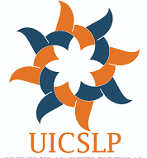


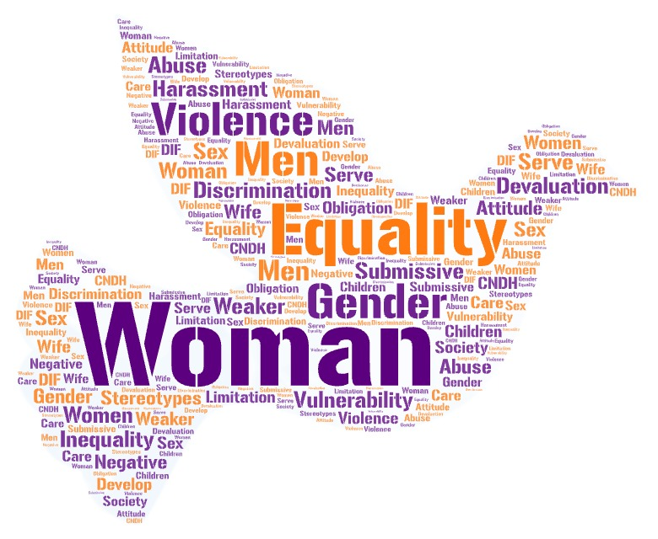
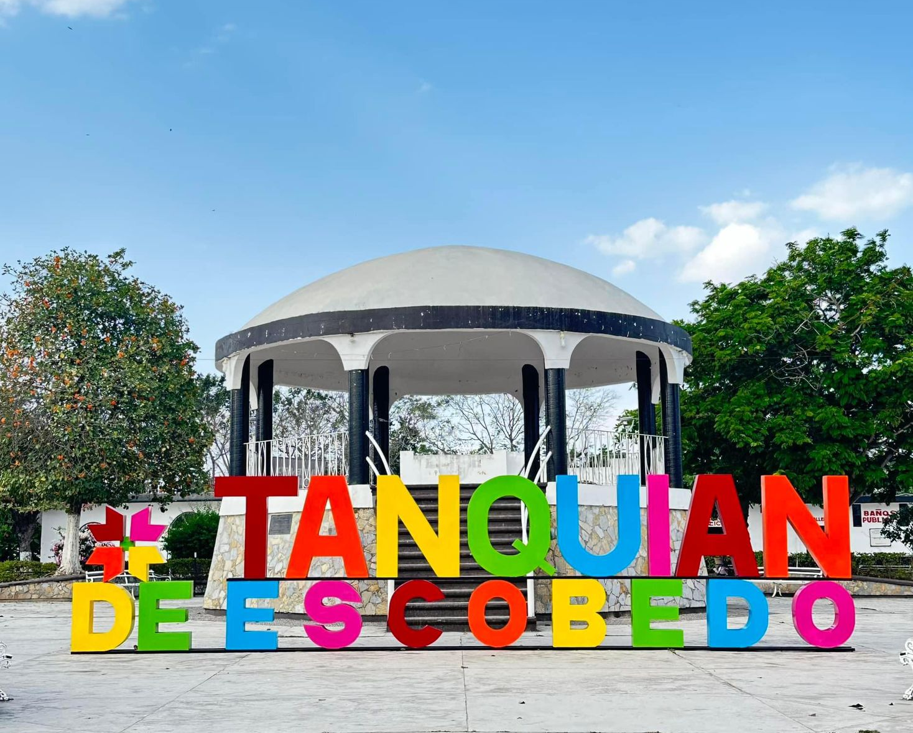
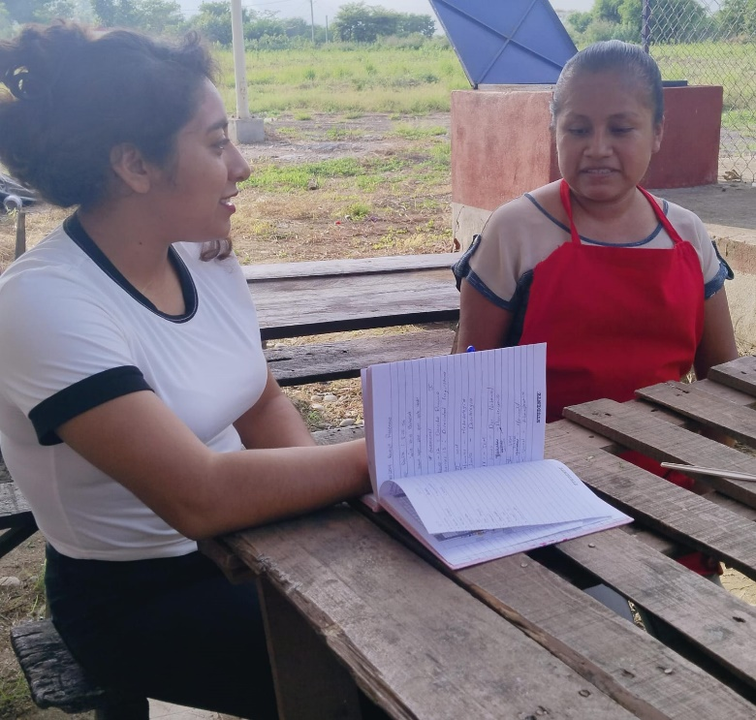
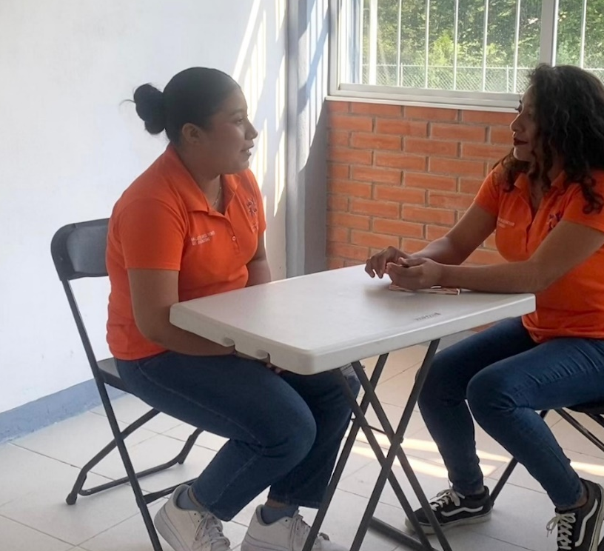
MACHISM AS A LIMITING FACTOR IN THE FREE DEVELOPMENT OF WOMEN
INTRODUCTION
BACKGROUND & LITERATURE
Machismo is “A mandate according to which women must be passive, subordinate to men and remain in the private sphere” (Sandoval, Reyes, & Santiago, 2018, page 401).
Machismo is a widely discussed topic and is present throughout the world, which is why the content of this research aims to explain it. This term is conceived as an ideology that considers women to be inferior in one or more aspects to men “…In machismo, women are the negative equivalent of men, hence their inferiority, hence the need to subject them.” to an order” (Sandoval, et al., 2018, p. 401).
From my own perspective, we long for a society in which men are not repressed for expressing their feelings and women are not labeled as submissive and in need of male protection. The work that is still missing is arduous, but it must be based on concrete and scientific facts resulting from formal investigations of how current societies develop, what are the processes of male protection in the environment, in order to be able to propose lines and action strategies that generate possible solutions for free human development, especially that of women.
This research will focus on the study and analysis to learn about the presence of machismo in Tanquián de Escobedo in its different areas (school, at home, at work and socially), thus collecting real, clear and precise information on impacts. that it has generated in the population and how it has become present in society since there are still gender prejudices towards women that occur on a daily basis and have not been analyzed from a gender perspective.
The investigation of this problem was carried out with the purpose of knowing all the reasons and circumstances that lead to taking this type of attitude within a certain context. Likewise, the purpose is to analyze what machismo is and propose some actions to eradicate this phenomenon in the municipality of Tanquián de Escobedo.
Machismo can be defined as an ideology derived from sexism that defends and justifies the superiority and dominance of men over women; in it, masculine qualities are exalted, such as aggressiveness, independence and dominance, while feminine qualities, such as weakness, dependence and submission, are stigmatized. Machismo has caused women to be unjustifiably discriminated against in different areas and in extreme cases they have even been denied the same rights as men (Arteaga Barba, et al., 2021, p. 46).
In most cultures the idea of ​​the masculine emerges as central, while the feminine appears as marginal. The most harmful effect of the above is sexism, that is, the discrimination of one sex because it is considered inferior to the other. Women have historically been discriminated against under the argument that their biological and physiological characteristics, closely related to menstruation, gestation, childbirth and breastfeeding, closely link them and subject them to the laws of nature; while men, precisely on the contrary, would be closer to the creation of culture and the laws of thought (Inter-American Court of Human Rights, 2007). Considering this premise, the research was developed in the contexts of the Tenek and mestizo cultures that cohabit in the municipality of Tanquián de Escobedo, to know the perspectives of machismo from these two cultures, outlining the role that men and women play in society according to the precepts that each culture has of being masculine or feminine. Some research maintains that the characteristics of the sexist attitude began to appear since the first civilizations. In ancient societies, the way in which women contributed was mainly through reproduction and care of children, while the production of goods and the making of laws corresponded mostly to men. For this reason, masculinity came to be conceived as an instrumental orientation that involves carrying out tasks and solving problems (Arteaga Barba, et al., 2021, p. 46). Ideology that still prevails in the contexts investigated.
Sexist language is a concrete manifestation of the idea that women do not experience equal status with men. In the 19th century, reflections on this inequality began, based on feminist studies on linguistics. Since that moment, there has been slow progress in efforts to consolidate non-sexist language and apply it to the characteristics of each community to eliminate the consequent discrimination (Inter-American Court of Human Rights, 2007). The fight for women's suffrage in other parts of the world also inspired Mexican women to form, in 1916, the first Feminist Congress in Mérida Yucatán, in the midst of the social transformation that our country was experiencing after the Revolution.
PROBLEM STATEMENT
up to eradicate this human behavior that is unacceptable. According to the report Findings from the local 2022, in San Luis Potosí the impunity rate for crimes that involve violence with a gender perspective rises above 90%; crimes such as sexual abuse at 98.9%, rape at 96.4%, family violence at 99.8% and feminicide at 90.5%. The veiled and elusive machismos that we experience daily are an adaptation of traditional machismo to new social scenarios (De la Garza & Derbez, 2020, page 14).
Machismo is manifested in different scenarios of the municipality; in the workplace, companies are a reflection of a patriarchal society, that is, sexist behavior at work results in, for example, hiring a woman as a personal assistant and explicitly expecting her to perform more tasks, beyond those required by the role (such as making coffee, performing personal tasks for the boss, among others).
There is a series of occupations, generally intended for women, such as receptionists, flight attendants, hostesses, assistants, because it is based on the idea that they are “the first thing the client sees” and therefore must offer a certain physical attractiveness, that is, function as a kind of ornament with legs and a big smile, ready to brighten the eyes of whoever looks at it (De la Garza & Derbez, 2020, page 39).
Likewise, in the school environment the same sexist and violent behaviors are exercised by the student community towards women, both students and administrative teaching staff:
I remember there was a boy who bullied me all the time and when I accused him of it with the teacher she said: “He just likes you”… Nice way to show it! Apparently, in the face of that, there was nothing to do, we had to show empathy with the child and let him do it, instead of teaching him to express his emotions in a non-aggressive way (De la Garza & Derbez, 2020, page 131).
In the family, it is reflected through the privileges that are granted to a man (such as being able to work, leave the house, etc.) and women are only designated to perform household chores just because they are women, limiting them. to carry out other activities.
“…The man must fulfill the role of protector and provider and the girl that of caretaker of the home and children, accepting machismo without objection and assuming as correct the functions established for each sex” (Sánchez Ríos, Ramírez Cuartas, Márquez Vergara , & González Bedoya, 2022)
Machismo takes place causing fear, shame, loss of authority, uncertainty and limitation in women to develop their skills, abilities and capacities in certain activities that must be carried out equally.
It is necessary to emphasize that many efforts have to be made to eliminate the problem at its roots, but each effort made will generate awareness in the attacked women and, if possible, in the aggressors, which little by little will help to restructure the social fabric building a different ideology in the new generations where men and women can fully enjoy their rights as well as the self-determination to enjoy life attached to what our laws and our Political Constitution of the United Mexican States establish.
This research will focus on the study and analysis to learn about the presence of machismo in Tanquián de Escobedo in its different areas (school, at home, at work and socially), thus collecting real, clear and precise information on impacts. that it has generated in the population and how it has become present in society since there are still gender prejudices towards women that occur on a daily basis and have not been analyzed from a gender perspective.
"Where someone fights for their dignity, for equality, to be free... Look them in the eyes." Bruce Springsteen.
Machismo is a problem that has been directly perpetuated on women, causing consequences on the emotional state, long-term physical effects, mental health, among others, promoting violence against women defined as “any action or omission, based on their gender, that causes psychological, physical, patrimonial, economic, sexual damage or suffering, or death in both the private and public spheres” (General Law on Women's Access to a Life Free of Violence, 2024, p. 3).
It is a social problem that damages the well-being mainly of women and becomes a public problem because many women are violated and attacked, but there are few cases that are addressed provides timely follow-
METHODOLOGY
RESULTS
To carry out this research, a qualitative methodology was used, studying certain sexist aspects in the municipality of Tanquián de Escobedo, whose data were collected under field research through interviews, visits to institutions where the observation was carried out, consultations of information on statistics provided by government agencies and research projects in relation to machismo.
Investigating the experience of machismo involved generating instances of contact with people where they were able to relate their opinions and experiences from their own perspective. One of the advantages that the qualitative methodology provided is that it allowed us to investigate, in this case, a phenomenon that is related to social reality from very diverse points of view.
By conducting interviews with different people to find out what they think or know about machismo, it was discovered that the inhabitants of the municipality of Tanquián de Escobedo define that machismo is the negative belief or ideology that men have with respect to women. Also, they are behaviors that are based on the belief of being superior to people of a gender other than the male sex. Considered a problem that has grown in society, it mainly affects women because men perceive women as the weaker sex and go so far as to physically, psychologically and sexually violate them. Some interviewees responded that machismo is:
“They are behaviors, attitudes and behaviors about gender roles and stereotypes” (35-year-old woman, teacher).
“There are several behaviors that I consider it entails, the most outstanding is the arrogance that the male gender has over the female gender. From this arises discrimination, violence, harassment” (26-year-old woman, worker at a banking institution)
Likewise, the results of the surveys allow us to see that sometimes it is difficult to detect signs of machismo because they are attitudes considered everyday within society. However, citizens recognize machismo through the following signs: violence, discrimination, “joking” offenses, etc. and they also mention that they mostly occur in the intra-familial area.
Within the ideas expressed, the individuals responded that sexist attitudes are treated through dialogue, going to the corresponding authorities, seeking a viable solution depending on the severity of the offense committed regarding this behavior.
Regarding the factors that intervene so that machismo continues to occur, one of the main responses mentioned was that the education that men receive from home, the values ​​and manners influence their daily behavior. Women take into account that one of the problems that machismo has brought to their lives is that they have not been able to develop or perform in the job of their choice, because their husbands or fathers have limited or belittled them because they think they have less ability to carry out said activities, and that they only serve to do housework and take care of children, among other things.
“Sometimes I can't go out to play soccer because I have to wash my brothers' clothes” (21-year-old woman, university student)
“There were times when I was discriminated against at work, referring to the fact that as I was a woman I did not have to work but rather take care of my family and my husband one hundred percent. Even my own family did it and I have also received harassment for my way of working.” dress (40-year-old woman, housewife)
After carrying out an analysis of the questions, it was identified that one hundred percent of women affirm that they have suffered the sexist phenomenon in different areas in society, at work, in the family and in the social sphere, ranging from small phrases sexist, to harassment and family violence. In the case of men, they deny having seen or carried out any sexist act, which is why it becomes a problem that only affects the most unprotected sectors of society such as women, children and even men with different sexual preferences.
Despite having ideological differences regarding machismo, men and women agree that it is important to eradicate these attitudes since in this way society would improve and with this problems such as domestic violence, femicides, discrimination could be combated. It is mentioned that we all have the same rights and obligations since we have the same capabilities to perform different tasks in different areas, at the same time that we are equal before the law and society.
Finally, with the information collected through the surveys, it is perceived that both men and women know few agencies that promote the eradication of machismo and gender equality, being the Comprehensive Development for the Family (DIF) and the National Commission of the Human Rights (CNDH) the best known.
In general and according to field research, machismo is a latent problem within society that must work hard to eradicate it, taking into account that it has become a daily part of our lives, which often goes unnoticed. and it is not given the importance or seriousness with which it should be treated, however, there are voices that demand a positive change in society's thoughts and that every effort made to end machismo becomes a significant step for gender equality and that all individuals can enjoy the same rights and duties as established by the Political Constitution.
For the research, the inhabitants of the town of Tanquian de Escobedo were considered, from whom twenty women between 18 and 45 years of age and five men between 18 and 30 years of age were randomly chosen, who underwent ten questions related to machismo. Five of the interviewees ranging from 18 to 22 years of age were taken into account to question them about the influence of machismo in school, at the upper secondary and higher educational level; Five more women who are housewives contributed specific ideas about machismo in the family; Another group of five working women between 20 and 35 years of age was chosen and gave their opinion on machismo in the workplace; Finally, the other five women were taken into account to know their point of view on machismo in the social aspect.
TECHNOLOGICAL REFLECTIONS
Talking about machismo and Artificial Intelligence (AI) is important for our time where this technology is advancing at an unprecedented pace; however, there are still barriers to gender equality even in the development of AI, because it can be seen that machismo is present in these technological advances.
A clear example of these circumstances is virtual assistants like Siri or Alexa that were initially designed with female voices and submissive behaviors, reflecting traditional stereotypes about the role of women. Misues of AI, such as deepfakes, also occurs when falsifying a person's face, which is used to affect someone’s integrity, generally of women. Likewise, AI represents stereotypical algorithms that perpetuate a worldview influenced by machismo and lack of gender equality where men are perceived as the superior sex.
However, not everything represents a disadvantage, because thanks to AI there is greater access to information, communication can be improved and help groups can be found, as well as the ability to identify abusive virtual content that may harm women and girls. It is of great help so that women can develop within their professional lives and be successful with determination, guidance, education and commitment to grow within the areas in which they best perform. AI can be used as an important platform to promote gender equality due to its long reach worldwide and be a spokesperson in the search for equality between men and women by eliminating current stereotypes that threaten women.

