Slide 1

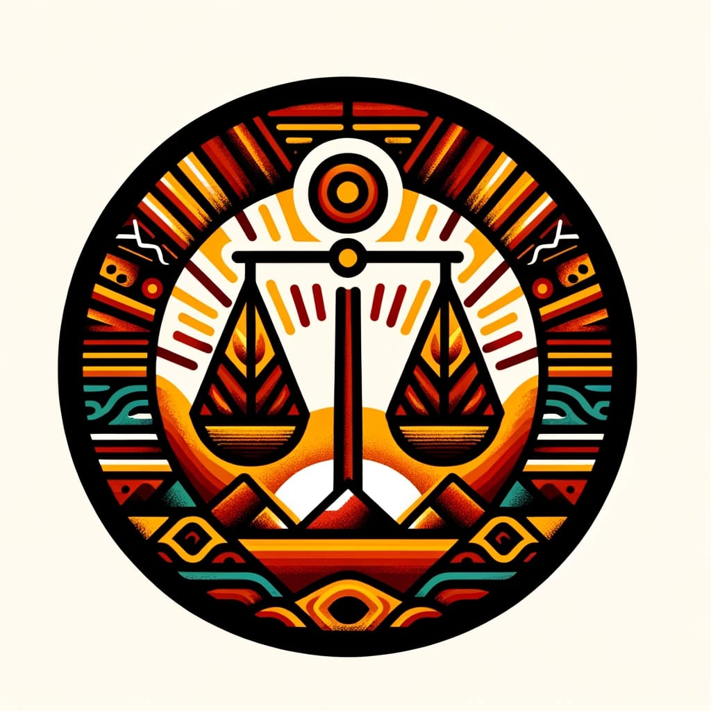
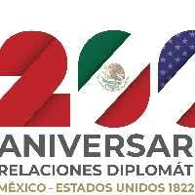
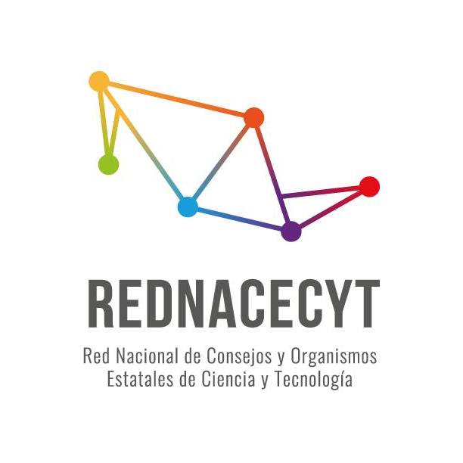
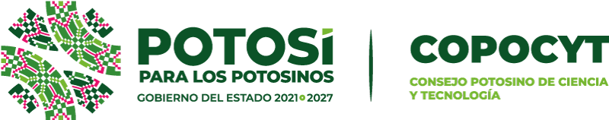

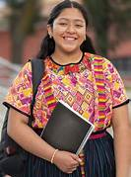
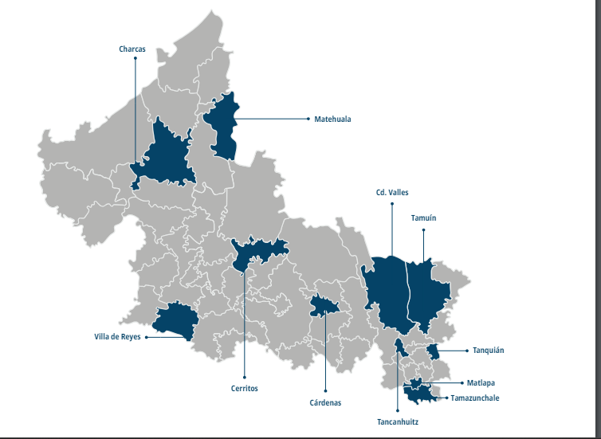
Ver diccionario
ACCESS TO HIGHER EDUCATION FOR INDIGENOUS WOMEN IN THE HUASTECA AREA IN THE TENEK REGION, S.L.P.
Autonomous University of Nuevo León
INTRODUCCION
JUSTIFICACION
In Mexico, there are a large number of illiterate people in both urban and rural areas, and even more so in indigenous communities that have difficulty accessing material and human resources. Three out of ten people are adolescents and young people. Investing in the development of this population group is crucial to closing inequality gaps, promoting social mobility and ensuring the full exercise of their rights. Hence the importance of knowing, based on evidence, the challenges that this population faces. Likewise, the joint participation of international organizations and the government is required through actions to promote the participation and leadership of youth, which will contribute to breaking down the barriers to access to secondary and higher education that they face, as well as guaranteeing the exercise of their rights.
OBJETIVES
In the state of San Luis Potosí, the level and educational characteristics of the population differ according to sex, age and place of residence, with women, and particularly those living in rural areas, being in the least favorable conditions in most cases. In 2005, the illiteracy rate for the population aged 15 years and older was 11.0% for women and 8.7% for men, that is, 2.3 percentage points against women. By municipality, the highest percentages of illiteracy in the female population were recorded in Santa Catarina (37.1%), Aquismón and San Martin Chalchicuautla with 31.1% each. These data beg the question, why are indigenous women from San Luis Potosí not furthering their education?
To identify the perception of indigenous women in the Huasteca area in the Tének region, S.L.P. regarding access to higher education.
PROBLEM STATEMENT
HYPOTHESIS
Indigenous women in Mexico face many obstacles to achieve a higher education degree. Many leave formal education after high school. A question that is still not known, is whether they do this because they do not wish to study any more, or because they don’t believe they have the tools to get there. Despite all the information that is shared online, many indigenous women are still unaware of their rights and the resources publicly available to them to further their education (MEDINA, 2020).
The perception of indigenous women in the Huasteca region of Tének, S.L.P. regarding access to higher education is that there is a lack of economic resources, difficulty in accessing higher education institutions, and a need for academic mobility. They do not yet know that there are resources online that can help them, including scholarships aimed specifically at them.
METHODs
This research is developed through a qualitative process, in which the perception of young indigenous women’s aspirations for higher education is elicited. For the preparation of this research work, I plan to carry out a structured interview. The inclusion criteria for the sample includes all women of high school to university age (16 – 19 years old) from the Tenek region, belonging to the community of Ejido la Lima, municipality of Ciudad Valles in the state of San Luis Potosí. I plan to collect sociodemographic data with a survey before the interview, and participants aspirations and perceptions with regards to higher education through a series of questions during the interview process. To analyze the data, I will use text analysis methodologies, including sentiment analysis and discourse analysis.
TECHNOLOGICAL IMPACT
Online platforms, archives, and social media have increased the reach of legal and educational information. However, this information only reaches a small segment of the population. Indigenous peoples are still not benefitting from the wealth of information online due to a lack of access to online resources and/or being unaware that the information is there.
REFERENCES
Claudia Martinez Martinez
MEDINA, L. G El derecho a la educación de las mujeres indígenas
Tuirán, R. (s.f.). La educación superior en México.
Nolasco, J. M. (Agosto de 2018). Derechos Humanos de las mujeres indígenas

