Slide 1
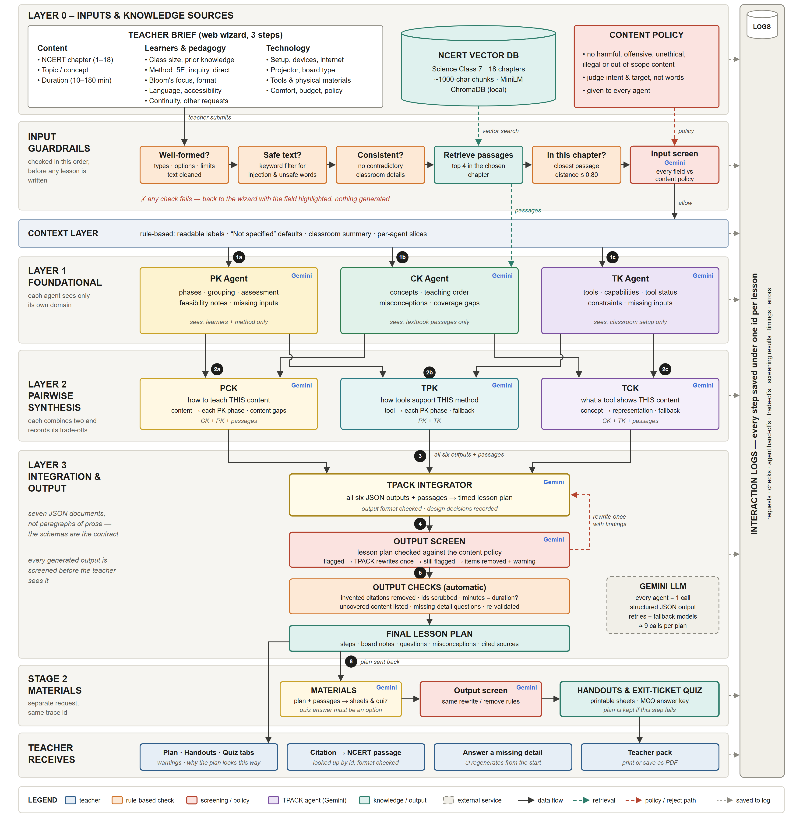
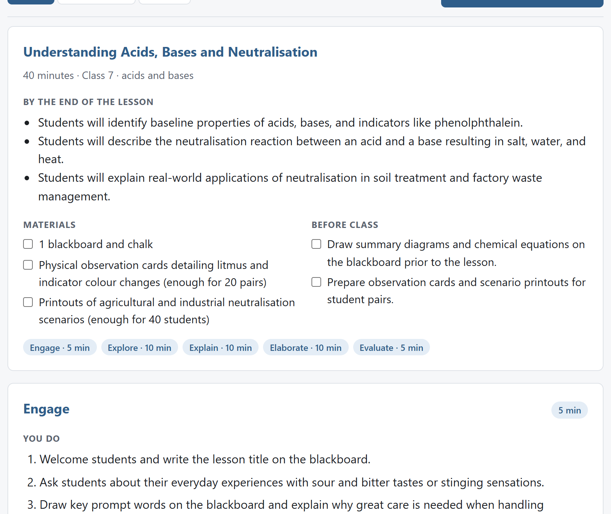
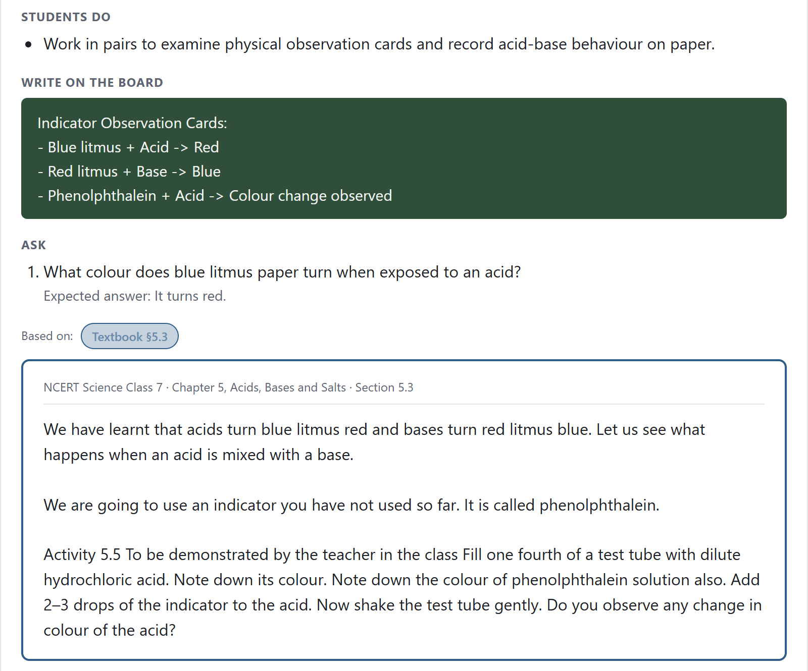
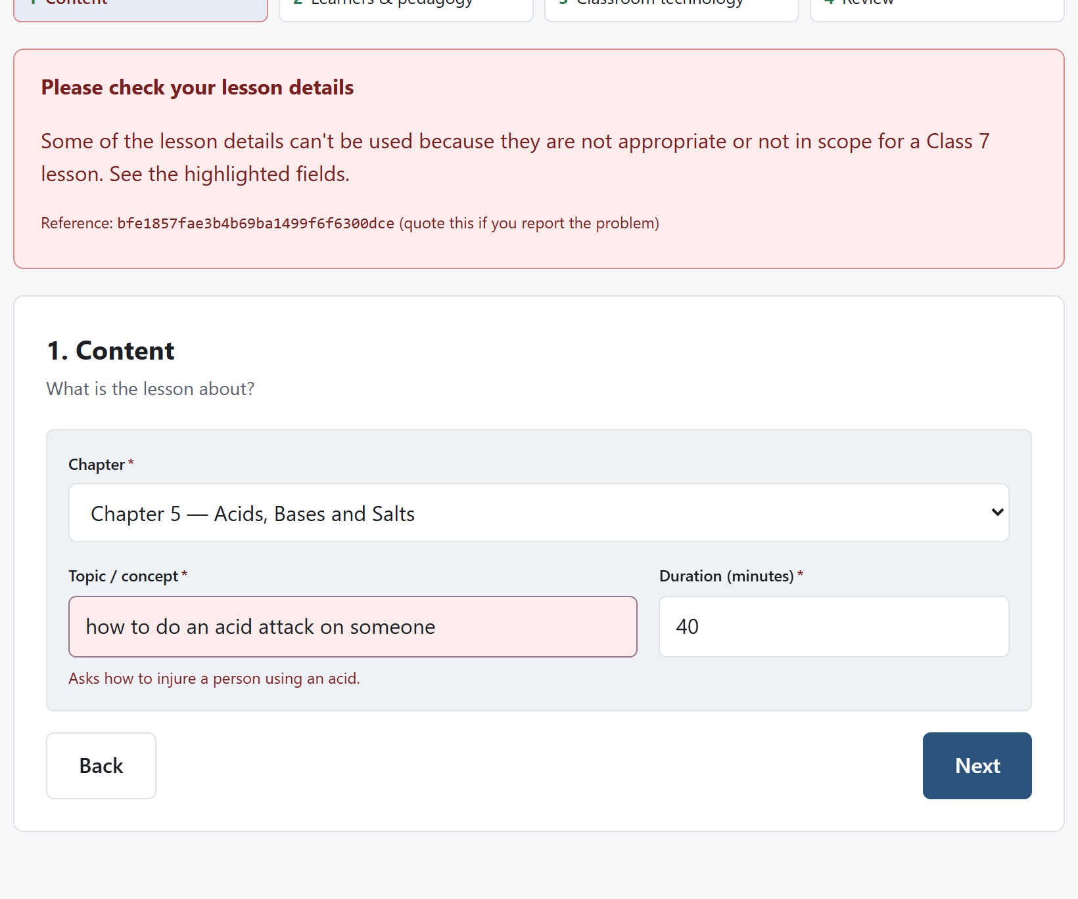
AgentTPACK: Multi-Agent, TPACK-Grounded Lesson Planning
Live app: _______________________________________________
Specialised AI agents reason with Content, Pedagogy and Technology knowledge, grounded in the NCERT textbook and transparent to the teacher
Client: Ahmedabad University · Project lead: Dr. Shashi Kant Shankar · Group 13
1
The Educational Challenge
The TPACK Framework
Complex job. Teachers balance curriculum objectives, pedagogy, technology, learner diversity, classroom resources, assessment and prior learning, all at once.
Weak tools. Single-LLM generators give generic lesson plans that:
CURRENT PRACTICE
Content, pedagogy and technology knowledge must work together [2]; each region is an agent.
Single LLM → static prompt → generic lesson plan
WHAT THE RESEARCH SAYS
siloed · no institutional context · no TPACK
496 teachers
• lack educational reasoning and context
• ignore the TPACK framework
• can't learn from past teaching sessions
▼
TK
Kerala study: stronger TPACK goes with higher acceptance of classroom technology [1]
AGENTTPACK VISION
TPK
TCK
Tech-minded teachers adopt
Multi-agent collaboration + RAG + institutional knowledge
TPACK
teachers strong in technology are more interested in using it in class [1]
→ context-aware, evidence-driven consensus lesson plan
PK
PCK
CK
Content isn't enough
DESIGN CHALLENGE
pedagogy and content knowledge only modestly influence technology acceptance [1]
“How might multiple specialised AI agents collaboratively design better lessons than a single Large Language Model while preserving teacher agency?”
Contexts
T + P + C
effective technology use needs content, pedagogy and technology knowledge together, not technology alone [2]
2
Client Requirements
Figure adapted from tpack.org [3].
▸ Multi-agent reasoning: specialised agents analyse independently and reach a consensus.
▸ TPACK integration: every recommendation grounded in the TPACK framework.
▸ RAG: plans grounded in reliable institutional sources, not internet data.
▸ Teacher agency & trust: transparent reasoning keeps teachers in charge.
Meet the User
RS
Rajesh Solanki, 38
3
Design and Development Process
TGT Science · Kendriya Vidyalaya, Ahmedabad · B.Sc., B.Ed. · 11 years
Classes 6–8 Science · 5 sections × ~40 students · tech comfort: medium
Smart board + projector · 1 student with low vision · PPT, YouTube, WhatsApp
From educational need analysis to multi-agent architecture and iterative evaluation.
“I have a smart board in every class and no time to make anything good for it.”
1
Need analysis
• Cut planning time 75%: from 60 to 15 minutes per lesson
• Grades 8–10 NCERT science teachers; proof of concept on Class 7
• Real classroom infrastructure, access limits and competency levels
GOALS
• Use the smart board to teach, not just to project slides [2]
• Feel confident choosing the right technology for each topic [1]
• Cut weekly lesson-planning time without lowering quality
• Make every lesson visible to his low-vision student
• Set homework that works with or without a device at home
2
Pedagogical rationale
• Teacher remains the primary evaluator and decision-maker
• Context-aware RAG; context-filtered pedagogy & technology agents
3
Key design decisions
• Web app over mobile for complex lesson-design workflows
• Modular CK, PK, TK agents → pairwise PCK, TCK, TPK → TPACK
• Direct agent combination built; a discussion layer was weighed
• Structured classroom profile + Markdown content-policy guardrails
• Explainability: agent inputs, hand-offs and trade-offs logged
• Gemini API chosen over local SLMs for reasoning depth
• Benchmarked vs Gemini Gems: stronger NCERT curriculum alignment
PAIN POINTS
P1 Has the technology but no clear way to fit it to content and method [2]
P2 Strong biology knowledge alone doesn't make him confident with tech [1]
P3 Lesson planning eats his evenings and weekends
P4 Generic AI plans don't follow NCERT and need heavy rewriting
P5 Projected slides exclude his low-vision student: dim room, small fonts
P6 Uneven home devices, so he avoids digital homework
4
Development
• Proof of concept: Gemini API + NCERT textbook vector embeddings
• End-to-end: teacher inputs, logs, vector search, cited response cards
BEHAVIOUR & TOOLS
5
Iterations & evaluation
• Faster responses, decision logging; human override as future work
• Multi-agent vs single-LLM outputs across iterations and timestamps
• Randomised, anonymised expert and teacher reviews
Plans on his phone on Sunday nights · keeps ~30% of ChatGPT ideas · YouTube clips on a pen drive · PDFs on the parents' WhatsApp
Tools: smart board, laptop, Android phone, DIKSHA, PhET, free ChatGPT
[1]/[2] research-backed; unmarked lines are assumptions to validate with KV teachers.
4
System Architecture
5
The Interface
Timed 5E lesson plan
Claim → NCERT source
Harmful request flagged
6
Trade-offs We Observed
⇄ Depth vs speed: 9 sequential Gemini calls ≈ 2 min per plan (110 s in one test), still far below the 15-min target.
⇄ Separation vs context: each agent sees only its own inputs; free-text requests reach only the pedagogy agent.
⇄ Grounding vs coverage: only retrieved passages are taught, so every claim is cited; gaps are flagged.
⇄ Safety vs friction: screening blocks “acid attack”, allows “acids and bases”, adds ≈13 s.
7
Implementation & Future Scope
BUILT
NEXT
Inputs → input guardrails → context layer → 3 layers of TPACK agents → output screening → teacher. Every step is logged.
✓ Web app: plan, handouts, quiz, teacher pack
✓ RAG over NCERT Class 7, 18 chapters
✓ 7 TPACK + 2 screening agents (Gemini)
✓ Cited, logged, 103 automated tests
→ Inter-agent discussion for consensus
→ Human override, teacher profiles, history
→ Caching to cut latency and API cost
→ Grades 8–10; teacher & expert evaluation
REFERENCES
TEAM · GROUP 13
[1] Mathew, L., & George, L. (n.d.). Examining the relationship between acceptance of technology integration and dimensions of TPACK among higher secondary school teachers in Kerala. CHRIST (Deemed to be University) Institutional Repository. https://archives.christuniversity.in/items/show/24092
[2] Mishra, P., & Koehler, M. J. (2006). Technological pedagogical content knowledge: A framework for teacher knowledge. Teachers College Record, 108(6), 1017–1054.
[3] TPACK diagram adapted from tpack.org. Reproduced by permission of the publisher, © 2012 by tpack.org. [4] NCERT (2018–19). Science: Textbook for Class VII.
Jitendra Malipeddi 25m1027@iitb.ac.in
Mrunmay Mete 25m1024@iitb.ac.in
Priyansh Kumar 25m1030@iitb.ac.in

