Slide 1
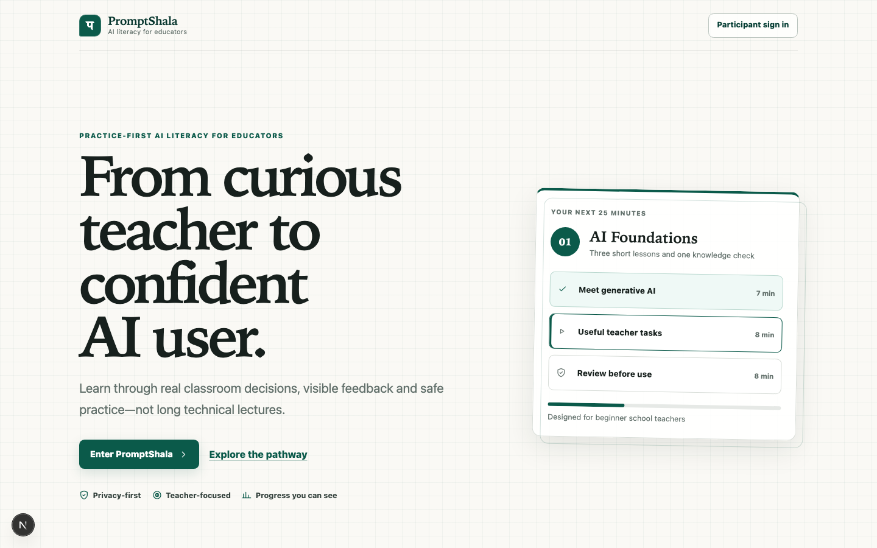
PromptShala
Five-minute assessment review
Practical AI literacy for beginner school teachers
10 September 2026
ET 617 Group 6
Working product, AI feedback and delivery evidence
Notes:
Speaker: Darshan. Timing: 20 seconds. PromptShala helps beginner school teachers learn practical AI use through short activities and feedback. We will show the teacher persona, working participant journey, live CRAFT evaluation, engineering evidence and the next delivery target.

Slide 2
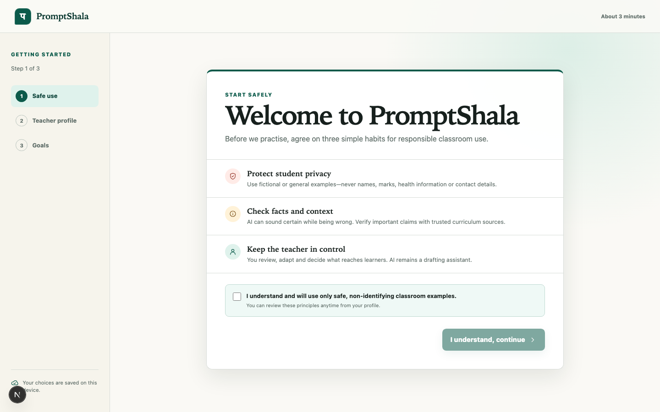
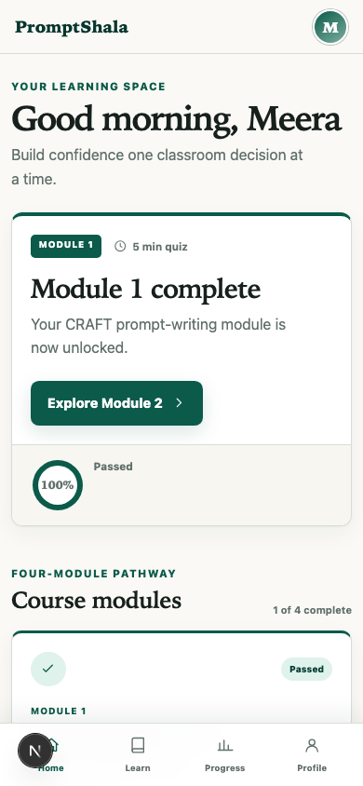
The teacher persona shaped the product
Meera
Science teacher, Classes 5 to 7
01
Beginner with generative AI
02
Uses a phone or shared laptop
03
Has 20 to 30 minutes per session
04
Needs plain feedback and safe classroom outputs
Design response
Wireframes became the responsive interface shown here
Short activities, clear locks, transcripts, captions, keyboard focus and mobile navigation
PromptShala assessment review
02
Notes:
Speaker: Vishal. Timing: 35 seconds. We designed for Meera, a beginner school teacher with limited time and mixed device access. The persona led directly to short activities, plain language, clear lock states, captions, transcripts, keyboard focus and mobile navigation. The Stitch wireframes were refined into the working responsive screens shown here.

Slide 3
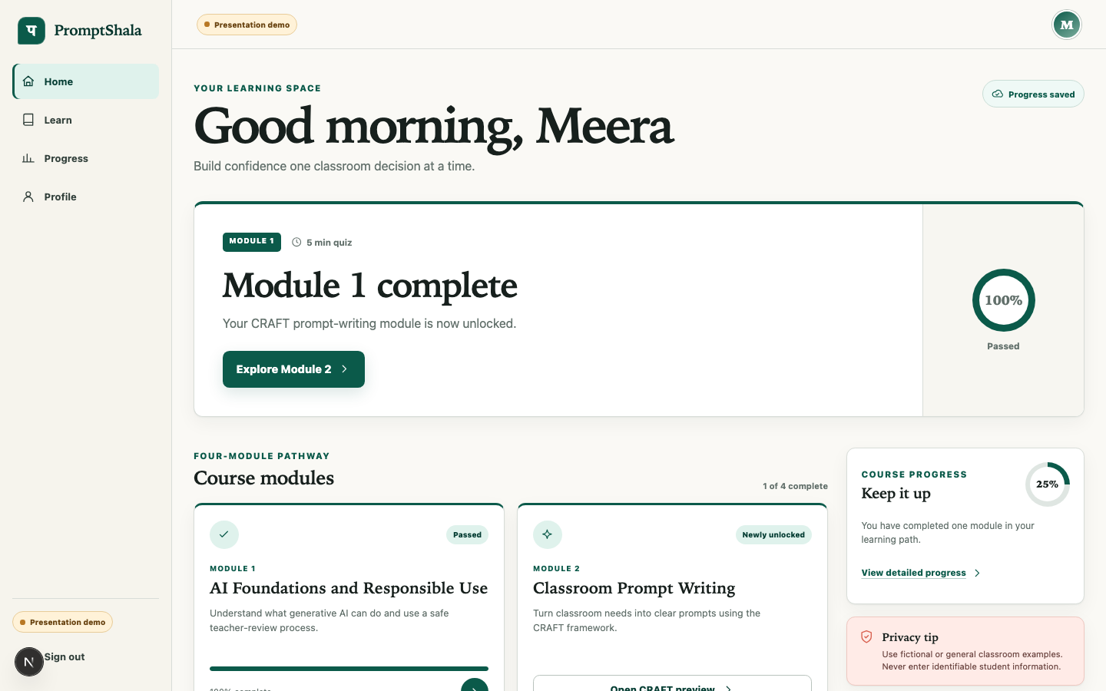
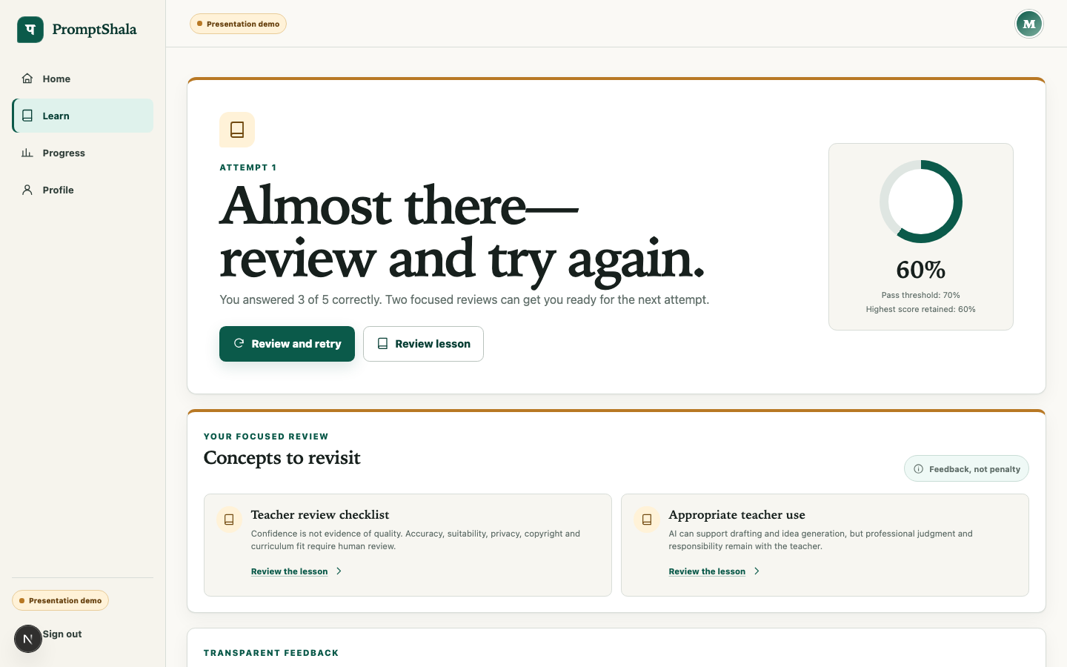
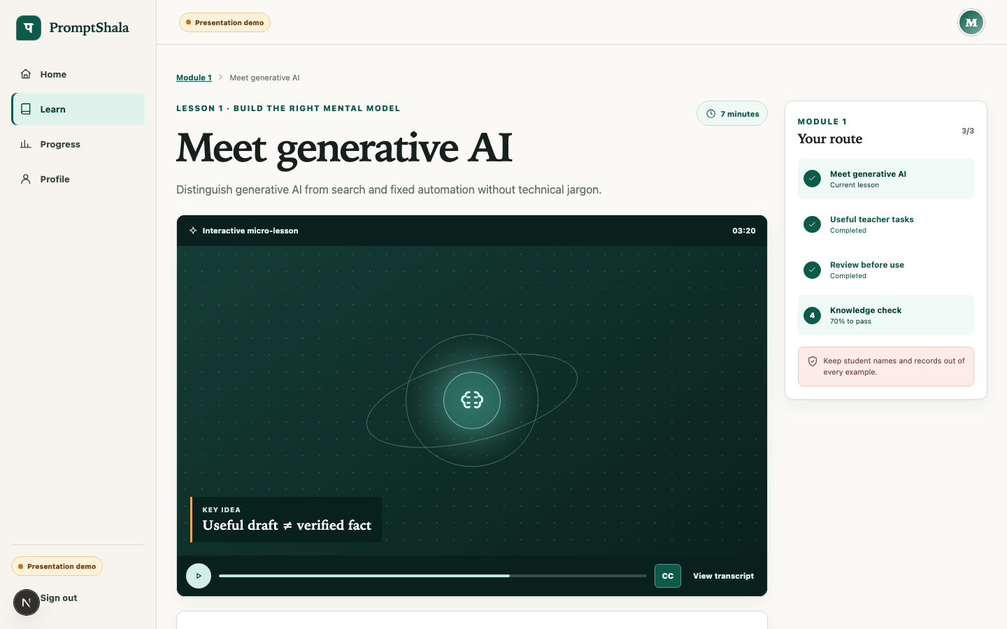
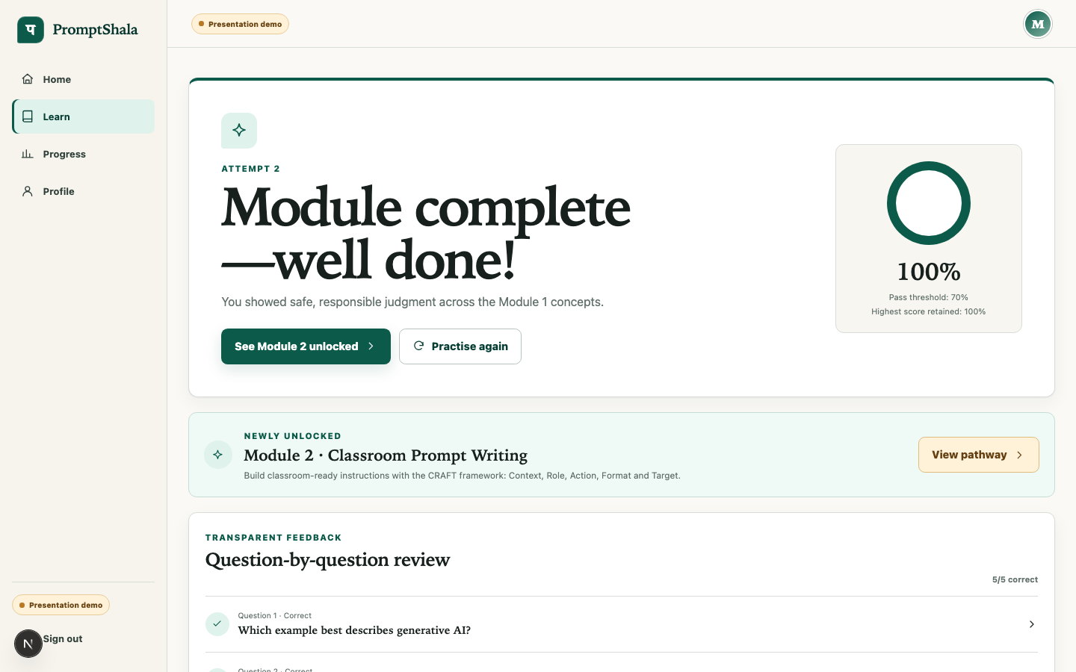
Working participant journey
01
Sign in
02
Safe onboarding
03
Dashboard
04
Lesson
05
Quiz
06
Retry or pass
07
Unlock Module 2
PromptShala assessment review
03
Notes:
Speaker: Darshan. Timing: 55 seconds. The approved flow now works from sign-in through Module 2 unlock. Module 1 contains three short lessons, transcripts and concept checks. A three-out-of-five result shows focused feedback and an immediate retry. Four out of five meets the 70 percent rule, preserves the best score and unlocks the next module.

Slide 4
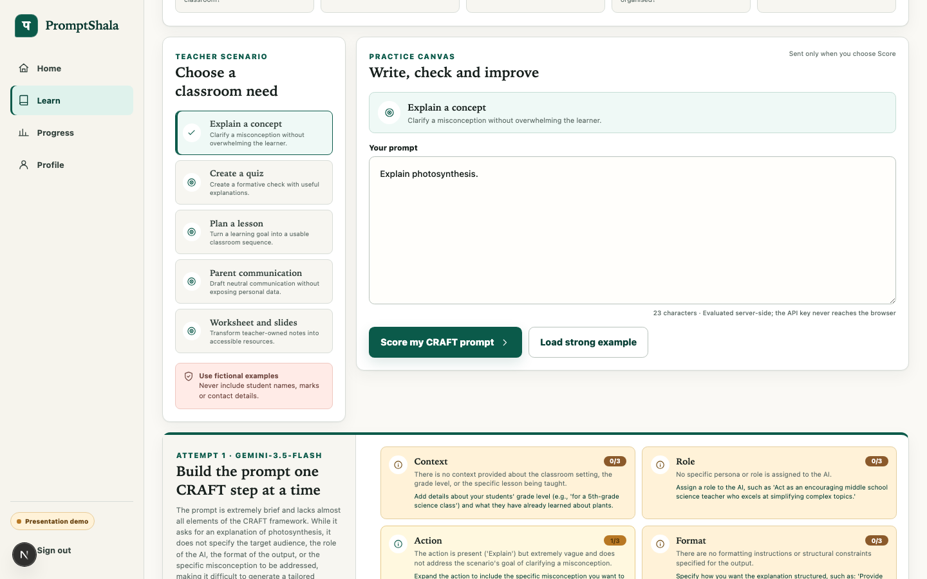
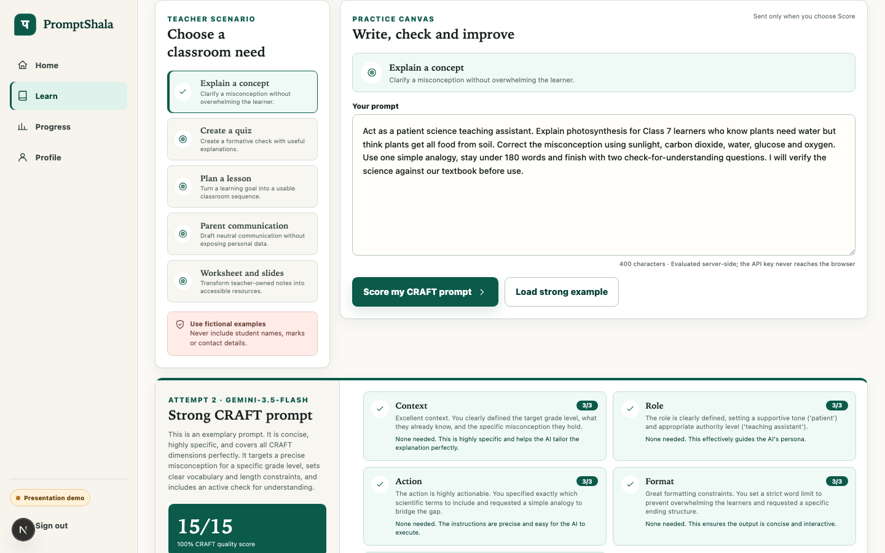
CRAFT feedback is live
1 / 15
15 / 15
“Explain photosynthesis.”
Revised classroom prompt
Five scores from 0 to 3, evidence, one improvement suggestion and a safe fallback
PromptShala assessment review
04
Notes:
Speaker: Ashok. Timing: 55 seconds. CRAFT means Context, Role, Action, Format and Target. The weak prompt receives one point out of fifteen because the action is present but vague. The revised prompt receives detailed feedback for all five dimensions and reaches fifteen. The evaluator runs on the server. The browser never receives the key, raw prompts are not stored, and the deterministic CRAFT fallback remains available.

Slide 5
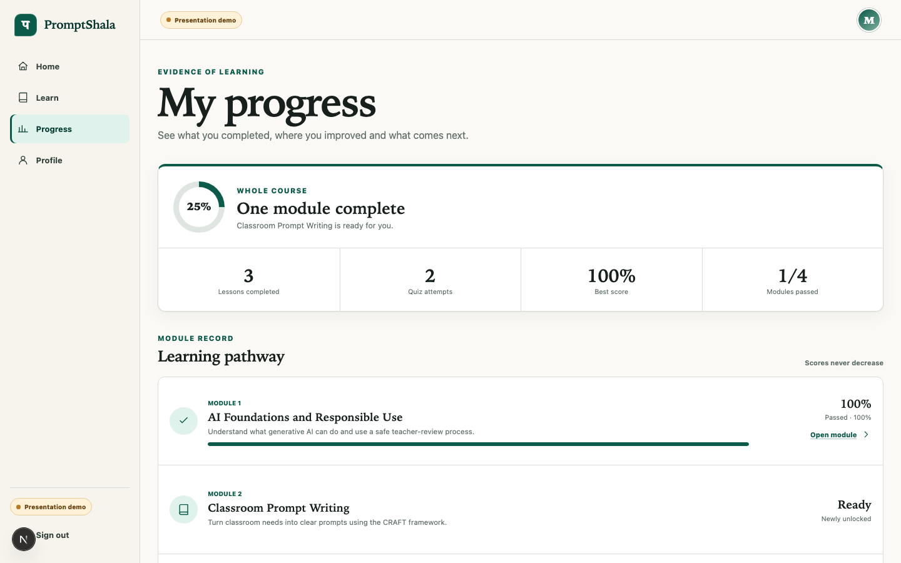
Working system evidence
56
automated tests in the final suite
12
public Supabase tables protected by RLS
01
Next.js, TypeScript and Supabase
02
Server-only Gemini 3.5 Flash evaluator
03
Desktop and 390 px mobile evidence
Boundary: a real multi-user staging journey still needs execution
PromptShala assessment review
05
Notes:
Speaker: Raghuram. Timing: 40 seconds. The final suite contains 56 automated tests, and lint, type checking and the production build pass. We applied three migrations to the connected Supabase project, seeded four modules and verified RLS on twelve public tables. The health route reports Supabase and the evaluator as configured. The remaining boundary is a real two-participant staging test.

Slide 6
Project evidence and team ownership
Darshan Sonawane
Vishal Patel
Ashok Chilka
Raghuram Gundi
Planning and client flow
Persona and experience design
Learning and CRAFT content
Platform and validation
HLD schedule, Jira structure, walkthrough
Teacher needs, wireframes, responsive UX
Lessons, scenarios, rubric and quiz review
Supabase, AI integration, tests and staging
HLD v1.3
4 MoMs
20 Jira tasks
16 commits
signed page preserved
date-wise client record
5 assigned to each member
scoped review-branch history
Individual GitHub authorship remains tied to the account that actually commits or reviews.
PromptShala assessment review
06
Notes:
Speaker: Vishal. Timing: 40 seconds. We divided delivery into four equally sized workstreams. Darshan owns planning and client flow. I own the persona and responsive experience. Ashok owns learning content and CRAFT review. Raghuram owns platform validation and staging. The evidence includes HLD v1.3, four meeting records, twenty Jira tasks with five per member, and sixteen scoped commits on the review branch. GitHub attribution remains truthful to the account that commits or reviews.

Slide 7
Next client review
Module 1 ready on staging by 20 September
We will show
Client confirmation needed
01
Stable staging link with real sign-in
01
CRAFT wording and first three scenarios
02
Two-participant RLS isolation evidence
02
Pilot subjects, grades and language preferences
03
Server-backed lesson, quiz and progress persistence
03
Privacy and teacher-review wording
04
Module 1 test report with accessibility checks
04
One non-sensitive syllabus or worksheet
Final project presentation remains fixed for 15 October 2026
PromptShala assessment review, 10 September 2026
07
Notes:
Speaker: Raghuram. Timing: 30 seconds. For the next client review we will show a stable staging link, real sign-in, two-participant data isolation, server-backed lesson and quiz progress, and the Module 1 test report. We need confirmation on CRAFT wording, scenario priority, pilot context, privacy wording and one safe teacher-owned source. The final presentation date remains 15 October.

