Slide 1
Welcome to the EAGE Annual Hackathon! Opening Session

Slide 2




Thank you to our sponsors who made this possible!
Supported by

Slide 3
Photography and recording
Disclaimer – if you do not want your photo taken in person in Madrid, please email the facilitators asap.
The final session will be recorded – if you have not received a consent form please email the facilitators asap.

Slide 4
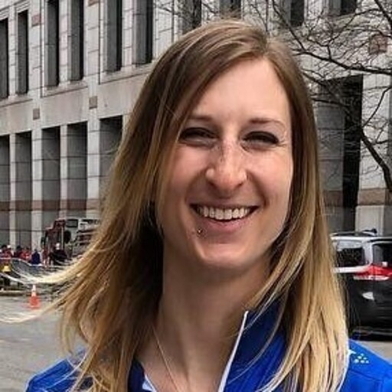

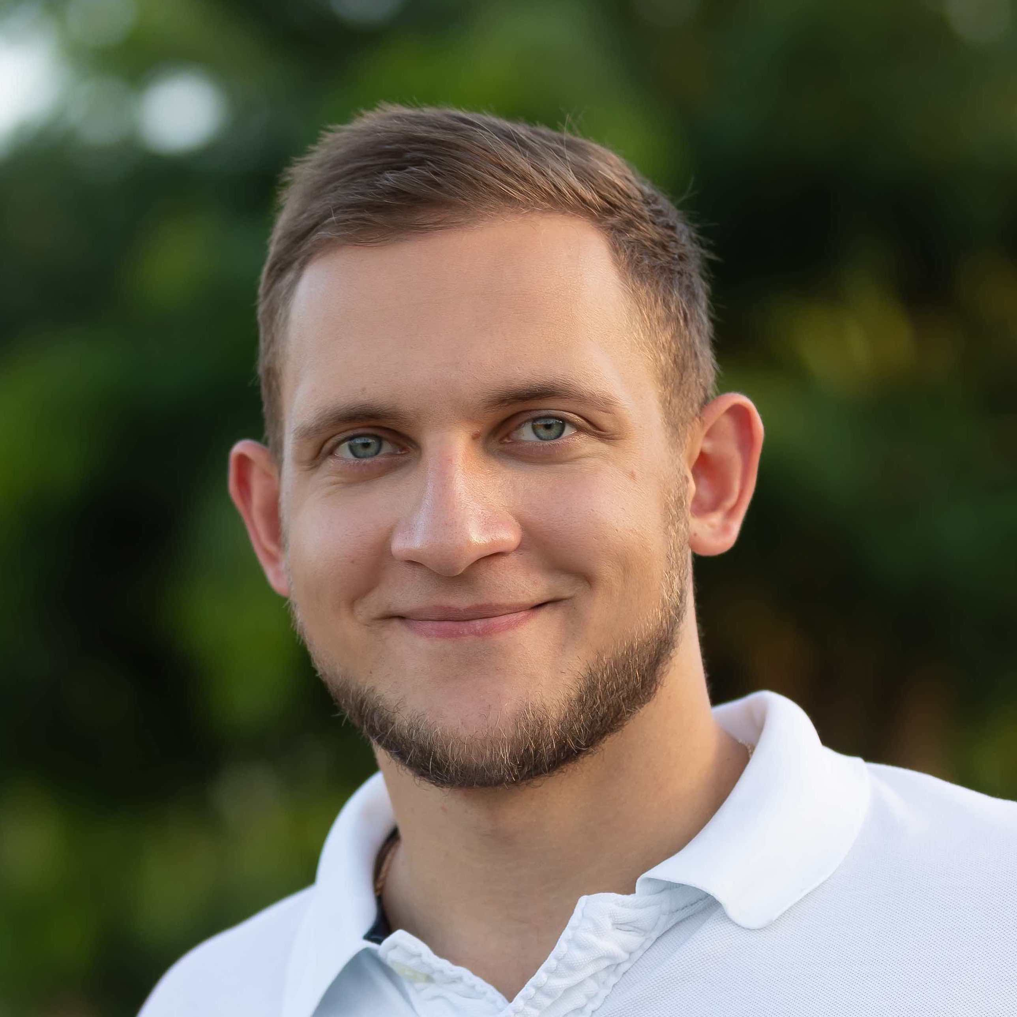
Meet your facilitators
Ashley Russell (Equinor ASA)
Leader for Data Science and Analytics for subsurface in Equinor. Geologist, self taught data scientist, expertise in Python, data visualization, including interactive plotting and dashboarding, statistics, and machine learning.
@ashleyr (softwareunderground) aruss@equinor.com
Lukas Mosser (Earth Science Analytics)
Lukas Mosser is Head of Research & Development at Earth Science Analytics. Lukas received his P.h.D from Imperial College London, where he worked on the stochastic reconstruction of porous media and geophysical inverse problems using deep learning. He currently also serves as a member of the EAGE AI committee and SEG special interest group for machine learning.
Oleg Ovcharenko (NVIDIA)
Oleg is Solutions Architect for Energy at NVIDIA. He received his Ph.D from KAUST where he was exploring data-driven methods for the initialization of full-waveform inversion. Oleg is broadly interested in HPC and deep learning applications in geophysics.

Slide 5
Agenda
Day 1: Sunday, June 5
Day 2: Monday, June 6
9:00 - 9:30 CEST - Welcome and coffee 9:30 - 10:30 CEST – Introduction Plenum Session 10:30 – 11:00 CEST – Project and team discovery time 11:00 - 18:00 CEST - Hacking all day
9:00 - 9:30 CEST - Welcome and coffee 9:30 – 13:00 CEST - Hacking 13:00 CEST: CODE FREEZE – Join online session to receive final presentation criteria (Jitsi) 13:15-15:00 CEST – Time for working and practicing presentations 15:00 - 16:30 CEST - Presentations to the Judging Panel Plenum Session Online (on Jitsi) 16:30 - 17:00 CEST - Announcement of the winners and prizes*

Slide 6
Awards!
There are two awards up for grabs.
These two teams will have their final presentations replayed in the AI special session during the annual meeting!
The winners will also be awarded free access codes for self-paced online courses from NVIDIA Deep Learning Institute
“Best in Show”
A panel of judges will join us for the presentations on the last day and will award this prize.
“Audience Choice”
Each hacker will vote for their favorite team (not their own) and the team with the most votes wins this one!

Slide 7
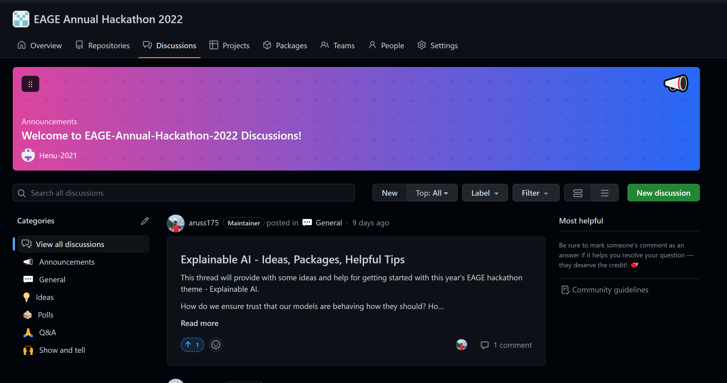
Github will be our main tool during the hack
Please keep on eye on the boards:
Notes:
If you need help getting started on Github – let one of the facilitators know.

Slide 8
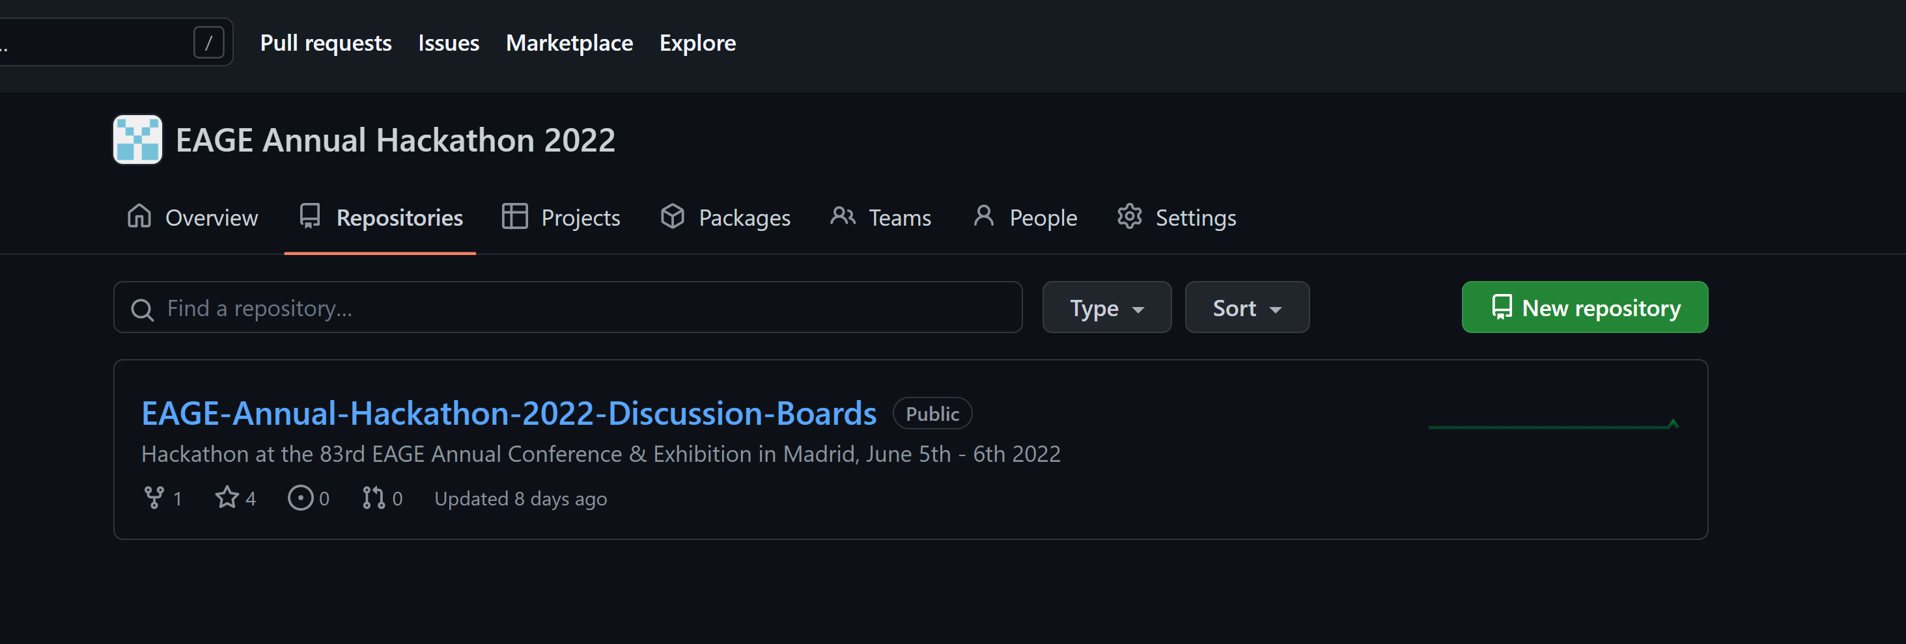
Github will be our main tool during the hack
For each team – please create your own repo for uploading your code and final presentations:
Notes:
If you need help getting started on Github – let one of the facilitators know.

Slide 9
Plenum Sessions are Online (hybrid hack)
Three plenum sessions:
Introduction (now)
Code Freeze and Final Presentation Instructions
Final Presentations
Every plenum session will be on Jitsi Meet at the same link as this one. Make sure you have your VPN off.
You are welcome to have your own team meetings using whichever tool you like.
Notes:
Moderater link: https://moderated.jitsi.net/7bffe47befcf47d6ae1a93ff20fba19cf5a4d3a6ef4a4a758ad9650337b07cb4

Slide 10
Theme Slides (Lukas)

Slide 11
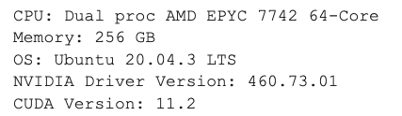
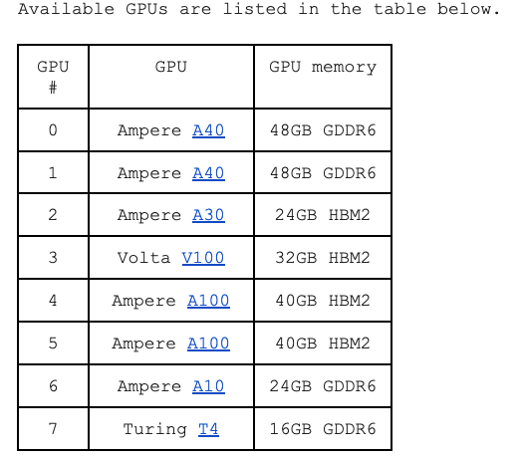
GPU resources
Connect to login node:
ssh you_login@nvpoc.ddnsfree.com
Run interactive session:
srun --gpus N --pty bash -i
NVIDIA Docker Container Repository
https://catalog.ngc.nvidia.com/
Full details:
https://docs.google.com/document/d/1ce94uqAhiggMm9IQvgMElNZiI-T3XDTklsjPcpcv0qA/edit?usp=sharing

Slide 12
Some Hackathon Tips
Take screenshots as you go along – this will save a lot of time when you come to preparing the final presentation
A little planning goes a long way – post its to organize your work or making a list can help keep focus. For those online try using a Jamboard (https://jamboard.google.com/) or Github Issues
By the end of the day today you should have settled on a specific case, sketched out a plan, and have started some work.

Slide 13
Reminder: Hackathons aren’t about getting a perfect solution or answer – it is about trying something new, being bold and learning along the way ☺

Slide 14
Icebreaker!

