Slide 2
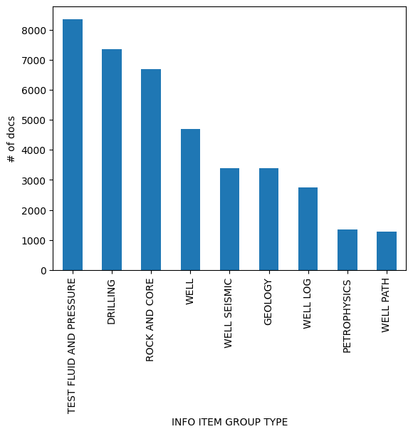
Diskos dataset
2752381 records
6456 wellbores (4183 wells)
39217 documents
258 document types (‘INFO ITEM TYPE’) grouped in 9 categories (‘INFO ITEM GROUP TYPE’)
Documents from 1 page to 950 pages

