Slide 1
NoCoalMiners Data optimisation for LLM

Slide 2
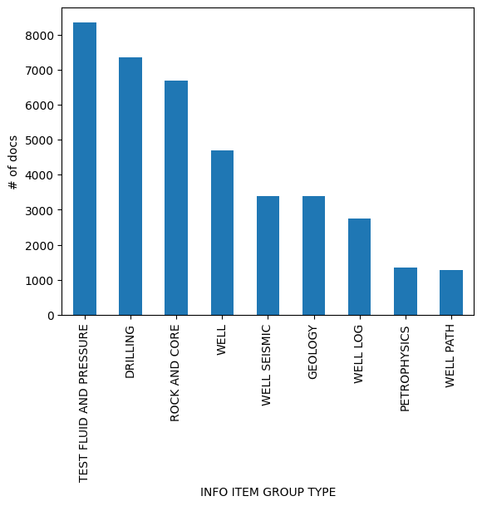
Diskos dataset
Objective:
To analyze a big dataset containing text extracted from PDF well reports from the Norwegian Offshore directorate.
To explore the use of LLM in processing and extracting data from these files
Dataset
5.7 GB
~2.7 million records
6456 wellbores (4183 wells)
39217 documents
258 document types (‘INFO ITEM TYPE’) grouped in 9 categories (‘INFO ITEM GROUP TYPE’)
Documents from 1 page to 950 pages

Slide 3
How this is relevant for our Net Zero goals
The reduction of tokens (“units of information”) results in:
less computations -> less emissions
Information Extraction | Extract subsurface relevant features from wellbore records and associated documents.
Document Summarization | Condense extensive reports into insights for rapid analysis.
Data Integration | Combine disparate data types (e.g., textual, tabular, spatial) to update/complement subsurface DBs.
Case Example: Legacy Well Integrity for CCS | Retrieve info about the construction of the wellbore, details about P&A. This could feed increase the efficiency in assessing the risk of leakage

Slide 4
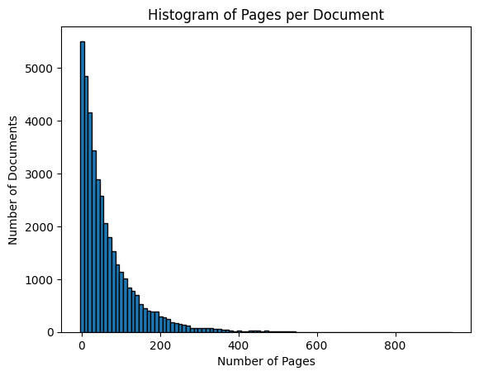
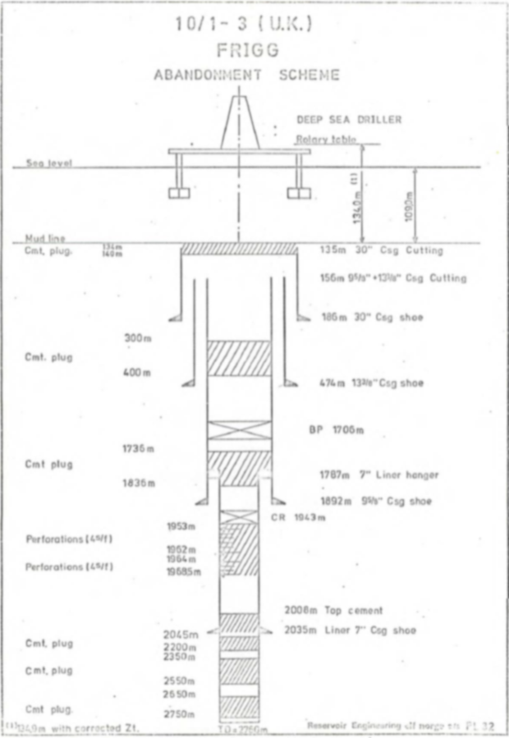
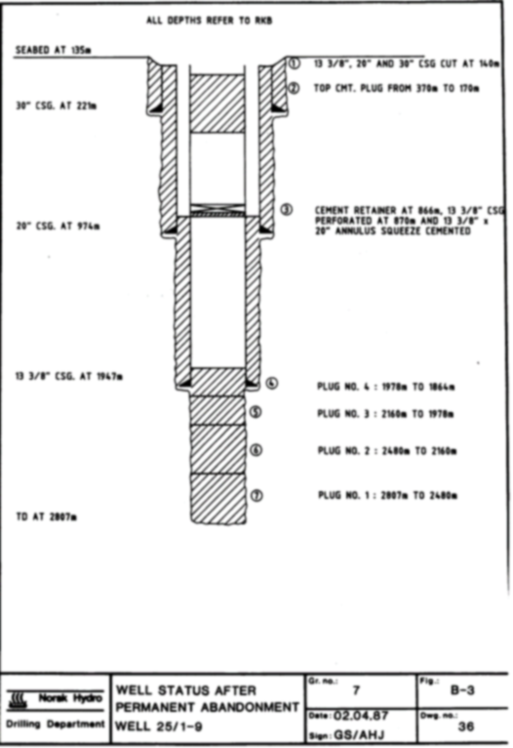
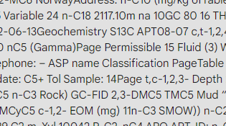
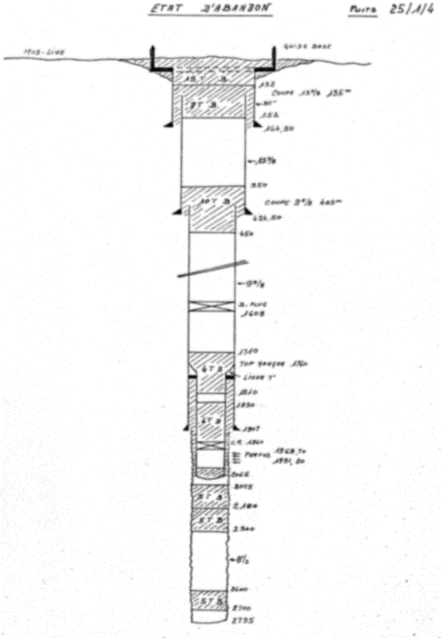
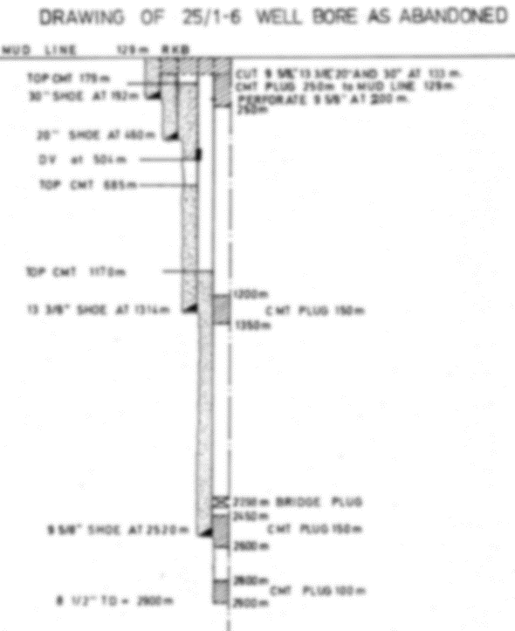
Preliminary data exploration
Wide range of file types:
Small documents (0-10 pages)
Full reports (> 100 pages)
Diverse content types:
Text reports
Data tables
Charts/infographics

Slide 5
Challenges
Complexity:
High computational and time-consuming for processing large text-based datasets.
Data Quality Issues: inconsistent and incomplete data due to PDF processing.
Irrecoverable Data: Acceptance that certain data may be permanently lost or unusable, despite advanced algorithms.
Analysis Complexity: Non-trivial extraction and interpretation challenges due to data diversity and volume.
Objective Specificity: What do we want to get out of this dataset?
Try to reduce the number of tokens without compromising the quality of data to save computational time.
NLP Trade-offs:
Reduction of data > Computational time vs Preservation of data > LLM accuracy

Slide 6
Plan
Preliminary data processing
Nemo Curator
Data Cleanup
LLM training
Interact with LLM

Slide 7
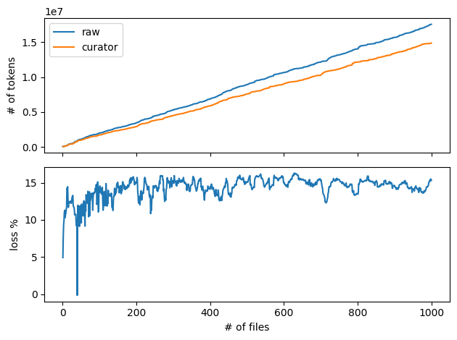
LLM Data Cleanup
Relative reduction of tokens after cleanup
11% in subsample of 10 files
18% in subsample of 1000 files
20.41% in whole dataset
# tokens: 682254403 to 566607633
Estimated time to train LLM
194 hours to 160 hours (34 hours difference on the same hardware)
209 kg CO2 equivalent for fossil fueled based electricity.
3.4 kg CO2 equivalent for Norway-based energy mix
1.99% files removed
Around only 10% of the token reduction is due to the file filtering.
Remaining token reduction is due to word removal

Slide 8
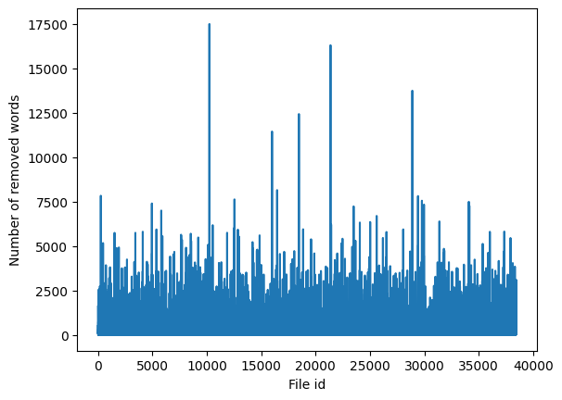
LLM Data Cleanup – Word reduction (whole dataset)
Word reduction is not constant:
Average 382 words per document.
Few paper with a high Word loss.

Slide 9
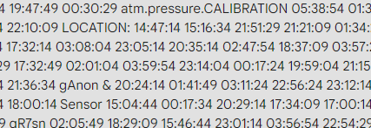
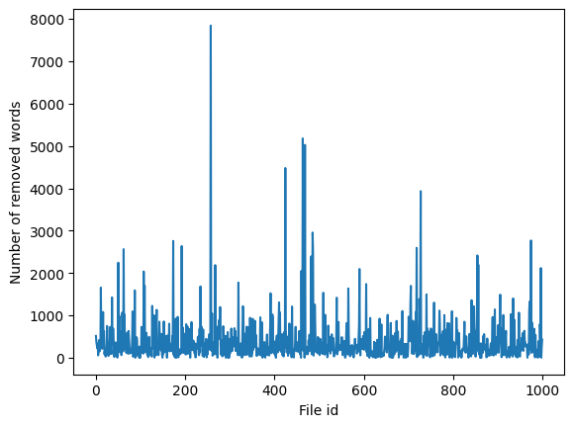
LLM Data Cleanup – Word reduction
Removed words sample

Slide 10
Way forward
Train LLM and compare the accuracy of the LLM with different number of tokens.
Challenge is to find a benchmark for the LLM (time-consuimg, bias-prone)
Chunk size optimization.
Impact of the computational time but also on LLM accuracy
Very promising :
20% token reduction for only 2% of files reduction
We remove specific words in document -> Few data loss for high computational save

