Slide 1
NoCoalMiners

Slide 2
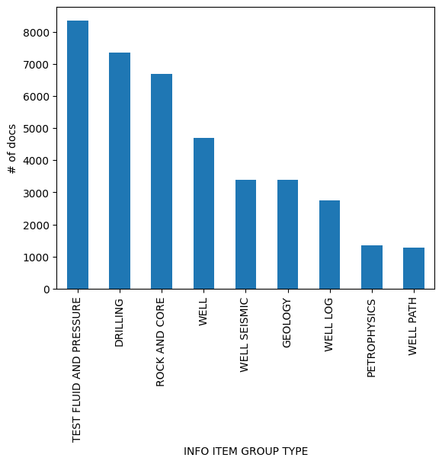
Diskos dataset
5.7 GB
~2.7 million records
6456 wellbores (4183 wells)
39217 documents
258 document types (‘INFO ITEM TYPE’) grouped in 9 categories (‘INFO ITEM GROUP TYPE’)
Documents from 1 page to 950 pages

Slide 3
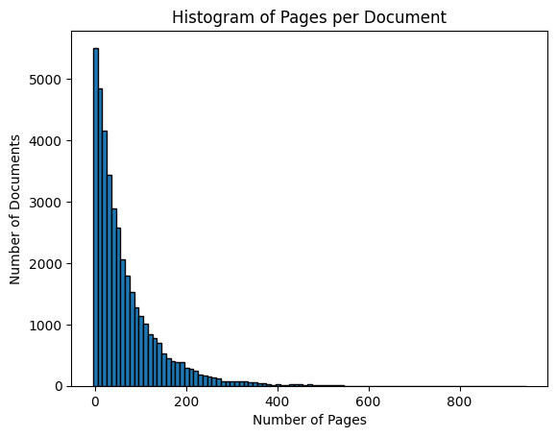
EDA

Slide 4
Plan
EDA / Pandas processing
Process data
Export JSONL files
Nemo Curator
Cleanup
LLM training
Questions

Slide 5
How this is relevant for our Net Zero goals
Information Extraction | Extract subsurface relevant features from wellbore records and associated documents.
Document Summarization | Condense extensive reports into insights for rapid analysis.
Data Integration | Combine disparate data types (e.g., textual, tabular, spatial) to update comprehensive subsurface models.
Case Example: Legacy Well Integrity for CCS | Retrieve info about the construction of the wellbore, details about P&A. This could feed increase the efficiency in assessing the risk of leakage

